Slide 1
Protocol Design for UL Beamforming
Date: 2024-02-05
Authors:

Slide 2
Introduction
Rate-vs-Range (RvR) enhancement is an important goal for UHR.
When transmitting the trigger-based (TB) PPDU, multiple STAs simultaneously transmit UL frames according to the resource allocation information, contained in the preceding trigger frame.
There is a scenario that some STAs participating in the TB PPDU transmission show low throughput or do not meet the target SNR.
As a Rate-vs-Range (RvR) enhancement scheme, the beamforming (BF) technology is one of the solutions to increase the throughput or meet the target SNR
Several user-cases were shown in [1], where the beamforming for TB PPDU is effective in throughput enhancement
In this contribution, we present a high level design of sounding and channel information feedback protocols for UL beamforming in UHR TB PPDU.

Slide 3
Recap: Trigger Frame in 11be
 | Trigger Type | UL Length | More TF | CS Required | UL BW | GI And EHT-LTF Type | MU-MIMO EHT-LTF Mode | Number of EHT-LTF Symbols And Mid-amble Periodicity | …
Bits: | 4 | 12 | 1 | 1 | 2 | 2 | 1 | 3
 | UL STBC | LDPC Extra Symbol Segment | AP Tx Power | Pre-FEC Padding Factor | PE Disambiguity | UL Spatial Reuse | Doppler | HE/EHT P160 | Special User Info Field Present | Reserved | Trigger Dependent Common Info
Bits: | 1 | 1 | 6 | 2 | 1 | 16 | 1 | 1 | 1 | 8 | variable
Frame Control | Duration | RA | TA | Common Info | Special User Info | User Info List | Padding | FCS
User Info | User Info | … | User Info
 | AID12 | RU Allocation | UL FEC Coding Type | UL EHT-MCS | Reserved | SS Allocation / RA-RU Information | UL Target Receiver Power | PS160 | Trigger Dependent User Info
Bits: | 12 | 8 | 1 | 4 | 1 | 6 | 7 | 1 | variable

Slide 4
Overview
An example of the proposed ULBF procedure is shown below
An UHR beamformee (AP) that solicits UHR TB sounding NDP shall transmit BSNP Trigger frame to one or more UHR beamformers (non-AP STAs)
An UHR beamformee (AP) that solicits UHR TB PPDU using a beamforming steering matrix derived from a UHR ULBF CBF shall transmit Basic Trigger frame to one or more UHR beamformers (non-AP STAs), where Beamformed subfield in the User Info field is set to 1
Note: ULBF CBF and Basic Trigger can be either an A-MPDU or separate PPDUs spaced by SIFS

Slide 5
Beamforming Sounding NDP Poll (BSNP)
Define a new Trigger variant as shown in the table below
Beamforming Sounding NDP Poll (BSNP)
Triggers the TB sounding NDP
Trigger Type subfield value | Trigger frame variant
0 | Basic
1 | Beamforming Report Poll (BFRP)
2 | BR-BAR
3 | MU-RTS
4 | Buffer Status Report Poll (BSRP)
5 | GCR MU-BAR
6 | Bandwidth Query Report Poll (BQRP)
7 | NDP Feedback Report Poll (NFRP)
8 | Ranging
9 | Beamforming Sounding NDP Poll (BSNP)
10-15 | Reserved

Slide 6
Beamforming Sounding NDP Poll (BSNP)
Trigger Dependent Common Info subfield
The Trigger Dependent Common Info is not present
Trigger Dependent User Info subfield
The Trigger Dependent User Info is defined in the figure below
Sounding Dialog Token Number contains a value selected by the beamformee (AP) to identify the BSNP Trigger frame
 | Sounding Dialog Token Number | Reserved
Bits: | 6 | 2

Slide 7
Basic Trigger frame
UHR variant User Info subfield
E.g.) Use B25 to carry Beamformed subfield, which is reserved in 11be
 | B0 B11 | B12 B19 | B20 | B21 B24 | B25 | B26 B31 | B21 B38 | B39
 | AID2 | RU Allocation | UL FEC Coding Type | UL UHR-MCS | Beamformed | SS Allocation/RA-RU Information | UL Target Receive Power | PS160 | Trigger Dependent User Info
Bits: | 12 | 8 | 1 | 4 | 1 | 6 | 7 | 1 | variable
[Exemplary design based on 11be]

Slide 8
UHR TB Sounding NDP
UHR TB Sounding NDP
New variant of the TB PPDU
Uses the TB PPDU format but without the Data field
It can be transmitted in UL MU-MIMO or UL OFDMA

Slide 9
UHR ULBF Compressed Beamforming Frame
UHR ULBF CBF format
The Action field of the UHR ULBF Compressed Beamforming frame contains the information shown in the table below
Category
UHR
UHR Action
UHR ULBF compressed beamforming
Define new values for these fields by using the reserved values
Order | Information
1 | Category
2 | UHR Action
3 | UHR ULBF MIMO Control for STA 1
4 | UHR ULBF Compressed Beamforming Report for STA 1
5 | UHR ULBF MIMO Control for STA 2
6 | UHR ULBF Compressed Beamforming Report for STA 2
… | …
2N_{STA}+1 | UHR ULBF MIMO Control for STA N_{STA}
2N_{STA}+2 | UHR ULBF Compressed Beamforming Report for N_{STA}

Slide 10
UHR ULBF Compressed Beamforming Frame
UHR ULBF MIMO Control
Differences to UHR MIMO Control are
AID12 subfield
Address to an associated STA which is equal to the value in the AID12 subfield in the BSNP Trigger frame
Feedback Type
0: SU, 1: MU
C.f.) In case of UHR MIMO Control, 0: SU, 1: MU, 2: CQI 3: Reserved
Sounding Dialog Token Number
Set to the same value as the Sounding Dialog Token Number field in the BSNP Trigger frame
B0 B11 | B12 B15 | B16 B19 | B20 B22 | B23 | B24 | B25 B27 | B28 B30 | B31 | B32 B40 | B41 B46 | B47 | B48 B50
AID12 | Nc Index | Nr Index | BW | Grouping | Feedback Type | Reserved | Remaining Feedback Segments | First Feedback Segment | Partial BW Info | Sounding Dialog Token Number | Codebook Information | Reserved
12 | 4 | 4 | 3 | 1 | 1 | 3 | 3 | 1 | 9 | 6 | 1 | 3
[Exemplary design based on 11be]

Slide 11
UHR ULBF Compressed Beamforming Frame
UHR ULBF Compressed Beamforming Report
Carries compressed beamforming feedback matrices to determine beam-steering matrix of each beamformer (non-AP STA)
Difference to EHT Compressed Beamforming Report is
Average SNR of each space-time stream is not carried in this field

Slide 12
Summary
We propose new protocols to support the sounding and feedback procedure for UL beamforming in UHR
Beamforming Sounding NDP Poll (BSNP)
Basic Trigger frame
Carry Beamformed subfield in the UHR variant User Info subfield
UHR TB Sounding NDP
UHR ULBF Compressed Beamforming frame

Slide 13
SP #1
As a Rate-vs-Range (RvR) enhancement scheme, do you think that further investigation on TB UL beamforming should be considered in UHR?
Y/N/A:

Slide 14
Reference
[1] 802.11-20/1672r0, UL Beamforming for TB PPDUs in 11be.
[2] 802.11-20/1375r1 EHT NLTF Design.
[3] 802.11-20/1469r0 EHT Sounding Discussion.

Slide 15
Appendix

Slide 16
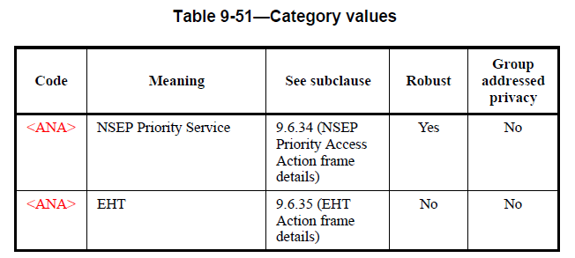
Category and EHT Action Field
Category
EHT Action Field

Slide 17
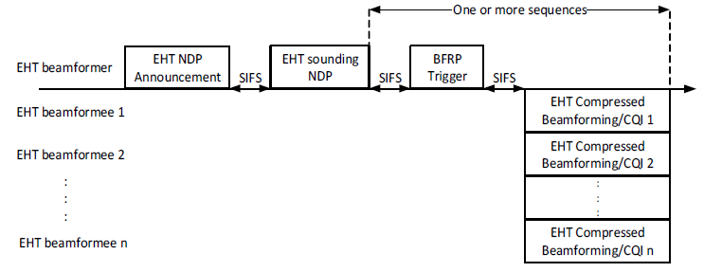
EHT TB Sounding Procedure

Slide 18
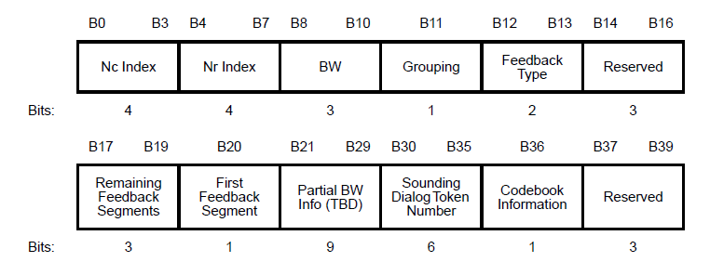
EHT MIMO Control Filed Format

