Slide 1
Clarifications on the LDPC rate matching
Date: 01/29/24
Name | Affilations | Address | Email
Xiaogang Chen | Spreadtrum Communications, USA | 2680 N 1st St. San Jose, CA. 95134 | Xiaogang.chen1@unisoc.com
Chunyu Hu
William Li

Slide 2
Outline
Background
PSDU size statistics for different scenarios
  Online meeting;
  Remote desktop;
  Daily WFH;
  File download;
  Streaming.
Summary and clarifications

Slide 3
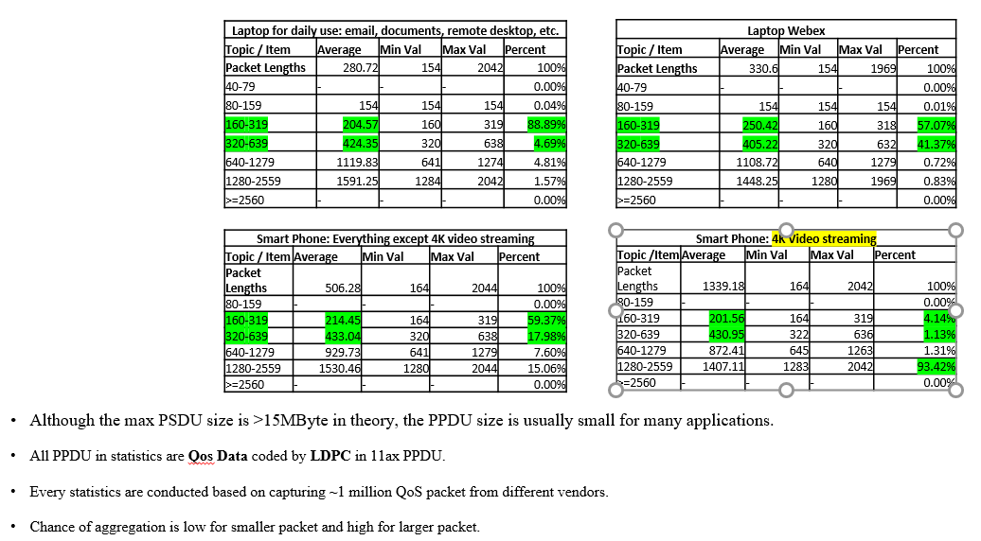
Background
The statistics of PSDU size in [1] (copied to the right) are leading different interpretations based on offline discussions;
The one page slide of statistics on the PSDU size in [1] needs to be well elaborated;
More post processing and measurements have been done in this deck.

Slide 4
Measurements setup
Single family house with two 11ax mesh AP.
  Considered as good coverage.
  Six 11ax compatible device in the house.
Measurements duration:
  Online meeting: ~ 1 hour;
  Remote desktop: ~ 4 hours;
  Daily WFH: ~ 4 hours;
  File download: 10GB;
  UHD/SD Video streaming: ~ 0.5 hour each.
Post processing:
  ONLY LDPC coded Qos data is counted;
  Measurement is done per App and per non-AP STA.
  Convert MPDU to A-MPDU size if aggregation presents;
  CDF to show the distribution of packet size in general;
  CCDF to zoom in the percentile of large packet size.
Note: The measurement conducted represents a typical home scenario, but different traffic pattern may be observed for different setups. e.g. dense apartment, enterprise, level of MSDU aggregation etc.

Slide 5
Scenario 1: Remote desktop & online meeting
These two apps are the most frequently used by myself.
Very similar as the statistics in [1] for webex.

Slide 6
Scenario 2: WFH - RemoteDesktop, email, chat, search etc.
Sniffed from morning to noon when conducting daily work.
Match the statistics of the 1st table in [1].

Slide 7
Scenario 3: Streaming – auto rate
Auto rate means the default rate auto selected by the streaming app (Mostly 720P).
~10% large (relatively) packet was observed.
Most packets are still sub-1KB.

Slide 8
Scenario 4: UHD Streaming
UHD (2160P) movie streaming is traffic demanding.
Stair shape is not because of small number of samples but due to only a few A-MSDU size.
The table of streaming in [1] didn’t show the details because of no post-processing had been done.

Slide 9
Scenario 5: File Download
Similar trend with UHD streaming with larger aggregation observed.
Packet size is larger:
~25% A-MPDU observed. Packet size vary in the range of 3KB ~ 200KB
~30% A-MSDU observed (3164B)
~28% MSDU observed (16xxB)

Slide 10
Summary and clarifications
For non-traffic demanding apps, observations are similar as the statistics shown in [1].
  A-MPDU post processing improves the accuracy of statistic on the 10% tail (for small packet size dominated apps). Refer to the backup.
For traffic demanding apps, post processing shows more details that are not included in [1].
The PSDU size is quite related to the traffic pattern of individual applications:
  Throughput demanding application is dominated by large packets.
    The PSDU size could be quite large (hundreds of KB observed).
    MB packets was observed in [1].
  Several daily working related apps is dominated by small packets.
  The optimization of features in 11bn should consider different traffic patterns.

Slide 11
Reference
[1] 11-23-0667-01-0uhr-revisiting-of-the-rate-matching-for-ldpc

Slide 12
Backup
Converting MPDU to A-MPDU change the distribution only for the 5%-10% tail.

