Slide 1
Security Considerations for Ambient Power Communications (AMP)
Date: 2024-1-18
Authors:

Slide 2
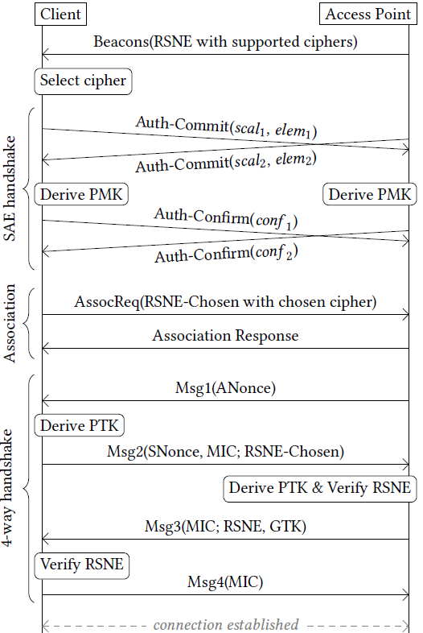
What is a suitable communication model for AMP devices?
If an ambient device follows the conventional Wi-Fi MAC (maintaining a secure link for layered networking)
It will take 10+ frames to establish a secure association.
The ambient device needs to have sufficient power to maintain the secure association and low power operating mode (e.g., TSF timer).
Questions
Do AMP devices have sufficient power for such overhead?
Current layered networking model has been designed to support multiple applications and large-volume data exchange. Do AMP devices need this?
Arguments
Layered networking model over conventional Wi-Fi MAC is not the best fit for AMP devices that are often designed for a single application.
Compact transaction-based communication model, as described here, may be better.
Notes:
https://unit42.paloaltonetworks.com/iot-threat-report-2020/

Slide 3
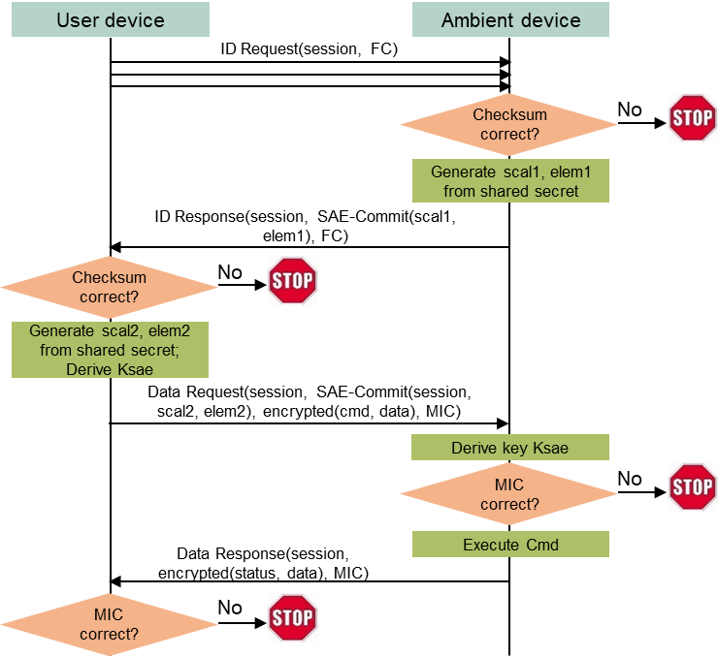
A compact transaction-based communication model
Assumptions
AMP devices typically support one application (function).
AMP devices do not have large data volume to exchange at each transaction.
AMP devices do not need to maintain association and/or low power mode (they can simply power off or lose the power after communication).
Initial ideas
A simple Request (by regular STA) + Response (by ambient device) transaction model.
Integrated security based on a shared secret between the requester and the respondent (AMP device).
Absolutely minimize exchanged messages during the aforementioned secure data transaction.
Notes:
https://unit42.paloaltonetworks.com/iot-threat-report-2020/

Slide 4
Transaction details
A (ambient device) has a unique ID (MAC address) and a secret shared with N (normal STA).
N intermittently sends an ID_Request message to A on different bands/channels, until an expected ID_Response message is received.
ID_Request. Header: A’s ID (or broadcast address), N’s MAC address, frame type. Payload: a session ID, supported AKM/cipher parameters, PHY/MAC parameters, etc.
ID_Response. Header: A’s ID, N’s MAC address, frame type. Payload: the session ID, selected AKM/cipher parameters, A-to-N SAE-Commit parameters based on the shared secret.
N sends a Data_Request message to A, containing the session ID, N-to-A SAE-Commit parameters based on the shared secret, the encrypted command, and a MIC.
A verifies the MIC, and carries out the command, then sends a Data_Response message to N, containing the session ID, the encrypted response data, and a MIC.
N verifies the MIC and decrypts the response data. A can power off.
Notes:
https://unit42.paloaltonetworks.com/iot-threat-report-2020/

Slide 5
Conclusions
A compact, transaction-based communication model is proposed for AMP devices (instead of the current layered networking model). Both models can co-exist.
A secure request and respond model for ambient devices is illustrated, which only needs 4 messages to finish a secure transaction.
Notes:
https://unit42.paloaltonetworks.com/iot-threat-report-2020/

