Slide 1
Thoughts on Power Control for CSR
Date: 2024-01-12
Authors:

Slide 2
Introduction
Coordinated Spatial Reuse (CSR) is a technology being considered for UHR
In [1-2], authors show gains of CSR
In [3], authors show gains of CSR and CBF
In [4], authors proposed a sharing AP to control the transmit power of shared APs
In [5], authors proposed a non-AP STA to measure neighboring APs’ signal level (e.g. RSSI)
In this contribution, we compared two different schemes, with and without transmit power control, and shared our concern on transmit power control for CSR

Slide 3
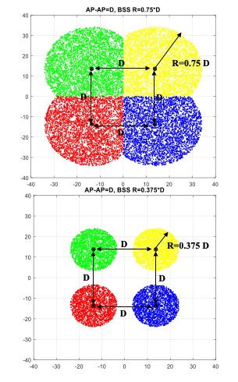
Results From Other Contributions (1/3)
In [1], a CSR scheme with fairness constraint is evaluated
  The Sharing AP will limit the amount of SINR reduction allowed
3-30% gain is observed for scenario in right above figure
23-53% gain is observed for scenario in right below figure
 | Midpoint SNR
% CSR Gain vs TDMA | 1K QAM |  |  | 4K QAM
 | 22.5 | 28.5 | 33.5 | 22.5 | 28.5 | 33.5
20M 1x1-1ss AWGN | 20% | 8% | 8% | 17% | 6% | 3%
80M 1x1-1ss AWGN | 20% | 11% | 8% | 17% | 8% | 4%
20M 1x1-1ss B-LOS | 30% | 18% | 13% | 28% | 15% | 8%
80M 1x1-1ss B-LOS | 20% | 11% | 8% |  |  |  | R=3/4*D
20M 1x1-1ss D-NLOS | 26% | 13% | 11%
20M 2x2-2ss B-LOS | 22% | 11% | 9% | 20% | 8% | 5%
80M 2x2-2ss B-LOS | 20% | 11% | 7%
20M 1x1-1ss AWGN | 53% | 44% | 51% | 43% | 24% | 23%
20M 1x1-1ss D-NLOS | 53% | 44% | 51% |  |  |  | R=3/8*D
20M 2x2-2ss B-LOS | 43% | 36% | 39% | 34% | 23% | 20%
  Midpoint SNR 22.5 dB → -82 dBm RSSI @ far AP
  Midpoint SNR 42.5 dB → -62 dBm RSSI @ far AP

Slide 4
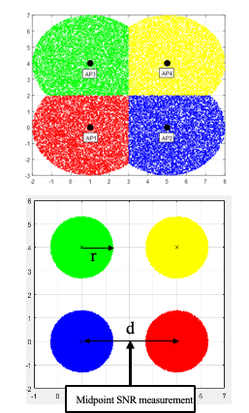
Results From Other Contributions (2/3)
In [2], a CSR scheme with fairness constraint (CSR-MCSmax) is evaluated
  The shared AP can’t reduce throughput of the sharing AP
5-29% gain is observed for scenario in right above figure
75-90% gain is observed for scenario in right below figure

Slide 5
Results From Other Contributions (3/3)
In [3], CSR and CBF scheme with full power transmission at sharing AP and shared AP is evaluated
18-91% gain (depending on STA’s SNR and interference level) is observed in two AP with one STA per AP
16-98% gain (depending on STA’s SNR and interference level) is observed in two AP with two STA per AP
  Detail results is captured in appendix
42-262% gain (depending on STA’s SNR and interference level) is observed in four AP with one STA per AP
  Detail results is captured in appendix
Two AP, one STA per AP
X is pathloss difference between serving AP and neighboring AP
Rows with white color is for the gain of CSR over TDMA. Purple color is for the gain of CBF over TDMA.

Slide 6
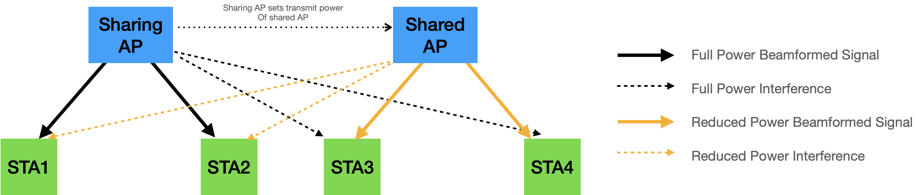
Evaluated Scheme: A Scheme with Power Control
CSR scheme with fairness constraint [1]
  Sharing AP will always transmit during its TXOP, and the sharing AP will limit the amount of SINR reduction allowed
Sharing AP: TXOP holder
Shared AP: AP which is allowed to transmit during the TXOP by the sharing AP
Victim STA(s): selected STA(s) for the sharing AP

Slide 7
A Scheme with Power Control:
High-level Concept for Simulation
An AP grabs a medium and selects a STA
  The AP becomes a sharing AP, the STA become a victim STA
  If the selected STA has a MU-MIMO pair, then the MU-MIMO pair STA becomes a victim STA as well
The sharing AP sets each shared AP’s signal power to be not greater than the noise level at the victim STAs
  This is done based on periodic OBSS RSSI measurement by non-AP STAs
  This results in maximum 8.5 dB SINR degradation (including ±3 dB RSSI measurement error and maximum 3 shared APs) at the victim STA(s)

Slide 8
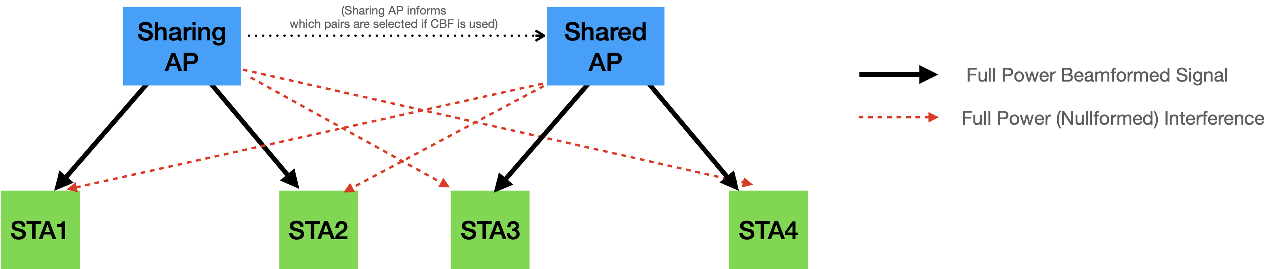
Evaluated Scheme: A Scheme without Power Control
CSR for center STAs and CBF for other STAs
  A center STA is an STA with high RSSI for the serving AP
  Sharing AP and shared APs use its maximum transmit power

Slide 9
A Scheme without Power Control:
High-level Concept for Simulation
An AP grabs a medium and selects a STA
  The AP becomes a sharing AP, the STA become a victim STA
  If the selected STA has a MU-MIMO pair, then the MU-MIMO pair STA becomes a victim STA as well
If the victim STA(s) are center STA(s), then
  The shared APs select its center STA(s) for transmission
    If there is no center STA in a shared AP, then there is no transmission by the shared AP
    If the center STA has a MU-MIMO pair (another center STA), then the shared AP performs MU-MIMO
If the victim STA(s) are not center STA(s), then
  The sharing AP performs CBF with a shared AP that has the CBF pair of the selected STA(s)
  For CBF, we have evaluated two cases
    CBF (local CSI) is that a non-AP STA feed backs MU Exclusive Beamforming Report (V matrix and delta SNR) for its own AP and the paired AP
    CBF (full CSI) is that a non-AP STA feed backs MU Exclusive Beamforming Report as well as U matrix for its own AP and the paired AP

Slide 10
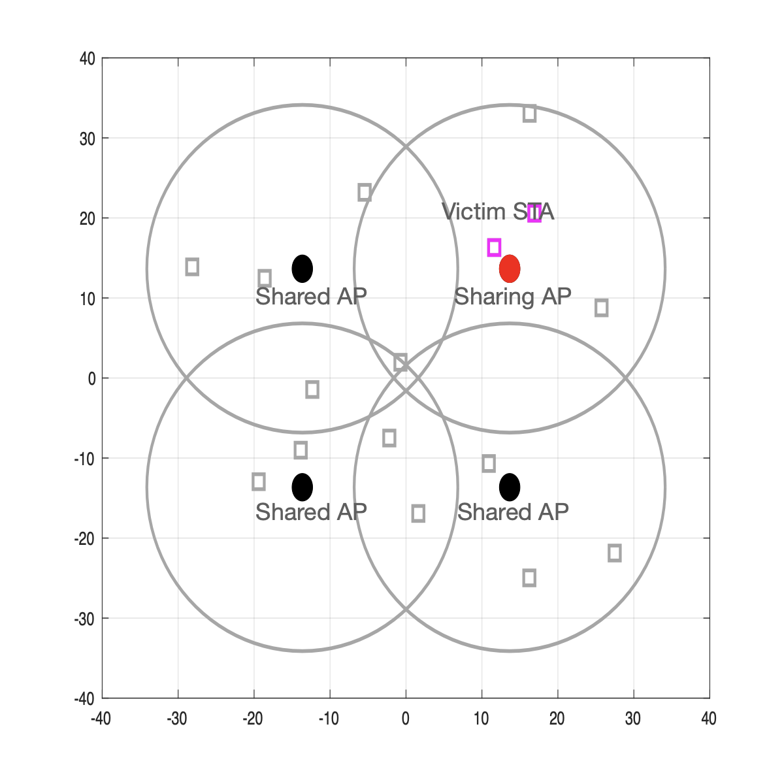
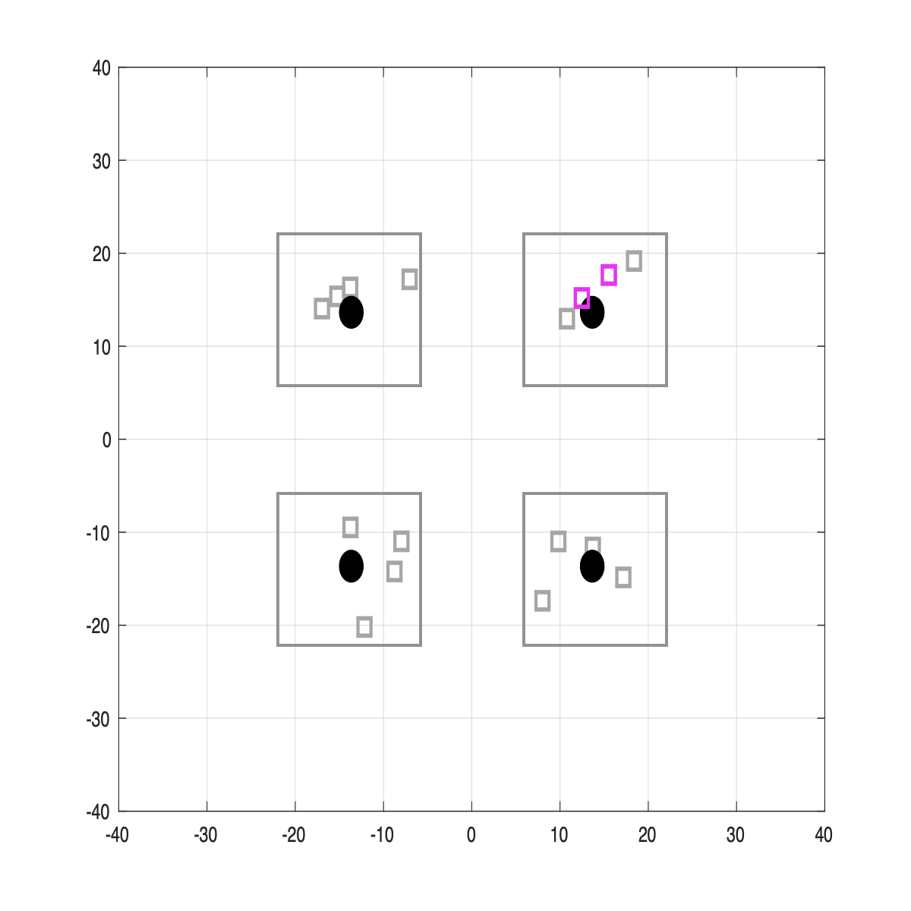
Simulation Scenarios
Frequency Reuse 1 (80 MHz):
All BSSs are using the same channel
STAs are within BSS radios (R=0.75D) and associated with the closest BSS
Frequency Reuse 4 (20 MHz):
APs use four different channels. The illustration depicts APs with the same channel. Simulation is done only with APs with the same channel.
STAs are within BSS radios (R=0.375D) and associated with the closest BSS

Slide 11
Common Simulation Assumptions (1/3)
PHY level simulation
  Downlink full buffer traffic
  All PPDUs are aligned
  All BSSs can hear each other
  There is no collision
  There is no SIG error
  There is no MAC overhead
  Number of antennas: AP (Ntx) = 4, non-AP STA (Nrx) = 2,
  Maximum Nss = 2 for each non-AP STA with maximum MCS = 11
  5 GHz and channel B (both for fading channel and path loss)
  Ideal beamforming (SU/MU/CBF depending on scheme and scheduler decision) is assumed
All evaluated BSSs have the same bandwidth on the same channel

Slide 12
Common Simulation Assumptions (2/3)
AP to AP distance: 27.3 meters (D=27.3)
AP’s maximum power: from 10 to 30 dBm
  10 dBm: PD at far AP, i.e. RSSI of -82 dBm at the diagonal AP
  30 dBm: ED at far AP, i.e. RSSI of -62 dBm at the diagonal AP
100 drops, and each drop contains
  200 packets of initialization to settle link adaptation and feedback
  500 packets of data transmission: 5 ms PPDU length, all PPDUs are aligned
  Time-varying channel
  It is generated by an interpolation of two independent channels at every 800 ms
  There are about -40dB changes in frequency domain every 5 ms
  This is no channel variation within a PPDU
Baseline (legacy)
  A single AP transmits to a single STA (SU-MIMO) or two STAs (MU-MIMO)

Slide 13
Common Simulation Assumptions (3/3)
Link adaptation/Fast feedback
  APs select MCS and NSS (best among [2 2]/[2 1]/[1 2]/[1 1]/[2 0]/[0 2]/[1 0]/[0 1] streams) based on long term SNR + SINR adjustment (initially set to a certain value based on the mode of operation)
  A non-AP STA feeds back effective SINR of the received PPDU
  AP updates SINR adjustment (= Effective SINR (feedback by a non-AP STA) - SINR used by AP when selecting MCS and Nss of the PPDU)
  Note that for different PHY parameters (e.g. CSR/CBF/MU-MIMO, Nss, Nss,tot, etc), AP needs to maintain different SINR adjustments: AP maintains feedback information for each PHY parameter
  For MU-MIMO, pairs are maintained within a drop unless the link adaptation chooses to fall back to SU
  If the estimated SINR is below the required SINR for MCS0, Nss1, AP will not transmit to the STA except for the victim STA(s)
  If victim STA(s) can’t be served, then remove one of the shared AP (the closest AP to the sharing AP first, randomly between two closest APs)

Slide 14
Simulation Results: Reuse 1, 4 STAs per AP
A scheme without power control performs much better than a scheme with power control
As observed in others’ contributions, CSR with power control provides less gain as the transmit power of AP increases
This is due to the interference level from the sharing AP to shared APs increases while the shared AP’s transmit power is determined by path loss of the shared AP and victim STA(s) which is fixed regardless of the maximum transmit power of the AP (or sharing AP’s transmit power)
A CSR with power control was proposed for fairness
If an AP selects victim STAs properly and another AP shares its TXOP as well, then there seems no fairness issue as shown in per STA throughput in the next slide
4 STAs per AP

Slide 15
Per STA Throughput: Reuse 1, 4 STAs per AP

Slide 16
Simulation Results: Reuse 1, 16 STAs per AP
A scheme without power control performs much better than a scheme with power control
A scheme without power control works better as there are more center STAs
A CSR with power control performs slightly worse than the case with 4 STAs per APs
The reason for this is as follows
  As there are more STAs in sharing AP, the transmit power level of shared APs will vary more and thus makes link adaptation difficult even with fast feedback
  In the simulation, a STA to serve in shared AP as well as sharing AP is selected randomly
  Shared APs may choose a good SNR STA to serve but it gives much more opportunity to good SNR STAs (fairness issue), and it still is not a general solution as shown in reuse 4 results in slide 18
16 STAs per AP

Slide 17
Per STA Throughput: Reuse 1, 16 STAs per AP

Slide 18
Simulation Results: Reuse 4, 4 STAs per AP
A CSR with power control provides more gain than reuse 1 case but is still worse than a CSR without power control because we assume that the sharing AP sets each shared AP’s signal power to be not greater than the noise level at the victim STAs. Some optimization may increase the gain at the cost of higher complexity
For legacy or a CSR without power control performance are similar for different transmit power level as SINR is saturated
However, the performance of a CSR with power control is getting worse as the interference level from the sharing AP to the shared APs increases
A CBF does not provide gain in this scenario as there is no room for improving SINR and all transmission is done with MU-MIMO (mostly 3-4 streams within a BSS)
4 STAs per AP

Slide 19
Per STA Throughput: Reuse 4, 4 STAs per AP

Slide 20
Discussions (1/3)
A CSR scheme with power control has several problems
Performance
  It may not perform better than a scheme without power control depending on the power control algorithm
  Also optimizing transmit power control is not simple
  For example,
    If a sharing AP uses fixed power while a shared AP reduces its power to maintain MCS level at the sharing AP (fairness constraint), then the sharing AP’s performance could be bad as interference from sharing AP could be too high
    If a joint power control algorithm is used (power control for both shared AP and sharing AP), then there could be a fairness issue

Slide 21
Discussions (2/3)
Hidden node problem
  Even if it transmits a control frame to reserve a medium, OBSS STA or devices in power save may miss the control frame
  Results and discussions in [6, 7] show that the probability of successfully decoded preambles of OBSS is low due to multiple sources of transmissions
  If the actual transmission’s transmit power is low, then OBSS STA’s transmission may overlap in time
Limitation of PHY simulation
  In many simulations, authors assume the network is synchronized
  As discussed in [6, 7], due to multiple sources of transmissions, the network often becomes asynchronized, and thus the network already operates on an aggressive CCA level in a dense environment
  Thus, it is better to evaluate CSR using a network simulator

Slide 22
Discussions (3/3)
Link Adaptation
  It complicates link adaptation due to varying signal and interference level
  It suffers from inaccuracy of RSSI measurements, e.g. ±3dB in class A device
Non-AP STA feedback
  Most power control algorithm requires knowing the interference level between non-AP STA and neighboring AP
  It makes a non-AP STA consume more power by measuring non-serving APs’ RSSI
  It is better to improve efficiency by a scheme not require feedback
  Note that a scheme without power control does not require a (periodic) report of non-AP STA measurement of neighboring BSS

Slide 23
Conclusion
We have identified several problems in a CSR scheme with transmit power control
  Performance depends on power control algorithm which could be complex for optimization
  Creates hidden nodes
  Difficulty in link adaptation
  Makes non-AP STA to consume more power
Also, we have identified a limitation of PHY level simulation (network synchronization assumption) which has been done in many studies
It is recommended to study CSR more with system-level simulators with more realistic simulation scenarios such as in [8]

Slide 24
References
[1] 11-23/1023r2, “Coordinated Spatial Reuse in a 4 AP Topology”
[2] 11-23/1037r0, “Performance of Coordinated Spatial Reuse”
[3] 11-23/776r1, “Performance of C-BF and C-SR”
[4] 11-23/1868r2, “Coordinated Spatial Reuse Design”
[5] 11-23/1917r0, “Coordinated Spatial Reuse”
[6] 11-15/367r0, “OBSS Preamble Detection”
[7] 11-14/1420r1, “The Impact of Preamble Error on MAC System Performance”
[8] 11-14/980r16, “TGax Simulation Scenarios”

