Slide 1
Regarding MPDU Identification Issue in Cross Link Error Recovery
Date: 2024-01-13
Authors:

Slide 2
Abstract
Fast Error Recovery methods were discussed in UHR SG [1], [2].
A STA may know whether MPDU is broken or not. On the contrary, the STA may not know which MPDU is broken.
To decrease delay, 11bn needs error recovery method with MPDU identifying methods
In this submission, an error recovery method with MPDU identifying method is discussed.

Slide 3
Background
In [1] and [2], fast error recovery methods are proposed.
When an error is occurred in a TXOP, an error feedback can be transmitted via multi-link.
The error can be recovered in the TXOP by the feedback .
Source: [2]: 11-23/1207r0

Slide 4
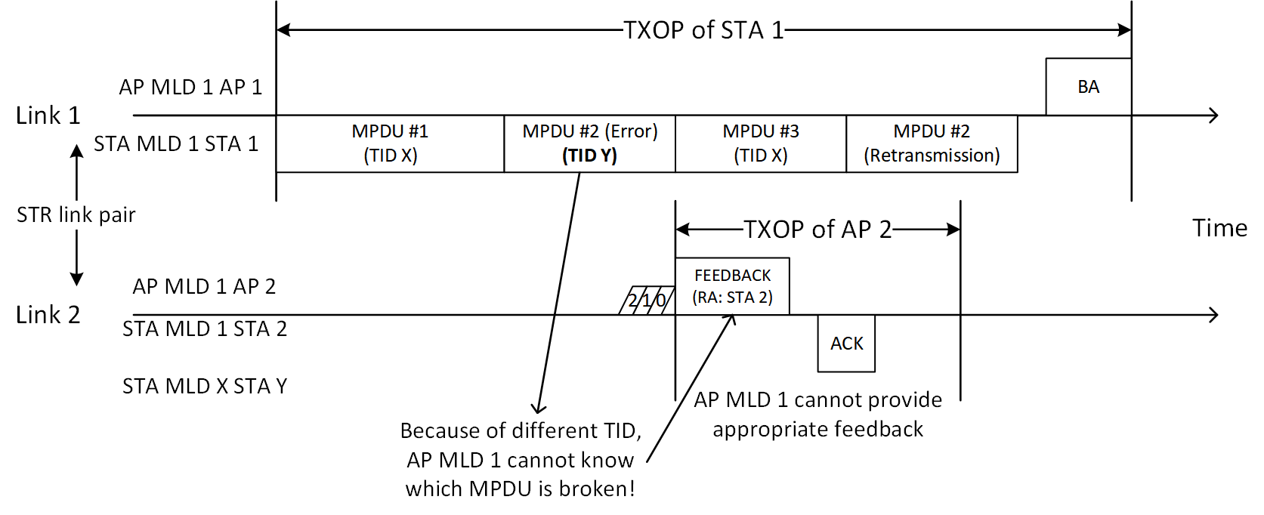
Issue
When the MPDU has an error, the MPDU may not be identified.
An MPDU of a delay-sensitive TID may be inserted among other MPDUs of other TID.
Or, MPDUs may not be transmitted sequentially.
E.g., SN of MPDU #1 is 1, SN of MPDU #2 is 3, SN of MPDU #3 is 2

Slide 5
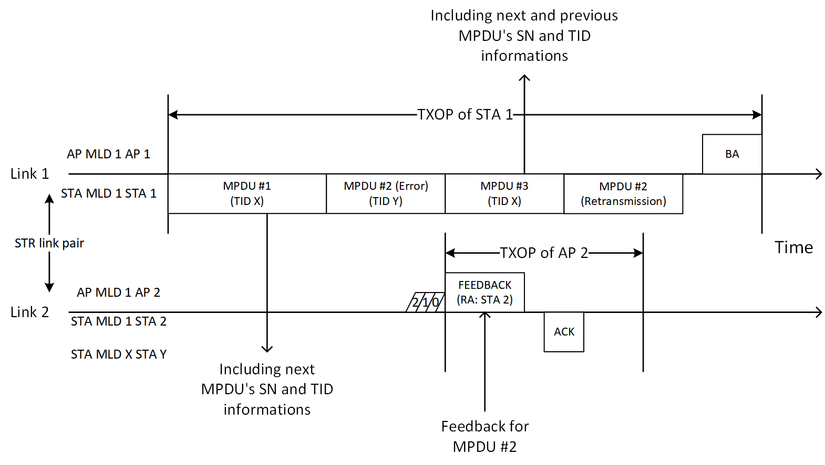
Option 1: Information for MPDU error recovery
Each of MPDUs includes an information about previous and/or next MPDU’s TID and SN
When an MPDU is broken, the MPDU can be identified from another MPDU’s TID and SN information.

Slide 6
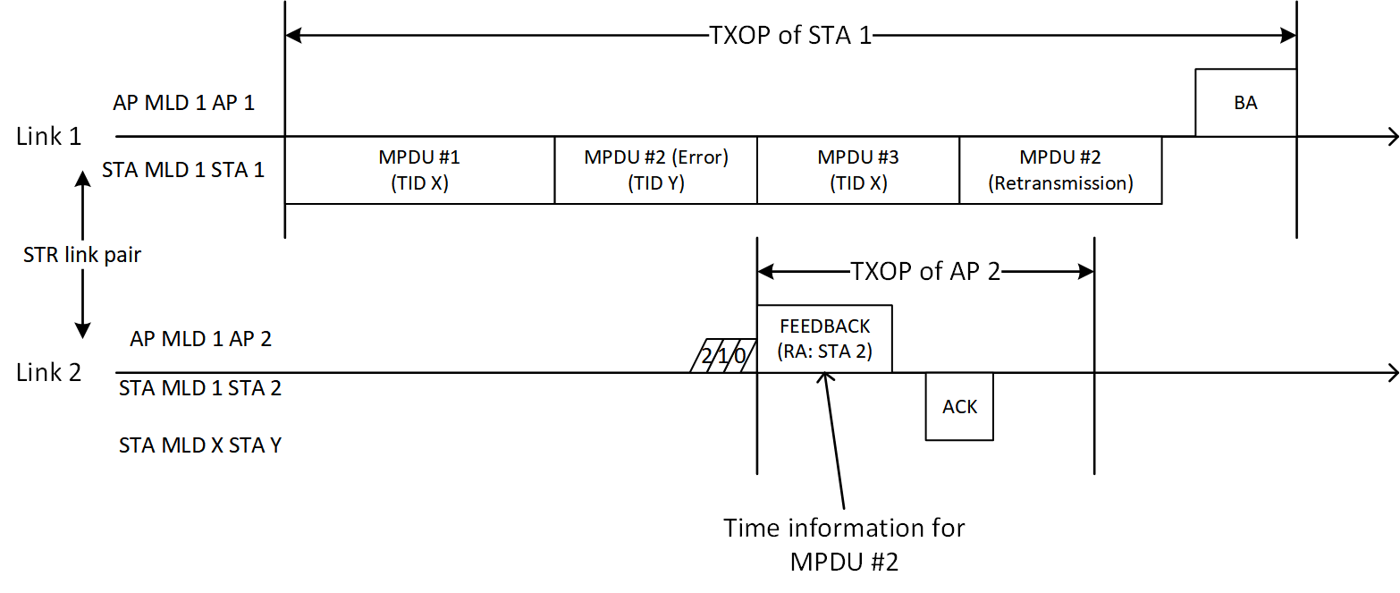
Option 2: Time based indication
When an MPDU is broken in an A-MPDU, in a feedback frame, the errored MPDU can be identified with a time indication.
E.g., time offset, TSF timestamp, etc.,

Slide 7
Summary
The methods for identifying errored MPDU(s) are proposed.
First method is information for MPDU error recovery
Each of MPDUs have information about previous and next MPDU’s information
Broken MPDU can be identified with another MPDU’s information
Second method is time-based indication method
Broken MPDU can be identified with time information
With proposing method, Error recovery can be enhanced in 11bn.

Slide 8
References
[1] 11-23/1201r0: Enhanced Acknowledgement for Low Latency Communication, https://mentor.ieee.org/802.11/dcn/23/11-23-1201-00-0uhr-enhanced-acknowledgement-for-low-latency-communication.pptx
[2] 11-23/1207r0: QoS Enhancements for Next Generation Wi-Fi Networks, https://mentor.ieee.org/802.11/dcn/23/11-23-1207-00-0uhr-qos-enhancements-for-next-generation-wi-fi-networks.pptx

