Slide 1
TGbh-agenda-2024-January-Interim
Date: 2024-01-15
Authors:

Slide 2
Abstract
Agenda for:
802.11 TGbh, January 2024 Interim Session

Slide 3
IEEE 802.11 TGbh Randomized and Changing MAC Addresses (RCM)
Agenda
January 2024 Interim Session
Chair: Mark Hamilton (Ruckus/CommScope)
Vice Chair & Sct’y: Peter Yee (NSA-CSD/AKAYLA)
Vice Chair: Stephen Orr (Cisco)
Editor: Carol Ansley (Cox)

Slide 4
Registration for the January IEEE 802 wireless interim session
This meeting is part of the January IEEE 802 wireless interim session
You must pay the registration fee whether attending in-person or remotely
If you have not already done so, you can register here: https://touchpoint.eventsair.com/2024-jan-ieee-802-wireless-interim-session
If you do not intend to register for this session you must leave this meeting and, if you have logged attendance on IMAT, email the 802.11 chair or vice chairs to have your attendance cancelled

Slide 5
Attendance, etc.
Reminders to attendees:
Sign in for .11 attendance credit
Noises off (if remote connected)
NO AUDIO CXN (if on-site connected)
No recordings

Slide 6
Meeting Protocol
Please announce your affiliation when you first address the group during a meeting slot

Slide 7
Participants have a duty to inform the IEEE
Participants shall inform the IEEE (or cause the IEEE to be informed) of the identity of each holder of any potential Essential Patent Claims of which they are personally aware if the claims are owned or controlled by the participant or the entity the participant is from, employed by, or otherwise represents
Participants should inform the IEEE (or cause the IEEE to be informed) of the identity of any other holders of potential Essential Patent Claims
Early identification of holders of potential Essential Patent Claims is encouraged
Slide #1

Slide 8
Ways to inform IEEE
Cause an LOA to be submitted to the IEEE-SA (patcom@ieee.org); or
Provide the chair of this group with the identity of the holder(s) of any and all such claims as soon as possible; or
Speak up now and respond to this Call for Potentially Essential Patents
If anyone in this meeting is personally aware of the holder of any patent claims that are potentially essential to implementation of the proposed standard(s) under consideration by this group and that are not already the subject of an Accepted Letter of Assurance, please respond at this time by providing relevant information to the WG Chair
Slide #2

Slide 9
Other guidelines for IEEE WG meetings
All IEEE-SA standards meetings shall be conducted in compliance with all applicable laws, including antitrust and competition laws.
Don’t discuss the interpretation, validity, or essentiality of patents/patent claims.
Don’t discuss specific license rates, terms, or conditions.
Relative costs of different technical approaches that include relative costs of patent licensing terms may be discussed in standards development meetings.
Technical considerations remain the primary focus
Don’t discuss or engage in the fixing of product prices, allocation of customers, or division of sales markets.
Don’t discuss the status or substance of ongoing or threatened litigation.
Don’t be silent if inappropriate topics are discussed … do formally object immediately.
---------------------------------------------------------------
For more details, see IEEE-SA Standards Board Operations Manual, clause 5.3.10 and Antitrust and Competition Policy: What You Need to Know at http://standards.ieee.org/develop/policies/antitrust.pdf
Slide #3

Slide 10
Patent-related information
The patent policy and the procedures used to execute that policy are documented in the:
IEEE-SA Standards Board Bylaws (https://standards.ieee.org/about/policies/bylaws/sect6-7.html)
IEEE-SA Standards Board Operations Manual (https://standards.ieee.org/about/policies/opman/sect6.html)
Material about the patent policy is available at
http://standards.ieee.org/about/sasb/patcom/materials.html
If you have questions, contact the IEEE-SA Standards Board Patent Committee Administrator at patcom@ieee.org
Slide #4

Slide 11
IEEE SA Copyright Policy
By participating in this activity, you agree to comply with the IEEE Code of Ethics, all applicable laws, and all IEEE policies and procedures including, but not limited to, the IEEE SA Copyright Policy.
Previously Published material (copyright assertion indicated) shall not be presented/submitted to the Working Group nor incorporated into a Working Group draft unless permission is granted.
Prior to presentation or submission, you shall notify the Working Group Chair of previously Published material and should assist the Chair in obtaining copyright permission acceptable to IEEE SA.
For material that is not previously Published, IEEE is automatically granted a license to use any material that is presented or submitted.

Slide 12
IEEE SA Copyright Policy
Secretary to record that copyright policy slides were presented
The IEEE SA Copyright Policy is described in the IEEE SA Standards Board Bylaws and IEEE SA Standards Board Operations Manual
IEEE SA Copyright Policy, see Clause 7 of the IEEE SA Standards Board Bylaws https://standards.ieee.org/about/policies/bylaws/sect6-7.html#7 Clause 6.1 of the IEEE SA Standards Board Operations Manual https://standards.ieee.org/about/policies/opman/sect6.html
IEEE SA Copyright Permission
https://standards.ieee.org/content/dam/ieee-standards/standards/web/documents/other/permissionltrs.zip
IEEE SA Copyright FAQs
http://standards.ieee.org/faqs/copyrights.html/
IEEE SA Best Practices for IEEE Standards Development
http://standards.ieee.org/develop/policies/best_practices_for_ieee_standards_development_051215.pdf
Distribution of Draft Standards (see 6.1.3 of the SASB Operations Manual)
https://standards.ieee.org/about/policies/opman/sect6.html

Slide 13
Participant behavior in IEEE-SA activities is guided by the IEEE Codes of Ethics & Conduct
All participants in IEEE-SA activities are expected to adhere to the core principles underlying the:
IEEE Code of Ethics
IEEE Code of Conduct
The core principles of the IEEE Codes of Ethics & Conduct are to:
Uphold the highest standards of integrity, responsible behavior, and ethical and professional conduct
Treat people fairly and with respect, to not engage in harassment, discrimination, or retaliation, and to protect people's privacy.
Avoid injuring others, their property, reputation, or employment by false or malicious action
The most recent versions of these Codes are available at
http://www.ieee.org/about/corporate/governance

Slide 14
Participants in the IEEE-SA “individual process” shall act independently of others, including employers
The IEEE-SA Standards Board Bylaws require that “participants in the IEEE standards development individual process shall act based on their qualifications and experience”
This means participants:
Shall act & vote based on their personal & independent opinions derived from their expertise, knowledge, and qualifications
Shall not act or vote based on any obligation to or any direction from any other person or organization, including an employer or client, regardless of any external commitments, agreements, contracts, or orders
Shall not direct the actions or votes of other participants or retaliate against other participants for fulfilling their responsibility to act & vote based on their personal & independently developed opinions
By participating in standards activities using the “individual process”, you are deemed to accept these requirements; if you are unable to satisfy these requirements then you shall immediately cease any participation

Slide 15
IEEE-SA standards activities shall allow the fair & equitable consideration of all viewpoints
The IEEE-SA Standards Board Bylaws (clause 5.2.1.3) specifies that “the standards development process shall not be dominated by any single interest category, individual, or organization”
This means no participant may exercise “authority, leadership, or influence by reason of superior leverage, strength, or representation to the exclusion of fair and equitable consideration of other viewpoints” or “to hinder the progress of the standards development activity”
This rule applies equally to those participating in a standards development project and to that project’s leadership group
Any person who reasonably suspects that dominance is occurring in a standards development project is encouraged to bring the issue to the attention of the Standards Committee or the project’s IEEE-SA Program Manager

Slide 16
TGbh Agenda – 15 Jan 2024, 19:30-21:30 ET
Attendance, noises/recording, meeting protocol
Policies, duty to inform, participation rules
Organization topics:
November Plenary meetings (6): Monday, 19:30-21:30; Tuesday, 8:00-10:00; Tuesday, 13:30-15:30; Wednesday, 10:30-12:30; Thursday 8:00-10:00; Thursday 13:30-15:30
Approve September Interim and teleconference minutes (next slide)
Timeline reminder (slide 18)
Motions record: 11-22/0651r32
Comment Resolution
Comment resolution document: https://mentor.ieee.org/802.11/dcn/24/11-24-0040-04-00bh-ieee-802-11bh-lb282-comments.xlsx
Comment resolution queue (slide 19)
Editorials – any issues? (Ansley)
Discussion on non-AP MLD device identification (individuals interested in working on this via email, for submission/ballot comment in TGbe?): 11-23/2190r0 (Yang)
Probability of IRM duplicates: 11-23/2148r0 (Smith)
Other, from the queue…

Slide 17
Approve prior TGbh minutes
Approve the minutes of
November plenary session: 11-23/2068r0
Teleconference minutes:
Jan 9: 11-24/0032r0
Moved:
Seconded:
Result:

Slide 18
Timeline
PAR approved Feb 2021
First TG meeting Mar 2021
D0.2 CC May 2022
Initial WG Letter Ballot (D1.0) May 2023
Recirculation LB (D2.0) Nov 2023
Recirculation LB (D3.0) Jan 2024
[ “Clean” recirc (D3.0) Feb 2024 ]
Initial SA Ballot (D3.0) Mar 2024
Final 802.11 WG approval Jul 2024
802 EC approval Jul 2024
RevCom and SASB approval Sep 2024

Slide 19
Comment Resolution queue
Editorials – any issues? (Ansley)
Discussion on non-AP MLD device identification (individuals interested in working on this via email, for submission/ballot comment in TGbe?): 11-23/2190r0 (Yang)
Probability of IRM duplicates: 11-23/2148r0 (Smith)
CIDs 210, 256, 211, 208, 209, 235, 164, and 165: 11-24/0044r3 (Huang)
CIDs 243, 239, 242: 11-24/0068r0 (Harkins)
CIDs 187, 189, 188, 198, 191, 194, 195, 196: 11-24/0068r0 (Harkins)
CIDs 66, 67, 200, 201, 279, 202, 280, 219, 109, 107, 35, 112, 113, 55, 56, 220, 79, 71, 206, 36, 145, 228, 143, 146, 60, 76, 77, 147, 229, 46, 150, 231, 151, 152, 153, 47, 245, 10, 245, 246, 156, 51, 232, 148, 233, 159, 234, 207, 161, 166, 44, 237: 11-24/0048r3 (Smith)
CIDs 74, 65: 11-24/0059r0 (Yang)
CIDs 92, 4, 100, 24, 203, 217, 18, 97, 249, 101, 103, 105, 110: 11-24/0053r0 (Yang)
CIDs 282, 72, 121, 123, 238, 124, 73, 37, 240, 126, 40, 128, 129, 226, 50, 41, 130, 132, 42, 59, 227, 255, 142, 140, 169, 177, 134: 11-24/0049r0 (Yang)

Slide 20
Comment Resolution pending submission
CIDs 64, 83, 86, 88, 89, 93, 1, 111, 116, 224, 223, 43, 241, 131, 230, 171, 284, 2, 3, 133, 117, 135: (Hamilton)
CID 225: (Mutgan)
CIDs 236, 181, 48, 183, 184: (Orr)
CIDs 91, 179: (Ansley)
CIDs 6, 98, 108, 62, 283, 163, 144 (Smith)

Slide 21
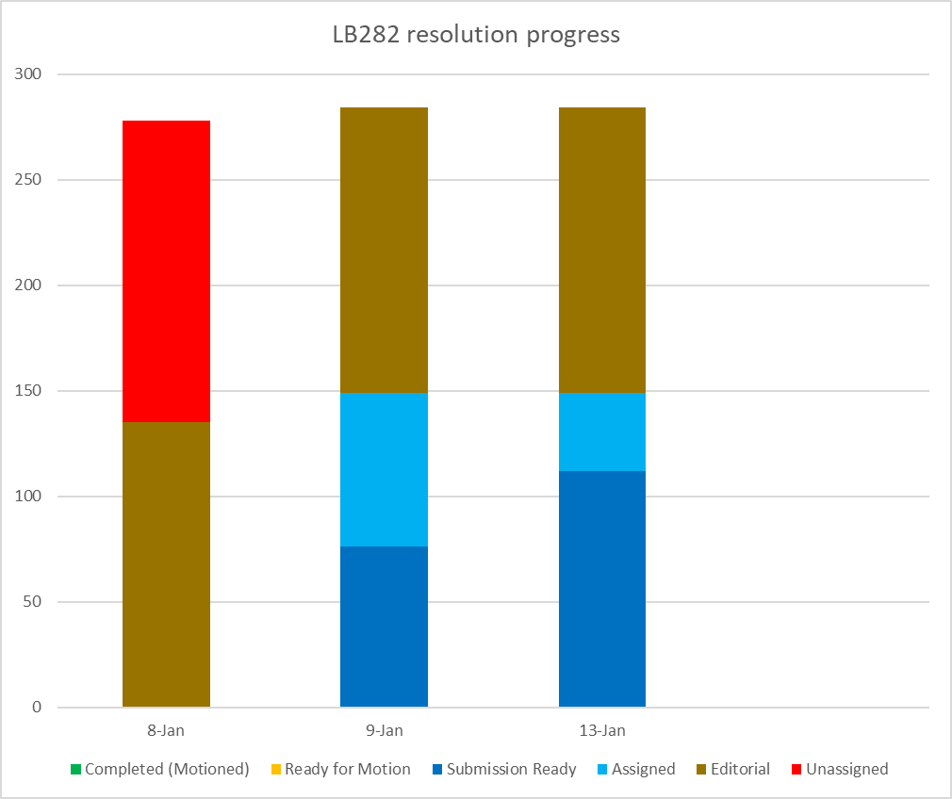
Resolution progress

Slide 22
TGbh Agenda – 16 Jan 2024, 8:00-10:00 ET
Attendance, noises/recording, meeting protocol
Policies, duty to inform, participation rules
Organization topics:
November Plenary meetings (6): Monday, 19:30-21:30; Tuesday, 8:00-10:00; Tuesday, 13:30-15:30; Wednesday, 10:30-12:30; Thursday 8:00-10:00; Thursday 13:30-15:30
Timeline reminder (slide 18)
Motions record: 11-22/0651r31
Comment Resolution
Comment resolution document: <tbd>
Comment resolution queue (slide 19)
CIDs 243, 239, 242: 11-24/0068r0 (Harkins)
CIDs 187, 189, 188, 198, 191, 194, 195, 196: 11-24/0068r0 (Harkins)
CIDs 210, 256, 211, 208, 209, 235, 164, and 165: 11-24/0044r3 (Huang)

Slide 23
TGbh Agenda – 16 Jan 2024, 13:30-15:30 ET
Attendance, noises/recording, meeting protocol
Policies, duty to inform, participation rules
Organization topics:
November Plenary meetings (6): Monday, 19:30-21:30; Tuesday, 8:00-10:00; Tuesday, 13:30-15:30; Wednesday, 10:30-12:30; Thursday 8:00-10:00; Thursday 13:30-15:30
Timeline reminder (slide 18)
Motions record: 11-22/0651r31
Comment Resolution
Comment resolution document: <tbd>
Comment resolution queue (slide 19)

Slide 24
TGbh Agenda – 17 Jan 2024, 10:30-12:30 ET
Attendance, noises/recording, meeting protocol
Policies, duty to inform, participation rules
Organization topics:
November Plenary meetings (6): Monday, 19:30-21:30; Tuesday, 8:00-10:00; Tuesday, 13:30-15:30; Wednesday, 10:30-12:30; Thursday 8:00-10:00; Thursday 13:30-15:30
Timeline reminder (slide 18)
Motions record: 11-22/0651r31
Comment Resolution
Comment resolution document: <tbd>
Comment resolution queue (slide 19)

Slide 25
TGbh Agenda – 18 Jan 2024, 8:00-10:00 ET
Attendance, noises/recording, meeting protocol
Policies, duty to inform, participation rules
Organization topics:
November Plenary meetings (6): Monday, 19:30-21:30; Tuesday, 8:00-10:00; Tuesday, 13:30-15:30; Wednesday, 10:30-12:30; Thursday 8:00-10:00; Thursday 13:30-15:30
Timeline reminder (slide 18)
Motions record: 11-22/0651r31
Comment Resolution
Comment resolution document: <tbd>
Comment resolution queue (slide 19)

Slide 26
TGbh Agenda – 18 Jan 2024, 13:30-15:30 ET
Attendance, noises/recording, meeting protocol
Policies, duty to inform, participation rules
Organization topics:
November Plenary meetings (6): Monday, 19:30-21:30; Tuesday, 8:00-10:00; Tuesday, 13:30-15:30; Wednesday, 10:30-12:30; Thursday 8:00-10:00; Thursday 13:30-15:30
Timeline reminder (slide 18)
Motions record: 11-22/0651r31
Comment Resolution (finalize): <link tbd>
Motion to approve LB282 resolutions (Motion #xx of motion deck)
Motion for Recirculation Letter Ballot on D3.0 (Motion #xx)
Motion to approve report to EC (Motion #xx)
Motion for Conditional SA ballot (Motion #xx)
Motion for PAR re-confirmation (Motion #xx)
Teleconference and March planning

Slide 27
TGbh Teleconferences
Teleconferences through March session?
Feb 13, 9:30-11:30 am ET
(D3.0 LB results, Conditional SA ballot prep)
Notes: WGLB ~ Jan 24-Feb 8
[ Clean recirc Feb 14-Feb 24 ]
OR
SA ballot starts ~ Feb 14 through March session

Slide 28
March interim session plan
? Meeting slots
Avoid conflicts with (TGs): TGbi, REVme, ARC, TGbn, TGbe(MAC/Joint) if/as much as possible
Goals:
D3.0 SA ballot

Slide 29
Backup material

Slide 30
TGbh PAR Scope (emphasis added)
This amendment specifies modifications to the medium access control (MAC) mechanisms to preserve the existing services that might otherwise be restricted in environments where STAs in an ESS use randomized or changing MAC addresses, without affecting user privacy. User privacy includes exposure of trackable information to third parties or exposure of an individual's presence or behavior.
This amendment introduces mechanisms to enable session continuity in the absence of unique MAC address-to-STA mapping. For STAs in an ESS that use randomized or changing MAC addresses, this amendment preserves the ability to provide customer support, conduct network diagnostics and troubleshooting, and detect device arrival in a trusted environment.
There is a need to:
Ensure that IEEE Std 802.11 provisions that refer to a STA MAC address remain valid when that MAC address is random or changes.
Design mechanisms that enable an optimal user experience when the MAC address of a STA in an ESS is randomized or changes. These mechanisms should not decrease user privacy.

