Slide 1
Ascon: The Lightweight Cryptography Standard for IoT
Date: 2023-11-15
Authors:

Slide 2
Motivation

Slide 3
Internet of Things
There are over 15 billion connected IoT devices worldwide
  This number is expected to double by 2030
  Increasing number of devices running on battery power
Connected devices are subject to an increased attack surface
  Devices connected to the Internet can be attacked if not properly protected
  Each connected device adds a doorway for attackers
Strong need to protect data on IoT devices
  Secured data storage
  Secured communication
Palo Alto Networks 2020
IoT Threat Report:
98% of all IoT device traffic is unencrypted!
Notes:
https://unit42.paloaltonetworks.com/iot-threat-report-2020/

Slide 4
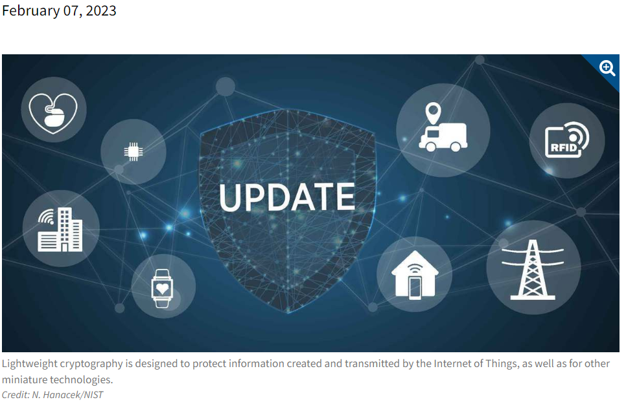
NIST selects Ascon as the standard to protect small devices
“The algorithms are designed to protect data created and transmitted
by the Internet of Things and other small electronics.”
NIST LWC competition (2019-2023)
Authenticated encryption and hashing
57 submissions, 3 rounds, 1 winner
https://csrc.nist.gov/projects/lightweight-cryptography
Inspired by
NIST AES, SHA-3, PQC competitions

Slide 5
Why Ascon? “We have AES and SHA!”
Ascon provides authenticated encryption and hashing with minimal overhead
Comparable security level as AES-128, SHA-256 and SHAKE128
More efficient on low-end devices (Ascon-128 vs AES128-GCM)
  Up to 3-5x speed on microcontrollers
  Up to 2x throughput with 0.5x energy in hardware
Very efficient to protect against physical attacks
  No table lookups, easy to mask, key used less often
Ascon allows to secure data, where this was too costly before
(energy, area, latency)

Slide 6
Ascon in 802.11
Alternative to AES-GCMP 128

Slide 7
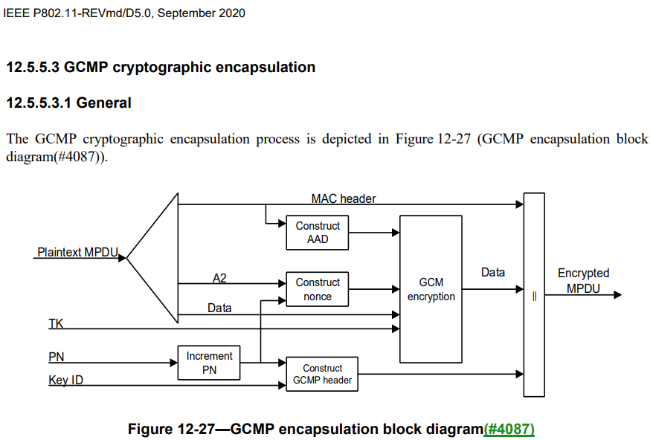
AES GCMP (128 or 256): Encapsulation and encryption
Increment the PN, to obtain a fresh nonzero PN for each MPDU, so that the PN never repeats for the same temporal key. Retransmitted MPDUs are not modified on retransmission.
Use the fields in the MPDU header to construct the additional authentication data (AAD) for GCM. The GCM algorithm provides integrity protection for the fields included in the AAD. MPDU header fields that might change when retransmitted are muted by being masked out when calculating the AAD.
Construct the GCM nonce from the PN and A2, where A2 is MPDU Address 2.
Construct the GCMP header.
Use the temporal key (16/32 octets), AAD (22-30 octets or 16-28 octets), nonce (12 octets), and MPDU data to form the ciphertext and the MIC. This step is known as GCM originator processing.
Form the encrypted MPDU by combining the original MPDU header, the GCMP header, the encrypted data and the MIC.
NIST SP 800-38D describes the GCM authenticated encryption function given a key, nonce, AAD, and plaintext data to produce ciphertext and a tag (MIC)
Ascon
encyption

Slide 8
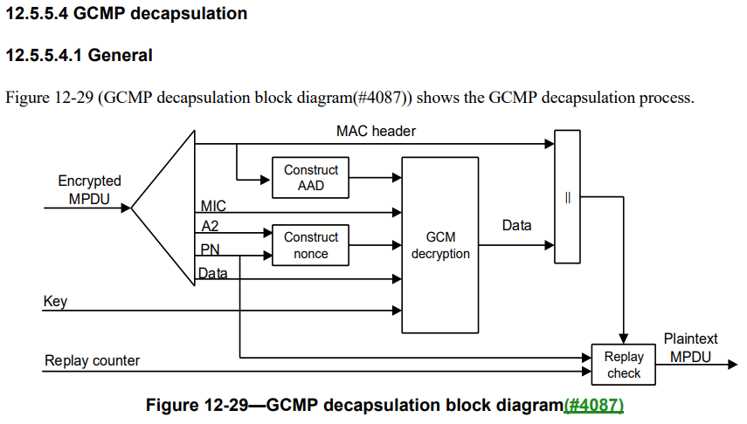
AES GCMP (128 or 256): Decryption and decapsulation
The encrypted MPDU is parsed to construct the AAD and GCM nonce values.
The MIC is extracted for use in GCM integrity checking.
GCM recipient processing uses the temporal key (16/32 octets), AAD (22-30 octets or 16-28 octets), GCM nonce (12 octets), MIC, and MPDU ciphertext data to recover the MPDU plaintext data as well as to check the integrity of the AAD and MPDU plaintext data by checking the MIC. This is performed by comparing the received MIC with a MIC calculated as described in GCMP cryptographic encapsulation. The plaintext is returned only if the MIC check is successful.
The received MPDU header and the MPDU plaintext data from GCM recipient processing are concatenated to form a plaintext MPDU.
The decryption processing prevents replay of MPDUs by validating that the PN in the MPDU is greater than the replay counter maintained for the session.
Ascon
decyption

Slide 9
Ascon: Authenticated encryption
Ascon-128 and Ascon-128a

Slide 10
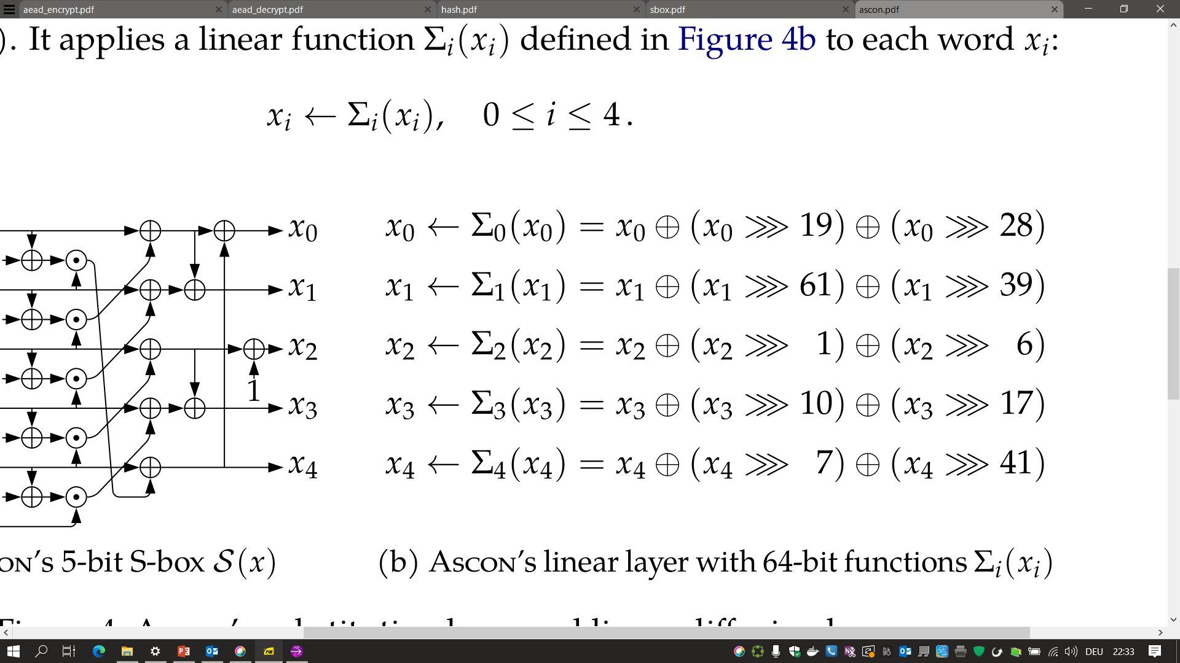
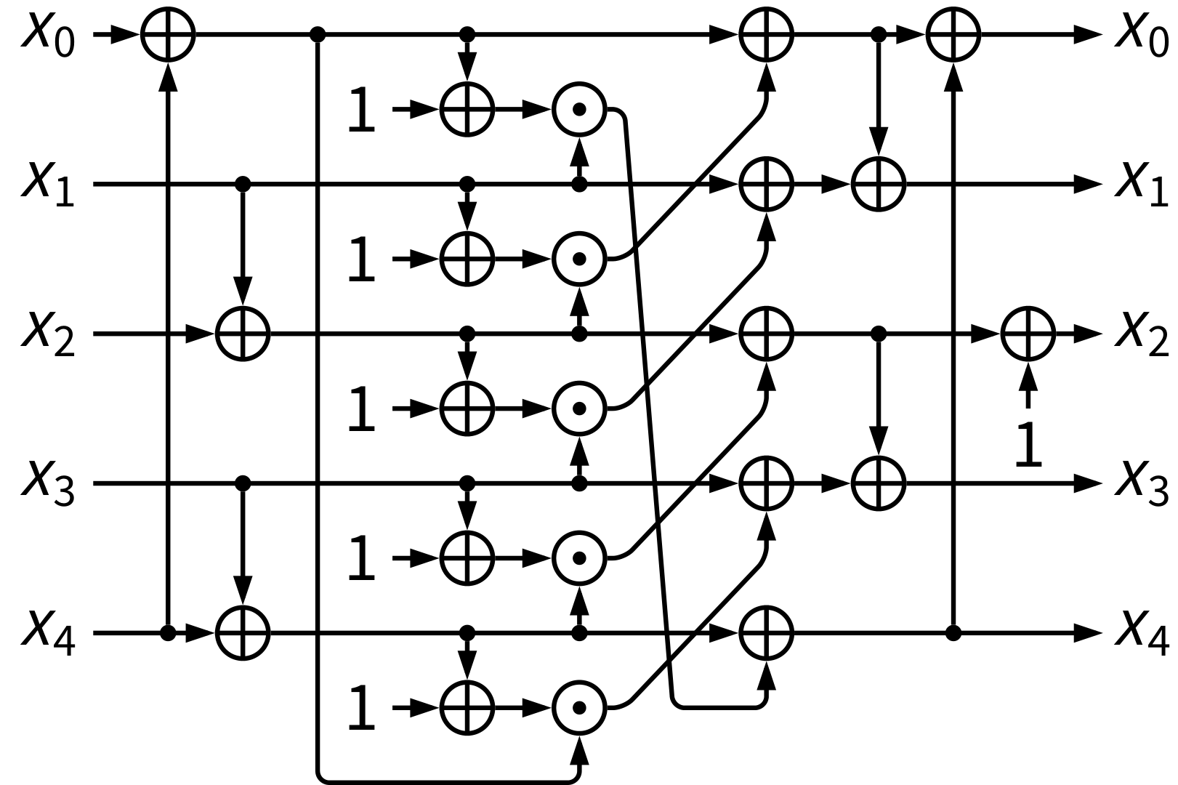
Ascon: Simple round function
S-box layer
Linear layer

Slide 11
Properties of the permutation
Strong security properties
  High diffusion and proven bounds
Simplicity
  Small 320-bit state size
  Defined on five 64-bit words
  Using bitwise Boolean functions
Flexible in hardware
  Small area to high speed
Fast in Software
  Up to 5 instructions in parallel
  Bit-sliced S-box (64 in parallel)
  Bit-interleaving on 32-bit processors
Very efficient SCA countermeasures
  No S-box table look-ups
  Easy to mask in HW and SW
  Lower randomness requirements

Slide 12
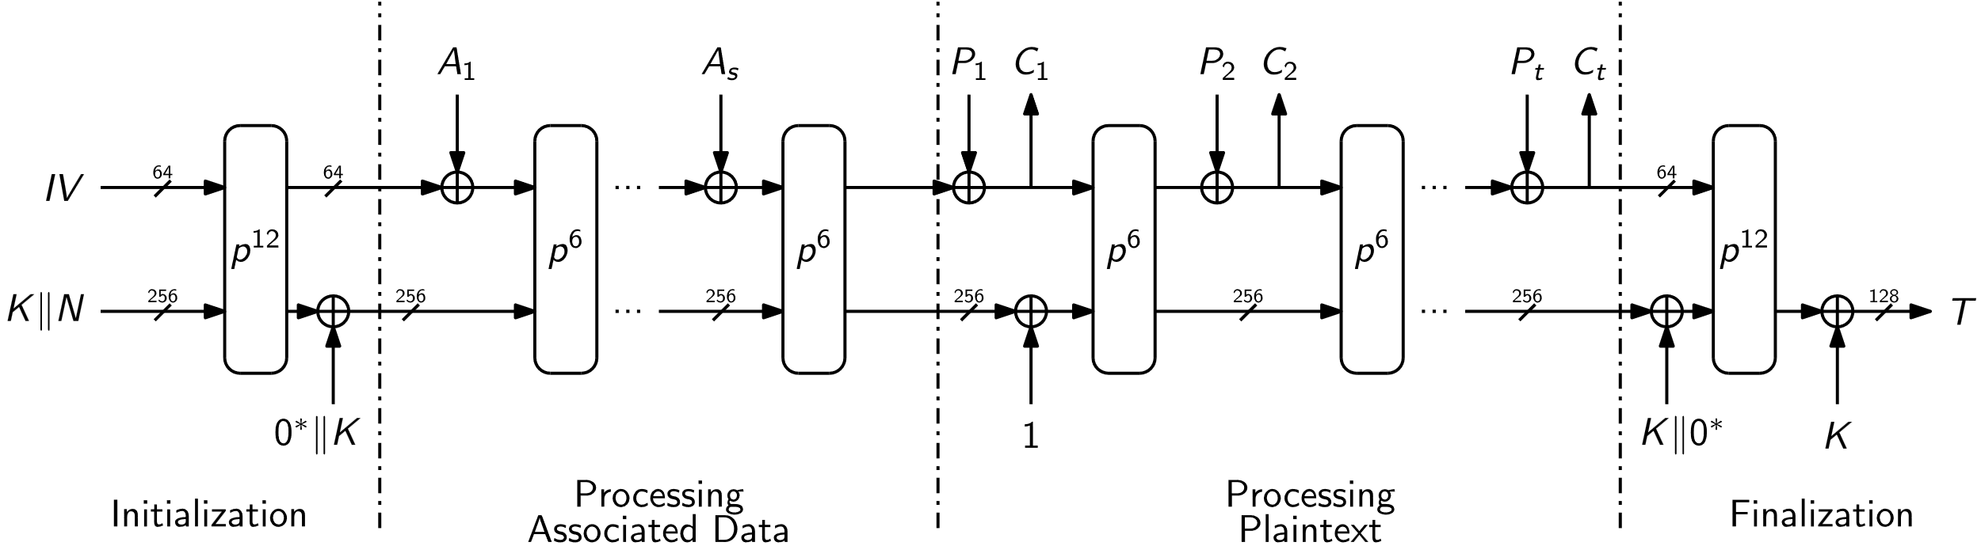
Ascon-128: Authenticated encryption
Encryption & Authentication
  (K, N, A, M) ⇒ (C, T)

Slide 13
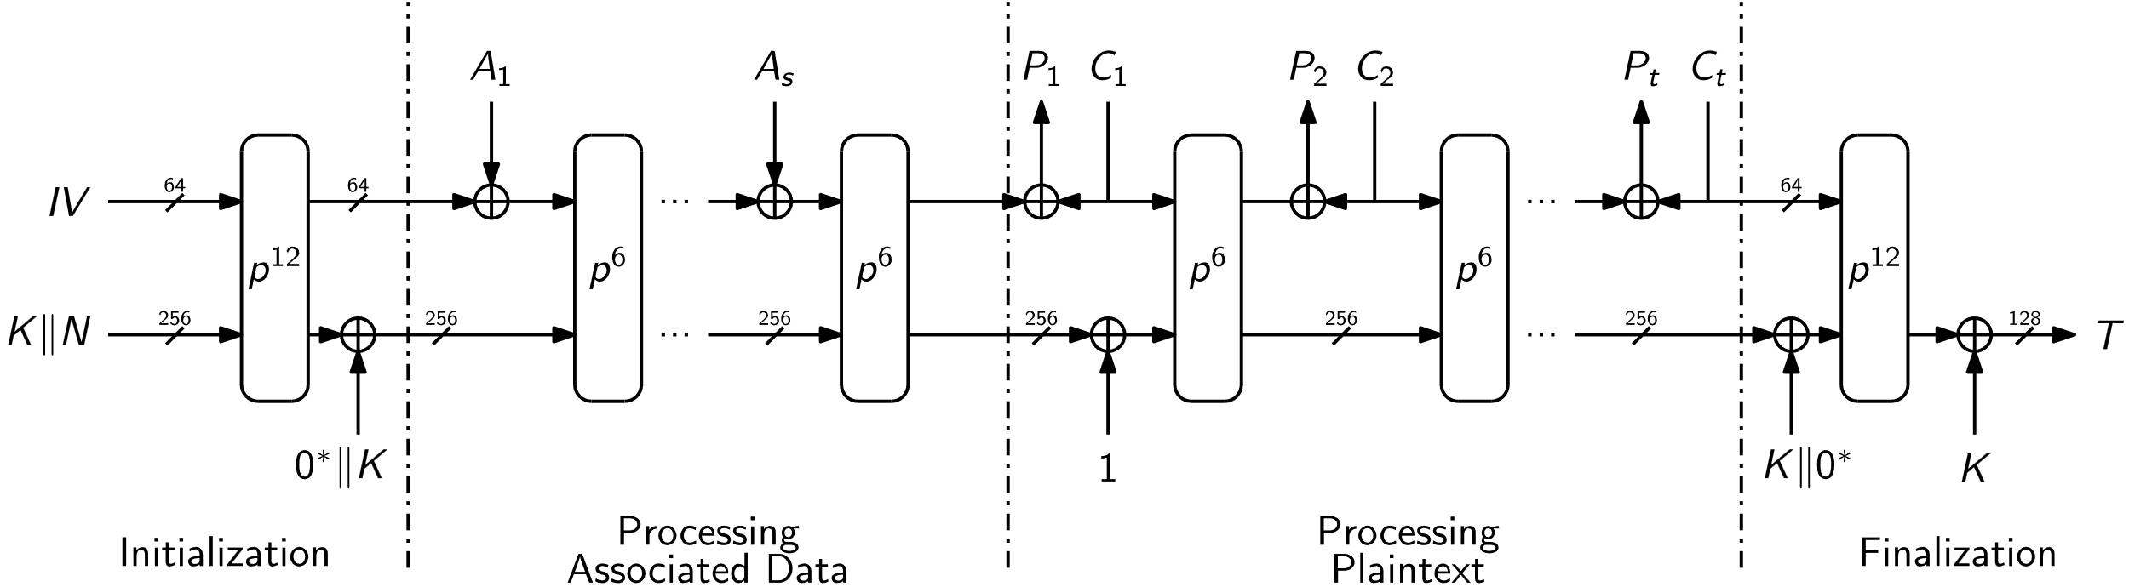
Ascon-128: Authenticated decryption
Decryption & Verification
  (K, N, A, C, T) ⇒ {M, ⊥}

Slide 14
Ascon-128 vs Ascon-128a
Same security, different trade-off (block size vs. number of rounds)
Both scrutinized for years in cryptographic competitions
Most security analysis can be applied to both algorithms
Tight security proof for Ascon (https://eprint.iacr.org/2023/775)
Ascon-128a: 33% more performance, more rounds, larger rate
Ascon-128: higher robustness in case of state recovery (https://eprint.iacr.org/2023/796)

Slide 15
Ascon: Hash and eXtendable-Output Function
Ascon-Hash and Ascon-XOF

Slide 16
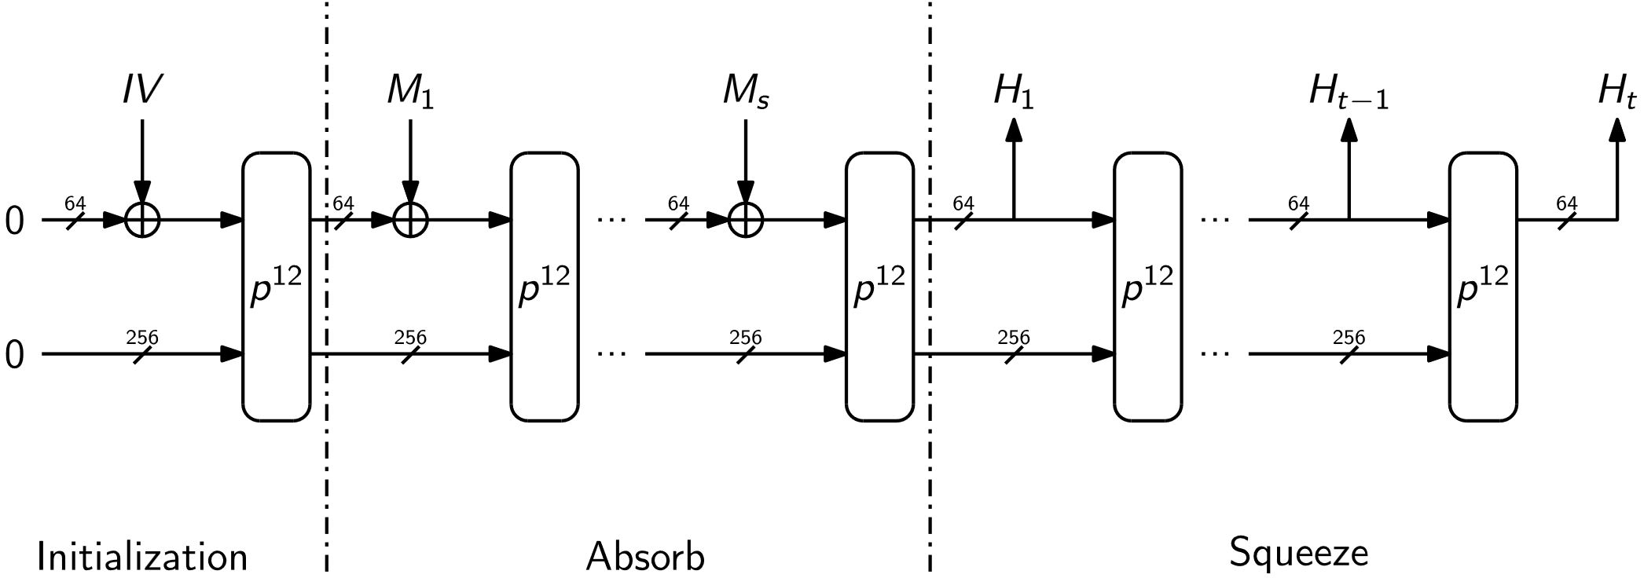
Ascon Hash / XOF
Ascon provides hashing at low overhead
Similar structure, same permutation as AEAD
Hash: Fixed output size (e.g. 256 bits)
XOF: Variable output size

Slide 17
Implementations
Fast and small

Slide 18
ASIC hardware benchmarks
Throughput in [bits/cycles]
 | Throughput | Area | Throughput / Area
Ascon-128a | 25.60 | 1.49 | 17.18
Ascon-128 | 16.00 | 1.56 | 10.25
AES128-GCM | 11.63 | 2.75 | 4.22
https://eprint.iacr.org/2021/049

Slide 19
Embedded implementations
Time to process NIST testvectors in [µs]
Code size in [bytes]
 | Uno | F1 | ESP | F7 | R5
Ascon-128a | 1981 | 66.4 | 18.4 | 11.8 | 7.3
Ascon-128 | 2337 | 76.7 | 22.3 | 13.8 | 8.5
AES128-GCM | - | 332.8 | 67.2 | 35.8 | 23.7
https://lwc.las3.de/
 | Uno | F1 | ESP | F7 | R5
Ascon-128a | 2544 | 2252 | 1200 | 1240 | 1792
Ascon-128 | 2552 | 2157 | 1120 | 1180 | 1792
AES128-GCM | - | 9908 | 14832 | 9836 | 14272
https://lwc.las3.de/

Slide 20
Ascon hardware extensions/instructions
A Fast and Compact RISC-V Accelerator for RV32 (also ARM)
  RI5CY Ascon with 4.7kGE: speedup factor 50x
  Reuse 10 registers of CPU register file
  https://eprint.iacr.org/2020/1083
ARM Custom Datapath Extension, RISC-V Bitmanip Extension, ...
  32-bit funnel shift instructions (RV32B: FSRI, ESP32: SRC)
  32-bit interleaving instructions (RV32B: ZIP/UNZIP, ARM CDE: CX3)
  Fused AND/XOR, BIC/XOR instructions (ARM A64: BCAX, ARM CDE: CX3A)
  SHA-2 like Sigma instructions (ARM CDE: CX3DA)

Slide 21
Summary

Slide 22
Summary
Security
  Security level comparable as AES-128 and SHA-256
  Well analyzed/understood, large security margin
  High amount of external analysis
Efficiency
  More efficient on constraint devices in HW and SW
  Allows efficient side-channel protection
  Fast on modern CPUs
Flexibility
  Additional constructions like MAC, PRF, …

Slide 23
What’s next?
What’s next with NIST?
  NIST work with the Ascon designers to draft the new lightweight cryptography standard
  Draft will be available for public comments soon
  Ascon will be used in higher level standards, protocols and implementations
What’s next in IEEE 802.11?
  802 tutorial (discussions ongoing with 802.11 chair)
  Contributions to LRTG/802.11bn for consideration in adoption in UHR

Slide 24
Backup slides

Slide 25
Larger nonce, shorter tags
We think that support for shorter tags is useful
  Recommend e.g., 64, 96 and 128 bits
We would recommend to encode the size of the tag in the IV
We do not see the immediate need to support larger nonce than 128 bits, considering the limit on messages that can be encrypted under a single key
In case someone would like to use a fixed prefix in the nonce, we suggest to put this prefix into the associated data

Slide 26
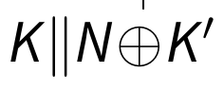
Secret nonce, larger keys
Also done in AES-GCM in TLS (RFC 8446)
Increases key size to 256 bits
Improves multi-user security (https://eprint.iacr.org/2023/924)

