Slide 1
Proposal on puncture pattern support for 11bk
Date: 2023-11-13
Authors:
Name | Affiliations | Address | Phone | Email
Tianyu Wu | Apple. Inc
Anuj Batra
Wook Bong Lee
Qi Wang
Notes:
September 2012

Slide 2
Background
There are discussions on supporting of preamble puncture patterns in 11bk.
[1] propose to focus on most important puncture modes and only support preamble puncture patterns with contiguous bandwidth
[2] propose to support all static puncture patterns, contiguous or non-contiguous.
This contribution continue to discuss the mandatory and optional preamble puncture patterns in 11bk.

Slide 3
Proposal
Mandatory support
320MHz (no puncture case)
Contiguous 240MHz preamble puncture
Optional support of all other preamble puncture patterns.
No separate signaling for individual optional puncture pattern.

Slide 4
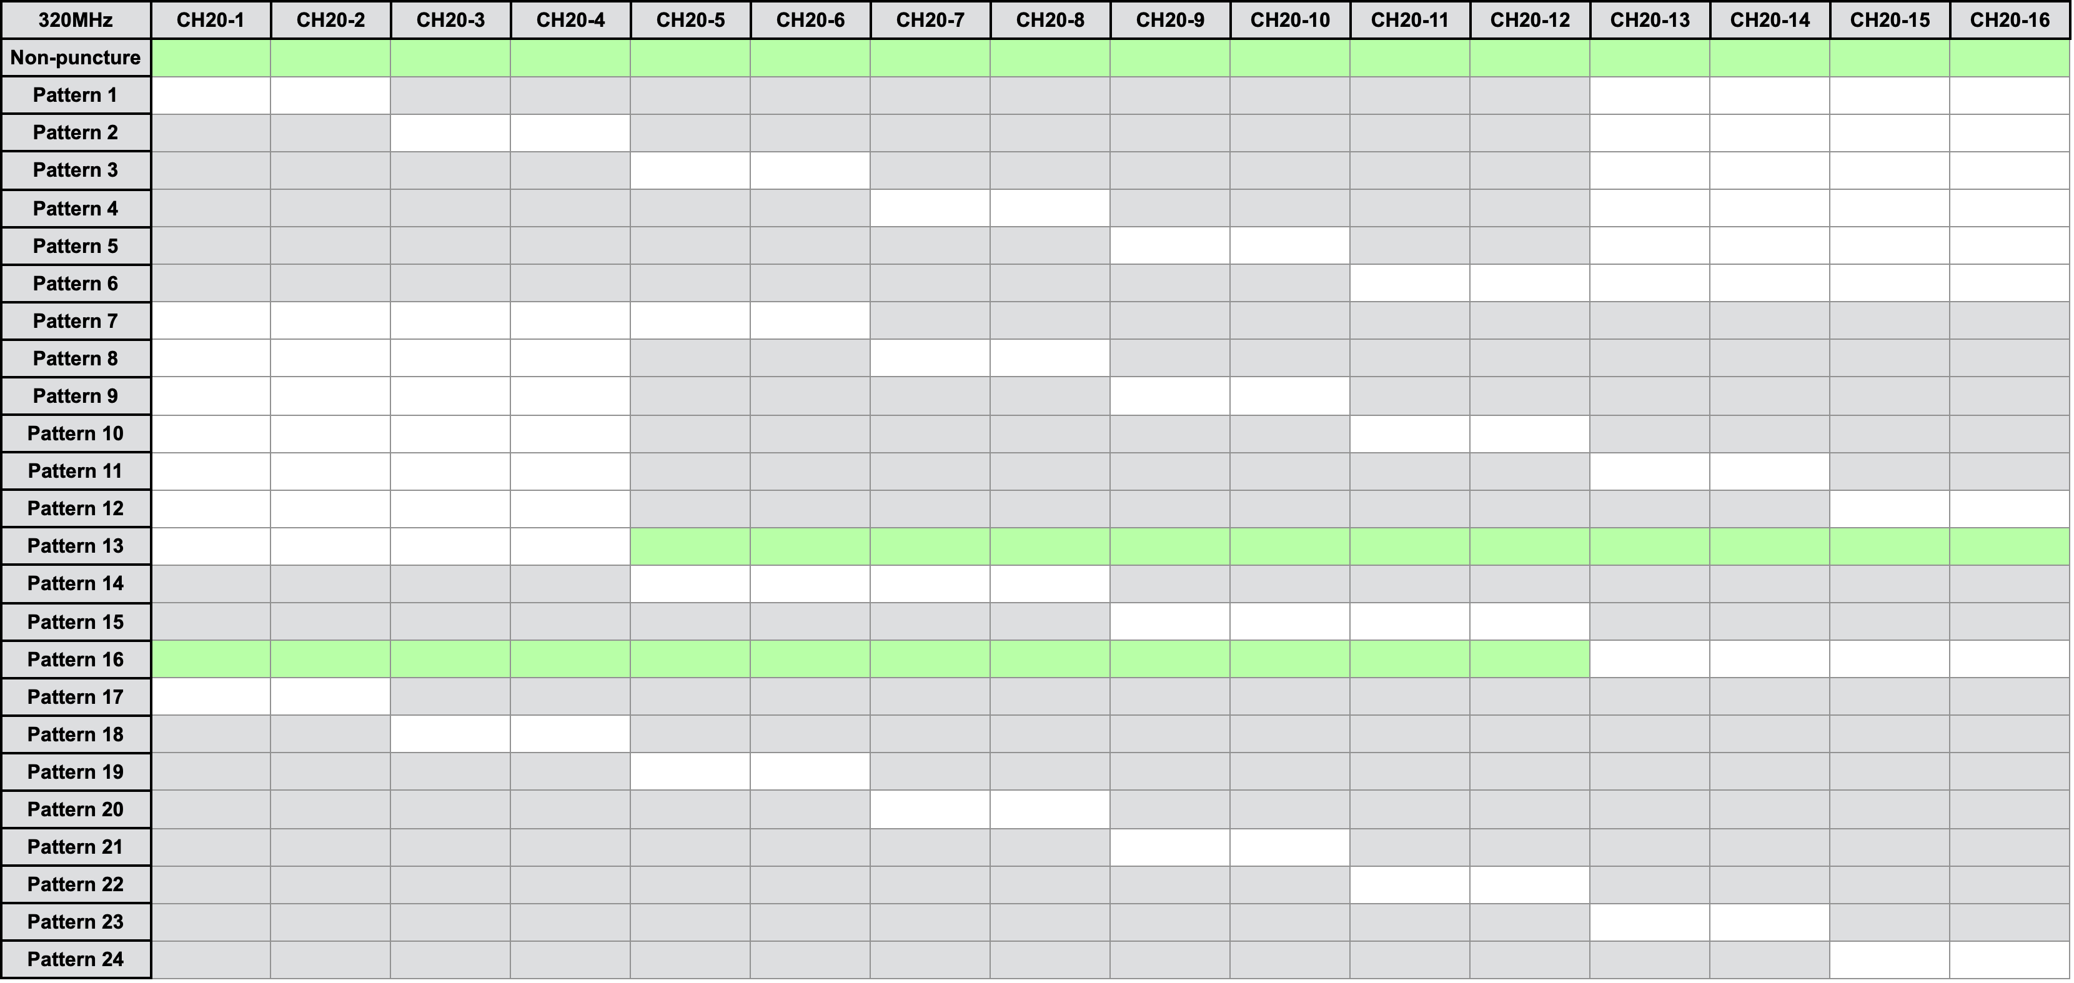
Puncture Pattern Support
Mandatory support 320MHz and contiguous 240MHz preamble puncture
Optional support all other puncture patterns.

Slide 5
Signaling of puncture patterns – Option 1
Change Value 6 in Format And Bandwidth subfield as EHT (with support of mandatory puncture patterns) for 320MHz BW.
Define Value 7 Format And Bandwidth subfield as EHT (with support of all puncture patterns) for 320MHz BW.
ISTA indicates capability, RSTA confirms the set of puncture patterns in ranging.
Confirmed puncture patterns shall be a subset of capabilities indicated by ISTA.
Format And Bandwidth subfield
Field Value | Format | Bandwidth
0 | HE | 20
1 | HE | 40
2 | HE | 80
3 | HE | 80+80
4 | HE (two separate RF LOs) | 160
5 | HE (single RF LO) | 160
6 | EHT (with support of mandatory puncture patterns) | 320
7 | EHT (with support of all puncture patterns) | 320
8-63 | Reserved | Reserved

Slide 6
Negotiation of puncture pattern
ISTA: Format And BW subfield in IFTMR | RSTA (AP): Format And BW subfield in IFTM | Puncture pattern indicated in Beacon | Ranging BW and Puncture pattern | Note
<6 | <6 | Any | 11az ranging | Value 6 and 7 are not allowed for RSTA.
6 | <6 | Any | Fall back to 11az
6 | 6 ^{(*)} | One of the mandatory puncture pattern | Use the puncture pattern in beacon | May update ranging puncture with Static puncture pattern amongst the mandatory set.
 |  | One of the optional puncture pattern | Fall back to 11az | May use mandatory pattern for ranging if Static puncture change to a mandatory pattern.
7 | <6 | Any | Fall back to 11az
7 | 6 | One of the mandatory puncture pattern | Use the puncture pattern in beacon | May update ranging puncture with Static puncture pattern amongst the mandatory set.
 |  | One of the optional puncture pattern | Fall back to 11az | May use mandatory pattern for ranging if Static puncture change to a mandatory pattern.
7 | 7 | Any | Use the puncture pattern in beacon | May update puncture pattern with the Static puncture pattern
* When ISTA indicates 6 in IFTMR, Value 7 is not allowed for RSTA in IFTM. RSTA respond a value beyond ISTA capability is not meaningful.

Slide 7
Signaling of puncture patterns – Option 2
Format And Bandwidth subfield
Signal puncture pattern support in 320MHz Ranging subelement
Puncturing pattern support:
Set to 0 indicate support of mandatory puncturing patterns.
Set to 1 indicate support of all puncturing patterns
Field Value | Format | Bandwidth
0 | HE | 20
1 | HE | 40
2 | HE | 80
3 | HE | 80+80
4 | HE (two separate RF LOs) | 160
5 | HE (single RF LO) | 160
6 | EHT (single RF LO) | 320
7-63 | Reserved | Reserved
320MHz Ranging subelement
 | B0 B7 | B8 B15 | B16 B18 | B19 B21 | B22 | B23
 | Subelement ID | Length | Max R2I Nss =320 MHz | Max I2R Nss =320 MHz | Puncturing Pattern Support | Reserved
Bits: | 8 | 8 | 3 | 3 | 1 | 1

Slide 8
Negotiation of puncture pattern
ISTA |  | RSTA (AP) |  | Puncture pattern indicated in Beacon | Ranging BW and Puncture pattern
Format And BW subfield in IFTMR | B22 in 320MHz ranging subelement | Format And BW subfield in IFTM | B22 in 320MHz ranging subelement
<6 | N/A | <6 | N/A | Any | 11az Ranging
6 | 0 (mandatory only) | <6 | N/A | Any | Fall back to 11az
6 | 0 | 6 | 0 | One of mandatory puncture pattern | Use the puncture pattern in beacon
 |  |  |  | One of optional puncture pattern | Fall back to 11az *
6 | 1 (all puncture patterns) | <6 | N/A | Any | Fall back to 11az
 |  | 6 | 0 | One of mandatory puncture pattern | Use the puncture pattern in beacon
 |  |  |  | One of optional puncture pattern | Fall back to 11az *
6 | 1 | 6 | 1 | Any | Use the puncture pattern in beacon
Note *: ISTA indicates support of mandatory puncture patterns and RSTA confirms mandatory puncture patterns can be used for ranging.
However, current puncture pattern in beacon is one of the optional puncture pattern so ranging will fall back to 11az.
If puncture pattern in beacon updated to a mandatory pattern, ranging can use the mandatory pattern in beacon without renegotiation.

Slide 9
Straw Poll 1
Do you agree the following:
11bk mandatory support contiguous 240MHz preamble puncture
11bk optionally support all other preamble puncture patterns

Slide 10
Straw Poll 2
Which signaling option do you prefer:
Option 1 as indicated in slide 5 and 6
Option 2 as indicated in slide 7 and 8

Slide 11
Reference
[1] 11-23/0110r0 Discussions on 320MHz puncturing
[2] 11-23/0382r0 Comments on 11bk Supporting Puncturing Patterns

