Slide 1
IEEE 802.11 Beacons and Bluetooth Coexistence Simulations
Date: 2023-11-15
Authors:

Slide 2
Introduction
What is the impact of Narrow-Band Frequency Hopping (NBFH) interference on Wi-Fi’s Beacon reception?
Beacon traffic characteristics
  Every 102.4 ms, 450 µs duration (duty cycle 0.44 %)
    Essentially not detectable by regular background scanning
  Broadcast, not ack’ed
    No retransmission, no “safety net”
  Essential for Wi-Fi operation
    Network discovery & management, service discovery
The following confirms & complements the results in doc. IEEE 802.11-23/1622r0 [1]

Slide 3
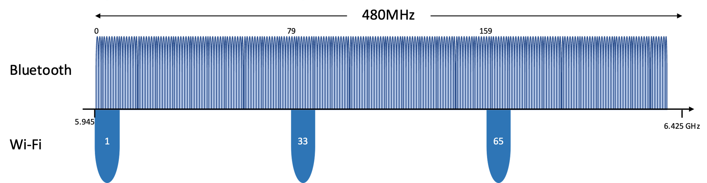
Assumption 1: Spectrum Usage / Channelization
Wi-Fi
Transmit beacons on
  channel 1 (BSS 1)
  channel 33 (BSS 2)
  channel 65 (BSS 3)
Bluetooth
1 MHz channels with 0.5 MHz guard band left & right
  Maximum 480 MHz ÷ 2 MHz = 240 channels
Due to eDAA, hopping bandwidth is limited to
  Lowest 10 channels (~ 20 MHz)
  Lowest 20 channels (~ 40 MHz)
  Lowest 40 channels (~ 80 MHz)
  Lowest 76 channels (~160 MHz)
  Lowest 160 channels (~320 MHz)
  236 channels (~ 480 MHz)

Slide 4
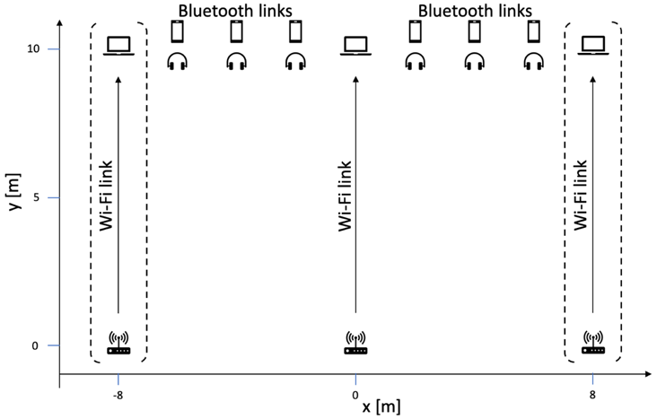
Assumption 2: Scenario
Six Bluetooth links
  Constant bitrate traffic
  320 B/20 ms (≙128 kb/s) 640 B/20 ms (≙256 kb/s)
  1280 B/20 ms (≙512 kb/s) KPI: Packet delay
1, 2, or 3 Wi-Fi links
  450 µs Beacon every 102.4 ms
  ~3 s start delay
  KPI: Beacon success rate
Channel model
  AWGN with
  Line-of-Sight for d < 5 m
  (pathloss coefficient 2.0),
  Non-Line-of-Sight for d > 5 m (3.5)

Slide 5
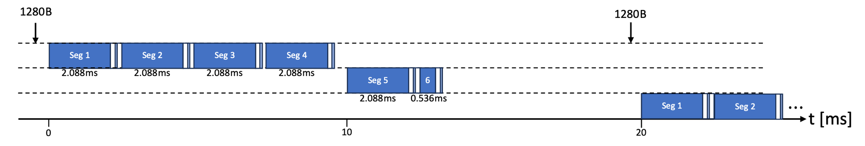
Assumption 3: Bluetooth uses ACL
(Async Connection-Oriented Link)
320 B payload every 20 ms:
  Two segments fit into one connection event
  Every other connection event remains idle
  ~16 % channel usage
1280 B payload every 20 ms:
  Five segments, require two connection events
  ~57 % channel usage

Slide 6
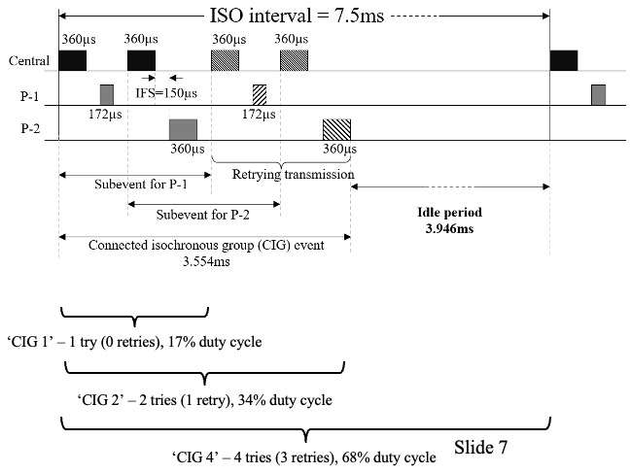
Bluetooth ACL versus Isochronous channels
[1]
One channel per connection event, reply is sent on the same channel after T_IFS
Separate channels for “downlink” and “uplink(s)”, 3 × spectrum usage

Slide 7
Coexistence mechanisms

Slide 8
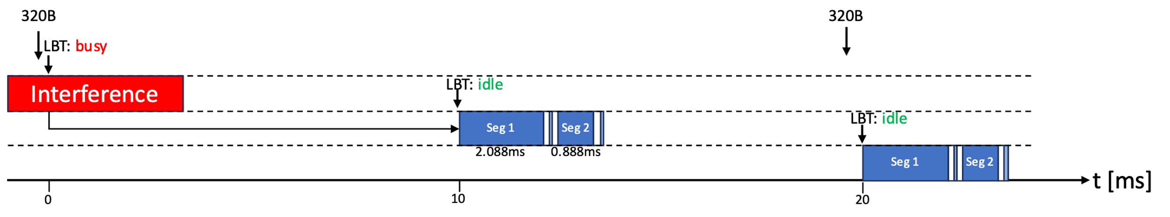
Bluetooth: LBT before Connection Event (CE-LBT)
Sense current channel before every connection event
  Idle: transmit
  Busy: defer until next connection event

Slide 9
Results

Slide 10
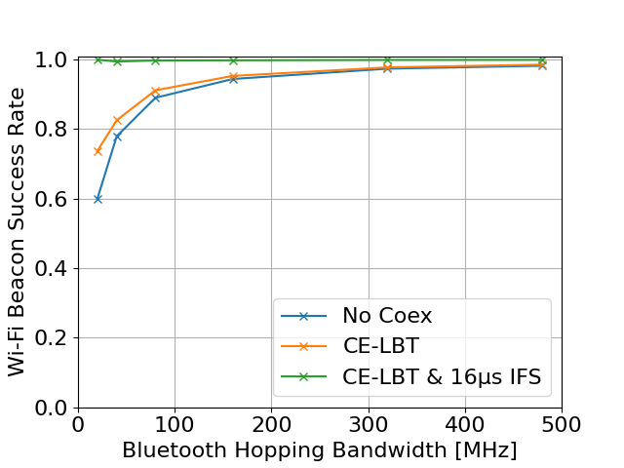
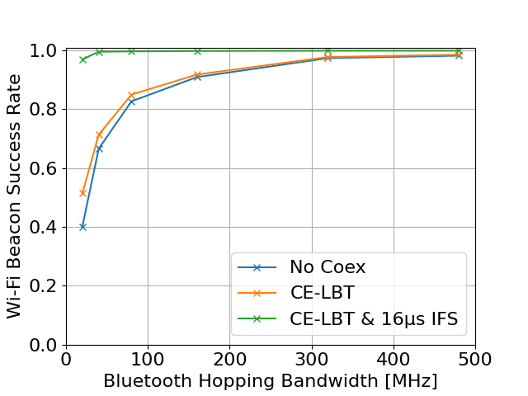
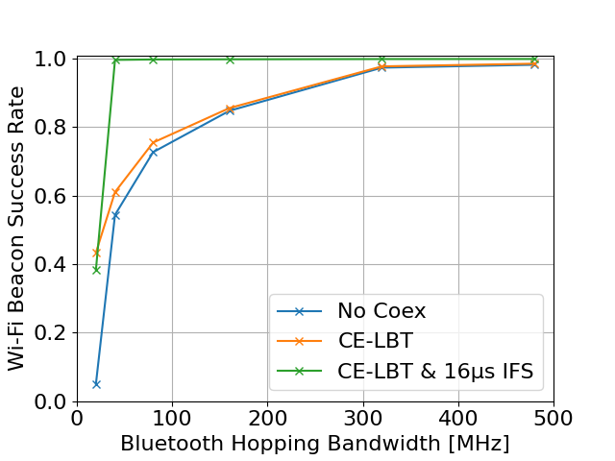
Wi-Fi Beacon Success Rate
320 B/20 ms (16 % channel usage)
640 B/20 ms (30 % channel usage)
1280 B/20 ms (57 % channel usage)
Impact proportional on amount of interference by NB links
  Beacon is interfered by later NB transmission
  NB transmission starts, leaves gap of T_IFS=150 µs which is sufficient to complete AC_VO backoff, Beacon is interfered by NB ack / 2nd segment.
CE-LBT has no significant effect on beacon success rate due to (ii)
CE-LBT and shorter T_IFS allow for spectrum sharing

Slide 11
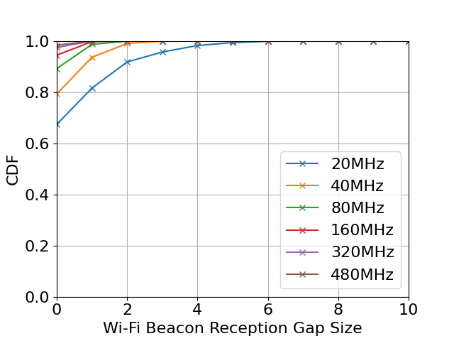
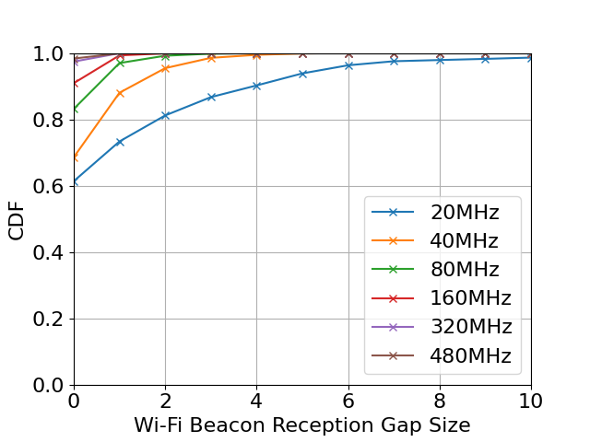
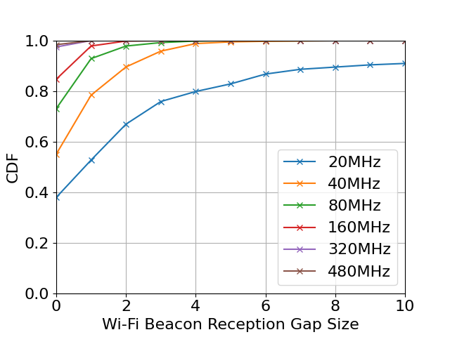
Wi-Fi Beacon Gap Sizes (No Coex)
Probability of n missed beacons in a row
320 B/20 ms (16 % channel usage)
640 B/20 ms (30 % channel usage)
1280 B/20 ms (57 % channel usage)
Hopping over 80 MHz reduces probability of more than 2 missed beacons close to zero

Slide 12
Assumption 2B: Scenario B
Decrease Bluetooth transmit power to 0 dBm
  Less signal strength at headsets
Move Bluetooth links to the center between the Wi-Fi links
  More interference by the downlink-heavy Wi-Fi traffic

Slide 13
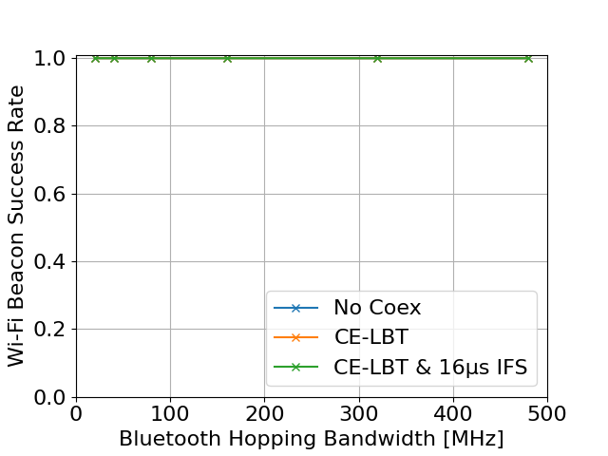
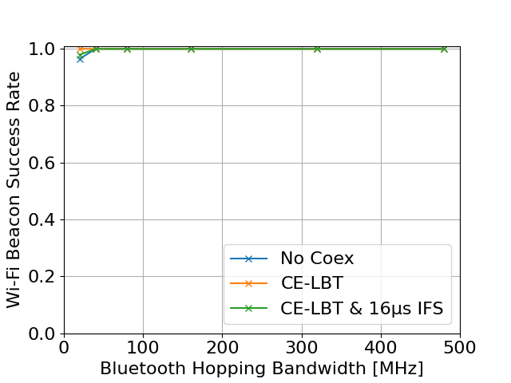
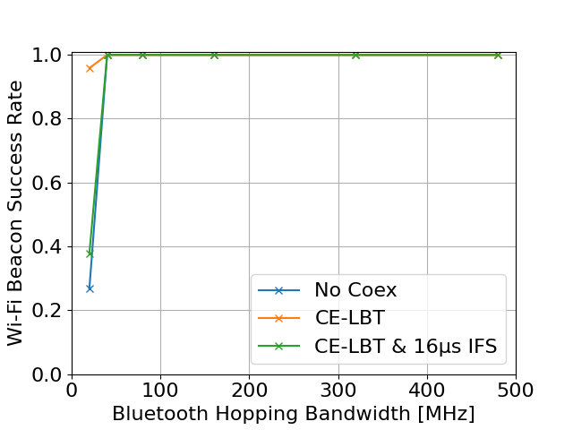
Wi-Fi Beacon Success Rate
320 B/20 ms (16 % channel usage)
640 B/20 ms (30 % channel usage)
1280 B/20 ms (57 % channel usage)
Wi-Fi is no longer impacted by NBFH
BPSK½ sufficient for reliable reception using the pessimistic Wi-Fi packet error rate model (see [2])

Slide 14
Conclusions
Wi-Fi Beacon traffic interfered by NBFH allows good insights in coexistence
  Simple traffic model
  Simple KPIs
Beacon reception rates might be impacted
  Passive scanning unlikely to detect beacons
  NBFH should use spectrum which is 99.5 % idle, but with coexistence mechanisms
    CE-LBT & short T_IFS
    LBT before every packet transmission (shown in [1])
... but only one side of the coin
  NBFH is barely impacted under these assumptions

Slide 15
References
[1] ”NBFH coexistence with Wi-Fi,” Menzo Wentink, Qualcomm,
IEEE 802.11-23/1622r0
[2] “IEEE 802.11 and Bluetooth Coexistence Simulations,” Sebastian Max et al., Ericsson, IEEE 802.11-23/1477r1

