Slide 1
Requirements Analysis for IMMW Use Cases
Date: 2023-11-07
Authors:
Name | Affiliations | Address | Phone | Email
Yue Xu | Huawei | Huawei Nanjing R&D Institute, Nanjing, Jiangsu, China, 210012 |  | xuyue57@Huawei.com
Chenhe Ji
Chun Pan
Xiaofei Bai

Slide 2
Introduction
Based on the 11bn PAR, this contribution analyzes the characteristics and corresponding requirements of several scenarios, like industrial, residential, etc. .
By analyzing gap between the existing standards (11ad, 11ay) and actual scenario requirements, The contribution finds that IMMW SG has both prospects and further improving aspects.
Finally, the contribution proposes some potential development directions and performance requirements.

Slide 3
Background
Utilizing mmWave has the following advantages:
- Resolve the spectrum problem of using 6 GHz band in some countries
Achieve the 11bn goals on high throughput, high reliability, and low latency
Applying the concept of ‘I’ (Integrated) has the following advantages:
Cost efficiency (e.g., sharing hardware parts)
Fast implementation (Reusing aspects, like some parts of sub-7G)
Facilitates to deploy in industrial, and others

Slide 4
Current related standard
Both 802.11ad and 802.11ay focus on the mmWave, the 11ay is one enhanced-version of 11ad (to some extent):
802.11ad support single stream communications, 7Gbps rate.
802.11ay further supports:
- More coverage and higher throughput (20Gbps)
- SU-MIMO, MU-MIMO, and corresponding beamforming (include hybrid)
Use Case [1] | Range | Throughput | Delay (ms) | Reliability
Ultra Short Range Communication | < 10 cm | 10 Gbps | <100
4k/8k UHD Transmission | < 5 m | < 28 Gbps | 10~20 | jitter<5ms
VR | < 10 m | ~20 Gbps | 5~10 | jitter <5 ms, PER<10E-2
Data Center | < 1.5 m | ~40 Gbps | <100 | >99.99%
Mobile Offloading & Multiband Operation | < 100 m | ~20 Gbps | <100 | >99.99%
Mobile Fronthauling | < 200 m | ~20 Gbps |  | >99.99%
Nowadays, especially industrial scenarios, higher throughput, lower latency, and more reliable wireless communication are required.
Therefore, it is necessary to analyze the real needs and ‘find the way out’

Slide 5
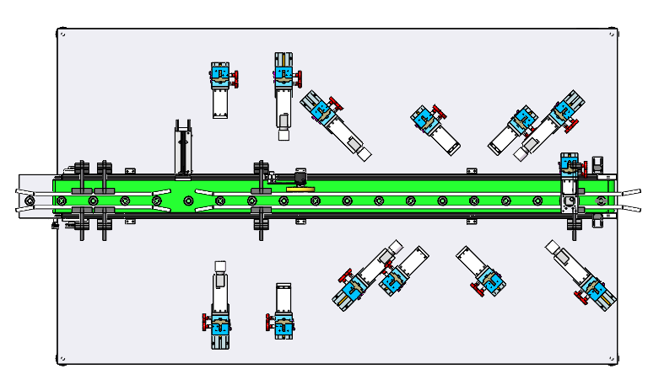
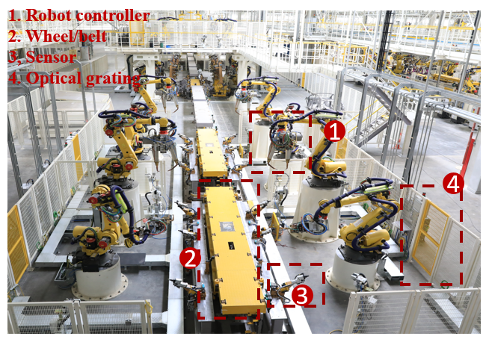
Case 1: 4K UHD Wireless Transfer at Industrial Environment
AMR (Autonomous Mobile Robot) | Involving communication, including guidance control, process data exchange, video/image, and emergency stop, between robots and a control system,
Sensors | Periodical report of information to the control system. High-density deployment environment.
Robot/drone motion control | Remote operation with haptics communication, programmed robot operation with emergency stop.
Video transfer | High-definition video transferring from cameras.
AR/VR/XR | Walk-by health monitoring, combining video feed with overlaid contextual information.
Assembly line | Combination of AMR, sensors, robot/drone motion control, and video transfer.
Example:
Wireless HD cameras quickly determine whether products on the line are defective, incomplete, etc.
One or more devices can save costs by uploading data to the cloud for analysis and feedback instructions (e.g., compared to distributed AI process hardware) .
Regardless of the time it takes for the image processing, sensing devices such as HD cameras require high throughput, low latency, and high reliability.
E.g., One 4K UHD streams (60 frame/s, 24 bits/pixel, minimum 4:2:2 chroma sampling) require at least 15 Gbps data rate. And 8K need at least 28 Gbps. And such a throughput requirement, also happens to be the advantage of IMMW.
HD camera
Requirements:
- Throughput ~ high
- Latency < 100ms
- Packet Error Rate < 1e-7
- Jitter < 5ms
- delay < 5ms.
- Reliability > 99.99%
Use case | Latency | Reliability
AMR | < 100ms | 99.99%
RFID | < 100ms | 99.99%
PLC to MES | < 100ms | 99.99%
PLC to IO | 8ms | 99.999%
Noted:
Reliability in industrial scenarios is determined by multiple dimensions: Response Latency, Roaming Latency, Roaming Successful Rate, consecutive packets lost rate, and others.
Mainly consider target use cases. (e.g., fixed equipment in industrial scenarios, such as distributed robotic arms).

Slide 6
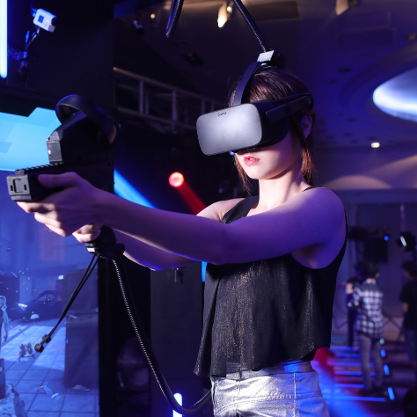
Case 2: AR and VR
Virtual reality technology not only provides better entertainments, but also facilitates people's health, such as telemedicine.
Whether recreational or medical, the real needs can be summarized as follows [4]:
 | Monocular Video Resolution | Bits per Pixel | Frame Rate | Raw Rate (Gbps) | Lightly Compressed Rate (Gbps) | Compressed Rate (Gbps) | RTT Latency
Partial Immersion | 6300*3000 | 12 | 60 | 2D, 40.83/ 20.42 | 2D, 4.83/ 2.04 | 2D, 0.48/ 0.20 | 10ms
 |  |  |  | 3D, 81.66/ 40.84 | 3D, 9.66/4.04 | 3D, 0.97/0.40
Deep Immersion | 16200*4500 | 12 | 90 | 2D, 236.20/118.10 | 2D, 23.6/ 11.8 | 2D, 2.36/1.18 | 5ms
 |  |  |  | 3D, 472.40/236.20 | 3D, 47.2/23.6 | 3D, 4.72/2.36
Ultimate Immersion | 21600*7200 | 12 | 144 | 2D, 806.22/403.11 | 2D, 80.62/ 40.31 | 2D, 8.06/4.03 | 5ms
 |  |  |  | 3D, 1612.44/806.22 | 3D, 161.24/80.62 | 3D, 16.12/8.03
Requirements:
- Throughput ~ high
- Latency 5~10ms
- Packet Error Rate < 1e-7
- Jitter < 10ms

Slide 7
Potential development direction
Here, we're more about the potential direction from the high level. For example, the following technologies can be considered based on requirements:
Hardware Friendly (baseband shared)
Higher Data Rate Support
SU-MIMO
Large Bandwidth Support
Spectral Efficiency Enhancement
Reliability Support
BF Training Enhancement
CFO Mitigation
Latency Support
MAC Enhancement
QoS (Quality-of-Service) Support
Others

Slide 8
Summary
IMMW is friendly to implement in different scenarios, e.g., industrial, medical, residential and others, as it is an efficient way to improve throughput, latency, and reliability performance and reduce costs. However, there is still some room for further thought and improvement.

Slide 9
References
[1] 11-15-0328-04-ng60-ng-60-usage-models
[2] 11-23-0066-01-0uhr-thoughts-on-utiliizing-mmwave
[3] 11-22-1872-00-0uhr-considerations-on-phy-designs-for-mmwave-band
[4] 11-18-0846-02-0wng-next-generation-phy-mac-in-sub-7ghz

