Slide 1
Evaluation of Coordinated Spatial Reuse – Follow Up
Date: 2023-11-12
Authors:
Name | Company | Address | Phone | Email
Kosuke Aio | Sony |  |  | Kosuke.Aio@sony.com
Yusuke Tanaka |  |  |  | Yusuke.YT.Tanaka@sony.com
Ryuichi Hirata |  |  |  | Ryuichi.Hirata@sony.com
Ken Tanaka |  |  |  | Ken.A.Tanaka@sony.com
Thomas Handte |  |  |  | Thomas.Handte@sony.com
Dana Ciochina |  |  |  | Dana.Ciochina@sony.com
Daniel Verenzuela |  |  |  | Daniel.Verenzuela@sony.com
Xia Qing |  |  |  | Qing.Xia@sony.com

Slide 2
Introduction
Multi-AP coordination is a candidate feature for next TG (TGbn) as a technology to realize the several objectives and use cases of UHR [1].
Coordinated Spatial Reuse (SR) is attracting attention as a method to improve throughput in multiple BSS environments, and evaluation results have been presented for various scenarios [2-4].
In this contribution, we conducted follow-up simulation evaluation of Coordinated SR in 4 AP scenarios for characterization and analysis.

Slide 3
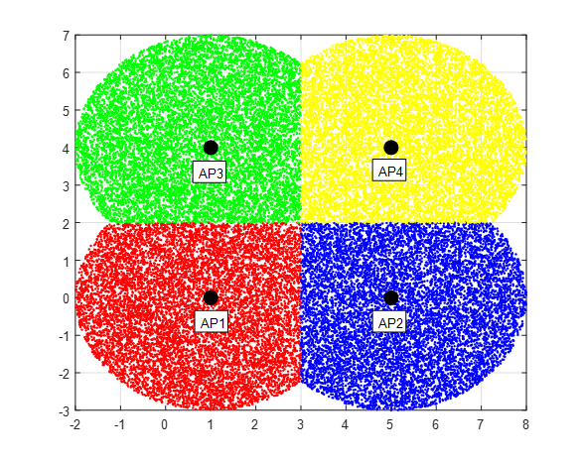
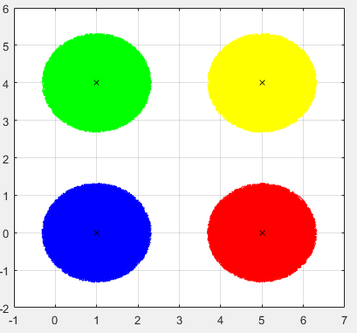
Simulation Topology
Simulation topology is the following 4APs scenario [3][4].
4APs on a square.
Midpoint SNR (SNR at the center point between APs) indexed with distance D.
Midpoint SNR = 22.5dB -> D = 27.4m, RSSI at Far AP = -82dBm (PD CCA threshold).
Midpoint SNR = 42.5dB -> D = 7.3m, RSSI at Far AP = -62dBm (ED CCA threshold).
Two cell patterns: Large Cell (D*0.75 w/o overlap) and Small Cell (D*0.33).
r
d

Slide 4
Simulation Parameters/Assumption
Parameters
BW: 20 MHz
Channel: AWGN
Tx/Rx Ant = 1
Uniform pathloss exponent of 3.5
Assumption
11ax PHY Abstraction model for MCS selection and PER estimation.
Goodput = PHY Rate * ( 1 – PER)
Which AP becomes TXOP holder (Sharing AP) is random.
Test in the case of accurate/inaccurate CSI
Accurate CSI : AP can estimate accurate RSSI value for each link.
Inaccurate CSI : AP estimates RSSI values that are off by a random value that follows a uniform distribution of -3dB to 3dB for each link.
We analyze the capacity (sum of throughput of all STAs) and fairness (each throughput of a STA)
7 dB Noise Figure
1000 Drops
HE PPDU, long GI (3.2us)
Max Tx power = 15dBm

Slide 5
Comparisons
TDMA
Sharing AP transmits at max Tx power. Other APs do not transmit.
CSR-4APopt
Determine Tx power value for each AP to maximize the capacity.
CSR-MCSmax(All Links)
Determine Tx power value for each Shared AP to maximize the capacity under the constraint that "Sharing APs must use Target MCS” for fairness.
CSR-MCSmax(My Link)
Sharing AP decides Tx power for all Shared APs, considering only to use Target MCS (not consider capacity optimization).
CCA-ED
Sharing AP transmits at max Tx power. Other APs transmit max Tx power if the received power of the signal from Sharing AP does not exceed CCA-ED value (-62 dBm/20 MHz). If it exceeds the value, they do not transmit.
Target MCS is (A) same as TDMA, or (B) Optimization for each drop between MCS 0–13
- “Optimization” : Maximize the capacity without worsen each throughput than TDMA.

Slide 6
Constraints
Optimization Method
Here, the optimal Tx power was calculated with respect to the MCS to reduce calculations.
The granularity is rougher and the capacity may be slightly worse than the method of assigning each AP's transmit power value in units of a few dB.
Backoff value for inaccuracy CSI case
To prevent cases where packet loss occurs due to overestimated MCS setting, the estimated RSSI is adjusted with a uniform 3dB backoff.
That is, SNR and SINR are set to -3dB and -6dB, respectively, and Tx power is calculated and MCS is set.
If there is a way to adjust them more precisely, the performance of CSR may be improved.

Slide 7
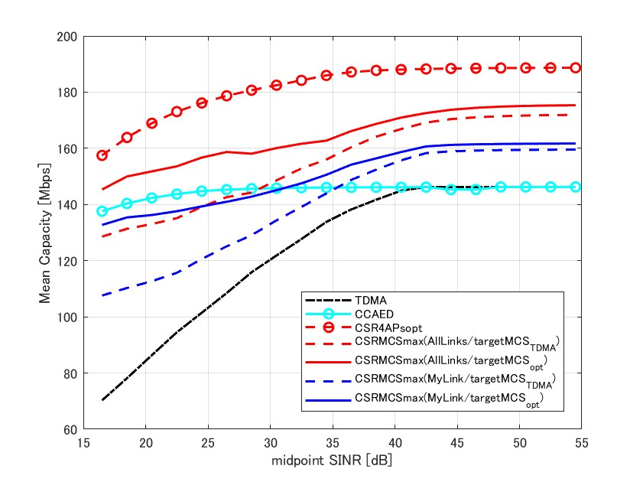
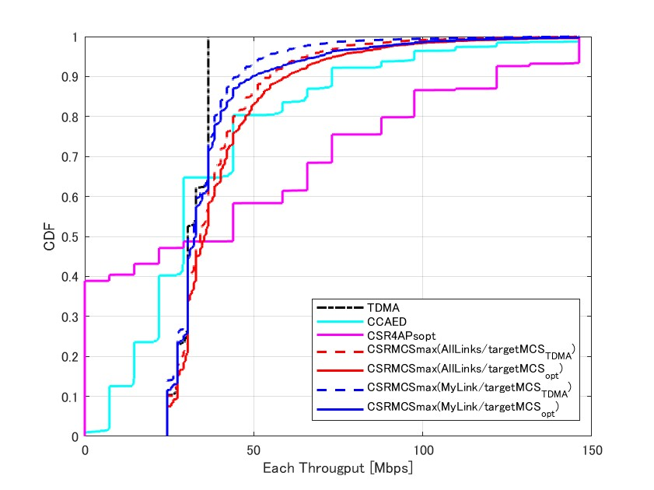
Simulation Results.1 (Large Cell/Accuracy CSI)
Mean Capacity at each Midpoint SNR
Each Throughput CDF at Midpoint SNR=32.5dB
 | Mean Capacity Gain (Mid SNR =22.5/32.5/42.5dB) | 5%-tile throughput gain (Mid SNR =32.5)
CSR-4APopt | x1.83 / x1.44 / x1.29 | x0.00
CSR-MCSmax (All Links) | (A) x1.43 / x1.20 / x1.16, (B) x1.62 / x1.27 / x1.16 | (A) x1.00 (B) x1.00
CSR-MCSmax (My Link) | (A) x1.22 / x1.09 / x1.08, (B) x1.46 / x1.16 / x1.10 | (A) x1.00, (B) x1.00
CCA-ED | x1.52 / x1.14 / x1.00 | x0.30
Target MCS
Same as TDMA
Optimization

Slide 8
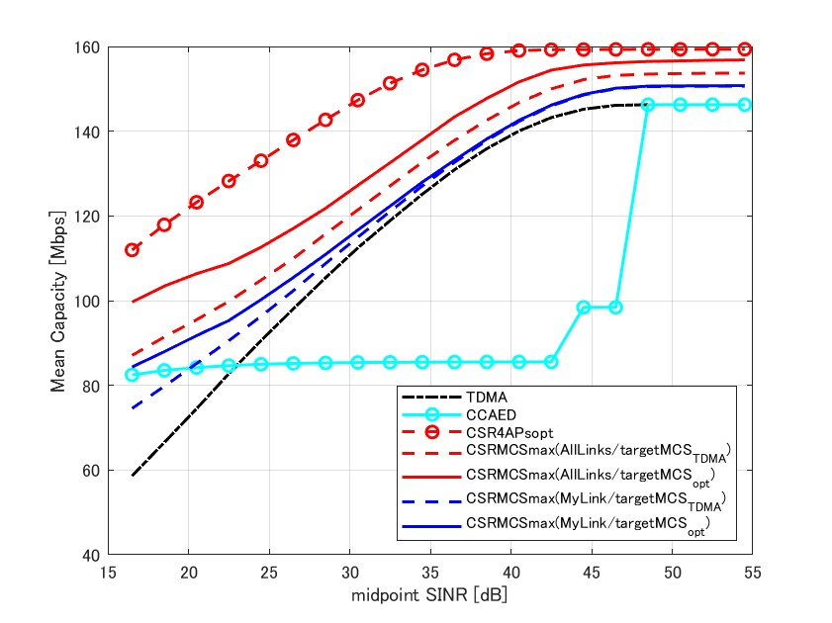
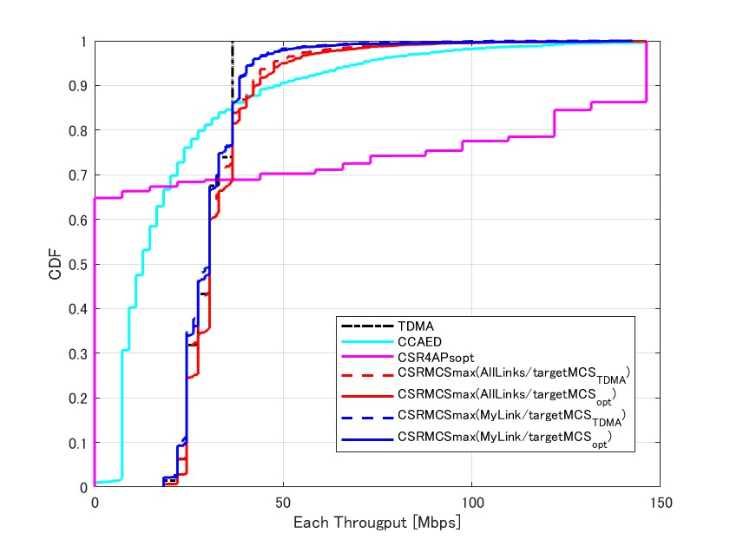
Simulation Results.2 (Large Cell/Inaccuracy CSI)
Mean Capacity at each Midpoint SNR
Each Throughput CDF at Midpoint SNR=32.5dB
 | Mean Capacity Gain (Mid SNR =22.5/32.5/42.5dB) | 5%-tile throughput gain (Mid SNR =32.5)
CSR-4APopt | x1.55 / x1.27 / x1.11 | x0.00
CSR-MCSmax (All Links) | (A) x1.21 / x1.07 / x1.05, (B) x1.31 / x1.12 / x1.08 | (A) x1.00 (B) x1.11
CSR-MCSmax (My Link) | (A) x1.09 / x1.02 / x1.02, (B) x1.15 / x1.03 / x1.02 | (A) x1.00, (B) x1.00
CCA-ED | x1.02 / x0.72 / x0.60 | x0.33
Target MCS
Same as TDMA
Optimization

Slide 9
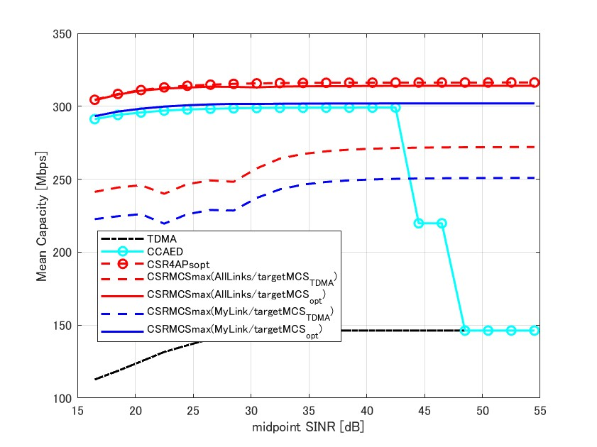
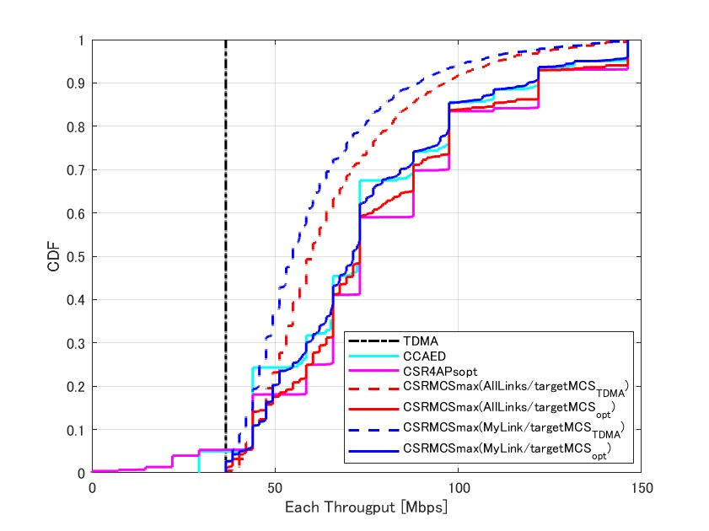
Simulation Results.3 (Small Cell/Accuracy CSI)
Mean Capacity at each Midpoint SNR
Each Throughput CDF at Midpoint SNR=32.5dB
 | Mean Capacity Gain (Mid SNR =22.5/32.5/42.5dB) | 5%-tile throughput gain (Mid SNR =32.5)
CSR-4APopt | x2.38 / x2.16 / x2.16 | x0.80
CSR-MCSmax (All Links) | (A) x1.82 / x1.81 / x1.86, (B) x2.37 / x2.14 / x2.15 | (A) x1.15, (B) x1.15
CSR-MCSmax (My Link) | (A) x1.67 / x1.66 / x1.71, (B) x2.28 / x2.06 / x2.06 | (A) x1.05, (B) x1.16
CCA-ED | x2.26 / x2.04 / x2.04 | x1.16
Target MCS
Same as TDMA
Optimization

Slide 10
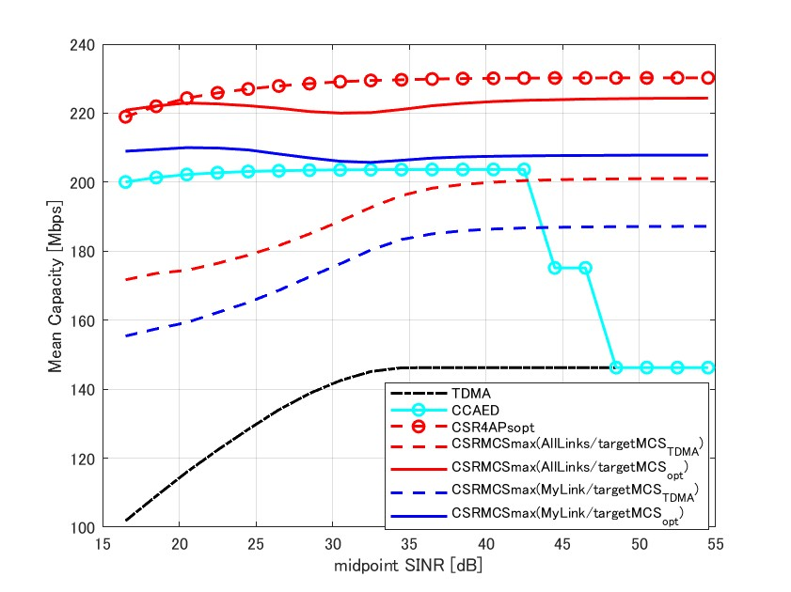
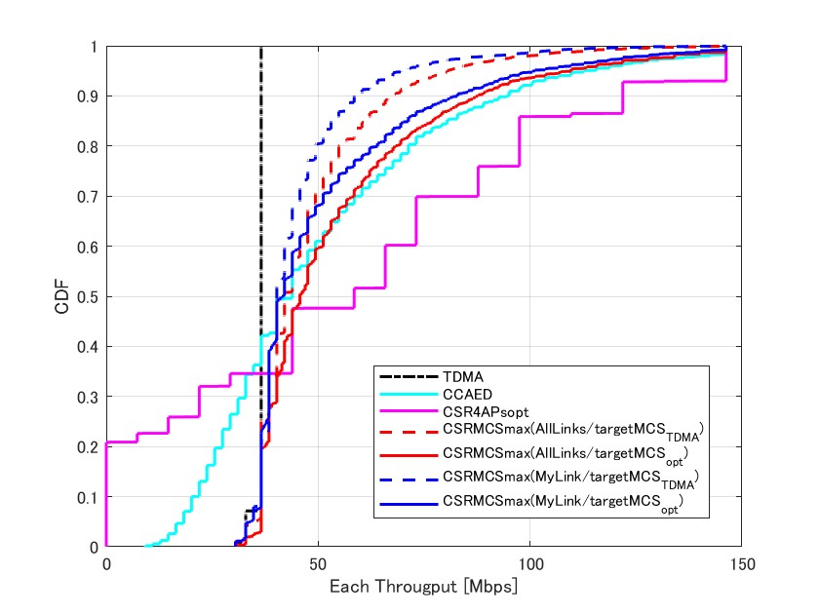
Simulation Results.4 (Small Cell/Inaccuracy CSI)
Mean Capacity at each Midpoint SNR
Mean Capacity at each Midpoint SNR
Each Throughput CDF at Midpoint SNR=32.5dB
Each Throughput CDF at Midpoint SNR=32.5dB
 | Mean Capacity Gain (Mid SNR =22.5/32.5/42.5dB) | 5%-tile throughput gain (Mid SNR =32.5)
CSR-4APopt | x1.84 / x1.58 / x1.57 | x0.00
CSR-MCSmax (All Links) | (A) x1.44 / x1.33 / x1.37, (B) x1.82 / x1.52 / x1.53 | (A) x1.06, (B) x1.11
CSR-MCSmax (My Link) | (A) x1.33 / x1.24 / x1.28, (B) x1.72 / x1.42 / x1.42 | (A) x1.04, (B) x1.04
CCA-ED | x1.66 / x1.40 / x1.39 | x0.56
Target MCS
Same as TDMA
Optimization

Slide 11
Observations
CSR-4APopt
Capacity can be maximized in all cases.
Fairness is a significant problem since 5%-tile throughput of each STA is worse than TDMA in all cases.
CCA-ED
Capacity can be increased except for “Large Cell & Inaccuracy CSI”.
Fairness is a problem since 5%-tile throughput of each STA is worse than TDMA in cases other than “Small Cell & Accuracy CSI”.
CSR-MCSmax
Capacity can be increased in all cases, and target MCS optimization significantly improves throughput gain (especially in Small Cell).
Fairness is not a problem because since 5%-tile throughput of each STA is no worse than TDMA in all cases.
Inaccuracy CSI cases will significantly lower capacity gain. Highly accurate link measurements and appropriate link adaptation are important.

Slide 12
Way to forward in TGbn
We prefer to focus on “CSR-MCSmax” (Terminology is TBD) as Coordinated SR in TGbn.
CSR-4APopt/CCA-ED are not suitable due to the fairness problem.
CSR-MCSmax can be selected from the following two types in terms of performance and ease of implementation. Both are no fairness problem.
CSR-MCSmax (All Links) can achieve high-capacity gain. However, Sharing AP must estimate RSSI for all links, which is computationally expensive.
CSR-MCSmax(My Link) can achieve lower capacity gain than CSR-MCSmax(All Links), but it requires fewer links to be estimated, which is computationally cheap.
Target MCS settings are implementation-dependent (Out of Scope)
There is also a combination of AP Capability, Link Adaptation and so on. Optimization is required on a system-by-system basis.
If low latency transmission is more important, Target MCS can be adjusted to allow many APs to transmit without aiming for capacity maximization.

Slide 13
Summary
We conducted follow-up simulation evaluation of Coordinated SR in 4 AP scenarios for characterization and analysis.
CSR-4APopt / CCA-ED are not suitable due to the fairness problem.
CSR-MCSmax can achieve higher capacity gain compared to TDMA without worsening fairness. Furthermore, capacity and flexibility can be further improved by "optimizing the target MCS".
The accuracy of CSI estimation is important for more improvement of Coordinated SR.

Slide 14
Reference
[1] Laurent Cariou (Intel), “UHR proposed PAR,” 23/0480r3, July 2023
[2] Kosuke Aio (Sony Group Corporation), “Recap on Coordinated Spatial Reuse Operation,” 22/1822r0, November 2023.
[3] Gary Anwyl (MediaTek), “Coordinated Spatial Reuse in a 4 AP Topoplogy,” 23/1023r2, July 2023
[4] Kanke Wu (Qualcomm), “Performance of Coordinated Spatial Reuse,” 23/1037r0, July 2023

Slide 15
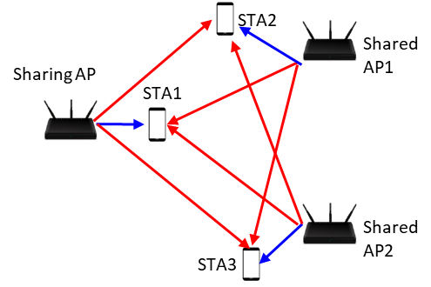
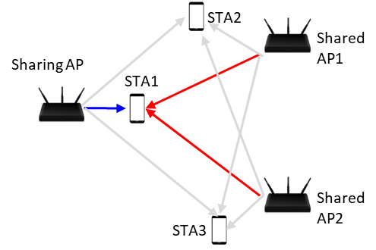
Appendix: Coordinated SR Type
Coordinated SR (All Links)
Coordinated SR (My Link)
Sharing AP estimates SINR of all receiving STAs and calculates “coordinated Tx power” for each AP.
First, to satisfy target SINR of at least a STA which Sharing AP intends to serve.
Then, to satisfy SINR of STAs in the TXOP to the extent feasible
Sharing AP estimates SINR of STA(s) which Sharing AP intends to serve and calculates “coordinated Tx power” for each AP.
Only to satisfy target SINR of a STA which Sharing AP intends to serve.

