Slide 1
Coordinated R-TWT for Multi-AP scenarios - Follow up
Date: 2022-11-06
Authors:
Name | Affiliation | Address | Phone | Email
Liuming Lu | OPPO |  |  | luliuming@oppo.com
Liuming Lu (OPPO)

Slide 2
Introduction
11be has specified R-TWT for the delivery of latency-sensitive traffic in one BSS.
R-TWT would impact the behavior of legacy STAs and EHT STAs supporting R-TWT, which causes network overhead and low efficiency of communication, and
The benefit of R-TWT is impacted by several factors, such as the population of EHT STAs not supporting R-TWT, OBSS interference or other interference such as IDC interference.
For 11bn it is appropriate time to extend R-TWT in one BSS to R-TWT in OBSSs, and coordinated R-TWT has been introduced during the UHR discussion.
11bn will focus on the specification of Ultra High Reliability capability for both an isolated Basic Service Set (BSS) and overlapping BSSs.
The function of Coordinated R-TWT is not limited to a mechanism for the delivery of latency-sensitive traffic, furthermore it can be considered as a tool for multi-AP coordination to avoid or reduce OBSS interferences and increase the efficiency of communication in OBSS scenario.
This contribution focus on how to improve the specification of coordinated R-TWT as a tool not only for the delivery of latency-sensitive traffic but also for multi-AP coordination.

Slide 3
Requirements for Coordinated R-TWT
Different Multi-AP operation schemes have different levels of requirements for interoperation
Coordinated R-TWT Type 1 (loose/light coordination)
transmission schemes may include OBSS PD-based/PSR-based spatial reuse etc.
The information（such as SPs, TX power constraints） is shared among APs
Specific time alignment – the alignment of start time and end time of SPs among BSSs
Interoperation level:
non-backhaul: such as beacon request/response, or co-channel signaling
Backhaul – mainly for information sharing
Coordinated R-TWT Type 2 (tight coordination)
transmission schemes may include coordinated OFDMA/MU-MIMO/Beamforming, Joint Transmission etc.
Real-time signaling among APs: strict time synchronization
Interoperation level:
non-backhaul – co-channel signaling
Backhaul - with different requirements for special transmission schemes

Slide 4
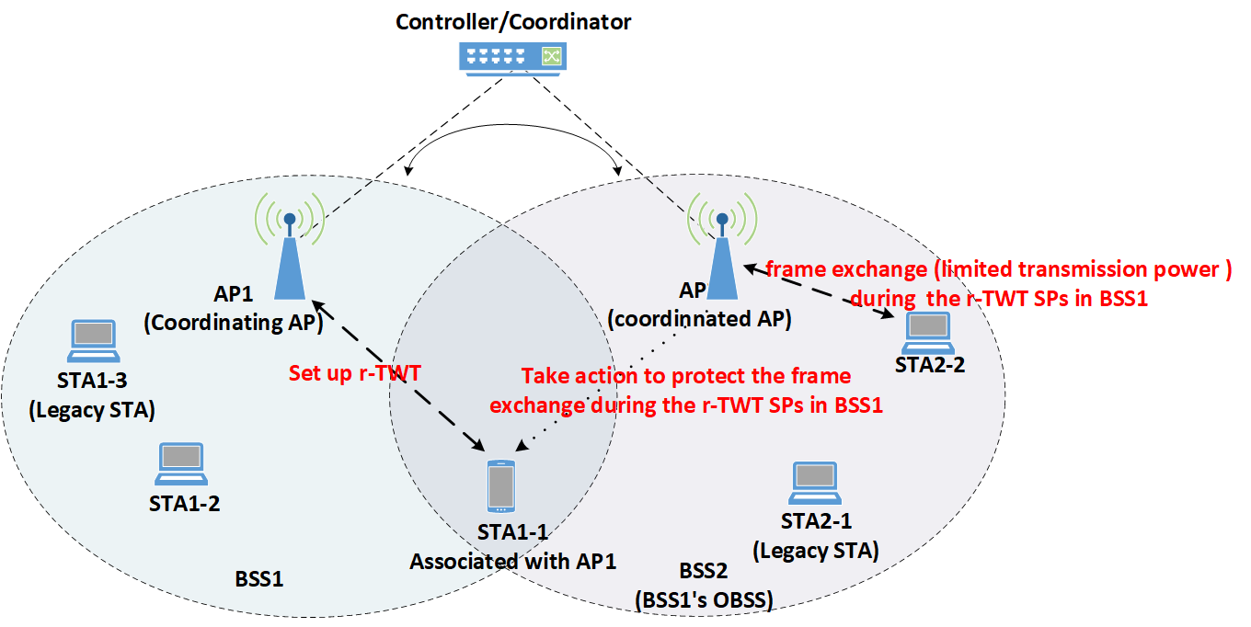
Scenario for Type1 Coordinated R-TWT
AP1 and AP2 can share the information through a backhaul with limited KPIs
AP1 and AP2 may not support coordinated OFDMA/MU-MIMO/Beamforming, Joint Transmission etc.
Under the condition of no multi-AP coordination for SP scheduling
OBSS interference from BSS2 would impact the STA1-1’s frame exchanges during r-TWT SPs in BSS1
Under the condition of multi-AP coordination for SP scheduling
AP2 take actions to protect the frame exchange during the r-TWT SPs in BSS1
Frame exchanges during the r-TWT SPs in BSS1 are limited in BSS2
Only STAs that satisfy the constraints are allowed to exchange frames with high priority
Transmission power is limited for STAs that exchange frames in BSS2
Figure. Scenario for Multi-AP operation Type1 (loose coordination)

Slide 5
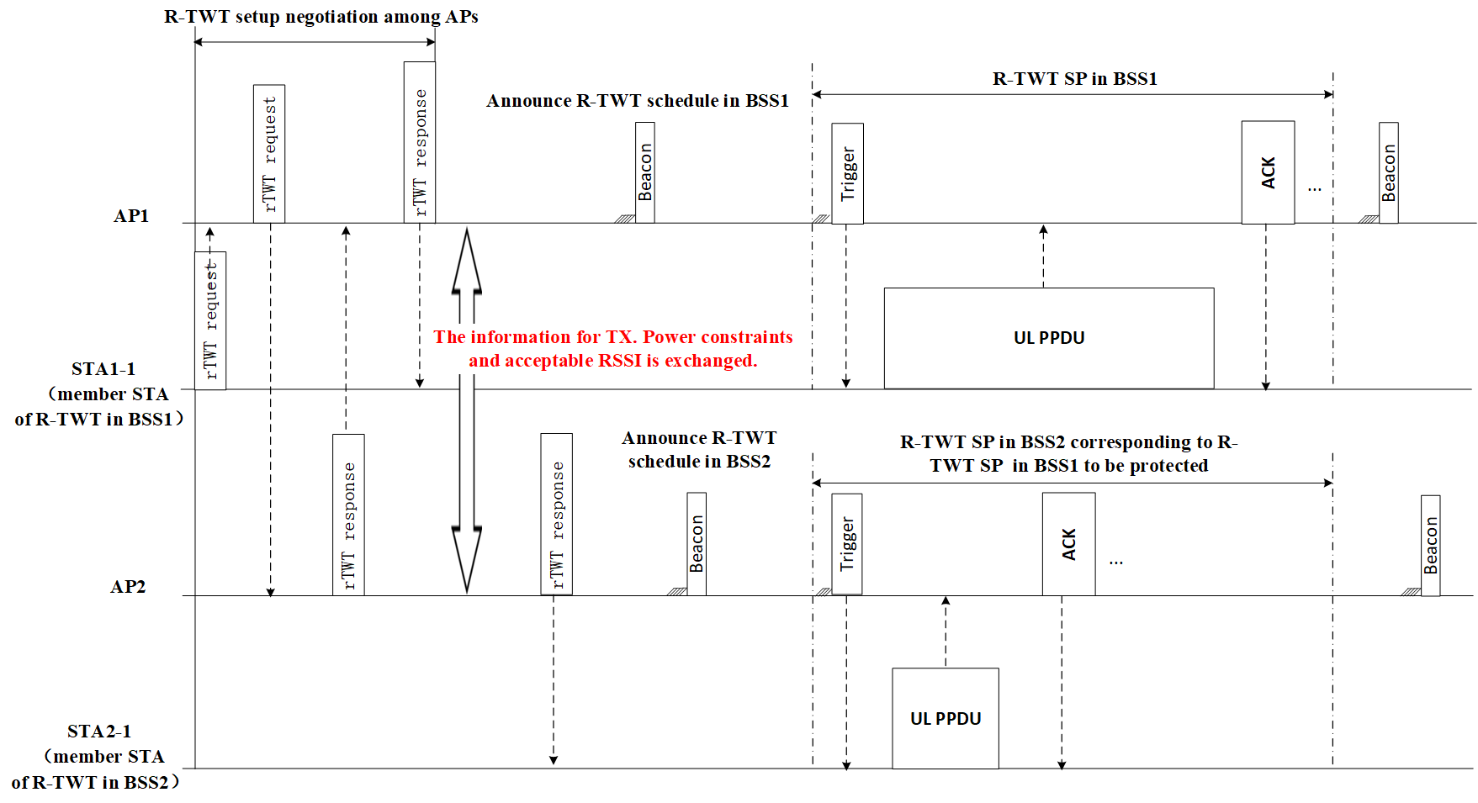
Signaling for Type1 Coordinated R-TWT
R-TWT setup is negotiated among APs
AP2 can accept or reject the R-TWT request from BSS1
The information for TX. Power constraints and acceptable RSSI of AP1 and STA1-1 is exchanged.
After successful R-TWT setup
STA1-1 exchanges frames initiated by AP1 during R-TWT SP in BSS1 with allowed TX. power.
AP2 initiates frame exchange with the STAs that satisfy the TX. constraints with allowed TX. power during R-TWT SP in BSS2 corresponding to R-TWT SP in BSS1 to be protected
Figure. Signaling for Multi-AP operation Type1 (loose coordination)

Slide 6
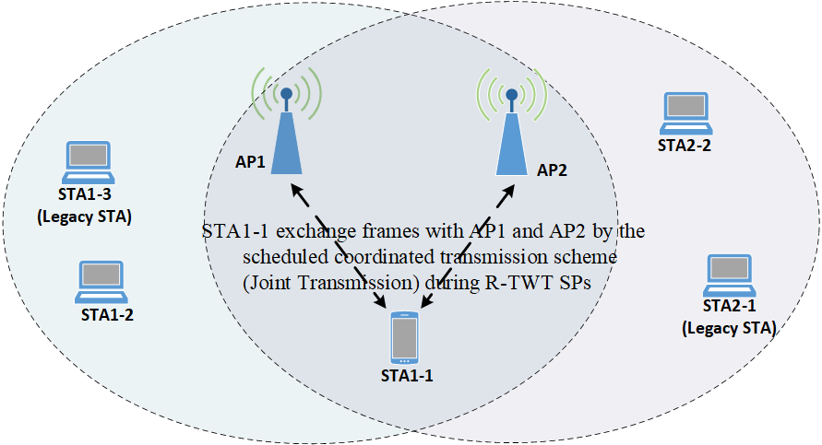
Scenario for Type2 Coordinated R-TWT
AP1 and AP2 communicate with each other by co-channel signaling or backhaul with better KPIs
AP1 and AP2 support one or more of coordinated transmission schemes, such as OFDMA/MU-MIMO/Beamforming, Joint Transmission etc.
Under the condition of no multi-AP coordination for SP scheduling
AP1 may not obtain the TXOP after the start time of R-TWT SPs
No guarantee for the frame exchange between AP1 and STA1-1 with the scheduled coordinated transmission scheme during R-TWT SPs
Under the condition of multi-AP coordination for SP scheduling
The R-TWT member STAs can exchange frames with AP1 and AP2 by the scheduled coordinated transmission scheme during R-TWT SPs
Figure. Scenario for Multi-AP operation Type1 (tight coordination)

Slide 7
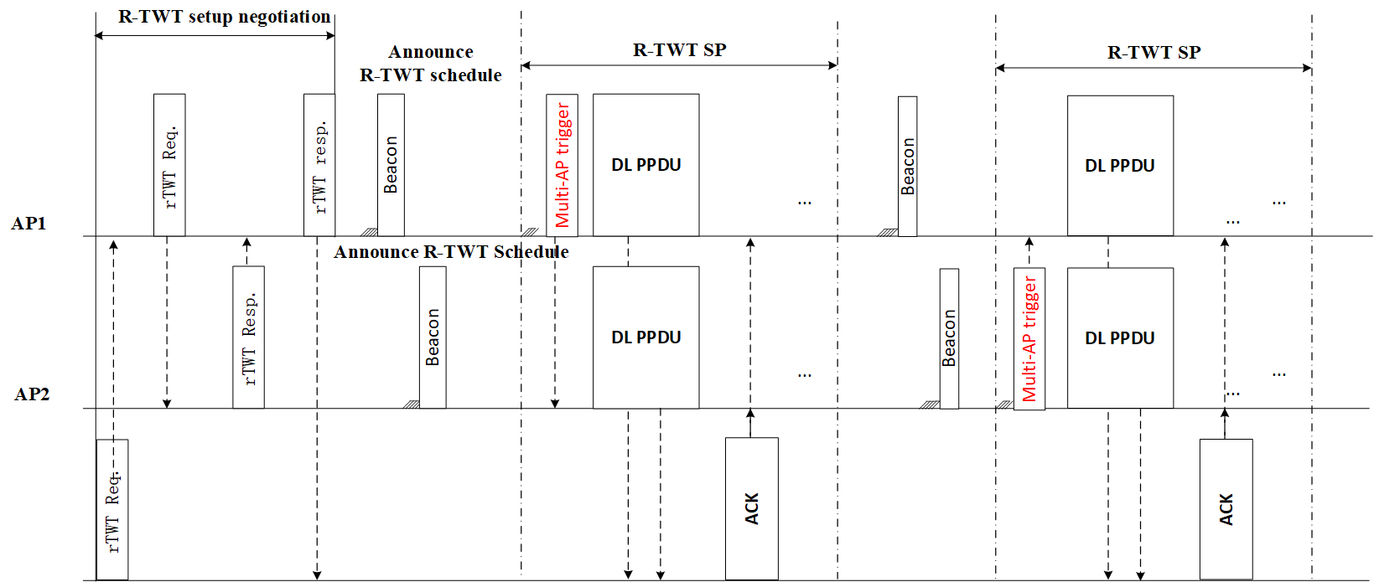
Signaling for Type2 Coordinated R-TWT
R-TWT setup is negotiated among APs
AP2 can accept or reject the R-TWT request from BSS1
the scheduled coordinated transmission scheme and related transmission parameters are exchanged.
After successful R-TWT setup
If obtaining the TXOP any AP (AP1 or AP2) initiate the frame exchanges with the R-TWT member STA by the scheduled coordinated transmission scheme during R-TWT SPs
Figure. Signaling for Multi-AP operation Type2 (tight coordination)

Slide 8
Summary
Coordinated R-TWT is suggested to provide higher reliability for delivering low latency traffic including enhanced medium access protection for reserved resource during scheduled time across different co-channel BSSs.
Two types of coordinated R-TWT can be considered based on different levels of requirements for interoperation among APs
(1) Type1 Coordinated R-TWT
TX. Power constraints and acceptable RSSI for related STAs are negotiated among APs for SP scheduling.
The coordinated AP takes actions to protect the frame exchange during the scheduled SPs in BSS of the coordinating AP (such as transmission with limited TX. power)
(2) Type2 Coordinated R-TWT
the scheduled coordinated transmission scheme and related transmission parameters are exchanged for SP scheduling
The member STAs exchange frames with APs by the scheduled coordinated transmission scheme during scheduled SPs

Slide 9
Straw Poll
Do you agree that UHR should specify a mode of coordinated R-TWT to provide higher reliability for delivering low latency traffic including enhanced medium access protection for reserved resource during scheduled time among co-channel BSSs?

Slide 10
Reference
[1] IEEE 802.11be Draft 4.1
[2] https://mentor.ieee.org/802.11/dcn/23/11-23-0046-02-0uhr-multi-ap-coordination-for-low-latency-traffic-delivery-usage-scenarios-and-potential-features.pptx
[3] https://mentor.ieee.org/802.11/dcn/22/11-22-1556-01-0uhr-multi-ap-coordination-for-low-latency-traffic-delivery.pptx
[4] https://mentor.ieee.org/802.11/dcn/22/11-22-1809-00-0uhr-a-perspective-on-uhr-features-for-operator-residential-deployments.pptx
[5]https://mentor.ieee.org/802.11/dcn/23/11-23-0297-00-0uhr-rtwt-for-multi-ap.pptx
[6] https://mentor.ieee.org/802.11/dcn/23/11-23-1499-00-0uhr-proposed-amendments-for-multi-ap-coordination-language-in-eht-sfd.pptx
Liuming Lu (OPPO)

