Slide 1
Coordinated TDMA (Follow up)
Date: 2023-11-13
Authors:
Name | Affiliation | Address | Phone | Email
Geonhwan Kim | LG Electronics | 19, Yangjae-daero 11gil, Seocho-gu, Seoul 137-130, Korea |  | geonhwan.kim@lge.com
Insun Jang |  |  |  | insun.jang@lge.com
Jinsoo Choi |  |  |  | js.choi@lge.com
Sunhee Baek |  |  |  | sunhee.baek@lge.com
Yelin Yoon |  |  |  | yl.yoon@lge.com
Dongju Cha |  |  |  | dongju.cha@lge.com
Eunsung Park |  |  |  | esung.park@lge.com
Dongguk Lim |  |  |  | dongguk.lim@lge.com
Jinyoung Chun |  |  |  | jiny.chun@lge.com
Insik Jung |  |  |  | insik0618.jung@lge.com
Hangyu Cho |  |  |  | hg.cho@lge.com
Sanggook Kim |  | 10225 Willow Creek Rd, San Diego, CA, USA |  | sanggook.kim@lge.com

Slide 2
Introduction
EHT AP can support non-TB PPDU transmission to the AP and P2P transmission to the non-AP STA by allocating the time of obtained TXOP.
This Triggered TXOP Sharing (TXS) can be further extended and utilized in Coordinated TDMA (C-TDMA) [1]-[4].
However, unlike TXS in EHT, TXOP sharing procedure in C-TDMA can be performed between APs (i.e., between different BSSs).
Protection issues may occur when sharing TXOP between APs.
Therefore, for C-TDMA to operate successfully, the C-TDMA procedure must be carefully designed to avoid protection issues.

Slide 3
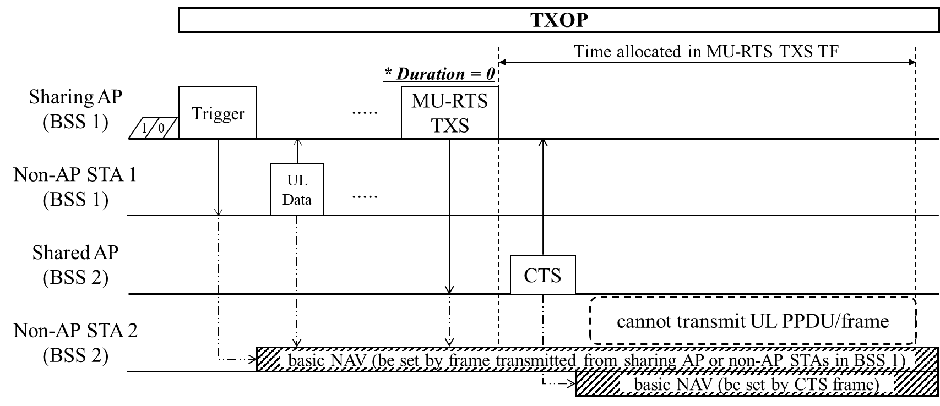
Recap: Protection in C-TDMA
In a previous SG contribution [5], we introduced protection issues in C-TDMA.
We also presented some potential solutions to avoid a NAV issues caused by a sharing AP and a non-AP STAs (associated with the sharing AP).
Sharing a TXOP to the shared AP as soon as it obtains the TXOP (assuming Duration field of MU-RTS TXS TF is set to 0) / Sending a frame to reset the NAV / Terminating a first TXOP before TXOP sharing occurs.
In this contribution, we share some methods to avoid protection issues that may arise when sharing TXOP for C-TDMA operation.

Slide 4
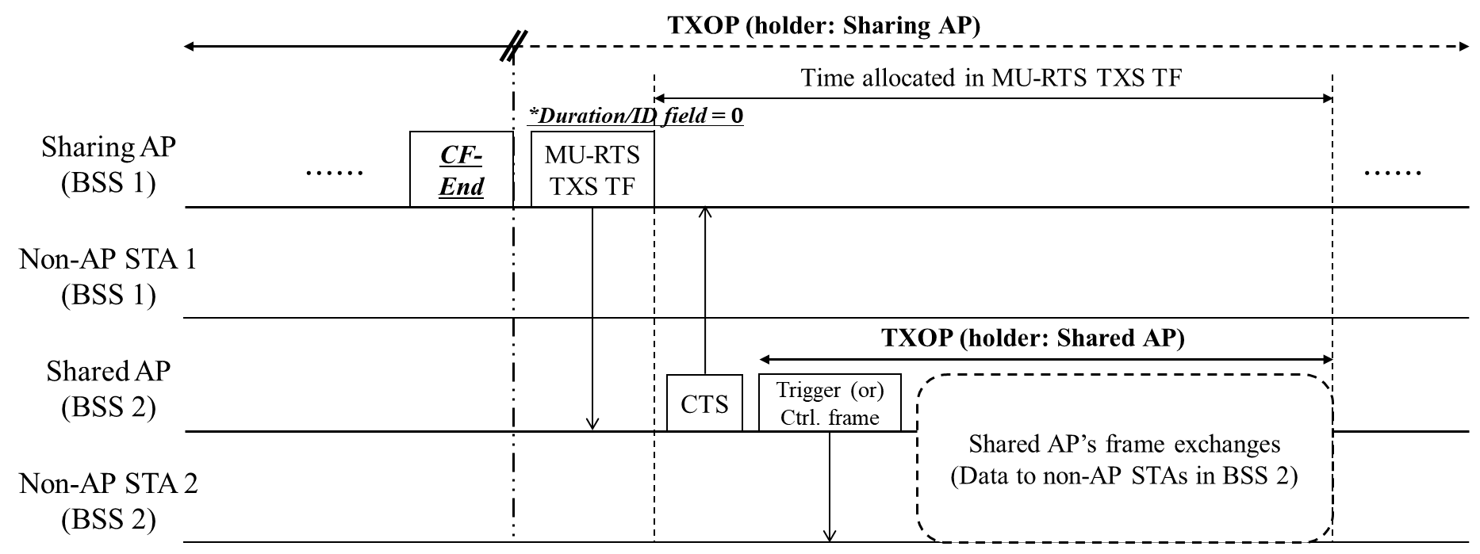
CF-End for TXOP Sharing in C-TDMA
Basically, resetting the NAV before sharing a TXOP may avoid protection issues.
Sharing AP can send a CF-End frame for NAV reset and TXOP termination.
That is, the CF-End frame is used to change the TXOP holder to a shared AP.
To share a TXOP, a sharing AP can send a MU-RTS TXS TF with a Duration/ID field of 0.
If the shared AP receives the CF-End frame and MU-RTS TXS TF, the shared AP may use the allocated time.

Slide 5
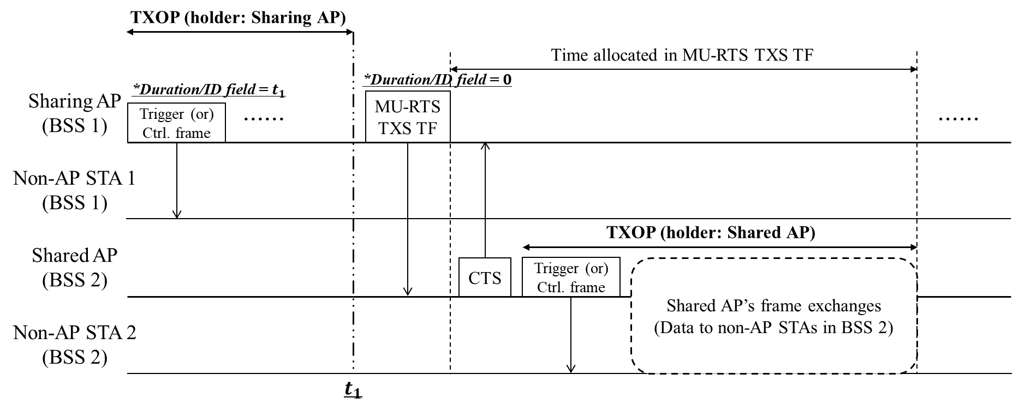

Short TXOP for TXOP Sharing in C-TDMA
Instead of using CF-End frame, the sharing AP can obtain TXOP only for a short duration that does not include the time allocated to the shared AP.
Sharing AP does not include the TXOP duration for the entire expected C-TDMA procedures in the Duration/ID field, and obtains TXOP only for the duration necessary for frame exchange (i.e., $t_{1}$) with non-AP STAs within its BSS.
To share a TXOP, a sharing AP can send a MU-RTS TXS TF with a Duration/ID field of 0.
Shared AP may use the allocated time after SIFS/PIFS upon receiving the MU-RTS TXS TF.

Slide 6
Two TXOPs for TXOP Sharing in C-TDMA
Both of the previously introduced methods have the problem that TXOP sharing is performed outside of TXOP.
This means that continuing separate TXOPs by changing the TXOP holder in SIFS/PIFS intervals is not guaranteed by baseline.
Therefore, an additional TXOP duration can be defined that authorizes subsequent APs scheduled by the sharing AP to continue TXOP.
Basic TXOP: The value included in the Duration field of each frame as the default TXOP.
Nominal TXOP: The nominal period scheduled by the sharing AP for C-TDMA operations.
A shared AP that has been notified of the Nominal TXOP duration may start its allocated time after SIFS/PIFS following the sharing AP’s Basic TXOP within the Nominal TXOP duration.

Slide 7
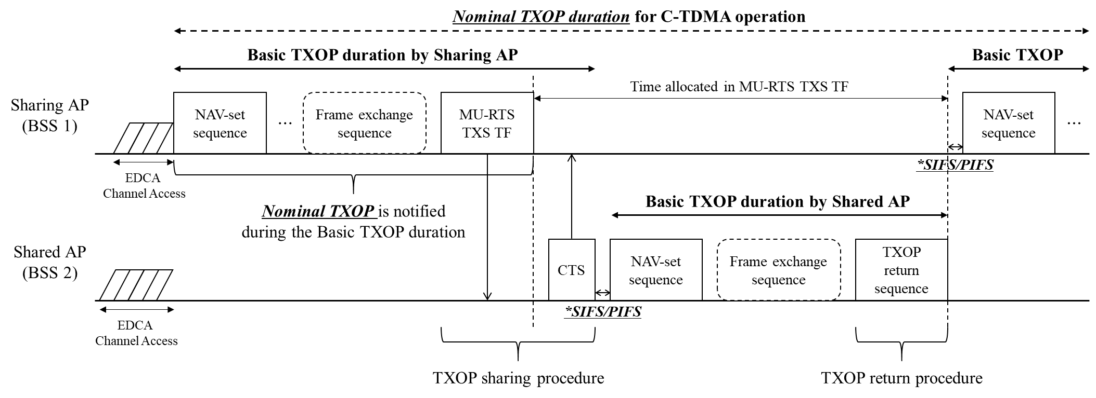
Two TXOPs for TXOP Sharing in C-TDMA
Nominal TXOP can be announced by the sharing AP during the Basic TXOP duration.
UHR APs/non-AP STAs can understand this Nominal TXOP duration.
Legacy STAs avoid protection issues by setting NAV only during the Basic TXOP duration.
Other cooperating AP(s) can defer channel access for the time allocated to a specific shared AP.
This may provide a similar effect as setting the NAV.
Within a Nominal TXOP duration,
The shared AP can use allocated time after SIFS/PIFS following the sharing AP’s Basic TXOP.
The sharing AP can get the TXOP back after SIFS/PIFS following the time allocated to the shared AP.

Slide 8
Conclusion
In this contribution, we have shared some methods to prevent protection issues that may arise when sharing TXOP for C-TDMA operation.
CF-End frame for TXOP sharing
Short TXOP for TXOP sharing
Two TXOPs for TXOP sharing
The three methods presented in this contribution are different from EHT’s TXS protocol in that the TXOP sharing & TXOP return processes are not performed within a single TXOP.
Therefore, for efficient C-TDMA operation, further discussion is needed on rules (e.g., SIFS/PIFS) and specific procedures (e.g., TXOP sharing/TXOP return).

Slide 9
References
[1] 23/0041r0, “Considerations on Coordinated TDMA (C-TDMA)”
[2] 23/0249r1, “Extended TXOP Sharing”
[3] 23/0261r0, “C-TDMA procedure in UHR”
[4] 23/0739r1, “Follow-up on Coordinated TDMA (C-TDMA)”
[5] 23/1085r0, “Thoughts on Coordinated TDMA”

