Slide 1
Channel Information Feedback for Smooth Beamforming – Follow Up
Date: 2023-11-05
Authors:

Slide 2
Introduction (1/2)
Beamforming can be a key solution that can achieve one of the goals of UHR [1].
Increase throughput including at different SNR levels (at least 25%).
However, the throughput of beamforming has been limited due to discontinuity issue of the beam-steering matrix.
This makes it difficult to achieve the channel smoothing gain (1~3dB).
This also makes it difficult to estimate the channel using 2x-LTF.
The 2x-LTF is a widely used LTF type in the commercial WLANs, which requires interpolation for channel estimation.
However, discontinuous (beamformed) channel cannot be estimated with simple linear interpolation.
Error floor is inevitable in high QAM (e.g., 4096-QAM), resulting in max throughput degradation.
The reason for the discontinuity is that the current standard of compressed beamforming feedback is optimized to minimize the size of the compressed beamforming report (CBR).

Slide 3
Introduction (2/2)
However, a slight increase in feedback overhead can solve the discontinuity problem, leading to significant throughput gain [2].
This maximizes the smoothness of the beam-steering matrix.
Through this, more channel smoothing gain can be obtained for the beamformed data.
Since actual channel conditions in local area networks are semi-static, the sounding process occurs sparsely compared to frequent transmission of beamformed data.
E.g., One sounding process per 20ms.
A slight increase (or decrease) of the feedback overhead has a negligible effect on throughput performance.
Following [3], this contribution shows additional feedback of channel information is very effective way to increase throughput.

Slide 4
Sounding & Beamforming Process

Slide 5
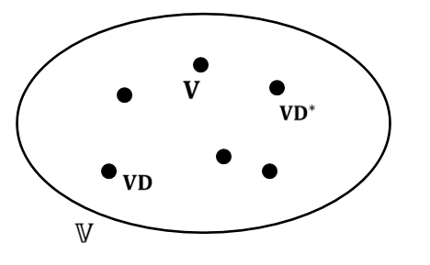
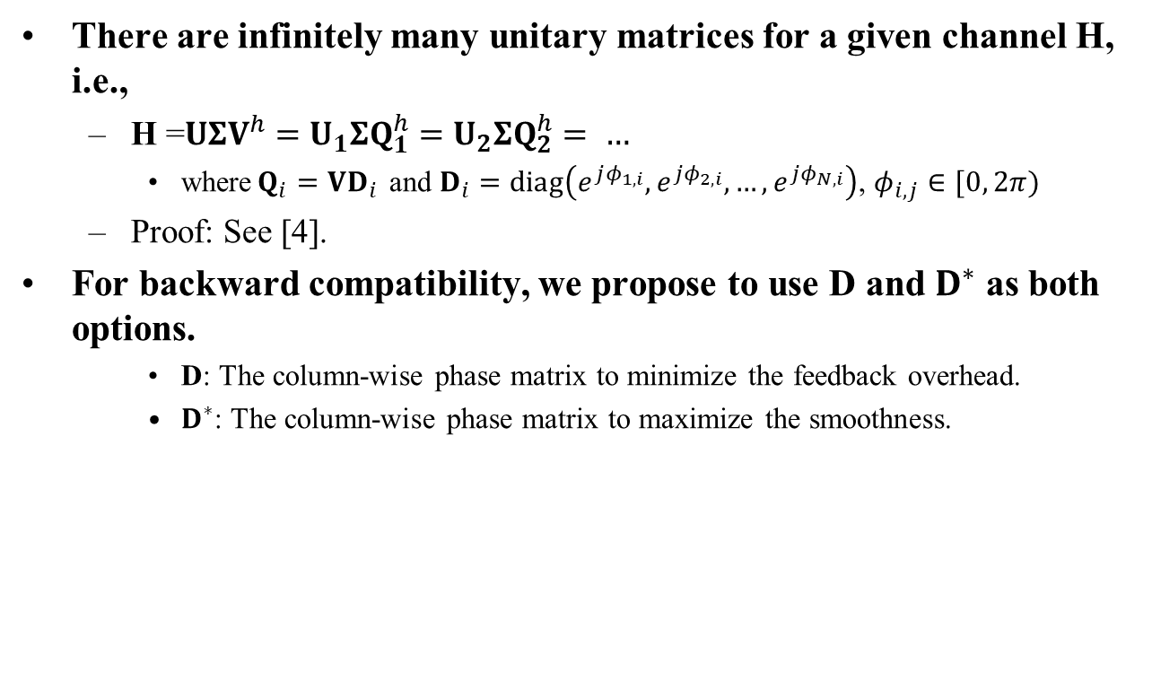
Background Theorem
There are infinitely many unitary matrices for a given channel H, i.e.,
H =$UΣV^{h}=U_{1}ΣQ_{1}^{h}=U_{2}ΣQ_{2}^{h}= …$
where$Q_{i}=VD_{i}$ and $D_{i}=diag\left(e^{jφ_{1,i}},e^{jφ_{2,i}},…,e^{jφ_{N,i}}\right)$, $φ_{i,j}∈[0, 2π)$
Proof: See [4].
For backward compatibility, we propose to use D and $D^{∗}$ as both options.
D: The column-wise phase matrix to minimize the feedback overhead.
$D^{∗}$: The column-wise phase matrix to maximize the smoothness.
Proposed: Optimal in terms of maximizing the smoothness
Conventional: Optimal in terms of minimizing the feedback overhead

Slide 6
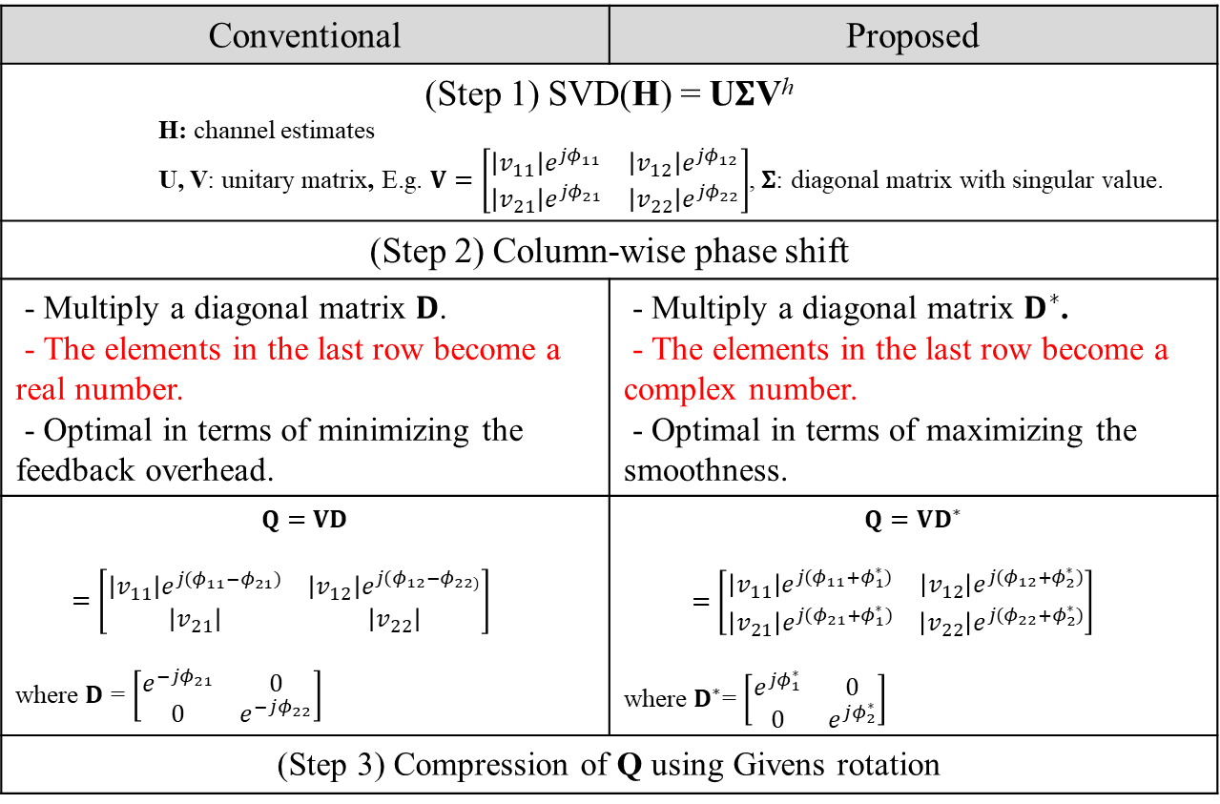
Proposed Smooth Beamforming Feedback
Conventional | Proposed
(Step 1) SVD(H) = U$Σ$V^{h} H: channel estimates U, V: unitary matrix, E.g. $V=\left[\begin{matrix}\left|v_{11}\right|e^{jφ_{11}} & \left|v_{12}\right|e^{jφ_{12}} \\ \left|v_{21}\right|e^{jφ_{21}} & \left|v_{22}\right|e^{jφ_{22}}\end{matrix}\right]$, $Σ$: diagonal matrix with singular value.
(Step 2) Column-wise phase shift
- Multiply a diagonal matrix 𝐃. - The elements in the last row become a real number. - Optimal in terms of minimizing the feedback overhead. | - Multiply a diagonal matrix $D^{∗}$. - The elements in the last row become a complex number. - Optimal in terms of maximizing the smoothness.
$$Q=VD$$ $=\left[\begin{matrix}\left|v_{11}\right|e^{j{(φ}_{11}−φ_{21})} & \left|v_{12}\right|e^{j{(φ}_{12}−φ_{22)}} \\ \left|v_{21}\right| & \left|v_{22}\right|\end{matrix}\right]$ where $D$ = $\left[\begin{matrix}e^{−jφ_{21}} & 0 \\ 0 & e^{−jφ_{22}}\end{matrix}\right]$ | $$Q=VD^{∗}$$ $=\left[\begin{matrix}\left|v_{11}\right|e^{j{(φ}_{11}+φ_{1}^{∗})} & \left|v_{12}\right|e^{j{(φ}_{12}+φ_{2}^{∗})} \\ \left|v_{21}\right|e^{j{(φ}_{21}+φ_{1}^{∗})} & \left|v_{22}\right|e^{j{(φ}_{22}+φ_{2}^{∗})}\end{matrix}\right]$ where $D^{∗}$= $\left[\begin{matrix}e^{jφ_{1}^{∗}} & 0 \\ 0 & e^{jφ_{2}^{∗}}\end{matrix}\right]$
(Step 3) Compression of Q using Givens rotation

Slide 7




How to Design $D^{∗}$ (1/3)
In case of N_{SS} = 1,
$V=H^{h}$
Since channel vector (H) is frequency-correlated, V is a smooth beamforming matrix.
Propose to use $D^{∗}=1$.
No computation cost required.
$$Q=VD= {\left[\begin{matrix}\left|h_{1}\right|e^{j(φ_{1}−φ_{3})} \\ \left|h_{2}\right|e^{j{(φ}_{2}−φ_{3})} \\ \left|h_{3}\right|\end{matrix}\right]}^{h}$$
Conventional
D = $e^{−jφ_{3}}$
$$H=\left[\begin{matrix}\left|h_{1}\right|e^{jφ_{1}} \\ \left|h_{2}\right|e^{jφ_{2}} \\ \left|h_{3}\right|e^{jφ_{3}}\end{matrix}\right]$$
$$V={\left[\begin{matrix}\left|h_{1}\right|e^{jφ_{1}} \\ \left|h_{2}\right|e^{jφ_{2}} \\ \left|h_{3}\right|e^{jφ_{3}}\end{matrix}\right]}^{h}$$
$$Q=VD^{∗}= {\left[\begin{matrix}\left|h_{1}\right|e^{jφ_{1}} \\ \left|h_{2}\right|e^{jφ_{2}} \\ \left|h_{3}\right|e^{jφ_{3}}\end{matrix}\right]}^{h}$$
Proposed
$D^{∗}$ = $1$

Slide 8
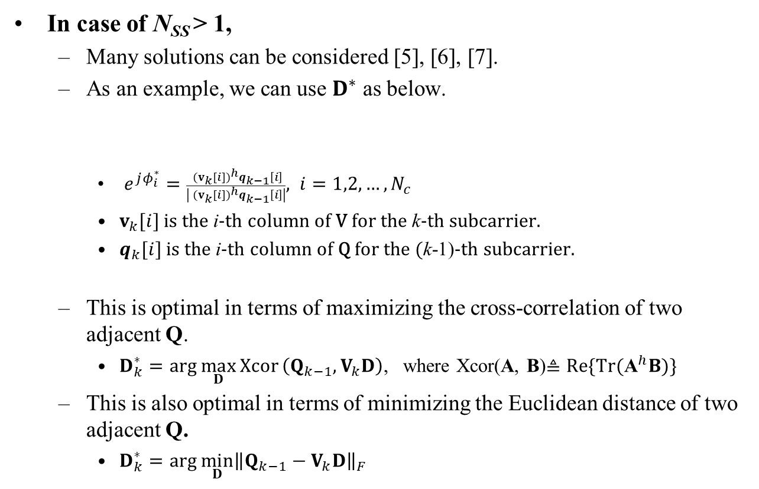
How to Design $D^{∗}$ (2/3)
In case of N_{SS} > 1,
Many solutions can be considered [5], [6], [7].
As an example, we can use $D^{∗}$ as below.
$e^{jφ_{i}^{∗}}=\frac{{ (v_{k}[i])}^{h}q_{k−1}\left[i\right]}{\left|{ (v_{k}[i])}^{h}q_{k−1}\left[i\right]\right|}, i=1,2,…, N_{c}$
$v_{k}[i]$ is the i-th column of V for the k-th subcarrier.
$q_{k}[i]$ is the i-th column of Q for the (k-1)-th subcarrier.
This is optimal in terms of maximizing the cross-correlation of two adjacent Q.
$D_{k}^{∗}=arg \max_{D}{Xcor}\left(Q_{k−1},V_{k}D\right)$, where Xcor(A, B)$≜Re\{\text{Tr}({\text{A}}^{h}B)\}$
This is also optimal in terms of minimizing the Euclidean distance of two adjacent Q.
$D_{k}^{∗}=arg \min_{D}{{\left\|Q_{k−1}−V_{k}D\right\|}_{F}}$
$$D_{k}^{∗}=diag\left(e^{jφ_{1}^{∗}},e^{jφ_{2}^{∗}}, …,e^{jφ_{N_{c}}^{∗}}\right)$$

Slide 9
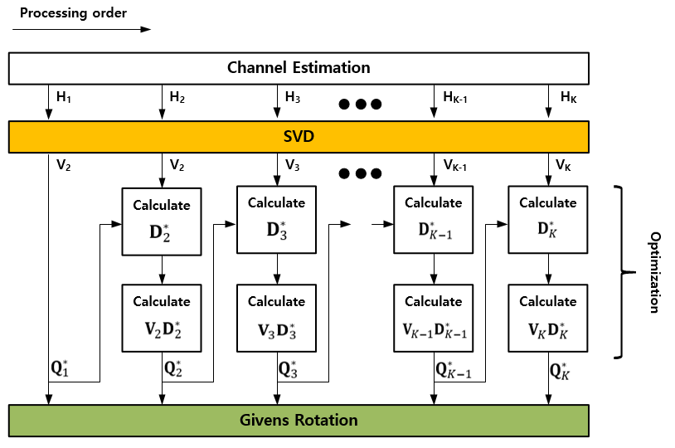
How to Design $D^{∗}$ (3/3)
Sequential processing
For N_{SS} > 1, the optimization of Q is performed sequentially from the beginning to the end of the subcarriers.
For N_{SS} = 1, the optimization process is bypassed. (i.e., $Q_{k}$=$V_{k})$

Slide 10
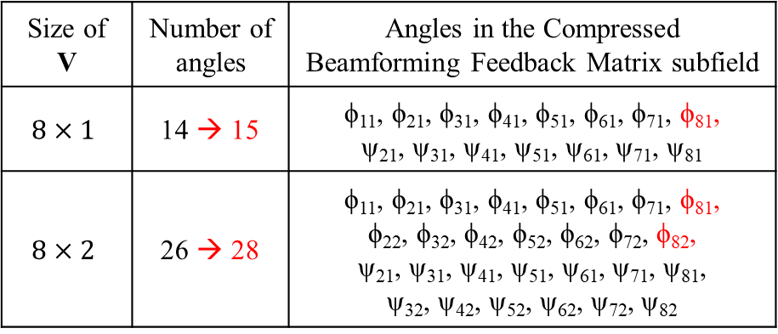
Feedback Overhead (1/2)
The number of angles is increased by $N_{c}$.
$N_{c}$numer of $φ_{N_{r}i}$, ($i=1,2,…, N_{c}$) is newly added in the Compressed Beamforming Feedback Matrix subfield*.
E.g., Red marked angles in the table below.
E.g., May be carried in a new Smooth Beamforming Report subfield
Due to the limited form factor, $N_{c}$ value is generally less than 2 in the current mobile devices.
Size of V | Number of angles | Angles in the Compressed Beamforming Feedback Matrix subfield
$$8×1$$ | 14 → 15 | ϕ₁₁, ϕ₂₁, ϕ₃₁, ϕ₄₁, ϕ₅₁, ϕ₆₁, ϕ₇₁, ϕ₈₁, ψ₂₁, ψ₃₁, ψ₄₁, ψ₅₁, ψ₆₁, ψ₇₁, ψ₈₁
$$8×2$$ | 26 → 28 | ϕ₁₁, ϕ₂₁, ϕ₃₁, ϕ₄₁, ϕ₅₁, ϕ₆₁, ϕ₇₁, ϕ₈₁, ϕ₂₂, ϕ₃₂, ϕ₄₂, ϕ₅₂, ϕ₆₂, ϕ₇₂, ϕ₈₂, ψ₂₁, ψ₃₁, ψ₄₁, ψ₅₁, ψ₆₁, ψ₇₁, ψ₈₁, ψ₃₂, ψ₄₂, ψ₅₂, ψ₆₂, ψ₇₂, ψ₈₂
Order | Information
1 | Category
2 | Action
3 | MIMO Control
4 | Compressed Beamforming Report
5 | MU Exclusive Beamforming Report
6 | CQI Report
7 | Smooth Beamforming Report
* Assuming no rank reduction, $N_{c}$ is equal to $N_{ss}$.

Slide 11
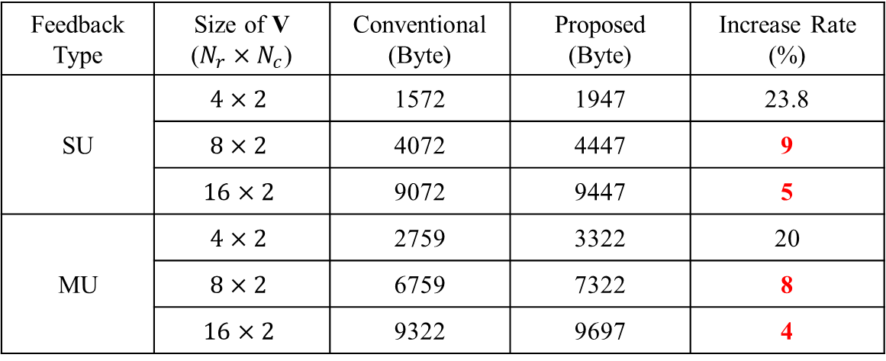
Feedback Overhead (2/2)
As the size of V increases, the increase rate of feedback overhead decreases.
For MU-MIMO which has larger feedback overhead, the increase rate is smaller.
This is because the CBR size of MU-MIMO is larger due to the delta-SNR information.
Feedback Type | Size of V ($N_{r}×N_{c}$) | Conventional (Byte) | Proposed (Byte) | Increase Rate (%)
SU | $$4×2$$ | 1572 | 1947 | 23.8
 | $$8×2$$ | 4072 | 4447 | 9
 | $$16×2$$ | 9072 | 9447 | 5
MU | $$4×2$$ | 2759 | 3322 | 20
 | $$8×2$$ | 6759 | 7322 | 8
 | $$16×2$$ | 9322 | 9697 | 4

Slide 12
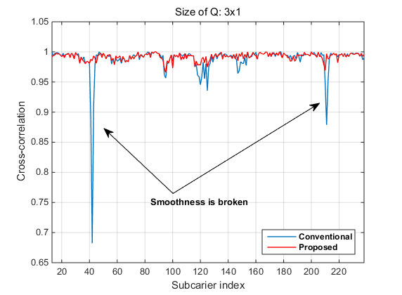
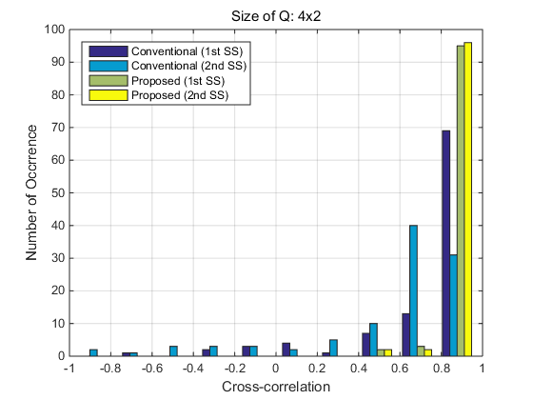
Cross-correlation Comparison
By feeding back additional phase information, cross-correlation between two adjacent beam-steering matrices is significantly improved.
[Snap-shot]
[Histogram]

Slide 13
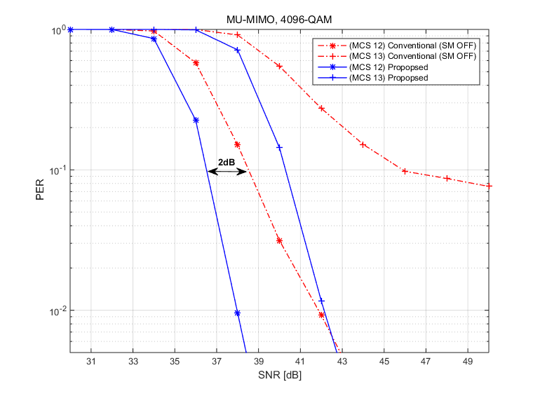
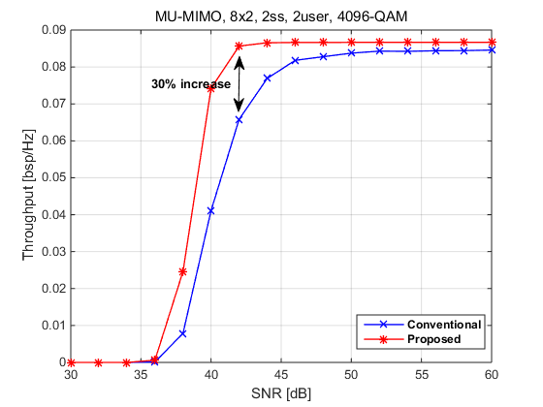
Performance Comparison (1/2)
MU-MIMO, 8x2, 2 user, 4096-QAM, 2x EHT-LTF
PER
More than 2dB gain thanks to the application of the channel smoothing.
Throughput
Throughput is calcalcuated with considering feedback overhead
Data payload / (Time for NDPA, NDP, BFRP, SIFS, CBR and Data) * (1-PER) / BW
About 30% increase in max throughput
Can satisfy the target of UHR project (25% increase in throughput)

Slide 14
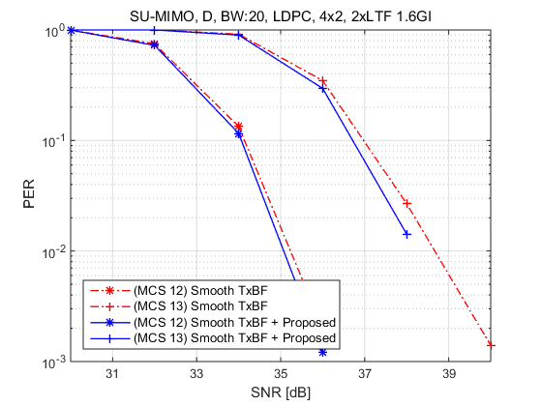
Performance Comparison (2/2)
Some beamformer may have smoothing capability (Smooth TxBF).
If the proposed scheme is used jointly with Smooth TxBF, more PER performance gain can be obtained.
SU-MIMO, 4x2, 2ss, 4096-QAM, 2x ETH-LTF
Around 0.5dB gain can be obtained.

Slide 15
Summary
We discussed the improvement of beamforming which can achieve a target of UHR.
Proposed to feedback additional phase information to obtain more channel smooth gain for the beamforming signal.
Considering that sounding occurs very sparsely, a slight increase in overhead has a very small effect on throughput loss,
but throughput gain of the smooth beamforming is significant.
If beamformer does not have smoothing capability,
The proposed scheme can be used as a stand-alone solution that provides a smooth beam-steering matrix to the beamformer.
If beamformer has smoothing capability,
By using the proposed scheme, additional performance gains can be obtained.

Slide 16
SP
Do you support AP to provide additional phase information to non-AP STA to improve the smoothness of the beam-steering matrix?
Note: This is limited to SU beamforming transmitted by non-AP STA, which means the non-AP STA is a SU beamformer.
Y/N/A

Slide 17
Reference
[1] 802.11-22/1392r0, Beamforming Improvement for UHR, Samsung.
[2] 802.11-22/1820r1, BF Feedback with the Optimal SVD, Zeku.
[3] 802.11-22/1842r0, Channel Information Feedback for Smooth Beamforming, Samsung.
[4] E. Sengul, H. J. Park and E. Ayanoglu, “Bit-Interleaved Coded Multiple Beamforming with Imperfect CSIT,” IEEE Trans. Commun, vol. 57, no. 5, May 2009.
[5] E. Jeon, M. Ahn, S. Kim, W. B. Lee and J. Kim, "Joint Beamformer and Beamformee Design for Channel Smoothing in WLAN Systems," in Proc. IEEE 92nd Veh. Technol. Conf. (VTC2020-Fall), Nov. 2020.
[6] Y. Qui, D. Qu, Da Chen and T. Jiang, “Smoothed SVD-based Beamforming for FBMC/OQAM Systems Based on Frequency Spreading,” in Proc. IEEE Global Communications Conference (GLOBECOM), Dec. 2016.
[7] J. S. Sadowsky, T. Yamaura and J. Ketchem, “WWiSE Preambles and
MIMO Beamforming,” IEEE, Tech. Rep. 802.11-05/1635r1, Jan. 2005.

