Slide 1
Supporting the case of rotating ota MAC Addresses in the non-MLD scenario
Date: 2023-09-13
Authors:
Name | Affiliations | Address | Phone | email
A. De la Oliva | InterDigital, UC3M | Avda. De la Universidad 30, Leganes, Madrid, Spain | +34 91 6248803 | aoliva@it.uc3m.es
J. Levy | Interdigital

Slide 2
Abstract
This presentation focuses on the technical details of enabling rotating over the air (ota) MAC addresses for non-MLD scenarios
The assumption is that an STA supporting rotation of ota MAC addresses associates to an AP supporting rotation of ota MAC addresses, operating both in a non-MLD fashion.

Slide 3
Antecedents
There has been numerous discussion in the past about this topic.
I have presented two different solutions tackling CCMP encapsulation and decapsulation for the non-MLD case
  Option 1: simply use a key for CCMP encapsulation that is binded to the DS MAC.
  Option 2: implement for non-MLD STAs and APs exactly the same CCMP encapsulation/decapsulation mechanism as in MLD BUT using DS MAC instead of MLD MAC.
Both are feasible mechanisms which do not entail complex implementations
Rotating ota MAC addresses for the non-MLD STA and AP is doable! And not complex in terms of CCMP
  More changes than CCMP are needed for both MLD and non-MLD cases

Slide 4
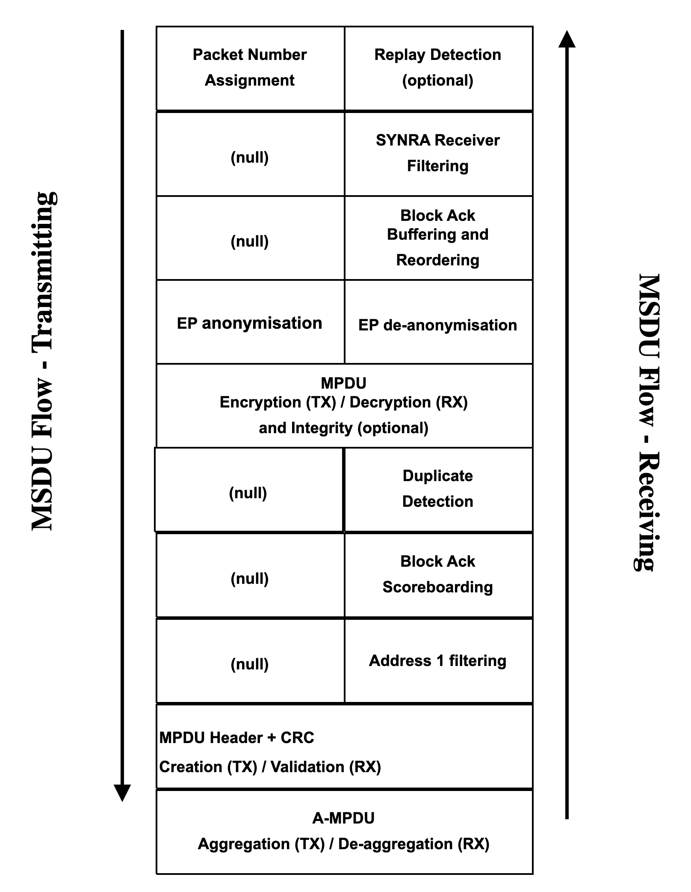
Option 1
The figure shows the Tx and Rx process for a non-MLD STA/AP.
Two new processing blocks have been added
  EP Anonymization
  EP De/Anonymization
Their function is to perform the change of otaMAC and related parameters

Slide 5
Option 1 (Tx)
On Tx, Option 1 process frames in a standard way up to the EP anonymization block
This block changes the MPDU DS MACs to otaMACs and other related parameters to the anonymized ones (otaMAC) before the CCMP block
Before Anonymization
Frame uses
A1=DS MAC1,
A2=DS MAC2
After Anonymization
Before CCMP
Frame uses
A1=otaMAC1,
A2=otaMAC2

Slide 6
Option 1 (Tx)
Anonymized frame reaches CCMP encapsulation
The frame uses otaMAC addresses instead of original DS MAC addresses
The CCMP encapsulation processes the frame as in current specification, but it uses a TK associated to the DSMAC (not indexed by A1)
Before Anonymization
Frame uses
A1=DS MAC1,
A2=DS MAC2
After Anonymization
Before CCMP
Frame uses
A1=otaMAC1,
A2=otaMAC2

Slide 7
Option 1 (Tx)
Anonymized frame reaches CCMP encapsulation
The frame uses otaMAC addresses instead of original DS MAC addresses
The CCMP encapsulation processes the frame as in current specification, but it uses a TK associated to the DSMAC (not indexed by A1)
TK must be associated to the DSMAC (PMKSA)

Slide 8
Option 1 (Rx)
On Rx, Anonymized frame reaches CCMP encapsulation
The frame uses otaMAC addresses instead of original DS MAC addresses
The CCMP de-capsulation processes the frame as in current specification, but it uses a TK associated to the DSMAC (not indexed by A1)
After De-anonymization
Frame uses
A1=DS MAC1,
A2=DS MAC2
After CCMP
Frame uses
A1=otaMAC1,
A2=otaMAC2
Before CCMP
Frame uses
A1=otaMAC1,
A2=otaMAC2

Slide 9
Option 1 (Rx)
On Rx, Anonymized frame reaches CCMP encapsulation
The frame uses otaMAC addresses instead of original DS MAC addresses
The CCMP de-capsulation processes the frame as in current specification, but it uses a TK associated to the DSMAC (not indexed by A1)
Key must be associated to the DSMAC (PMKSA)

Slide 10
Option 1 (from 1495-01)
Initial connection for a non-AP STA
  Authentication frame exchange with STA MAC address 1 (STA MAC address 1 becomes DS MAC, we can protect this if needed)
  Derive PTKSA using STA MAC address 1 (ok)
  Encrypt association request with DS MAC address 1 and encrypt association response (ok)
  AAD Swap based on ??? -> no need to modify the specification, use what is currently described
  Change STA MAC address from 1 to X (questions on PTKSA still based on STA MAC address 1?) -> yes, PTKSA based on DS MAC, everything works
  …
  Disassociation
Follow up connection for a non-AP STA (Exactly the same as before, nothing changes)
  Authentication frame exchange with STA MAC address 2
  Derive PTKSA using STA MAC address 2
  Encrypt (re)association request with DS MAC address 1 and encrypt (re)association response
  AAD Swap based on ???
  Change STA MAC address from 2 to X (questions on PTKSA still based on STA MAC address 2?)
  …
  Disassociation
11bi STA MAC address change while associated needs to solve the questions above -> Done

Slide 11
Option 2
Option 2 considers the IEEE 802.11be defined CCMP encapsulation/decapsulation for MLD mechanism to be applied to non-MLD 11bi enabled STA supporting rotation of ota MAC Addresses

Slide 12
Option 2
The figure shows the Tx and Rx process for a non-MLD STA/AP.
Two new processing blocks have been added
  EP Anonymization
  EP De/Anonymization
Their function is to perform the change of otaMAC and related parameters
Differencing from Option 1, these blocks can be before or after CCMP encapsulation/decapsulation based on implementation needs.
  CCMP processing is independent from the MAC addresses in the frame.

Slide 13
Option 2
Changes required to MLD CCMP to be applied in 11bi non-MLD STAs
DS MAC
The CCMP encapsulation/decapsulation process is exactly the same as in 11be, same implementation

Slide 14
Option 2 (from 1495-01)
Initial connection for a non-AP STA
  Authentication frame exchange with STA MAC address 1 (STA MAC address 1 becomes DS MAC, we can protect this if needed)
  Derive PTKSA using STA MAC address 1 (ok)
  Encrypt association request with DS MAC address 1 and encrypt association response (ok)
  AAD Swap based on ??? -> use the 11be MLD CCMP implementation, using the DS MAC instead of the MLD MAC Address in the same hardware
  Change STA MAC address from 1 to X (questions on PTKSA still based on STA MAC address 1?) -> yes, PTKSA based on DS MAC, everything works, anonymization and de-anonymization blocks are independent from the CCMP encapsulation/decapsulation
  …
  Disassociation
Follow up connection for a non-AP STA (Exactly the same as before, nothing changes)
  Authentication frame exchange with STA MAC address 2
  Derive PTKSA using STA MAC address 2
  Encrypt (re)association request with DS MAC address 1 and encrypt (re)association response
  AAD Swap based on ???
  Change STA MAC address from 2 to X (questions on PTKSA still based on STA MAC address 2?)
  …
  Disassociation
11bi STA MAC address change while associated needs to solve the questions above -> Done

Slide 15
Other considerations
Something we do need to consider is how to transport in a private way the DS MAC on association, can be done following approaches similar to IRM in bh
Some members claim Wifi 7 will only support MLD devices
  IEEE 802.11 follows a toolbox approach, we provide technical tools to overcome problems and advance technology.
  This issue is a matter of branding and from a different group, we should not shape our technical solutions based on this.
  Option 1 may be implemented by software, so it may be provided to already existing STAs
  Reducing our scope to MLD highly underminds the objectives of this group

