Slide 1
NBFH coexistence with Wi-Fi
Author:
Name | Affiliation | Address | Email
Menzo Wentink | Qualcomm | Utrecht, The Netherlands | mwentink qti qualcomm

Slide 2
Impact of NBFH on Wi-Fi Broadcast

Slide 3
Wi-Fi / NBFH simulation parameters – Beacon Rx
Wi-Fi settings
  Tx power: 23 dBm at AP (LPI), 21 dBm at STA (LPI)
  packet type: Beacons only (300 us, 20 MHz)
  beacon period: 100 ms (10 beacons/s)
  PHY rate: 6 Mbps OFDM
NBFH settings
  Tx power: 14 dBm (VLP)
  dwell time: 463 us
    150 us IFS, 313 us Tx, 68% duty cycle per link
    300 us IFS, 163 us Tx, 35% duty cycle per link
  hop width: 2 MHz (15 Mbps max PHY rate, Nss = 1)
  hopping pattern: random, 10 to 160 hops in 20 to 320 MHz, respectively
  eDAA settings: 0.125 s between CCA evaluations, 1.25 s before possible release (eDAA 125)
  CCA trigger settings: 7 us CCA before each hop, FBE, trigger thresholds 3+3/24, 20 MHz segments
    the values 3+3/24 indicate a threshold of 3, then a bump of 3 (to 6) for extra hysteresis, and 24 is the max value
  staggered startup during first 0.5 s
  bi-directional traffic with two peripherals
  isochronous audio, 1, 2 or 4 CIG events (tries) per ISO cycle (CIG 1, CIG 2, CIG 4)
Channel model
  AWGN channel with a breakpoint at 5 m
    pathloss = 40.05 + 20log10(f/2.4) + 20log10(min(d, b)) + (d > b) * (35log10(d/b))
    where f = 5.18 GHz, d = distance, b = breakpoint = 5 m

Slide 4
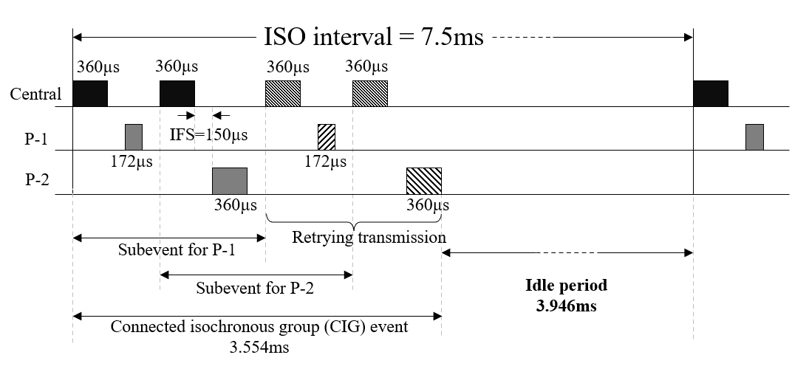
BT isochronous audio illustration
‘CIG 1’ – 1 try (0 retries), 17% duty cycle
‘CIG 2’ – 2 tries (1 retry), 34% duty cycle
‘CIG 4’ – 4 tries (3 retries), 68% duty cycle

Slide 5
Wi-Fi / NBFH topology – Beacon Rx
AP
LPI Wi-Fi link
downlink traffic
VLP NBFH links
VLP NBFH links
STA
nb_broadcast_edaa_r2102a-e
nb_broadcast_lbt_r2102a-e

Slide 6
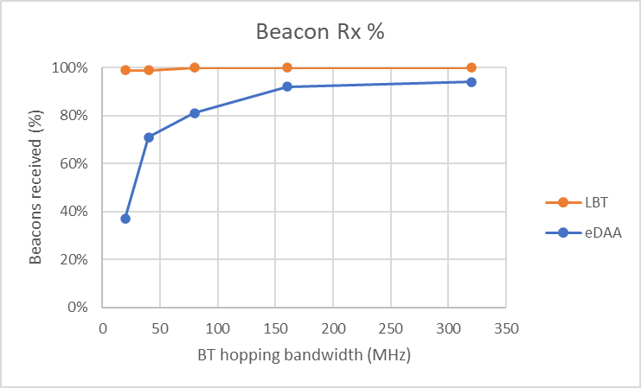
Impact on Beacon Rx (CIG 1)
eDAA 125
Wi-Fi: 0.45% dc, Beacons
NB: 17% dc per link
CIG 1
nb_broadcast_edaa_r2303a-e
nb_broadcast_lbt_r2303a-e

Slide 7
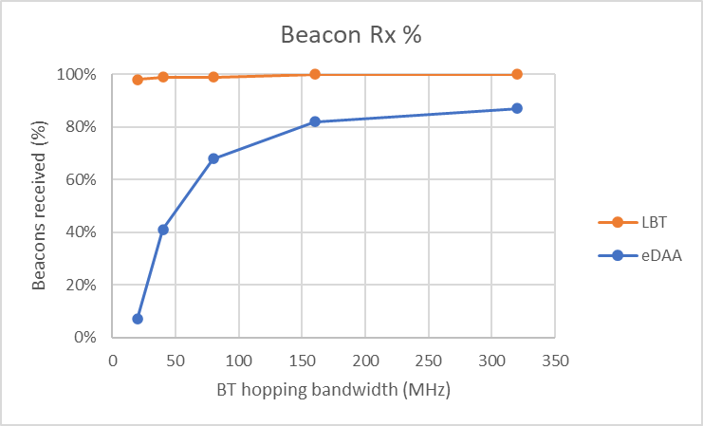
Impact on Beacon Rx (CIG 2)
eDAA 125
Wi-Fi: 0.45% dc, Beacons
NB: 34% dc per link
CIG 2
nb_broadcast_edaa_r2303a-e
nb_broadcast_lbt_r2303a-e

Slide 8
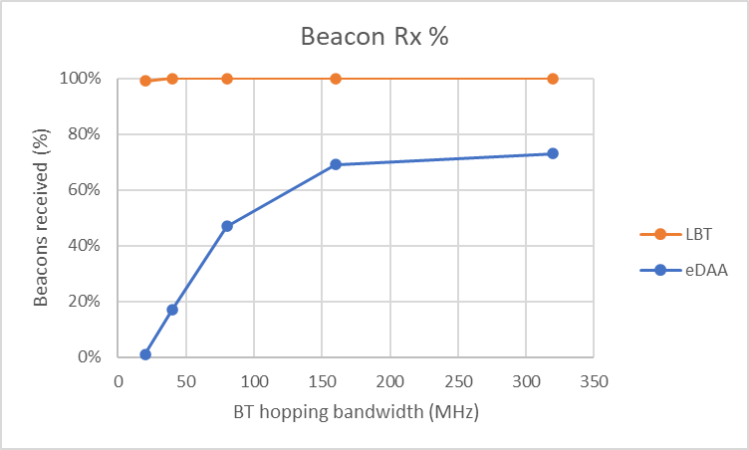
Impact on Beacon Rx (CIG 4)
eDAA 125
Wi-Fi: 0.3% dc, Beacons
NB: 68% dc per link
CIG 4
nb_broadcast_edaa_r2102a-e
nb_broadcast_lbt_r2102a-e

Slide 9
Observations – Beacon Rx
NB with eDAA can cause significant degradation in Wi-Fi broadcast packet receptions
NB with LBT sees no degradation
Broadcast is important for Wi-Fi operation, for several reasons:
  network discovery and management
    beacons, probe request, fast discovery (FILS), TIM power save, TIM broadcast, etc.
  service discovery
    ARP, Bonjour, Apple Airplay, Google Chromecast, mDNS, Wi-Fi direct, ANQP, etc.
  channel evacuation for radar detection (DFS)
    channel switch request (CSR)
    interfering with DFS signaling might have regulatory implications as well
  broadcast services
    802.11bc (EBCS), TV broadcast, radio broadcast, etc.
    see also the EBCS slides further in this slide deck
Without reliable broadcast, Wi-Fi will not work well

Slide 10
Enhanced Broadcast Services (EBCS)
EBCS is standardized in 802.11bc

Slide 11
Wi-Fi / NBFH simulation parameters – EBCS
Wi-Fi settings
  Tx power: 23 dBm at AP (LPI), 21 dBm at STA (LPI)
  packet size: 5 ms
  downlink traffic, EBCS
  channel width: 160 MHz
  max bitrate: 2402 Mbps at HE MCS 11, 160 MHz, 2x996-tone RU, Nss = 2, 800 ns GI
  frame exchange: Broadcast Data (EBCS)
  start time: 0 s
  20 pps (50 ms between packets), 4% on air duty cycle
NBFH settings (BT)
  Tx power: 14 dBm (VLP)
  dwell time: 625 us
  hop width: 4 MHz
  hopping width: 500 MHz (random hopping pattern, 125 hops)
  eDAA settings: 0.5 s between CCAs, evacuation in 20 MHz blocks, two options for channel restoration:
    option 1: after 0.5 s when CCA is clear
    option 2: after 2.5 s without CCA (exponentially increasing)
  start time: 5 s
  downlink traffic, full buffer
Channel model
  AWGN channel with a breakpoint at 5 m
    pathloss = 40.05 + 20log10(f/2.4) + 20log10(min(d, b)) + (d > b) * (35log10(d/b))
    where f = 5.18 GHz, d = distance, b = breakpoint = 5 m

Slide 12
Broadcast traffic
802.11bc – Enhanced Broadcast Services (EBCS)
AP
LPI Wi-Fi link
downlink traffic
Broadcast traffic
(EBCS)
(20 pps, 50 ms between packets, 4% on air duty cycle)
VLP NB link
4 MHz hop width
500 MHz hopping width
STA
nb_r400b

Slide 13
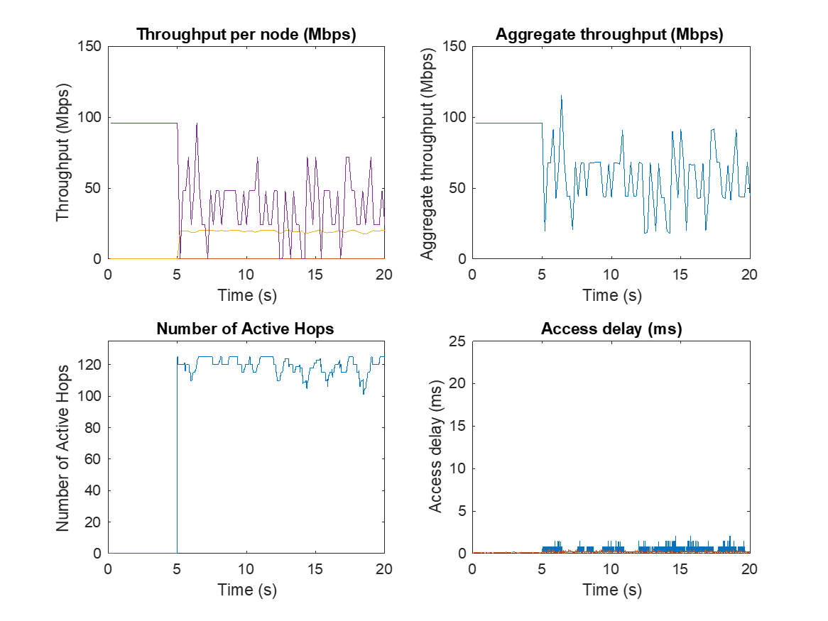
Wi-Fi/NB eDAA with Option 1 – EBCS
eDAA fails to reliably detect the low duty cycle Wi-Fi broadcast transmissions and NB causes major interference to Wi-Fi
NB starts at 5 s
eDAA detection of the periodic Wi-Fi broadcast traffic is very unreliable
The NB latency is considerable, especially for the low Wi-Fi duty cycle of 4%, because eDAA disables 20 MHz segments for a significant amount of time
nb_r414

Slide 14
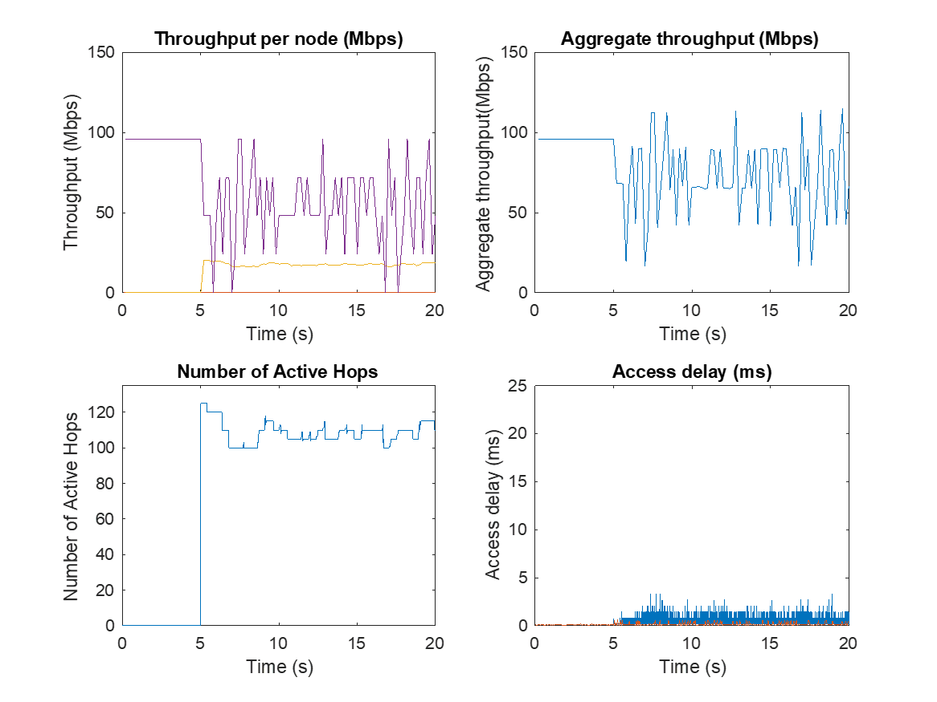
Wi-Fi/NB eDAA with Option 2 – EBCS
eDAA fails to reliably detect the low duty cycle Wi-Fi broadcast transmissions and NB causes major interference to Wi-Fi
NB starts at 5 s
eDAA detection of the periodic Wi-Fi broadcast traffic is very unreliable
The NB latency is considerable, especially for the low Wi-Fi duty cycle of 4%, because eDAA disables 20 MHz segments for a significant amount of time
nb_r400b

Slide 15
Wi-Fi/NB LBT – EBCS
NB with LBT defers for ongoing Wi-Fi broadcast transmissions
The NB throughput is essentially unaffected
NB starts at 5 s
(This plot is not defined for LBT)
The NB latency is low when it uses LBT
nb_r400b

Slide 16
eDAA dynamic behavior

Slide 17
eDAA 125
There has been a proposal for a further enhanced eDAA
  ‘eDAA 125’
  0.125 s between CCA evaluations (instead of 0.5 s)
  channel restoration after 1.25 s when the CCA is clear (instead of 0.5 s)
  evacuation in 20 MHz blocks (same as original eDAA)

Slide 18
1 CIG event per ISO interval

Slide 19
Wi-Fi / NBFH simulation parameters – 60% Wi-Fi dc, CIG 1
Wi-Fi settings
  Tx power: 23 dBm at AP (LPI), 21 dBm at STA (LPI)
  packet size: 5 ms
  downlink traffic, 60% duty cycle
    5 ms TXOP every 8.3 ms
  channel width: 80 MHz
  max bitrate: 1201 Mbps at HE MCS 11, 80 MHz, 996-tone RU, Nss = 2, 800 ns GI
  genie throughput
  frame exchange: RTS/CTS/A-MPDU/BA
  start time: 3 s
NBFH settings (BT)
  Tx power: 14 dBm (VLP)
  dwell time: 463 us
    313 us Tx, 150 us IFS, 68% duty cycle per link
    163 us Tx, 300 us IFS, 35% duty cycle per link
  hop width: 2 MHz (15 Mbps max PHY rate, Nss = 1)
  hopping pattern: random, 80 hops (160 MHz total)
  eDAA settings: 0.125 s between CCA evaluations, 1.25 s before possible release (eDAA 125)
  CCA trigger settings: 7 us CCA before each hop, FBE, trigger threshold 3+3/24, 20 MHz segments
    the values 3+3/24 indicate a threshold of 3, then a bump of 3 (to 6) for extra hysteresis, and 24 is the max value
  startup staggered during first 0.5 s
  bi-directional traffic with two peripherals
Channel model
  AWGN channel with a breakpoint at 5 m
    pathloss = 40.05 + 20log10(f/2.4) + 20log10(min(d, b)) + (d > b) * (35log10(d/b))
    where f = 5.18 GHz, d = distance, b = breakpoint = 5 m

Slide 20
Wi-Fi / NBFH topology – 60% Wi-Fi dc, CIG 1
Wi-Fi:
80 MHz
60% duty cycle
BT:
160 MHz
1 BT central,
2 peripherals per link
AP
VLP NBFH links
VLP NBFH links
STA
LPI Wi-Fi link
downlink traffic
nb_r2202a

Slide 21
Wi-Fi / NBFH (LBT with CCA trigger) – 60% Wi-Fi dc, CIG 1
trigger 3+3/24
60% dc on Wi-Fi link
68% dc per NB link
A more optimal approach is probably to have longer term (AFH-style) evacuation, in combination with a return based on an offline scan (like eDAA) and possibly some number of consecutive idle CCAs
nb_r2202c

Slide 22
Wi-Fi / NBFH (eDAA 125) – 60% Wi-Fi dc, CIG 1
260 ms
eDAA 125
60% dc on Wi-Fi link
68% dc per NB link
long tail
nb_r2202d

Slide 23
2 CIG events per ISO interval

Slide 24
Wi-Fi / NBFH simulation parameters – 60% Wi-Fi dc, CIG 2
Wi-Fi settings
  Tx power: 23 dBm at AP (LPI), 21 dBm at STA (LPI)
  packet size: 5 ms
  downlink traffic, 60% duty cycle
    5 ms TXOP every 8.3 ms
  channel width: 80 MHz
  max bitrate: 1201 Mbps at HE MCS 11, 80 MHz, 996-tone RU, Nss = 2, 800 ns GI
  genie throughput
  frame exchange: RTS/CTS/A-MPDU/BA
  start time: 3 s
NBFH settings (BT)
  Tx power: 14 dBm (VLP)
  dwell time: 463 us
    313 us Tx, 150 us IFS, 68% duty cycle per link
    163 us Tx, 300 us IFS, 35% duty cycle per link
  hop width: 2 MHz (15 Mbps max PHY rate, Nss = 1)
  hopping pattern: random, 80 hops (160 MHz total)
  eDAA settings: 0.125 s between CCA evaluations, 1.25 s before possible release (eDAA 125)
  CCA trigger settings: 7 us CCA before each hop, FBE, trigger threshold 3+3/24, 20 MHz segments
    the values 3+3/24 indicate a threshold of 3, then a bump of 3 (to 6) for extra hysteresis, and 24 is the max value
  startup staggered during first 0.5 s
  bi-directional traffic with two peripherals
Channel model
  AWGN channel with a breakpoint at 5 m
    pathloss = 40.05 + 20log10(f/2.4) + 20log10(min(d, b)) + (d > b) * (35log10(d/b))
    where f = 5.18 GHz, d = distance, b = breakpoint = 5 m

Slide 25
Wi-Fi / NBFH topology – 60% Wi-Fi dc, CIG 2
Wi-Fi:
80 MHz
60% duty cycle
BT:
160 MHz
1 BT central,
2 peripherals per link
AP
VLP NBFH links
VLP NBFH links
STA
LPI Wi-Fi link
downlink traffic
nb_r2202a

Slide 26
Wi-Fi / NBFH (LBT with CCA trigger) – 60% Wi-Fi dc, CIG 2
trigger 3+3/24
60% dc on Wi-Fi link
68% dc per NB link
A more optimal approach is probably to have longer term (AFH-style) evacuation, in combination with a return after some number of consecutive idle CCAs
nb_r2202a

Slide 27
Wi-Fi / NBFH (eDAA 125) – 60% Wi-Fi dc, CIG 2
520 ms
eDAA 125
60% dc on Wi-Fi link
68% dc per NB link
long tail
nb_r2202b

Slide 28
4 CIG events per ISO interval

Slide 29
Wi-Fi / NBFH simulation parameters – 60% Wi-Fi dc, CIG 4
Wi-Fi settings
  Tx power: 23 dBm at AP (LPI), 21 dBm at STA (LPI)
  packet size: 5 ms
  downlink traffic, 60% duty cycle
    5 ms TXOP every 8.3 ms
  channel width: 80 MHz
  max bitrate: 1201 Mbps at HE MCS 11, 80 MHz, 996-tone RU, Nss = 2, 800 ns GI
  genie throughput
  frame exchange: RTS/CTS/A-MPDU/BA
  start time: 3 s
NBFH settings (BT)
  Tx power: 14 dBm (VLP)
  dwell time: 463 us
    313 us Tx, 150 us IFS, 68% duty cycle per link
    163 us Tx, 300 us IFS, 35% duty cycle per link
  hop width: 2 MHz (15 Mbps max PHY rate, Nss = 1)
  hopping pattern: random, 80 hops (160 MHz total)
  eDAA settings: 0.125 s between CCA evaluations, 1.25 s before possible release (eDAA 125)
  CCA trigger settings: 7 us CCA before each hop, FBE, trigger threshold 3+3/24, 20 MHz segments
    the values 3+3/24 indicate a threshold of 3, then a bump of 3 (to 6) for extra hysteresis, and 24 is the max value
  startup staggered during first 0.5 s
  bi-directional traffic with two peripherals
Channel model
  AWGN channel with a breakpoint at 5 m
    pathloss = 40.05 + 20log10(f/2.4) + 20log10(min(d, b)) + (d > b) * (35log10(d/b))
    where f = 5.18 GHz, d = distance, b = breakpoint = 5 m

Slide 30
Wi-Fi / NBFH topology – 60% Wi-Fi dc, CIG 4
Wi-Fi:
80 MHz
60% duty cycle
BT:
160 MHz
1 BT central,
2 peripherals per link
AP
VLP NBFH links
VLP NBFH links
STA
LPI Wi-Fi link
downlink traffic
nb_r2201c

Slide 31
Wi-Fi / NBFH (LBT with CCA trigger) – 60% Wi-Fi dc, CIG 4
trigger 3+3/24
60% dc on Wi-Fi link
68% dc per NB link
A more optimal approach is probably to have longer term (AFH-style) evacuation, in combination with a return after some number of consecutive idle CCAs
nb_r2201c

Slide 32
Wi-Fi / NBFH (eDAA 125) – 60% Wi-Fi dc, CIG 4
210 ms
eDAA 125
60% dc on Wi-Fi link
68% dc per NB link
long tail
nb_r2201d

Slide 33
on/off traffic

Slide 34
Wi-Fi / NBFH simulation parameters – on/off traffic
Wi-Fi settings
  Tx power: 23 dBm at AP (LPI), 21 dBm at STA (LPI)
  packet size: 5 ms
  downlink traffic, full buffer on/off
    on/off traffic, 0.3 s on, 2 s off (15% duty cycle)
    like bursts of 4k Netflix streaming data in a Target Wake Time (TWT) setting at Wi-Fi
  channel width: 80 MHz
  max bitrate: 1201 Mbps at HE MCS 11, 80 MHz, 996-tone RU, Nss = 2, 800 ns GI
  genie throughput
  frame exchange: RTS/CTS/A-MPDU/BA
  start time: 3 s
NBFH settings (BT)
  Tx power: 14 dBm (VLP)
  dwell time: 463 us
    313 us Tx, 150 us IFS, 68% duty cycle per link
    163 us Tx, 300 us IFS, 35% duty cycle per link
    453 us Tx, 10 us IFS, 98% duty cycle per link
  hop width: 2 MHz (15 Mbps max PHY rate, Nss = 1, scaled Wi-Fi MCS)
  hopping pattern: random, 80 hops (160 MHz total)
  eDAA settings: 0.125 s between CCA evaluations, 1.25 s before possible release (eDAA 125)
  CCA trigger settings: 7 us CCA before each hop, FBE, trigger thresholds 3+3/24, 20 MHz segments
    3+3/24 indicates a threshold of 3, then a bump of 3 (to 6) for extra hysteresis, and 24 is the max value
  startup staggered during first 0.5 s
  bi-directional traffic with two peripherals
Channel model
  AWGN channel with a breakpoint at 5 m
    pathloss = 40.05 + 20log10(f/2.4) + 20log10(min(d, b)) + (d > b) * (35log10(d/b))
    where f = 5.18 GHz, d = distance, b = breakpoint = 5 m

Slide 35
Wi-Fi / NBFH topology – on/off traffic
Wi-Fi:
80 MHz
on/off traffic
BT:
160 MHz
1 BT central,
2 peripherals per link
AP
VLP NBFH links
VLP NBFH links
STA
LPI Wi-Fi link
downlink traffic
nb_r2101a

Slide 36
Wi-Fi / NBFH (LBT with CCA trigger) – on/off traffic
trigger 3+3/12
on/off traffic
68% dc per NB link
CIG 4
nb_r2101a

Slide 37
Wi-Fi / NBFH (eDAA 125 with LBT) – on/off traffic
eDAA 125
on/off traffic
68% dc per NB link
CIG 4
eDAA 125 does respond, but too late and in xome cases not at all
nb_r2101b

Slide 38
Wi-Fi / NBFH (LBT with CCA trigger) – on/off traffic
trigger 3+3/24
on/off traffic
98% dc per NB link
CIG 4
nb_r2101c

Slide 39
Wi-Fi / NBFH (eDAA 125 with LBT) – on/off traffic
eDAA 125
on/off traffic
98% dc per NB link
CIG 4
eDAA 125 does respond, but too late and in some cases not at all
nb_r2101d

Slide 40
Observations eDAA 125
eDAA 125
  eDAA 125 is an improvement over the initial eDAA, but probably not sufficient
    the response time still appears to be too slow
    ongoing Wi-Fi transmissions are not protected because there is no LBT
CCA trigger
  the trigger threshold is not related to 60% medium utilization, but to discerning NB from WB (through the consecutive aspect in the trigger)
    a trigger threshold of 3 is preferred over 6
    some more background is in section ‘NB/NB collision probability’ in this slide deck
  CCA trigger can be improved by increasing the upper limit to 24 and adding some extra hysteresis (+3 once 3 is reached)
  CCA trigger could be further improved by including the CCA result also before an Rx slot
    a busy CCA would of course not preempt the reception (as it would for a transmission), but it would tie into CCA trigger for a faster response in the presence of Wi-Fi
      not simulated yet
  once the trigger threshold has been reached (or some secondary threshold a little higher), evacuation can be the same as eDAA, including AFH
    returning to the channel could also be similar to eDAA (e.g. based on an offline spectrum scan), when several consecutive LBT CCAs are idle
      i.e. there is no need for continuous CCA checks on evacuated channels
    a longer absence time will also improve coexistence

Slide 41
Appendix
Overview of NB channel access mechanisms

Slide 42
LBT for NB
Listen before Talk (LBT) for NB uses a CCA before every hop
  fixed LBT before every scheduled transmission
  could also be referred to as Frame Based LBT (FB-LBT)
With some extra measures, the CCA time could be relatively short
  details are in the next slide on LBT with CCA trigger
  without extra measures, the CCA time should be in the order of 187 us, so that access will not happen during Wi-Fi backoffs and SIFS intervals
    the potentially high frequency of the NB CCAs makes it necessary that the CCA time is not too short
    but a long CCA time is difficult to integrate into the existing NB architecture

Slide 43
LBT with CCA trigger
CCA trigger is an LBT-based access mechanism that uses a short CCA (e.g. 7 us) before every hop, but disables a 20 MHz segment when multiple consecutive CCA-busies ('triggers') occur in the segment, until several consecutive CCA-idles occur in the segment
  the NB node keeps a tally of consecutive CCA busy events ('triggers') in each segment that it hops in:
    +1 when the CCA before a hop inside the segment is busy
    –1 when the CCA before a hop inside the segment is idle
  when the number of triggers ≥ 3 the segment is blocked, otherwise it can be used (provided that the CCA before hops in that segment is idle)
  the trigger count is capped between 0 and 6, which implies a hysteresis of 4 consecutive CCA idles before the segment is released
CCA trigger should be combined with AFH (like in eDAA)
  returning to a channel can be based on an offline spectrum scan (as in eDAA), possibly in combination with one or more idle CCAs just before returning (as in CCA trigger)

Slide 44
eDAA
Enhanced Detect and Avoid (eDAA) was proposed in ETSI BRAN as an enhanced version of DAA as defined in EN 300 328 (2.4 GHz), but with
  0.5 s between CCAs
  evacuation in 20 MHz blocks
  two options for channel restoration:
    option 1: after 0.5 s when CCA is clear
    option 2: after 2.5 s without CCA (exponentially increasing)
eDAA can use an offline sweep to determine a spectrum map
  the sweep can be in one go or in portions during the 0.5 s between CCA checks
  every 0.5 s eDAA analyzes the spectrum map and disable 20 MHz segments where WB is detected
    in the sims, WB is considered to be present when >60% of a 20 MHz segment has a CCA busy
  the use of a spectrum map avoids any issues between NB links, but it does not appear to be an improvement for coexistence with WB

Slide 45
eDAA 125
A further enhanced DAA (eDAA 125) was proposed in the BT SIG, with
  0.125 s between CCA evaluations
  evacuation in 20 MHz blocks
  channel restoration after 1.25 s when the CCA is clear

Slide 46
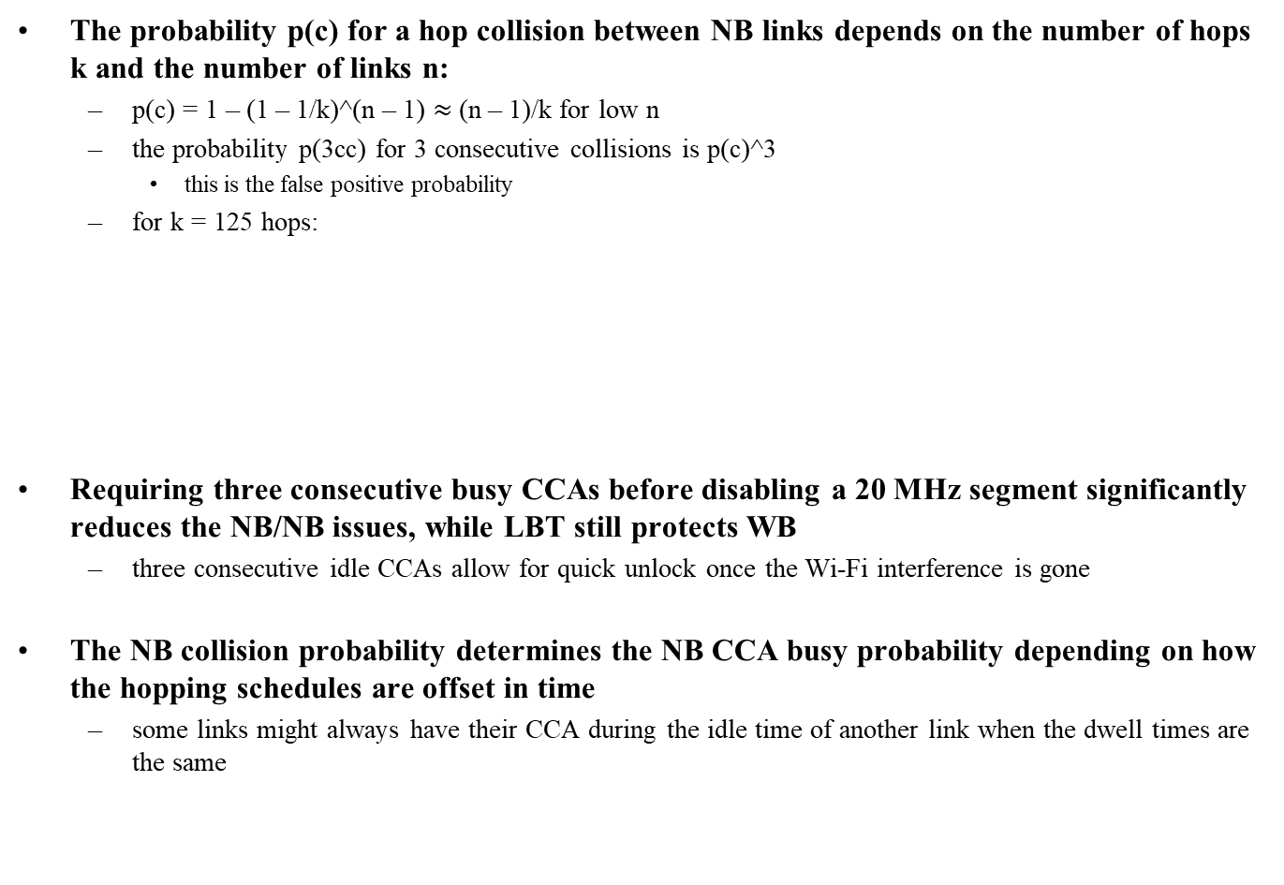
NB/NB collision probability
The probability p(c) for a hop collision between NB links depends on the number of hops k and the number of links n:
  p(c) = 1 – (1 – 1/k)^(n – 1) $≈$ (n – 1)/k for low n
  the probability p(3cc) for 3 consecutive collisions is p(c)^3
    this is the false positive probability
  for k = 125 hops:
Requiring three consecutive busy CCAs before disabling a 20 MHz segment significantly reduces the NB/NB issues, while LBT still protects WB
  three consecutive idle CCAs allow for quick unlock once the Wi-Fi interference is gone
The NB collision probability determines the NB CCA busy probability depending on how the hopping schedules are offset in time
  some links might always have their CCA during the idle time of another link when the dwell times are the same
# links (n) | 2 | 3 | 4 | 5 | 6 | 7
p(c) | 0.80% | 1.59% | 2.38% | 3.16% | 3.94% | 4.71%
p(3cc) | 0.00005% | 0.0004% | 0.0014% | 0.0032% | 0.0061% | 0.010%

Slide 47
References

Slide 48
References
NBFH
  BT SIG Bluetooth_Wifi_coex_LBTvsEDAA_intel_aug2023
  IEEE 11-23-1279-coex-00, IEEE Berlin, July 2023
  IEEE 11-23-0453-00-coex-nb-overview, IEEE Atlanta, March 2023
  IEEE 11-23-0877-00-coex-narrow-coex-studies, IEEE Orlando, May 2023
  IEEE 11-23-0454-00-coex-impact-of-bt-on-wlan-performance, IEEE Atlanta, March 2023
  IEEE 11-23-0455-00-coex-wi-fi-deferral-for-nb-signals, IEEE Atlanta, March 2023
  BRAN(21)109h004r2_EN_303_687_NB_Proposals_for_DAA_Optimisation
  BRAN(21)109h007_NB_coexistence_with_WB_in_6_GHz
  ETSI EN 300 328 (2.4 GHz)
  ETSI EN 301 893 (5 GHz)
  ETSI EN 303 687 (6 GHz)
NB-UWB
  15-21-0409-01-04ab-narrowband-assisted-multi-millisecond-uwb
  15-21-0593-00-04ab-more-on-nba-mms
  15-23-0119-00-04ab-coexistence
  15-22-0381-02-04ab-nba-uwb-ranging-text-proposal-for-15-4ab-tfd

