Slide 1
Operating Link Mismatch in EMLSR AP Operation
Date: 2023-09-11
Authors:

Slide 2
Abstract
EMLSR AP MLD operation was discussed in UHR SG [1, 2]
An AP MLD basically operates in a primary link
When the AP MLD detects OBSS transmission, it operates in a secondary link.
However, the discussed EMLSR AP operation needs further discussion especially when non-AP MLD’s and EMLSR AP MLD’s channel states are different.
Because of the difference of channel state between non-AP MLD and EMLSR AP MLD, non-AP MLD’s EDCA operation may not be properly performed
In this contribution, a multi-link channel access method for EMLSR AP MLD operation is discussed

Slide 3
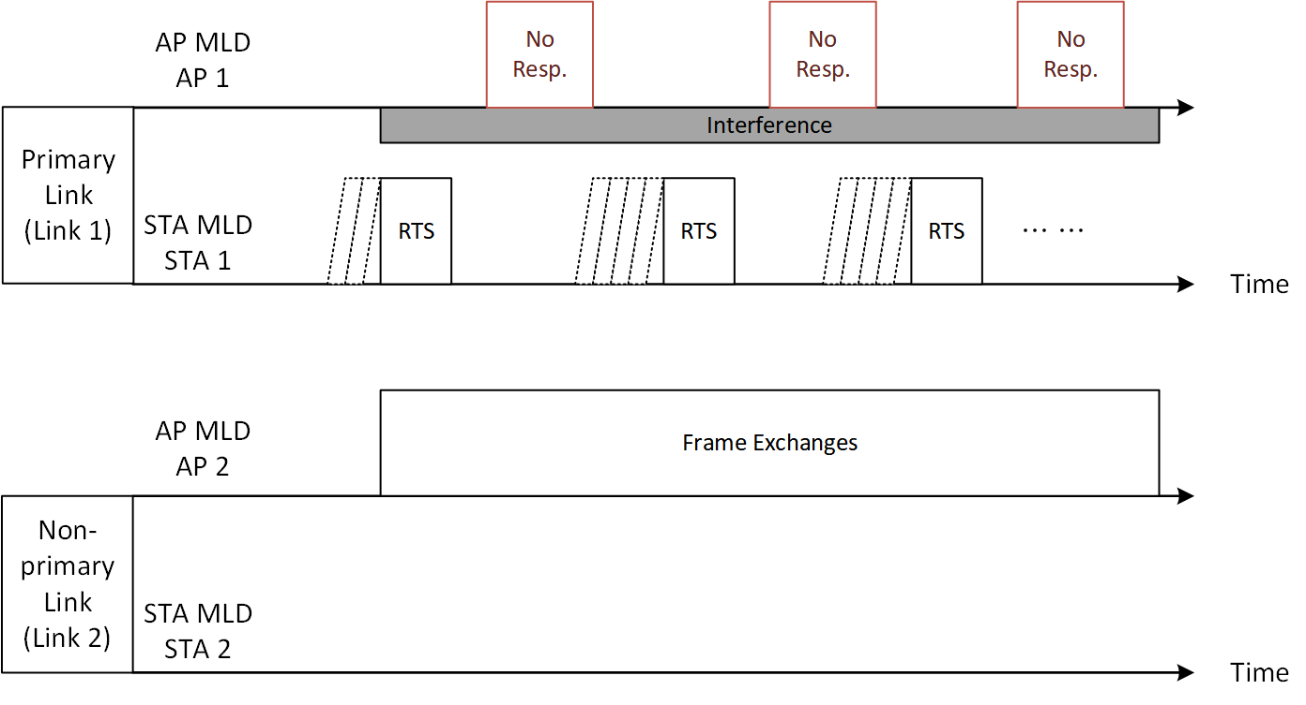
Issue
There might be a channel detection mismatch
For example, the EMLSR AP MLD may detect interference on link 1, whereas the non-AP MLD may not detect interference on link 1.
When the non-AP MLD transmits a frame to the AP MLD on link 1, the non-AP MLD cannot receive response from the AP MLD
The non-AP MLD cannot use non-primary link even though non-primary link is idle from the non-AP MLD point of view.
The non-AP MLD may try transmission repeatedly and it unnecessarily increases EDCA parameters due to transmission failure.
Non-primary channel operation for EMLSR AP is discussed in this contribution

Slide 4
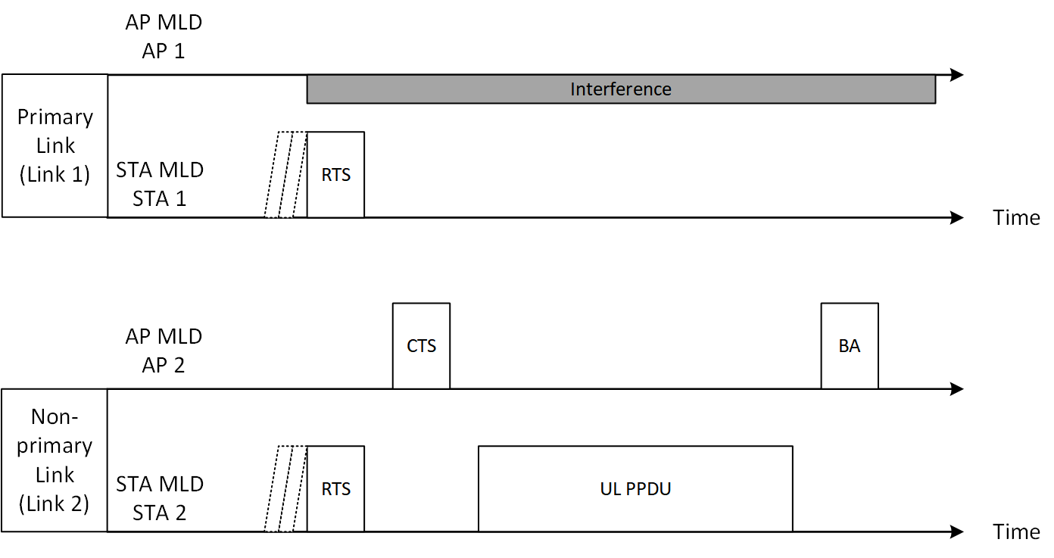
Synchronized Multi-Link RTS Transmission
In case of a MLMR non-AP MLD, the non-AP MLD may transmit RTS frames simultaneously in both primary link and non-primary link to the EMLSR AP MLD.
Unnecessary retransmission can be avoided in the link 1.
Successful reception of CTS in the non-primary link can be regarded as a success for the transmission attempt both in the primary link and the non-primary link.

Slide 5
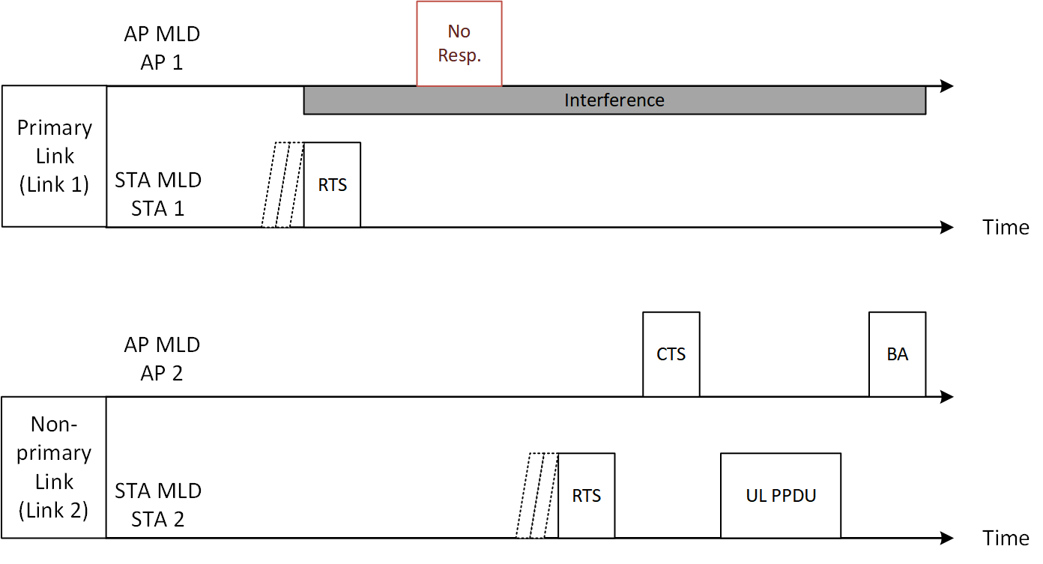
Sequential Multi-Link RTS Transmission
In case of a EMLSR / EMLMR / NSTR non-AP MLD, the non-AP MLD may transmit RTS frame sequentially on the primary link and the non-primary link when the non-AP MLD cannot receive CTS from the EMLSR AP MLD on the primary link.
Unnecessary retransmission can be avoided in the link 1
Successful reception of CTS for one of sequential RTS transmissions can be regarded as a success for the transmission attempt.

Slide 6
Summary
In this contribution, non-primary channel access methods for EMLSR AP MLD are discussed.
1. Simultaneous RTS polling method
2. Sequential RTS polling method
With the methods, the channel state mismatch issue can be alleviated and bandwidth efficiency in EMLSR AP MLD operation can be improved.

Slide 7
References
[1] 11-22/2203r0: EMLSR AP/mobile AP operation https://mentor.ieee.org/802.11/dcn/22/11-22-2203-00-0uhr-emlsr-ap-mobile-ap-operation.pptx
[2] 11-23/0016r0: Sigle Radio MLD, https://mentor.ieee.org/802.11/dcn/23/11-23-0016-00-0uhr-single-radio-mld.pptx

