Slide 1
IEEE 802.11 and Bluetooth Coexistence Simulations
Date: 2023-09-13
Authors:

Slide 2
Introduction
Multiple contributions on coexistence of
Listen-Before-Talk (LBT) based wideband (“Wi-Fi”)
with
Narrow-Band Frequency Hopping (NBFH) (“Bluetooth” or “BLE”)
in the same spectrum (5.945 GHz to 6.425 GHz)
  IEEE 802.11-23/0453:
    eDAA claimed to be inadequate
    LBT (for NBFH) appears to work quite well
  IEEE 802.11-23/0877:
    NBFH with eDAA can co-exist with Wi-Fi without LBT
Contributions are based on simulations
  What are the underlying assumptions / models?
  What is the impact of changing the assumptions on the results?
  Which assumptions are realistic / need to be considered?

Slide 3
Assumption 1: Spectrum Usage / Channelization
Wi-Fi
3 ⨯ 160MHz channels (channel number 15, 47, 79)
  Primary-20 always the first 20MHz
Bluetooth
1 MHz channels with 0.5MHz guard band left & right
  Maximum 480MHz ÷ 2MHz = 240 channels
  3 advertising channels (0, 79, 159)
  233 data channels (highest prime number below 237)
  Center frequency of channel 0 at 5.947MHz
Each connection selects its frequency hopping size randomly between 44 and 94
  Scaled up from 2.4GHz operation (37 channels, hopping size 7 to 15)

Slide 4
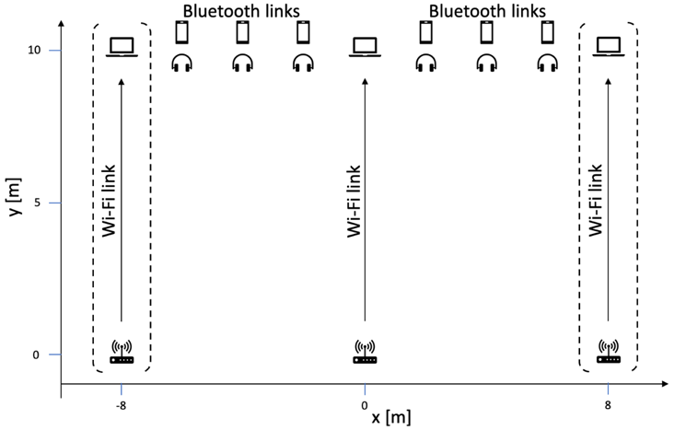
Assumption 2: Scenario
Six Bluetooth links
  Constant bitrate traffic
  320B/20ms (≙128kb/s) 640B/20ms (≙256kb/s)
  1280/20ms (≙512kb/s) KPI: Packet delay
1, 2, or 3 Wi-Fi links
  Infinite number of 10 MB file downloads via FTP
  ~3 s start delay
  KPI: File download delay
Channel model
  AWGN with
  Line-of-Sight for d < 5 m
  (pathloss coefficient 2.0),
  Non-Line-of-Sight for d > 5 m (3.5)

Slide 5
Assumption 3: Capabilities
Wi-Fi
Bluetooth
1 ⨯, 2 ⨯, or 3 ⨯ non-overlapping 160MHz channels
23dBm transmit power
Receiver Noise Figure 6dB
LBT: Energy detection threshold −71dBm/20MHz according to
EN 303 687
Optional: Puncturing of 20 MHz channels
233 data channels + 3 advertising channels
10dBm transmit power
Receiver Noise Figure 8dB
10ms connection interval between connection events
1 Mb/s PHY
Optional: enhanced Detect-And-Avoid (eDAA)
Optional: LBT before connection event

Slide 6
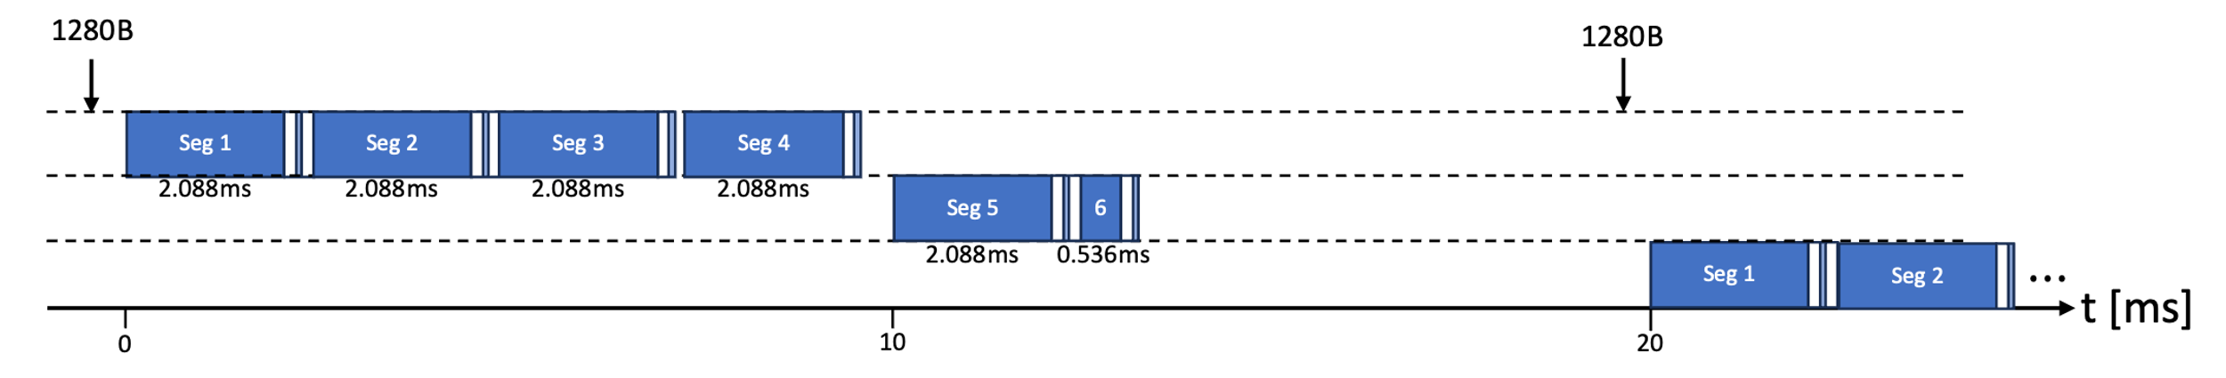
Scenario Impact: Bluetooth Load
320B payload every 20ms:
  Two segments fit into one connection event
  Every other connection event remains idle
  ~16 % channel usage
1280B payload every 20ms:
  Five segments, require two connection events
  ~57 % channel usage
Saturation at ~1600B/20ms
  Idle time required to handle retransmissions
  Build-up of transmit queues, unusable delay values

Slide 7
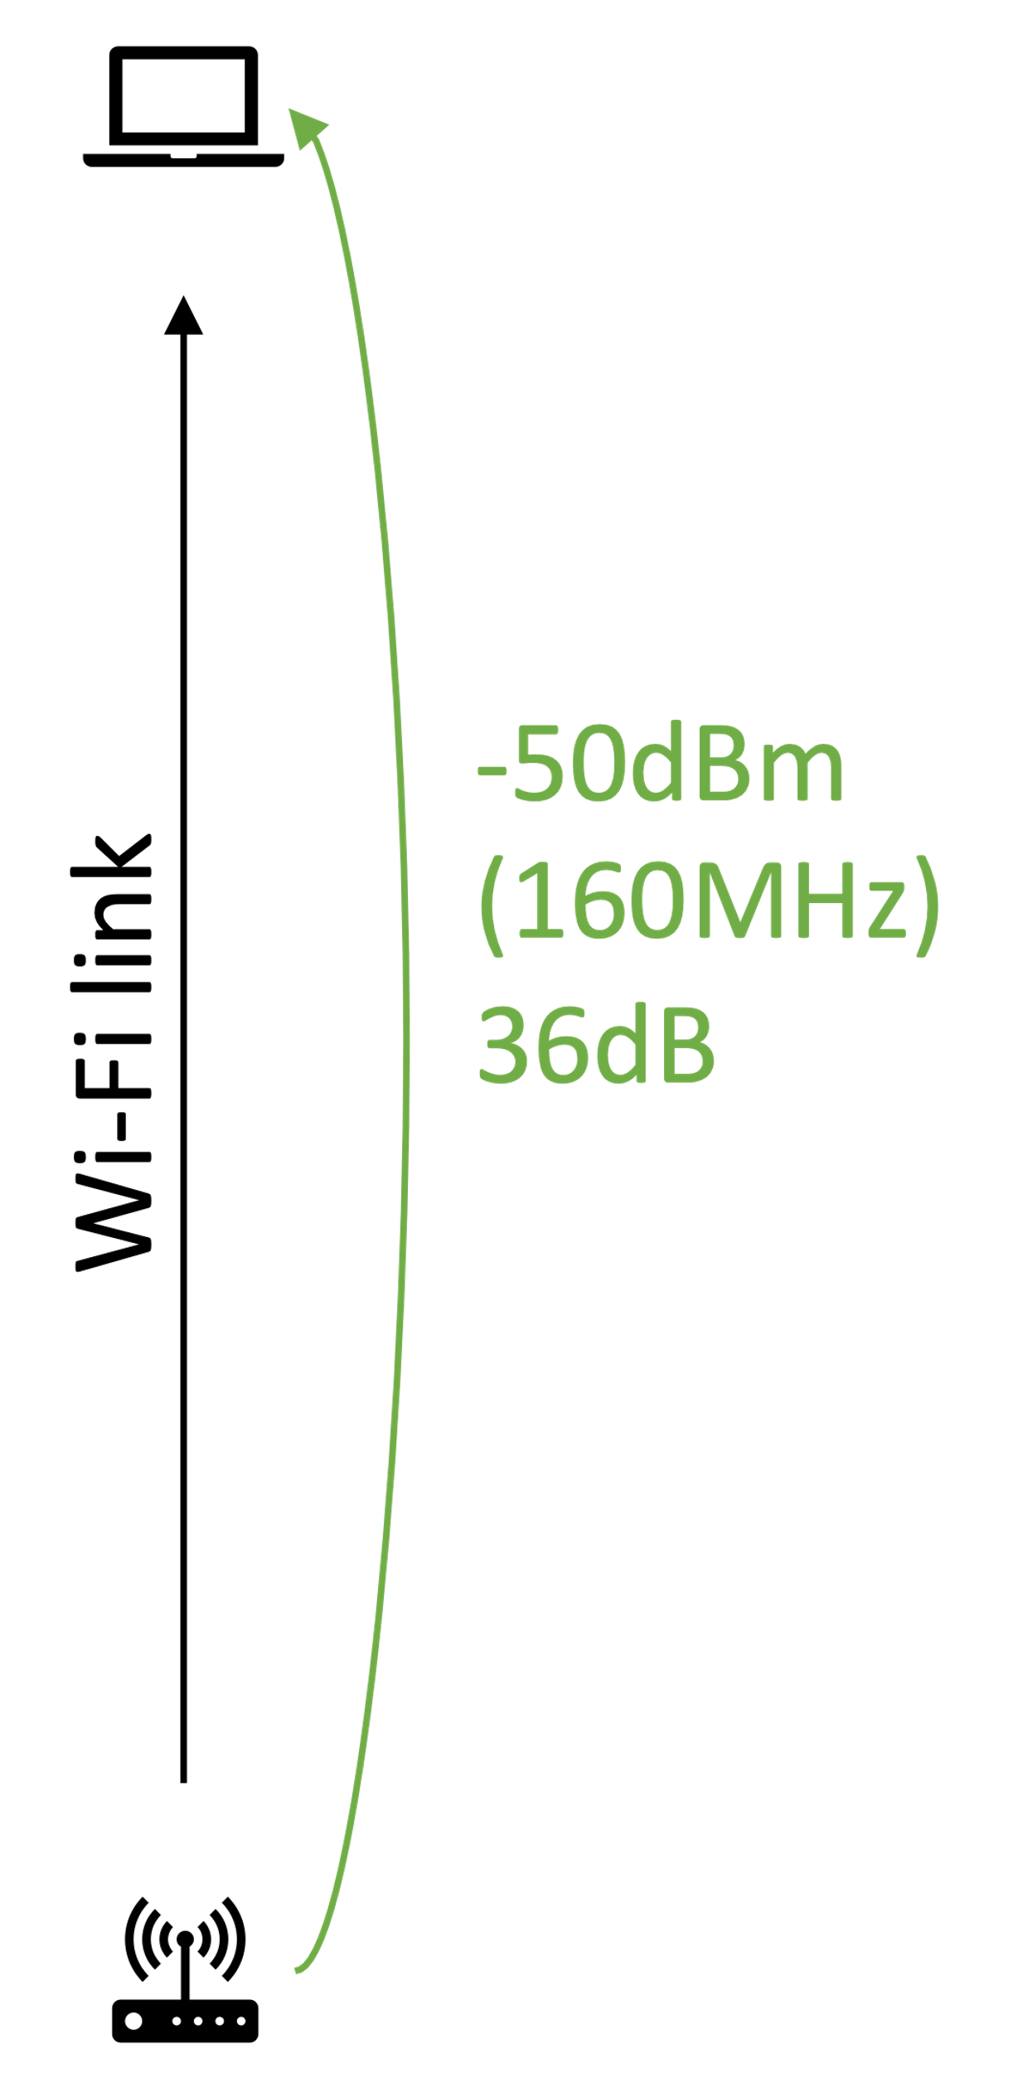
Scenario Impact: Channel Conditions
Static & deterministic channel model
  Received power only depends on frequency and distance
Allows calculation of possible channel conditions
Without interference:
  Wi-Fi has perfect conditions
  Bluetooth has perfect conditions

Slide 8
Scenario Impact: Channel Conditions
Wi-Fi interfered by Bluetooth
Bluetooth interfered by Wi-Fi
Interference triggers ED at STA & AP
Very strong interference at STA
  -49.5dBm received signal power vs.
  -44dBm received interference power
  SINR = −27 dB
  (on 1 MHz)
Impact depends on Packet error model
Slightly interfered
  Interference is spread over 160 MHz
  Large distance to AP
Interfered by AP: SINR = 33dB
Interfered by STA:
SINR = 15dB
Essentially no impact

Slide 9
Assumption 4.1: Wi-Fi Packet Error Model
average MI
= 159 ∕ 160 × MI(36dB) + 1 ∕ 160 × MI(-27dB)
= 159 ∕ 160 × 10b + 1 ∕ 160 × 0b
= 9.93b
⇒ OK
(strong narrow-band interference is averaged out)
PER Model A
(average Mutual Information,
according to 11ax evaluation methodology PHY abstraction
“optimistic”)
MI(C/I)
= MI( -71dBm/MHz × 160MHz –
-44dBm/MHz × 1MHz )
= MI (-49dBm – -44dBm)
= MI(-5dB)
= 0b
⇒ Failed
(strong narrow-band interference dominates the packet error probability)
PER Model B
(Mutual Information of C/I
“pessimistic”)

Slide 10
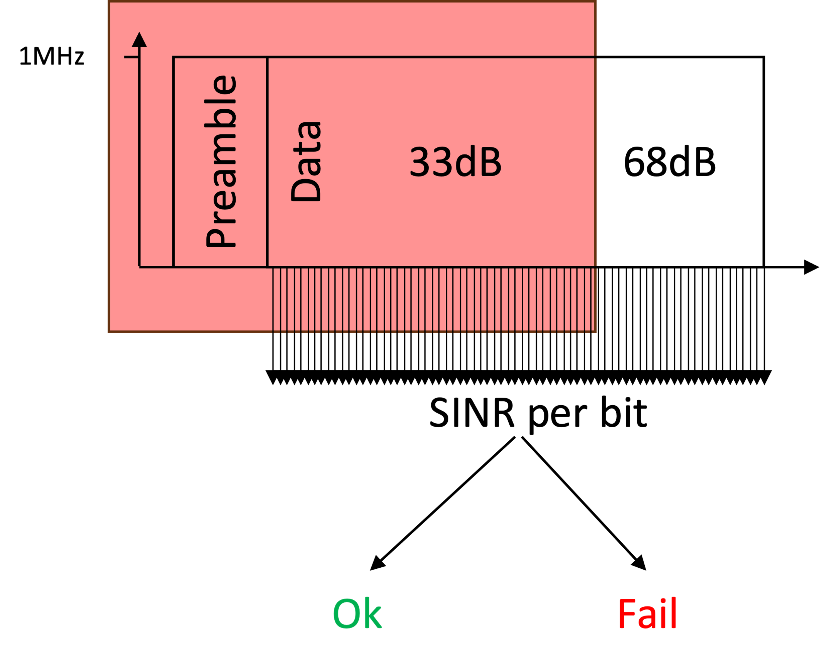
Assumption 4.2: Bluetooth Packet Error Model
For every reception
  Calculate SINR for every bit
  Map SINR to bit error rate
  Random number draw per bit
  Decision on success/failed reception

Slide 11
Coexistence mechanisms

Slide 12
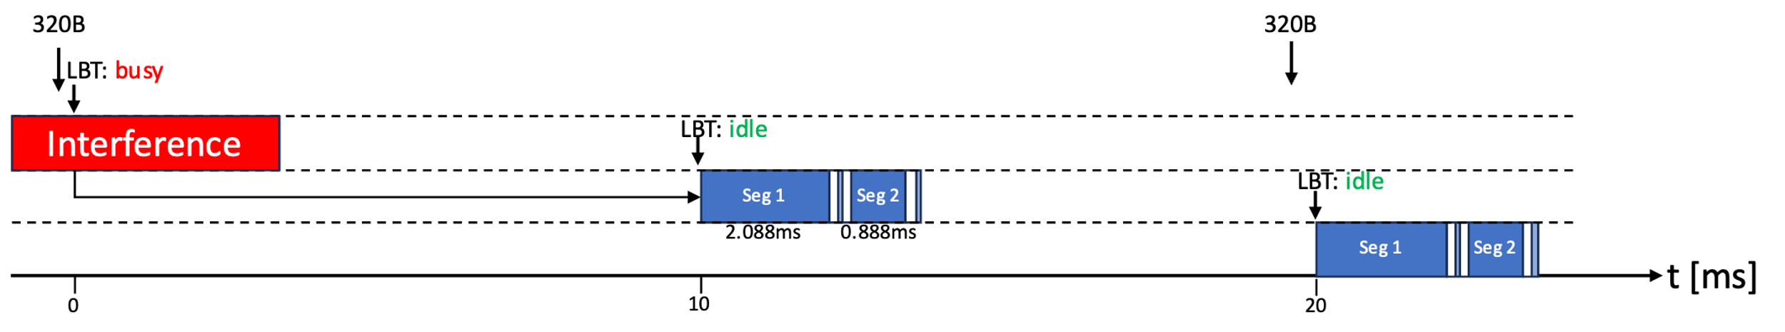
Bluetooth: LBT before Connection Event (CE-LBT)
Sense current channel before every connection event
  Idle: transmit
  Busy: defer until next connection event

Slide 13
Bluetooth: eDAA combined with CE-LBT
CE-LBT detects channel as busy
  Defer transmission to the next connection event
  Block channel and all channels belonging to the corresponding 20MHz block from future use
  Special case: if channel is centered between two 20MHz blocks, then block all channels belonging to the right and left block
Same procedure for two consecutive CRC failures within a connection event
At least 15 unblocked channels remain

Slide 14
Wi-Fi: Puncturing
LBT without Puncturing
LBT with Puncturing
AIFS / Backoff countdown starts on primary 20MHz only
Energy Detection (ED) on all channels begins 25µs before each transmission
Only transmit if all sub-channels are idle
Puncturing allows 20MHz “holes” in the spectrum
Primary 20MHz must be idle
Assumption: puncturing is fully dynamic and flexible concerning which 20MHz is punctured

Slide 15
Results

Slide 16
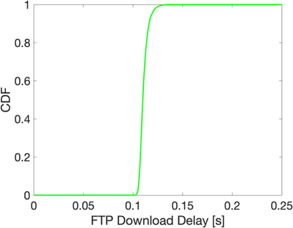
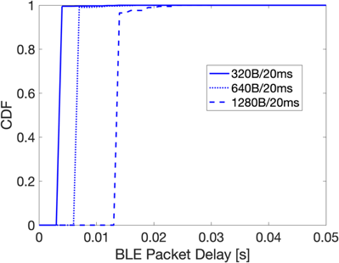
No Interference
Wi-Fi
FTP download delay slightly higher than 100ms
Bluetooth
Packet delay depends on size and if fragments fit into one connection event
Small chance of collisions of the six links

Slide 17
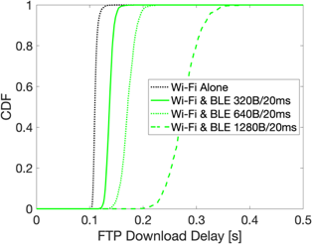
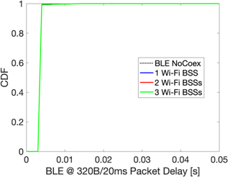
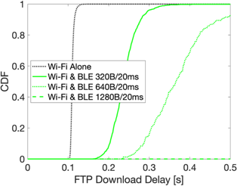
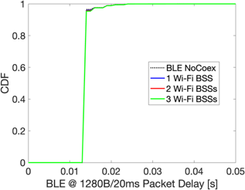
Baseline: No Coexistence Mechanisms
Optimistic PER Model
320B / 20ms load
⇐ Wi-Fi
High impact of Bluetooth interference
  Depending on Bluetooth load
Optimistic PER model: impact only due to LBT
Pessimistic PER model: impact due to LBT (interference first) and packet errors (interference second)
  Approx. factor 2 delay for 320B/20ms, unusable for 1280B/20ms
Bluetooth ⇒
No impact of Wi-Fi interference on packet delay
Pessimistic PER Model
1280B / 20ms load

Slide 18
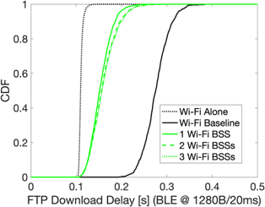
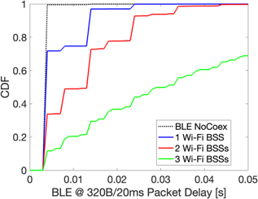
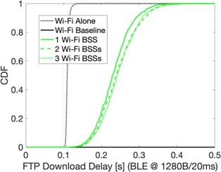
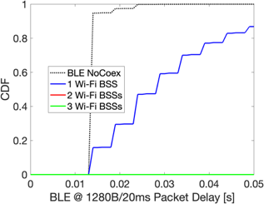
Coexistence 1: Bluetooth with CE-LBT (but no eDAA)
Optimistic PER Model
320B / 20ms load
⇐ Wi-Fi
(only for 1280B Bluetooth packets)
Significant improvement vs. Bluetooth without LBT
Bluetooth ⇒
Introduction of delay steps due to missed Connection Events (CEs)
Reduction of capacity leads to oversaturation case for many BSSs or large packet size
Pessimistic PER Model
1280B / 20ms load

Slide 19
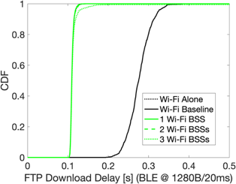
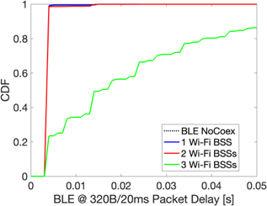
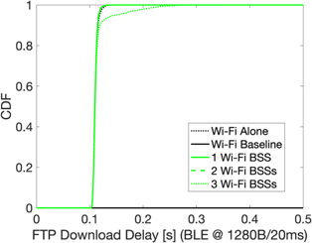
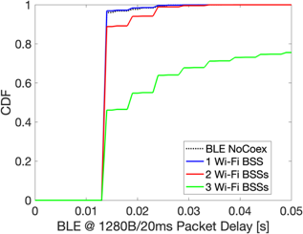
Coexistence 2: Bluetooth with CE-LBT and eDAA
Optimistic PER Model
320B / 20ms load
⇐ Wi-Fi
(only for 1280 B Bluetooth packets)
Bluetooth has essentially no impact on Wi-Fi
Bluetooth ⇒
One or two BSS, i.e., at least 160 MHz idle: Good coexistence
Three BSS: Links fail to find idle channels, oversaturation case even for 320B per 20ms
Pessimistic PER Model
1280B / 20ms load

Slide 20

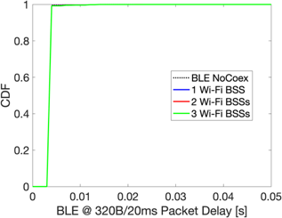
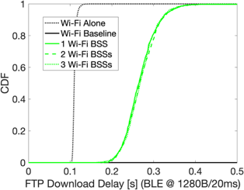

Coexistence 3: Wi-Fi with Puncturing
Optimistic PER Model
320B / 20ms load
⇐ Wi-Fi
(only for 1280 B Bluetooth packets)
Significant improvement over no coex mechanism
Channel access delay is reduced to interference-free case, only packet errors remain
Bluetooth ⇒
Same results as in no interference case
Pessimistic PER Model
1280B / 20ms load

Slide 21
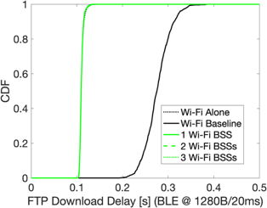
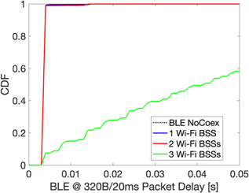
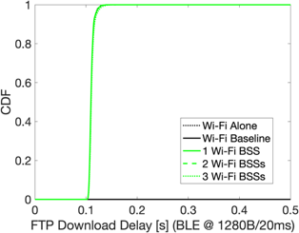
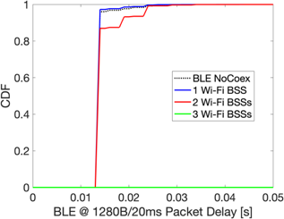
Coexistence 4: Wi-Fi with Puncturing,
Bluetooth with CE-LBT & eDAA
Optimistic PER Model
320B / 20ms load
⇐ Wi-Fi
(only for 1280B Bluetooth packets)
Significant improvement over no coex mechanism
Channel access delay is reduced to interference-free case, only packet errors remain
Bluetooth ⇒
Same results as if Wi-Fi does not puncture
Pessimistic PER Model
1280B / 20ms load

Slide 22
Conclusions
Wi-Fi interfered by Bluetooth
Increased channel access delay due to LBT
  Counteracted by puncturing
May increase packet errors due to strong, narrow-band interference
  Is it possible to enhance resilience if only 1MHz of 160MHz is interfered?
Bluetooth interfered by Wi-Fi
Robust against wideband interference (in this scenario)
Introduction of CE-LBT (together with eDAA)
  may increase delays and
  may suppress connections, depending on Wi-Fi channel usage

Slide 23
Assumption 2B: Scenario B
Decrease Bluetooth transmit power to 0dBm
  Less signal strength at headsets
Increase Bluetooth device distance to 2m
  More pathloss
Move Bluetooth links to the center between the Wi-Fi links
  More interference by the downlink-heavy Wi-Fi traffic

Slide 24
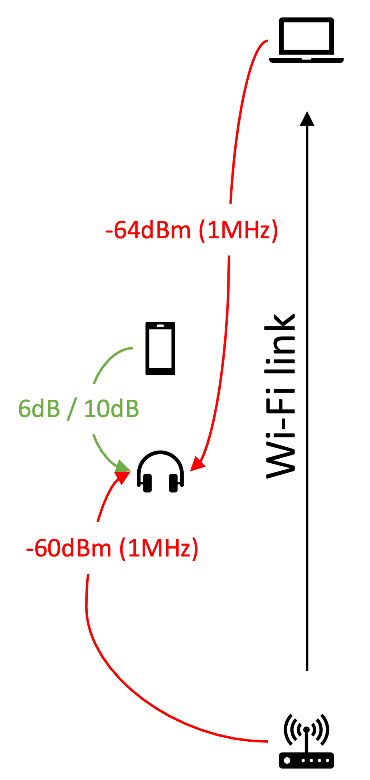
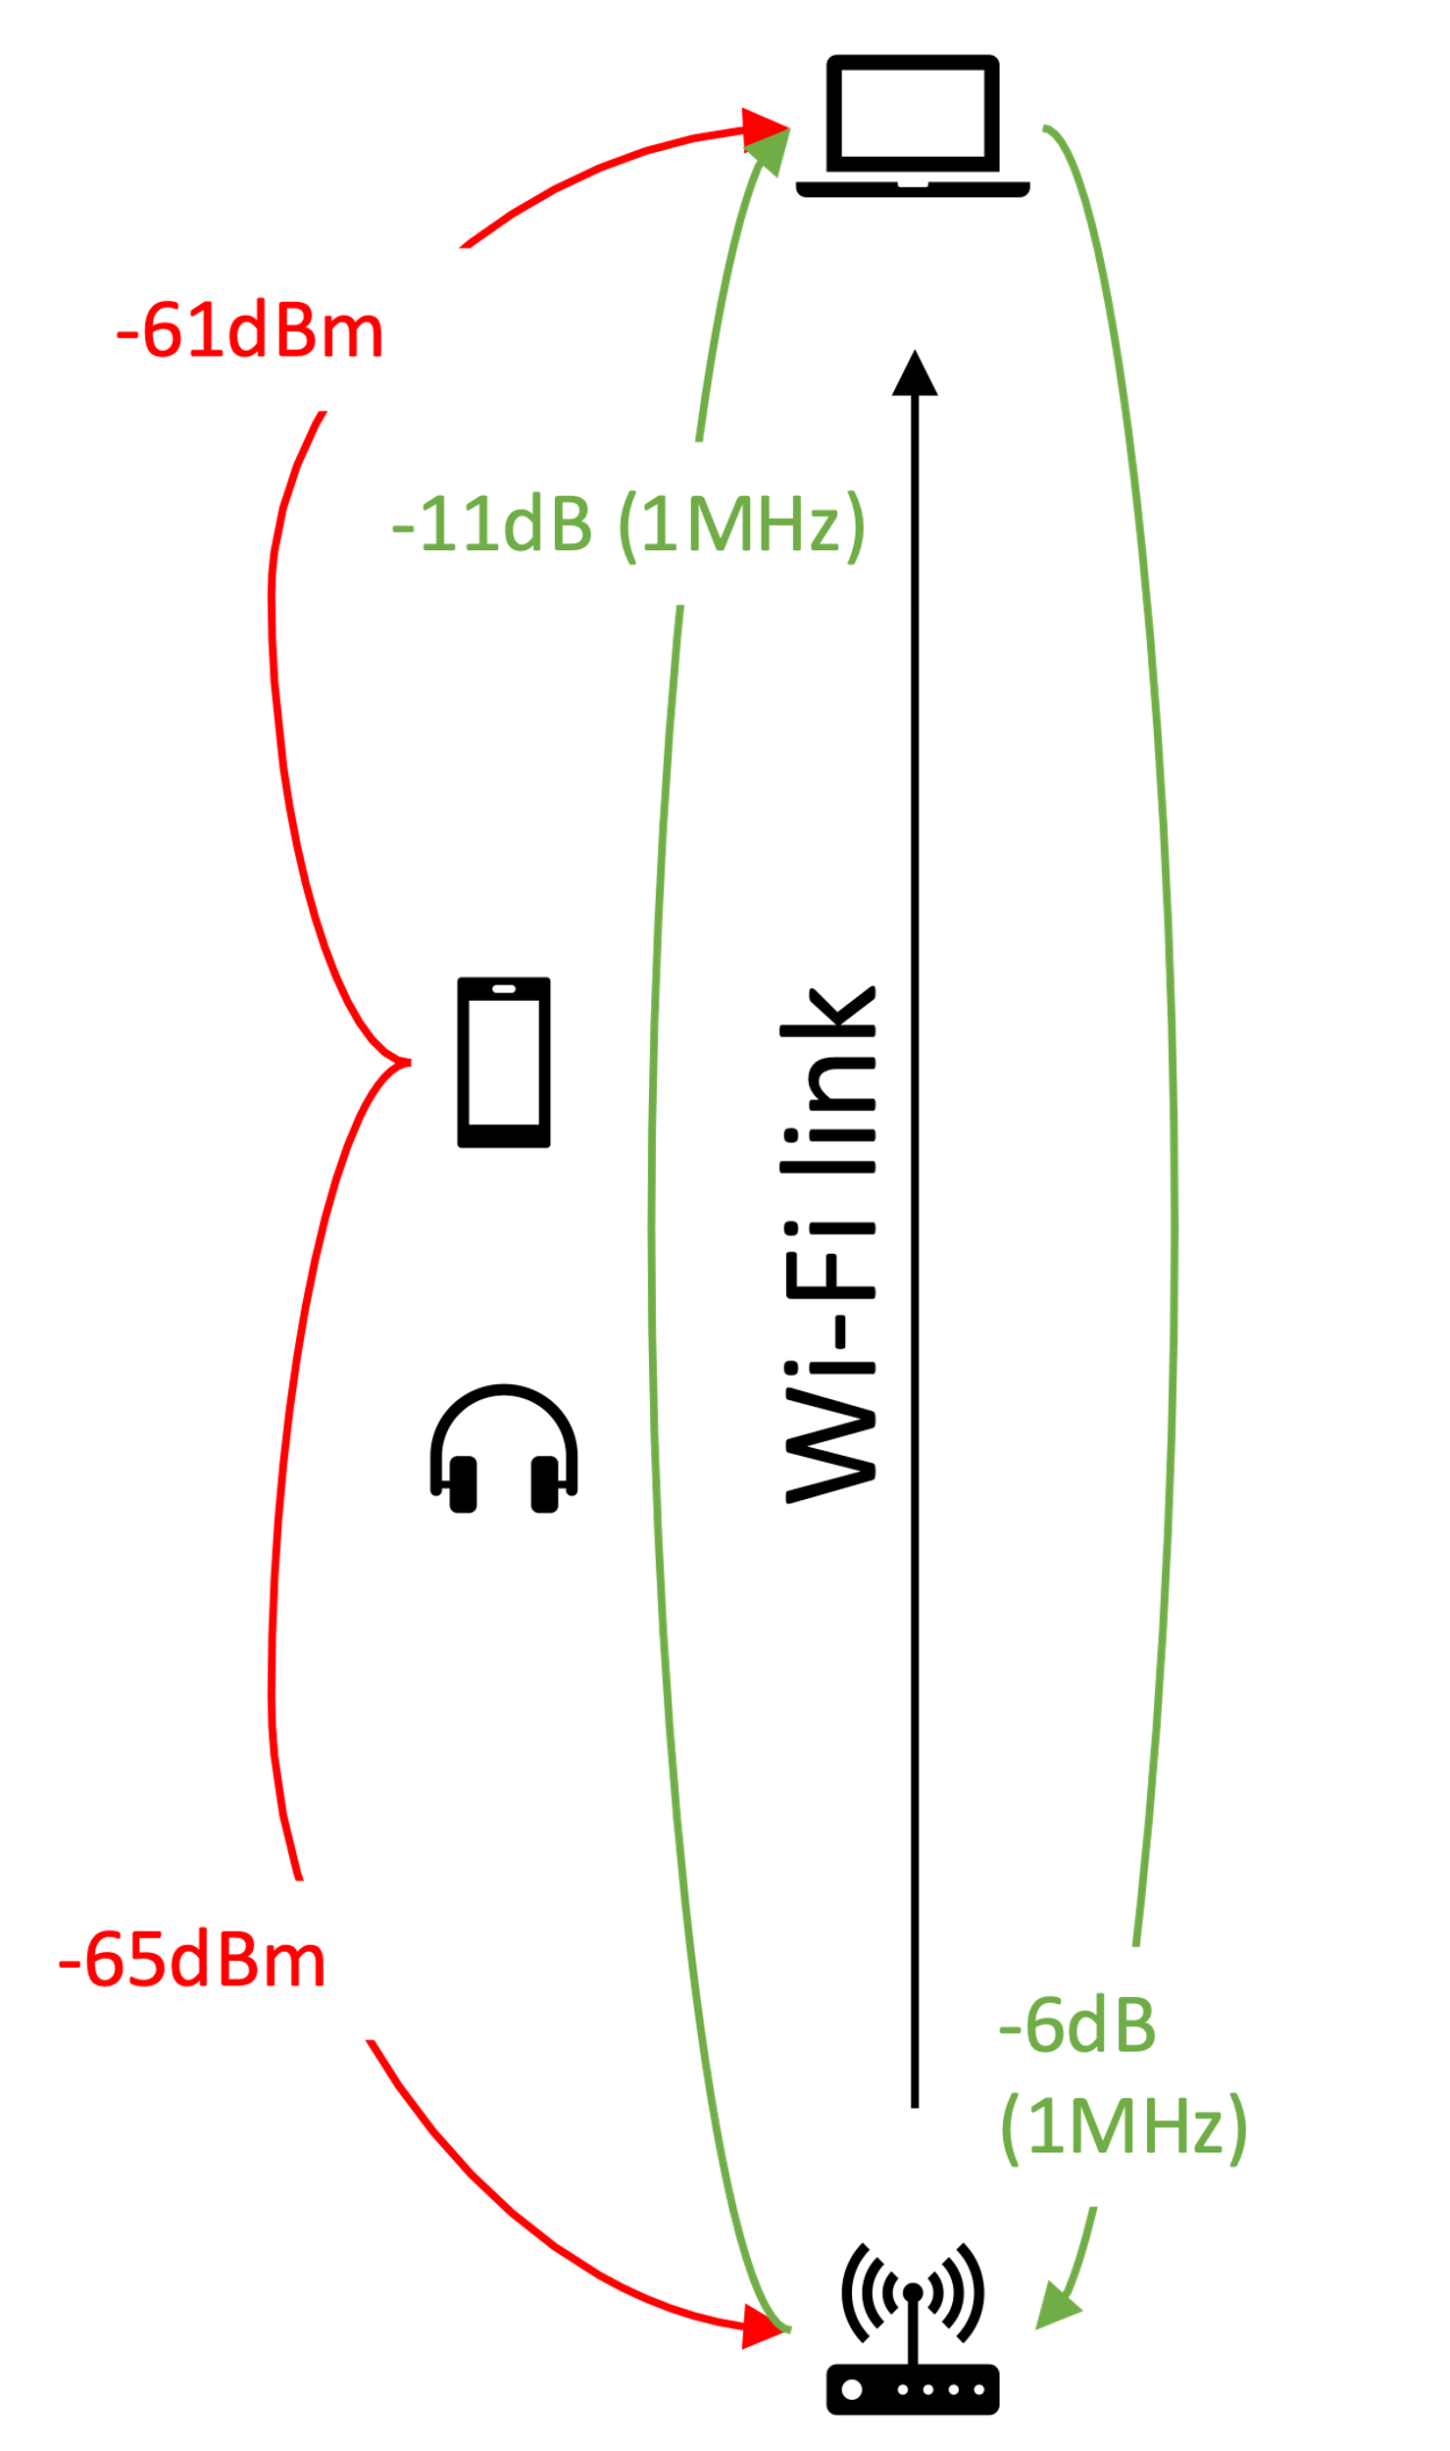
Scenario B Impact: Channel Conditions
Wi-Fi interfered by Bluetooth
Bluetooth interfered by Wi-Fi
Interference still triggers ED at STA & AP
Less (but still significant) interference at STA
  C/I = 11dB
  SNR = −11dB
  (on 1MHz)
Strong interference
  SNR from 52dB down to 6dB if AP is transmitting

Slide 25
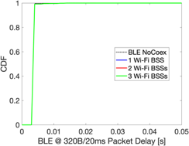

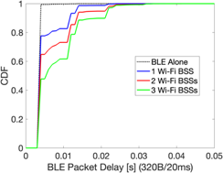
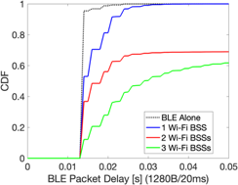
Scenario B Impact:
Baseline / No Coexistence Mechanisms
Scenario A
Scenario B
Increased packet delay for Bluetooth due to packet errors and retransmissions in the next connection event
Slightly higher delay for Wi-Fi due to increased Bluetooth interference

Slide 26
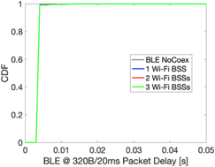
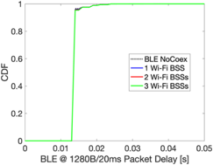
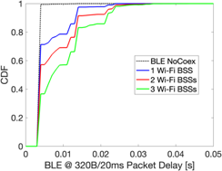
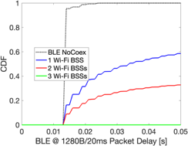
Scenario B Impact:
Wi-Fi with Puncturing
Scenario A
Scenario B
Increased packet delay for Bluetooth due to higher interference power in non-punctured channels
Wi-Fi delay slightly better than in Scenario A – less interference power from Bluetooth due to larger distance

Slide 27
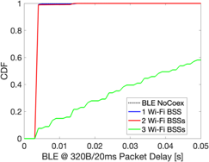

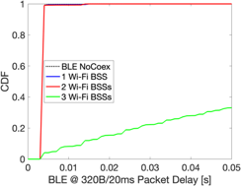
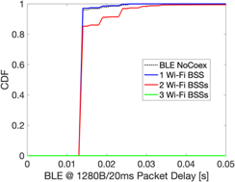
Scenario B Impact:
Wi-Fi with puncturing, Bluetooth with CE-LBT & eDAA
Scenario A
Scenario B
Bluetooth results are slightly worse than in Scenario A
Wi-Fi completely recovers, similar as in Scenario A

Slide 28
Conclusions (ii)
Wi-Fi interfered by Bluetooth
Increased channel access delay due to LBT
  Counteracted by puncturing
May increase packet errors due to strong, narrow-band interference
  Is it possible to enhance resilience if only 1MHz of 160MHz is interfered?
Bluetooth interfered by Wi-Fi
Introduction of CE-LBT (together with eDAA)
(i) reduces packet error rate caused by interference,
(ii) may increase delays and
(iii) may suppress connections, depending on Wi-Fi channel usage
Bluetooth requires some form of CE-LBT to reduce interference impact
The assumed approach is too sensitive – Bluetooth may be completely suppressed by Wi-Fi
Wi-Fi with puncturing eliminates the LBT access delay resulting from narrow-band interference

Slide 29
Appendix: All Simulation Results

Slide 30
Baseline: No Coex mechanisms

Slide 31
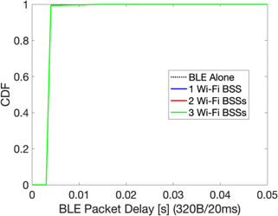

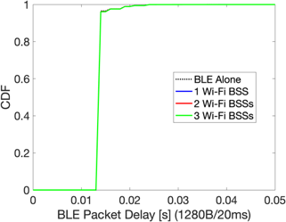
Scenario A, optimistic PER model

Slide 32
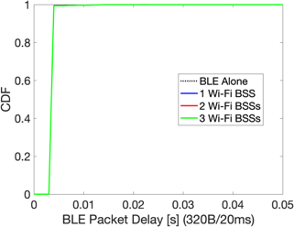
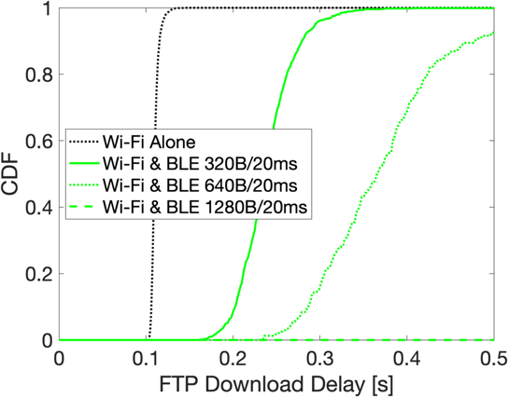

Scenario A, pessimistic PER model

Slide 33

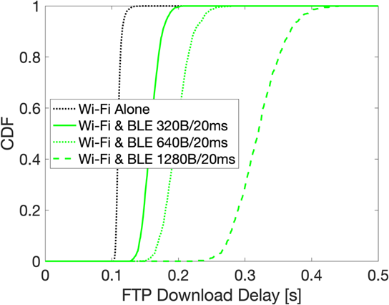
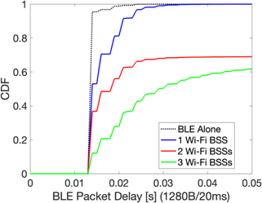
Scenario B, optimistic PER model

Slide 34

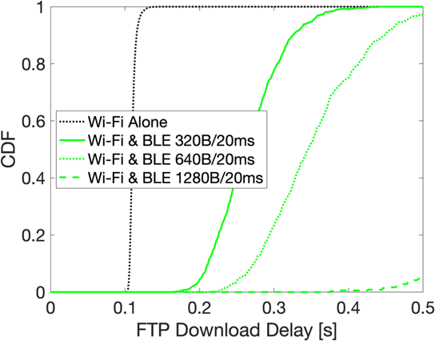
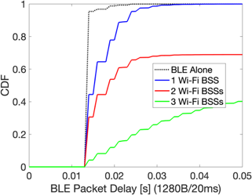
Scenario B, pessimistic PER model

Slide 35
Coex: BLE with LBT

Slide 36
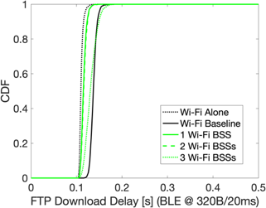
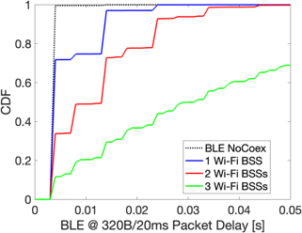
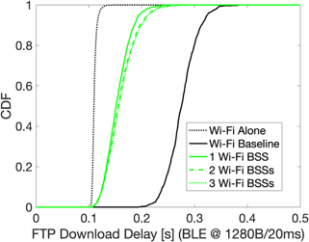
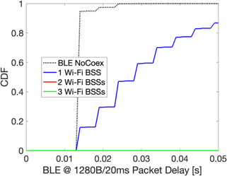
Scenario A, optimistic PER model

Slide 37
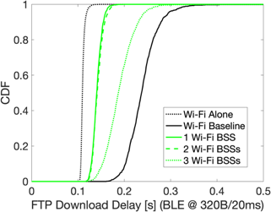



Scenario A, pessimistic PER model

Slide 38




Scenario B, optimistic PER model

Slide 39




Scenario B, pessimistic PER model

Slide 40
Coex: BLE with LBT & eDAA

Slide 41




Scenario A, optimistic PER model

Slide 42




Scenario A, pessimistic PER model

Slide 43




Scenario B, optimistic PER model

Slide 44




Scenario B, pessimistic PER model

Slide 45
Coex: Wi-Fi Dynamically Punctures Occupied 20 MHz

Slide 46




Scenario A, optimistic PER model

Slide 47




Scenario A, pessimistic PER model

Slide 48




Scenario B, optimistic PER model

Slide 49




Scenario B, pessimistic PER model

Slide 50
Coex: Wi-Fi Dynamically Punctures Occupied 20 MHz, BLE with LBT & eDAA

Slide 51




Scenario A, optimistic PER model

Slide 52




Scenario A, pessimistic PER model

Slide 53




Scenario B, optimistic PER model

Slide 54




Scenario B, pessimistic PER model

