Slide 1
Neural Network Quantization for Overhead Reduction in AIML Model Sharing
Date: 2023-05-15

Slide 2
Introduction
A use case for AIML model sharing has been defined in [1].
AIML model sharing is the most significant standard impact and its technical feasibility needs to be well discussed [2].
It been has discussed in [2] how to share AIML model parameters between STAs.
Neural network model is a key category of AIML models under discussion in AIML TIG [3]-[5]
In this contribution, we discussed what parameters can be shared for neural network based AIML model.

Slide 3
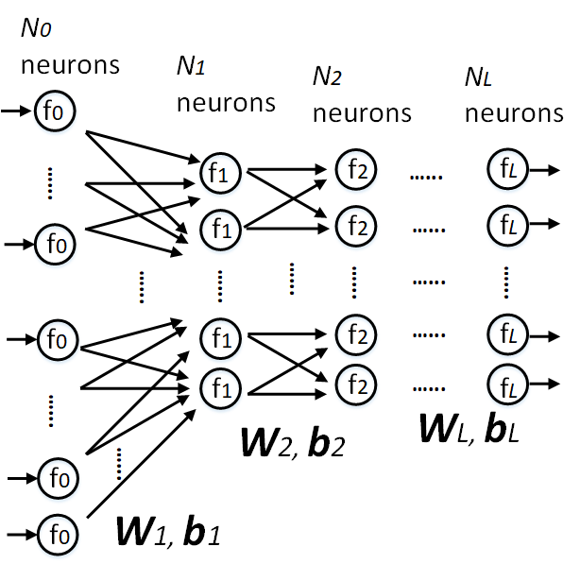
Neural Network Model Sharing
A feedforward neural network:
Training is performed at a STA
The STA may need to send the weighting and bias coefficients (W, b) to other STAs
The format of the coefficients is usually in single-precision floating-point (32-bits), thus requires a lots of communication overhead, especially for large models
$$s_{l}=W_{l}f_{l−1}\left(s_{l−1}\right)+b_{l}, l∈\left[1,L\right]$$

Slide 4
Neural Network Quantization for AIML Model Sharing
Neural network quantization is a well-known AI technique to reduce computational complexity and storage requirement [6], we propose to use the technique for communication overhead reduction for AIML model sharing.

Slide 5
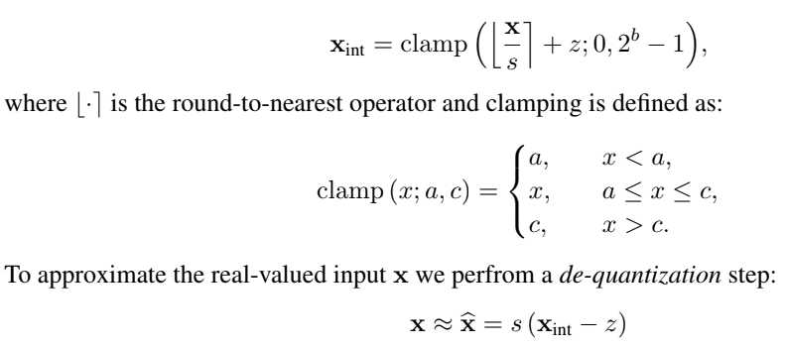
Fundamentals of Neural Network Quantization
x: a single-precision floating point coefficient to be quantized
xint: quantized integer from x
b: bit width of xint (<32)
s: scaling factor
z: zero-point
STAs share xint, s and z after quantization, stead of share x

Slide 6
Categories of Neural Network Quantization
Post-training quantization
Very effective and fast to implement because they do not require retraining of the network with labelled data.
May not be enough to mitigate the large quantization error incurred by low-bit quantization.
Quantization-aware training
Aiming for low-bit quantization, such as 4-bits and below.

Slide 7
Summary
We propose to use neural network quantization for communication overhead reduction for AIML model sharing

Slide 8
Question
By considering existing use case for “AIML Model Sharing” in [1], do you think this contribution should be considered as a separate use case for AIML TIG or merged into [1]?

Slide 9
References
[1] 11-23/0050r3, Proposed Technical Report Text for AIML Model Sharing Use case
[2] 11-23/0397r1, Technical Feasibility Analysis of ML Model Sharing
[3] 11-22/1934r5 Proposed IEEE 802.11 AIML TIG Technical Report Text for the CSI Compression Use Case
[4] 11-23/0290r1, Study on AI CSI Compression
[5] 11-23/0755r0, AIML Assisted Complexity Reduction For Beamforming CSI Feedback Using Autoencoder
[6] M. Nagel, et al., “A White Paper on Neural Network Quantization”, Qualcomm AI Research, Jun. 2021.

