Slide 1
Info related to 802.11bf Ad-hoc meeting in Lund, Sweden, July 2023
Date: 2023-06-26
Authors:

Slide 2
Contents
Lund
Traveling to Lund and traveling in Lund
Where to stay
Ericsson’s office – How to find the meeting location

Slide 3
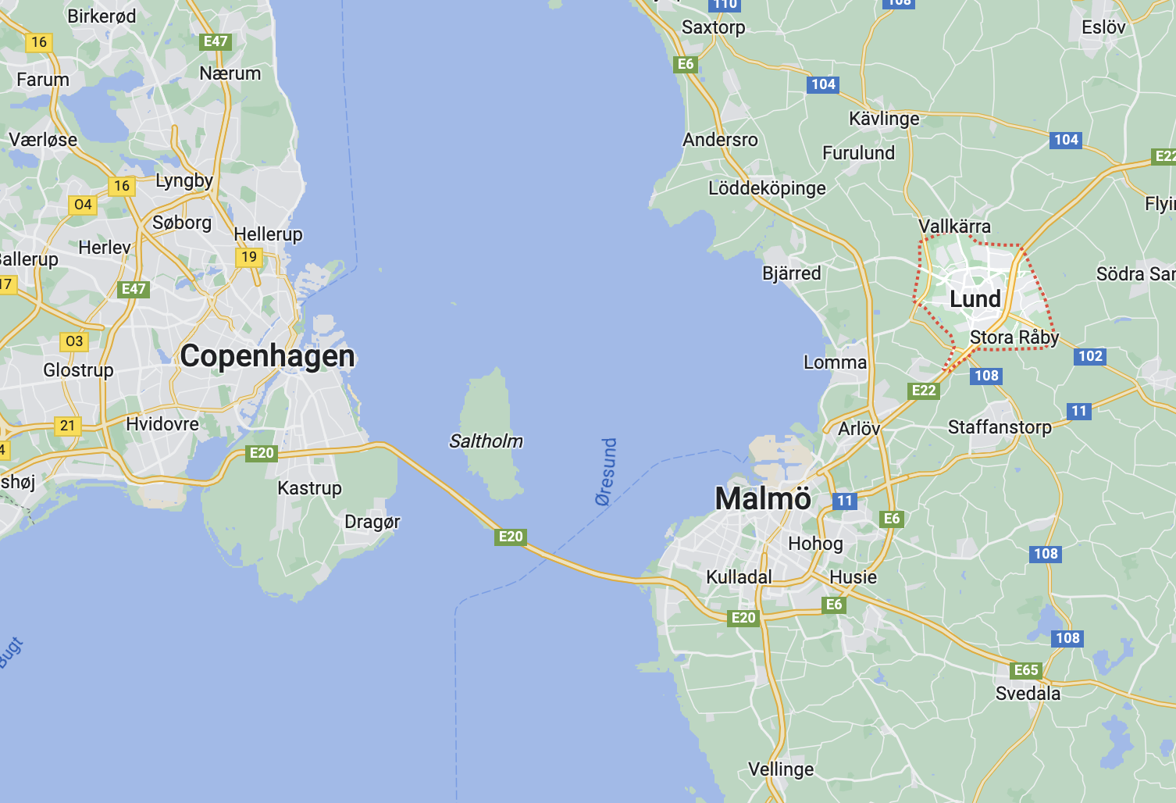
Lund
Lund is a small town more than 1000 years old with about 100 000 people
Located 20 km from Malmö, the third largest city in Sweden
Lund University has about 40 000 students
Many go by bike or walk to their destinations, or use the tram

Slide 4
Traveling to/from Lund
The closest major airport is Copenhagen Airport (CPH), about 50km from Lund
Train from CPH to Lund takes 40 minutes
Leaves every 20 minutes (except during some hours at night)
Costs 15 USD one-way
When going to Berlin, the simplest way is to fly from CPH, first taking the train from Lund to CPH

Slide 5
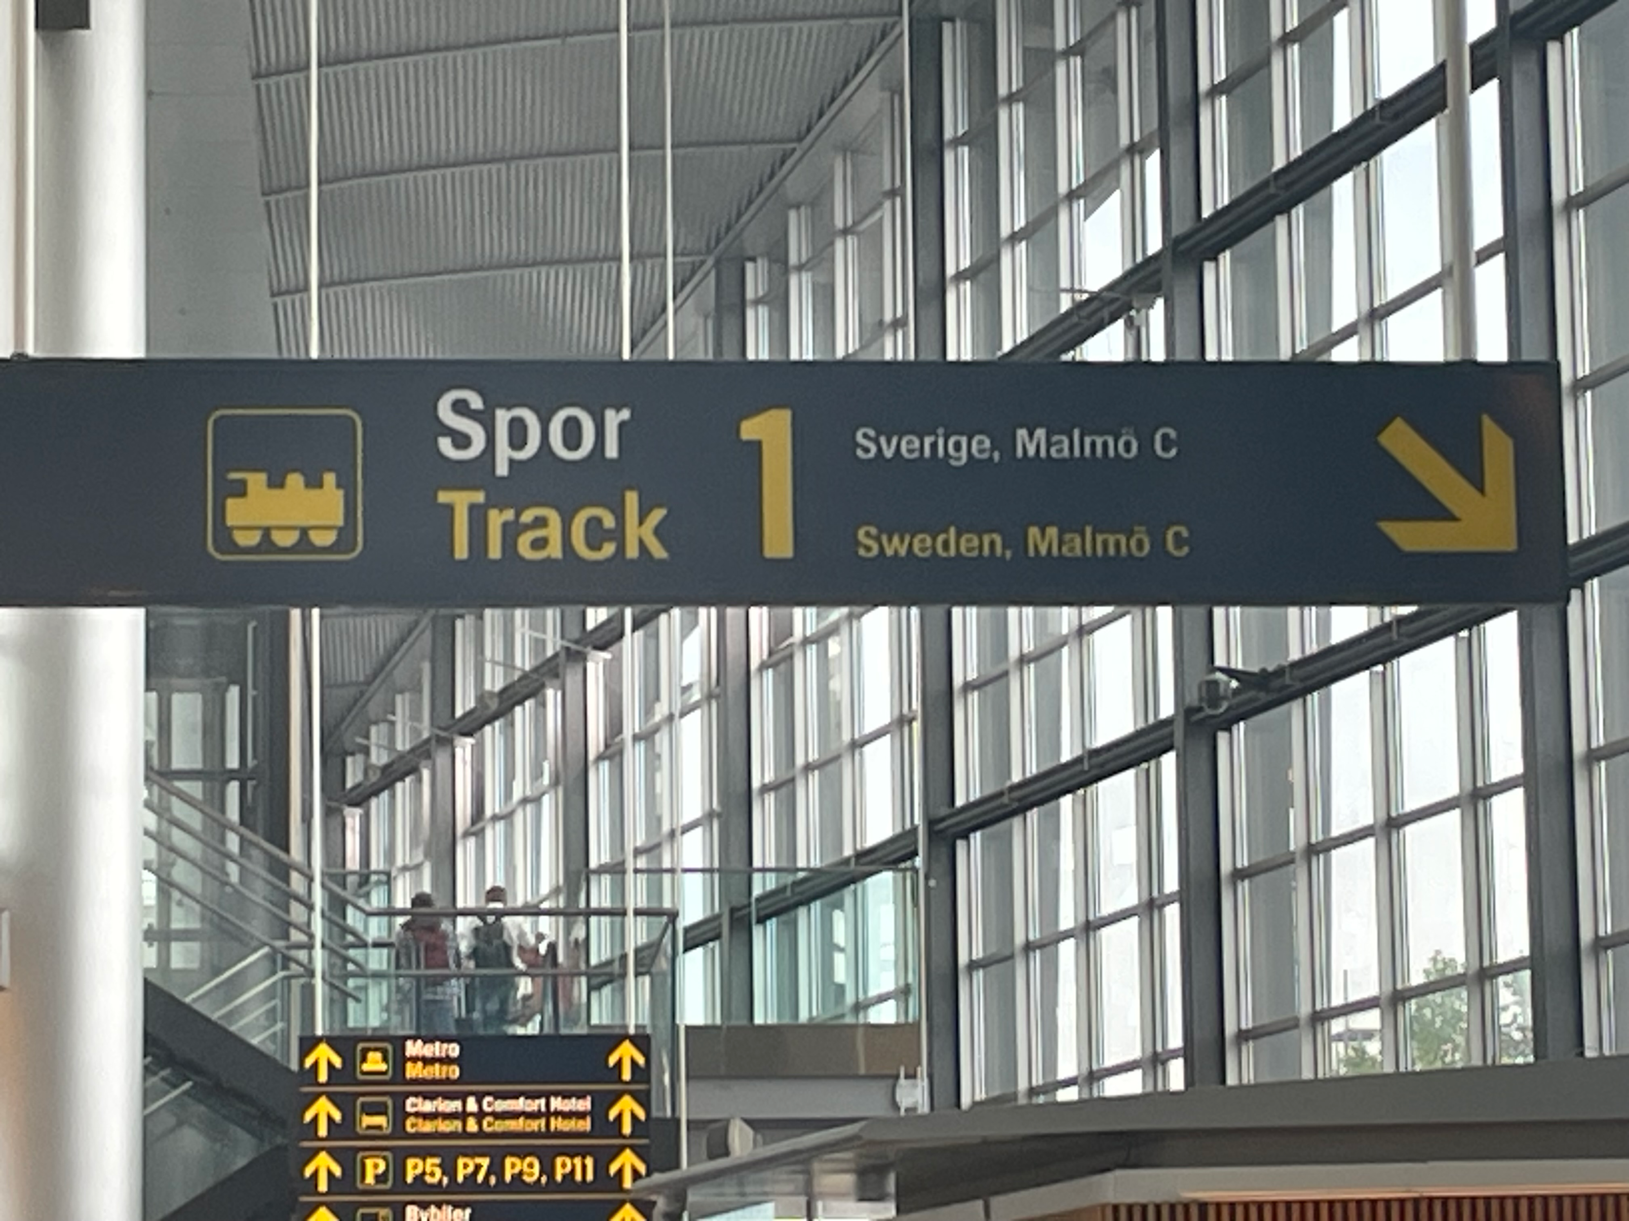
Traveling to/from Lund
Train from CPH to Lund takes 40 minutes
Leaves every 20 minutes (except during some hours at night)
Costs 15 USD one-way
After baggage claim, entering the arrival/departure area, look for the train to Sweden

Slide 6
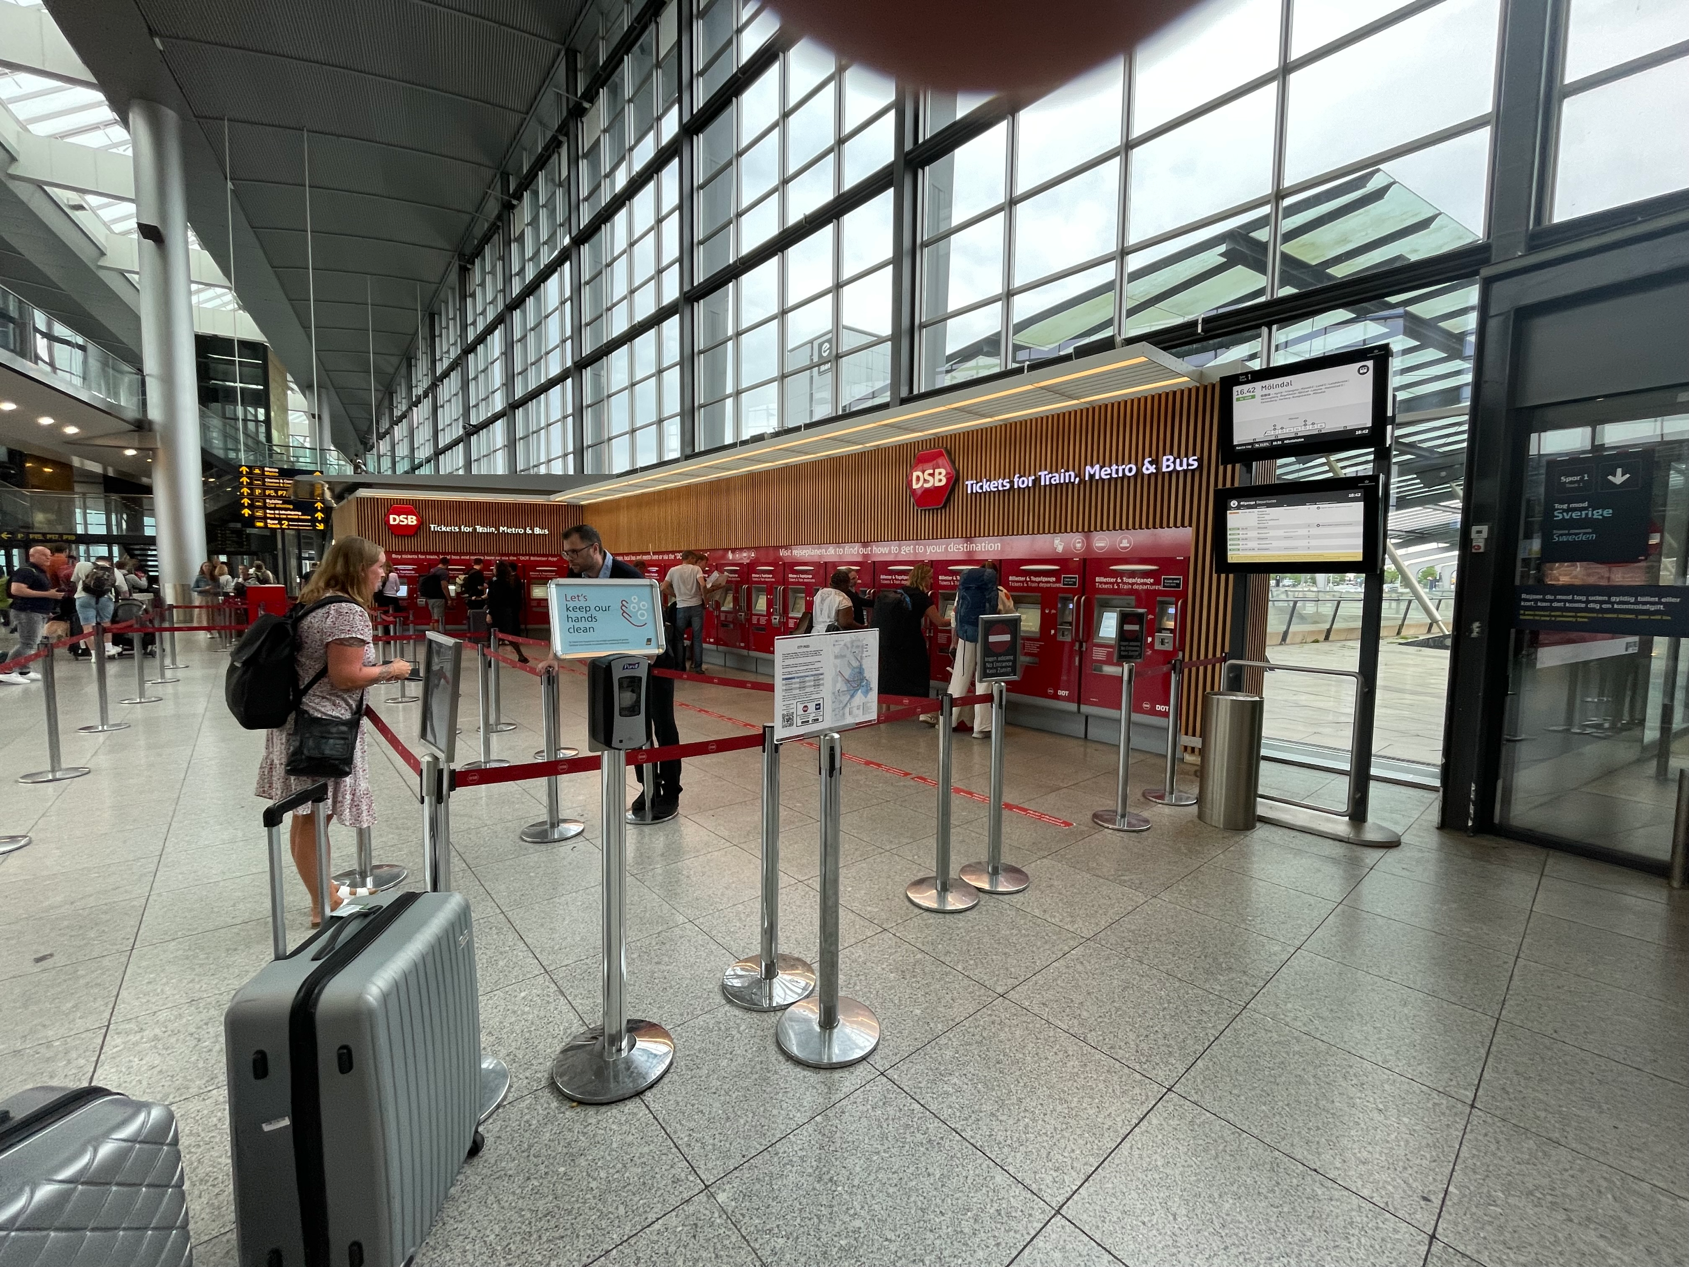
Buying tickets
There are ticket machines just before taking the escalator down to the train track
However, it more convenient if you use the app. This will also be used for the tram in Lund

Slide 7
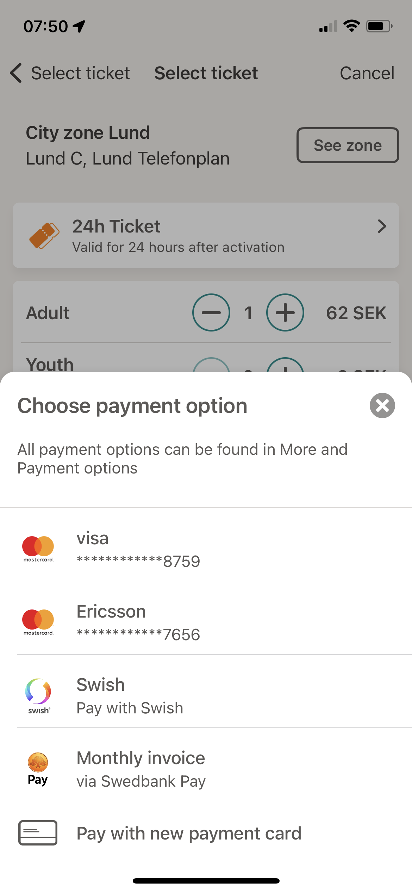
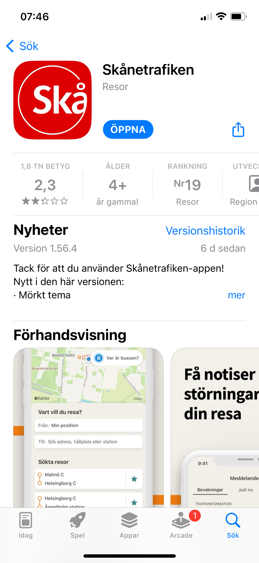
Buying tickets
The app you need is “Skånetrafiken”, see picture to the right
It is very important that you buy and activate your ticket before the train leaves. If they check, they charge quite a bit if the ticket is not activated
You can probably connect a card beforehand

Slide 8
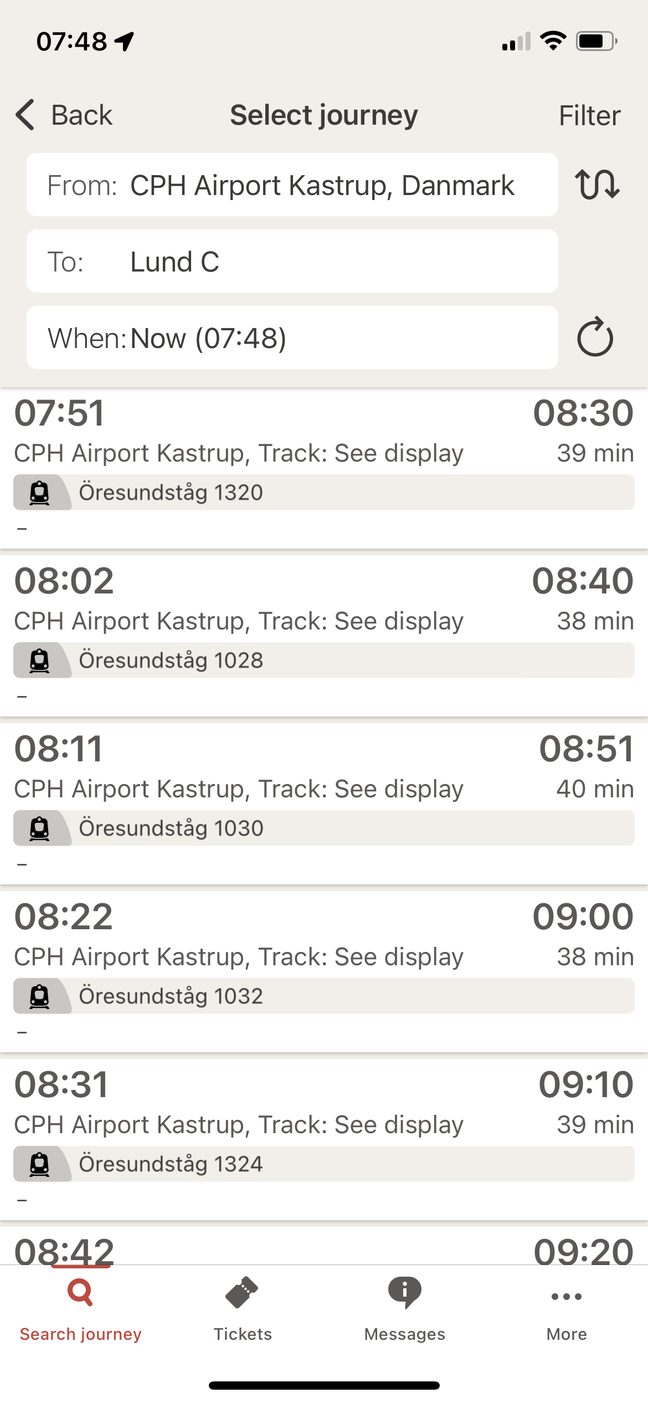
CPH -Lund
From the airport to Lund, you should buy one-way tickets
The ticket is valid for a certain time, but it is not for a specific train even though you select a specific trip when buying the ticket
For CPH-to Lund, you should select as indicated to the right

Slide 9
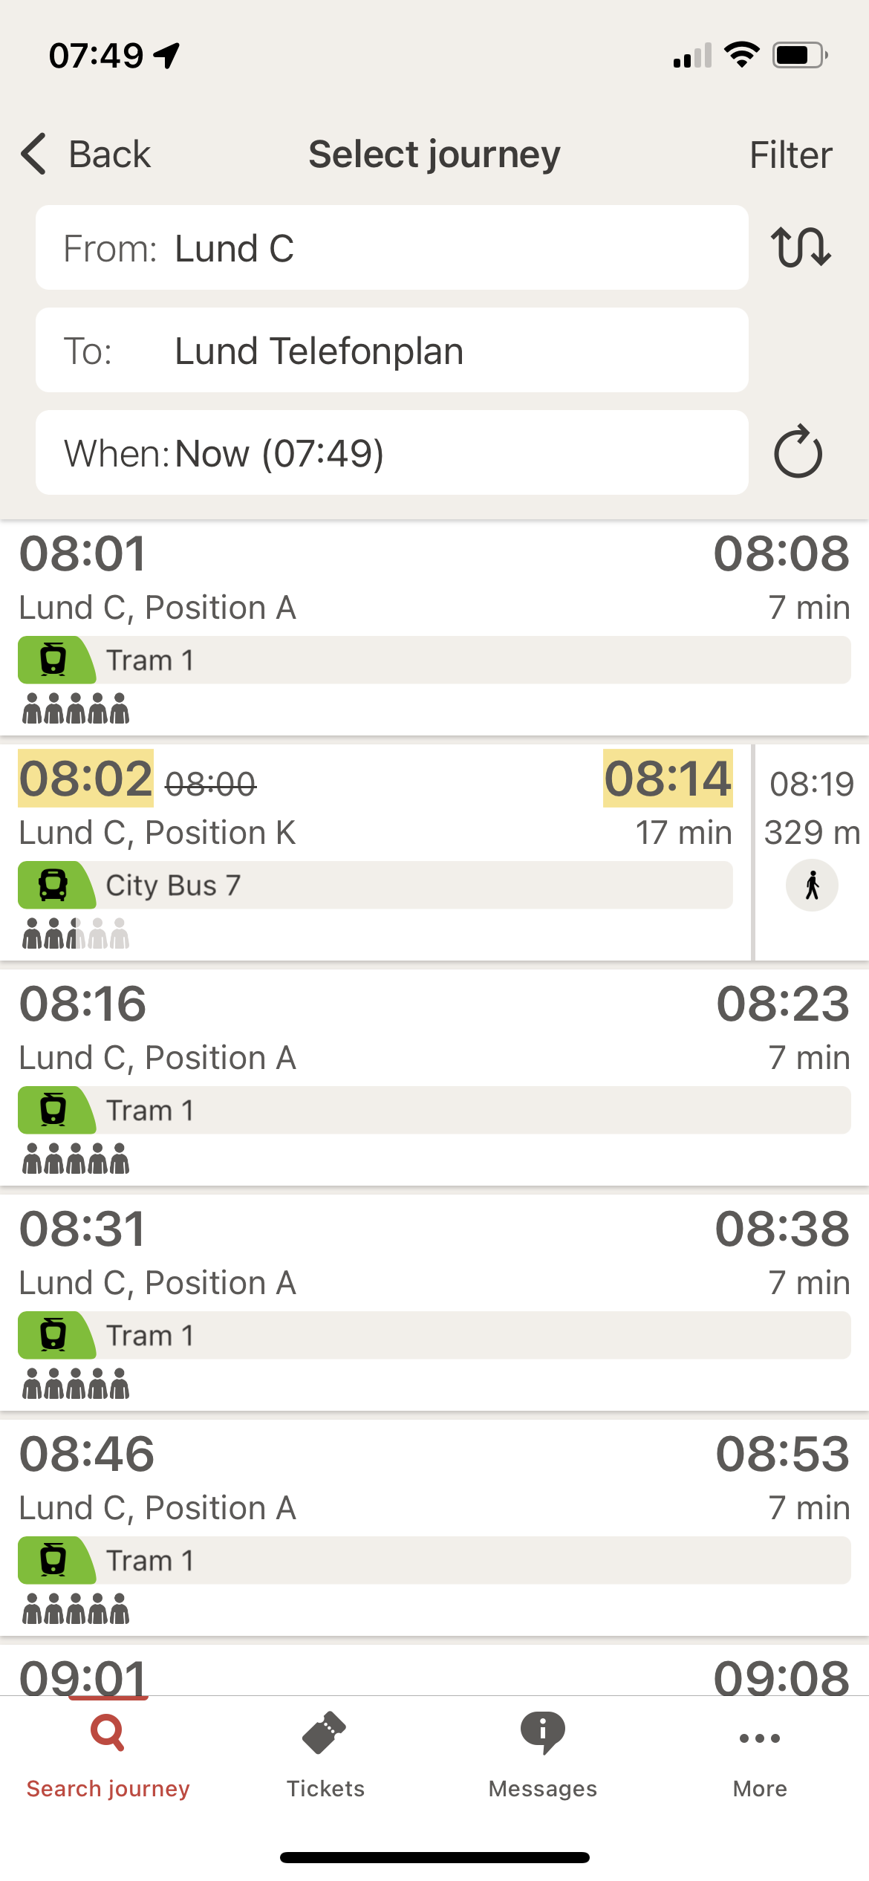
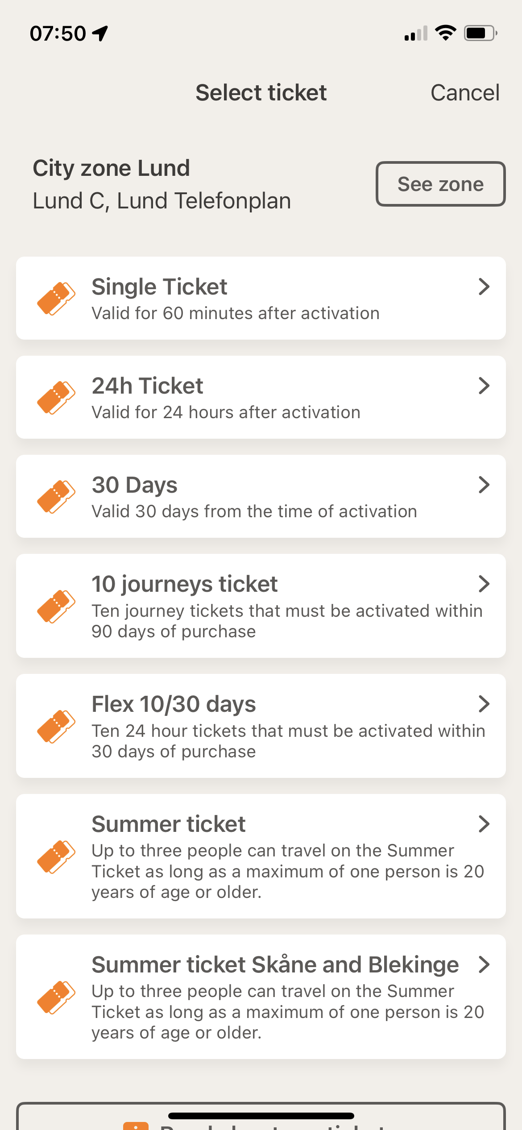
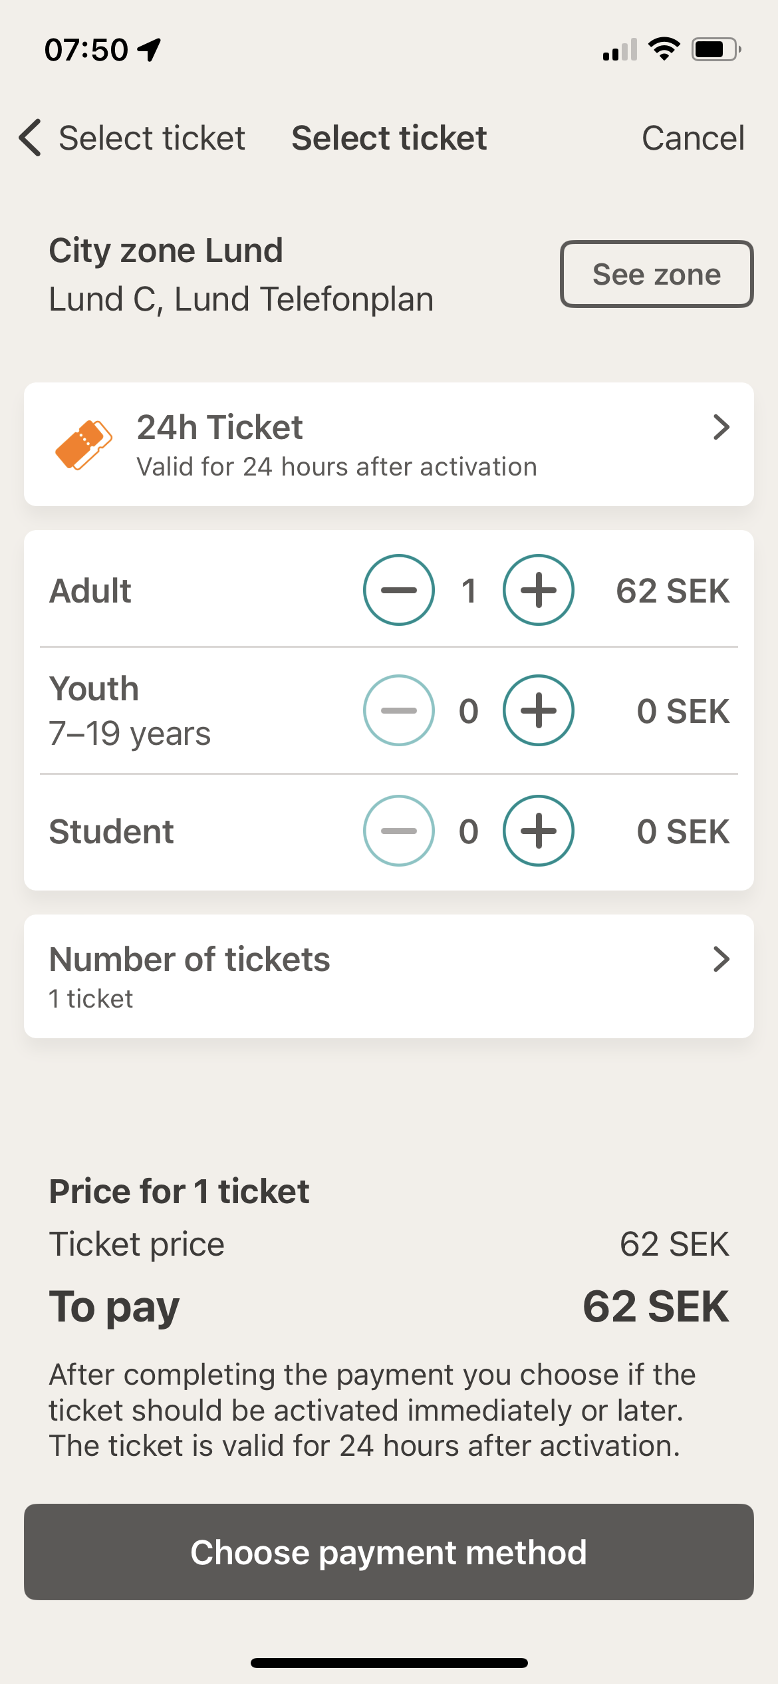
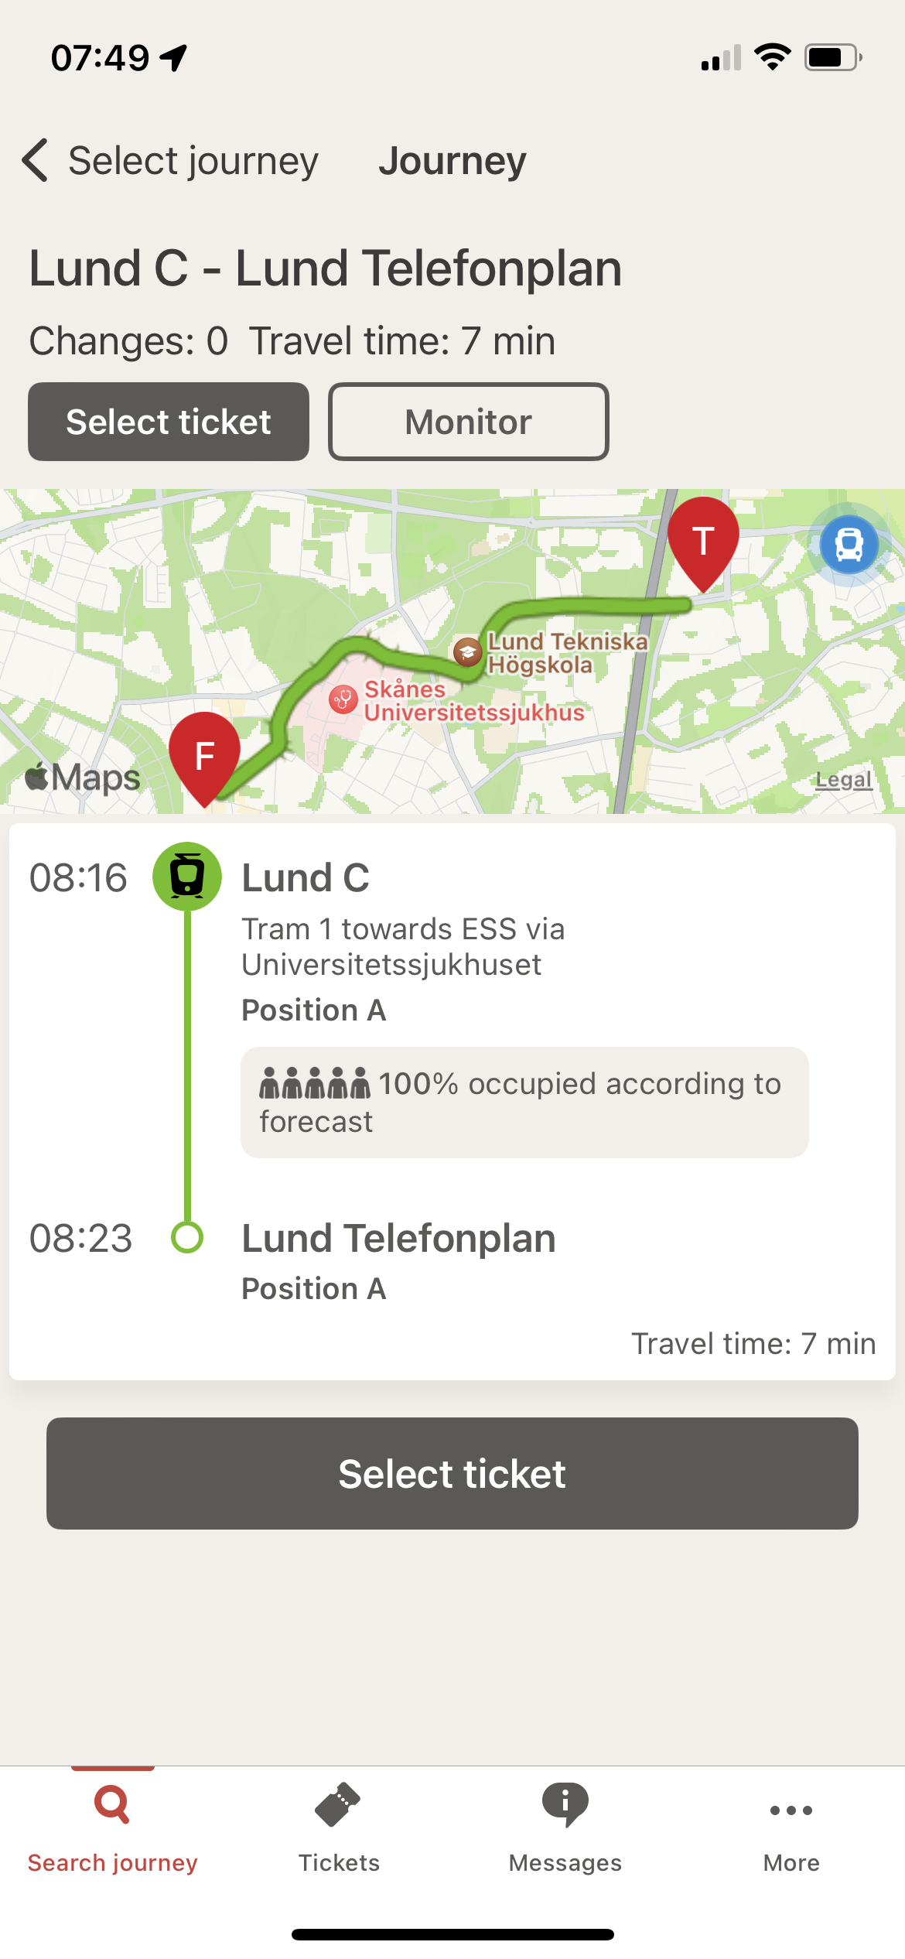
Using the tram in Lund
Going from the hotel to Ericsson office, buy day tickets rather than one-way tickets. From Lund C to Telefonplan for getting to Ericsson
Also here, it is important to activate the ticket not just buy it

Slide 10
Traveling long distance in Sweden
If you are not arriving at CPH, but in e.g. Stockholm, the simplest and least expensive way is to go by train https://www.sj.se/en/
The following may be worth to note
The price difference between first and second class may not be that big. Consider first class
You don’t need to buy a specific seat, but during summer time it is probably preferred

Slide 11
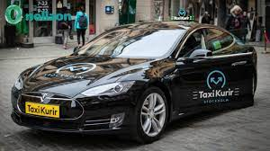
Taxi
Sweden is in general quite friendly and honest. Taxi is one exception.
It is unregulated and basically free pricing. This is used by some to fool turists and not run by the meter. Even if they run by the meter I am not sure if it is honest
Use the larger taxi companies, e.g Taxi kurir
At taxi stands, you usually find these
You can also book using https://www.taxikurir.se/
Or by their app

Slide 12
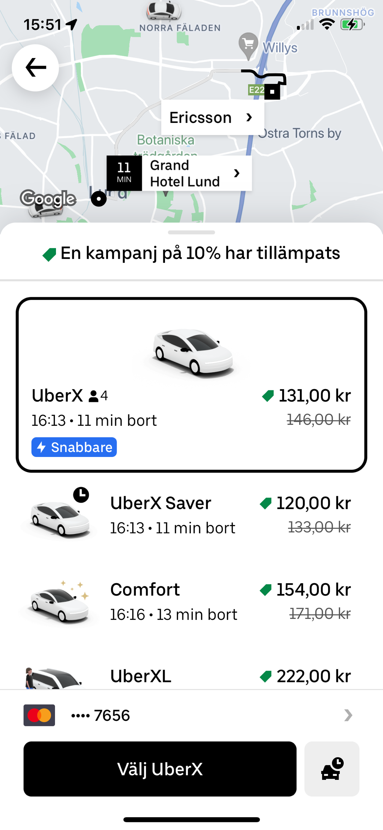
Uber
Not as common in Sweden as in e.g. US, but in Lund you should be able to find one
Most likely a better alternative than Taxi

Slide 13
Where to stay?
Ericsson is located 7 minutes by tram from the central station
You can stay close to the Ericsson office (and take the tram to the city center in the evening) or
You can stay in the city center and take the tram to Ericsson
Or you can stay in between
I believe it is nicer to stay in the city center, some options on the following pages

Slide 14
Hotels
Grand Hotel https://www.grandilund.se/en
Classic hotel, more expensive, around 200 USD
100m from the train station
200m from the tram station
10+ restaurants & bars within 200m
Motel L https://ligula.se/en/motel-l/motel-l-lund/
New hotel 50m from Ericsson, around 100 USD
150m from tram station
Elite Hotel https://elite.se/en/hotels/lund/hotel-ideon/?utm_source=google&utm_medium=organic&utm_campaign=google-local&utm_content=lund
5-10 minutes walk to Ericsson, around 120 USD
300 m to tram station

Slide 15
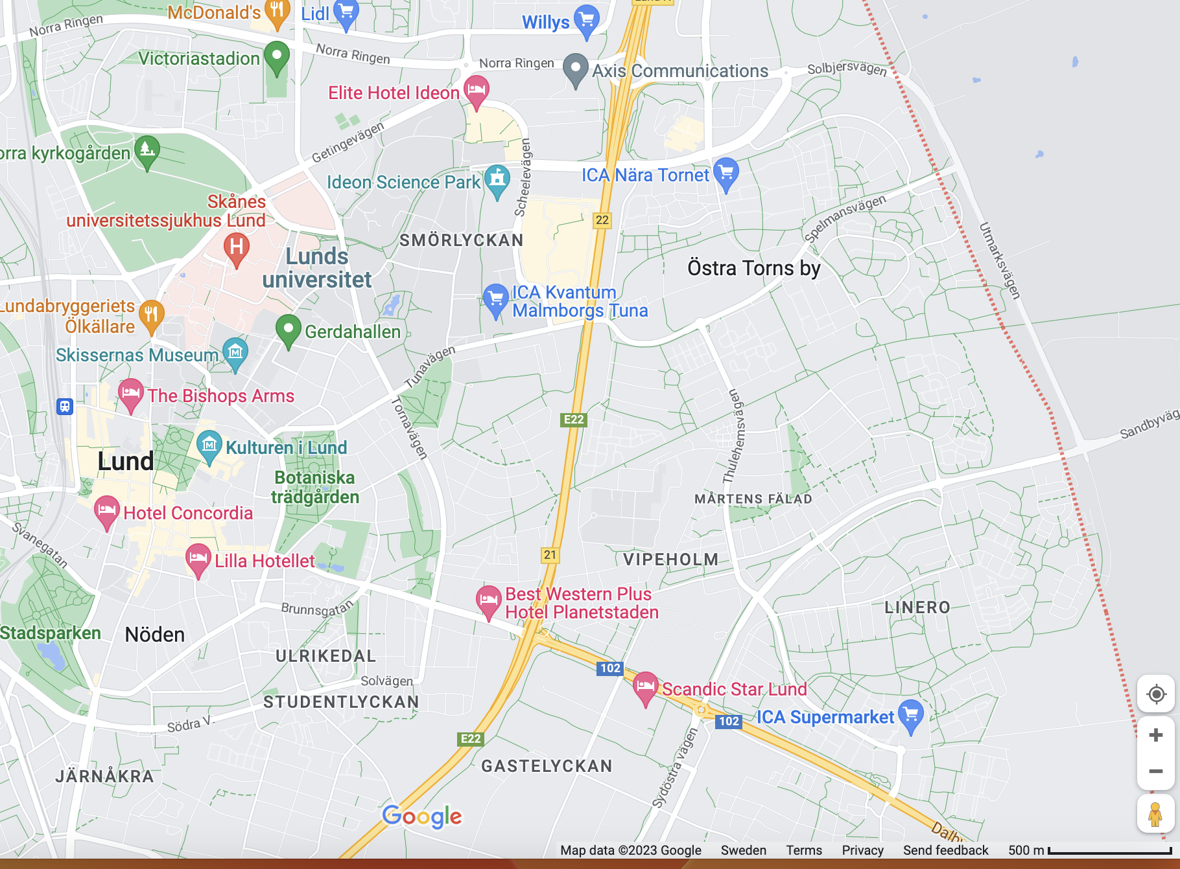
Ericsson location
Elite Hotel
Ericsson
Motel L
Tram station
Train station
Grand Hotel

Slide 16
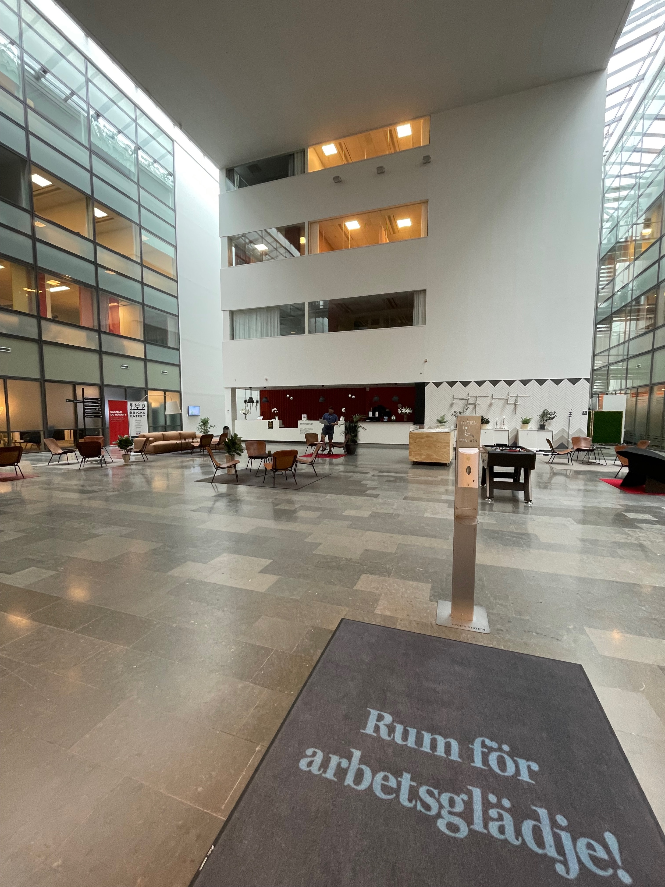
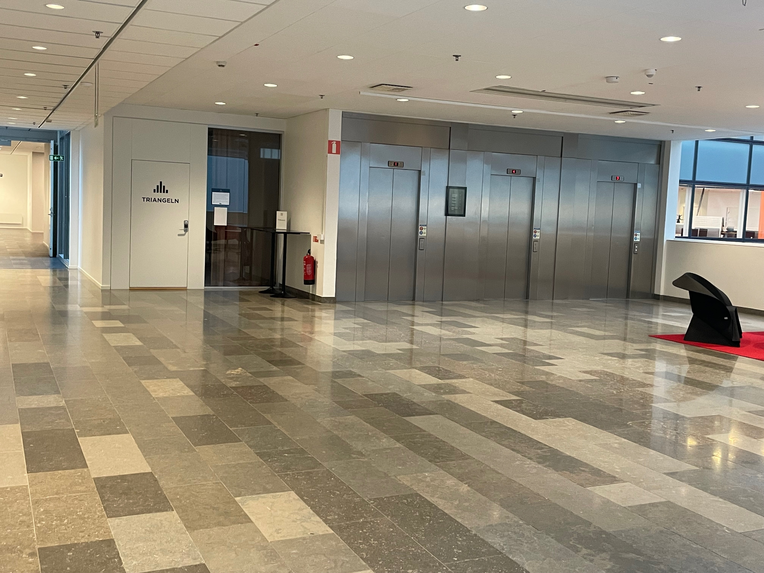
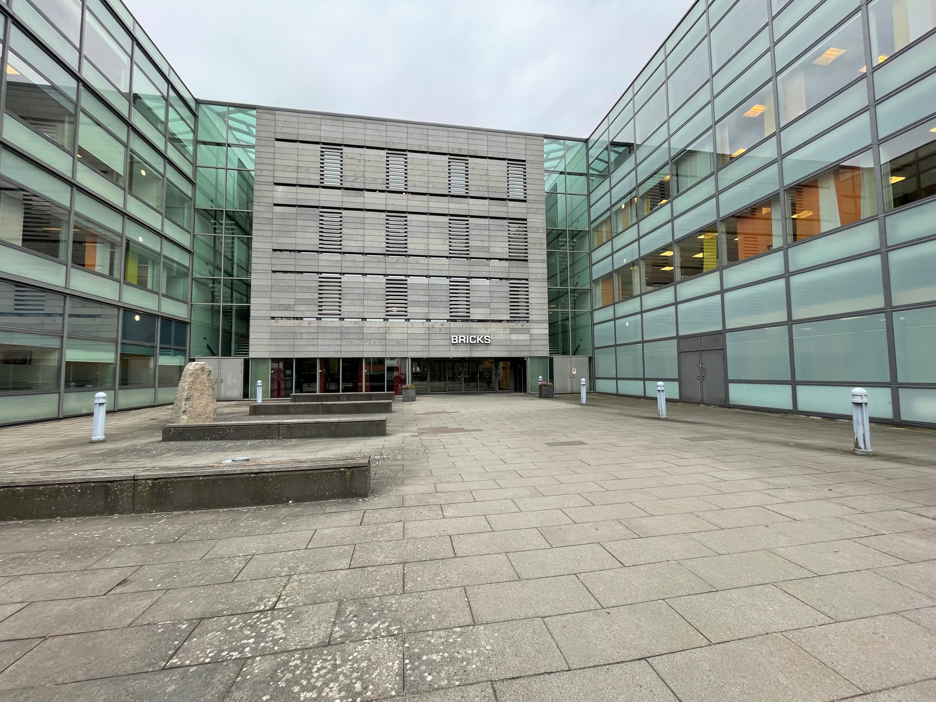
Meeting Venue
Reception area.
Entrence is to the left,
and you find…
… meeting room “Triangeln”
to the left
Building entrence

Slide 17
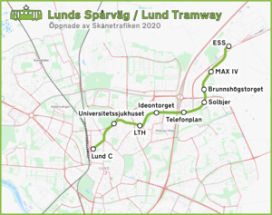
Getting around by tram
Elite Hotel
Ericsson
Telefonplan is the stop when going to Ericsson or to Motel L
Ideontorget is the stop for Elite Hotel
Lund C is the stop for Grand Hotel
Lund C- Telefonplan takes 7 minutes
Motel L
Leif Wilhelmsson, Ericsson

Slide 18
Participants in Lund
Tony
Claudio
Leif
Ali
Chris
Junghoon
Dong
Stephen
Naren
Rui
Benedikt

