Slide 1
Info related to 802.11bf Ad-hoc meeting in Lund, Sweden, July 2023
Date: 2023-04-19
Authors:

Slide 2
Contents
Lund
Traveling to Lund
Where to stay
Ericsson’s office – How to find the meeting location

Slide 3
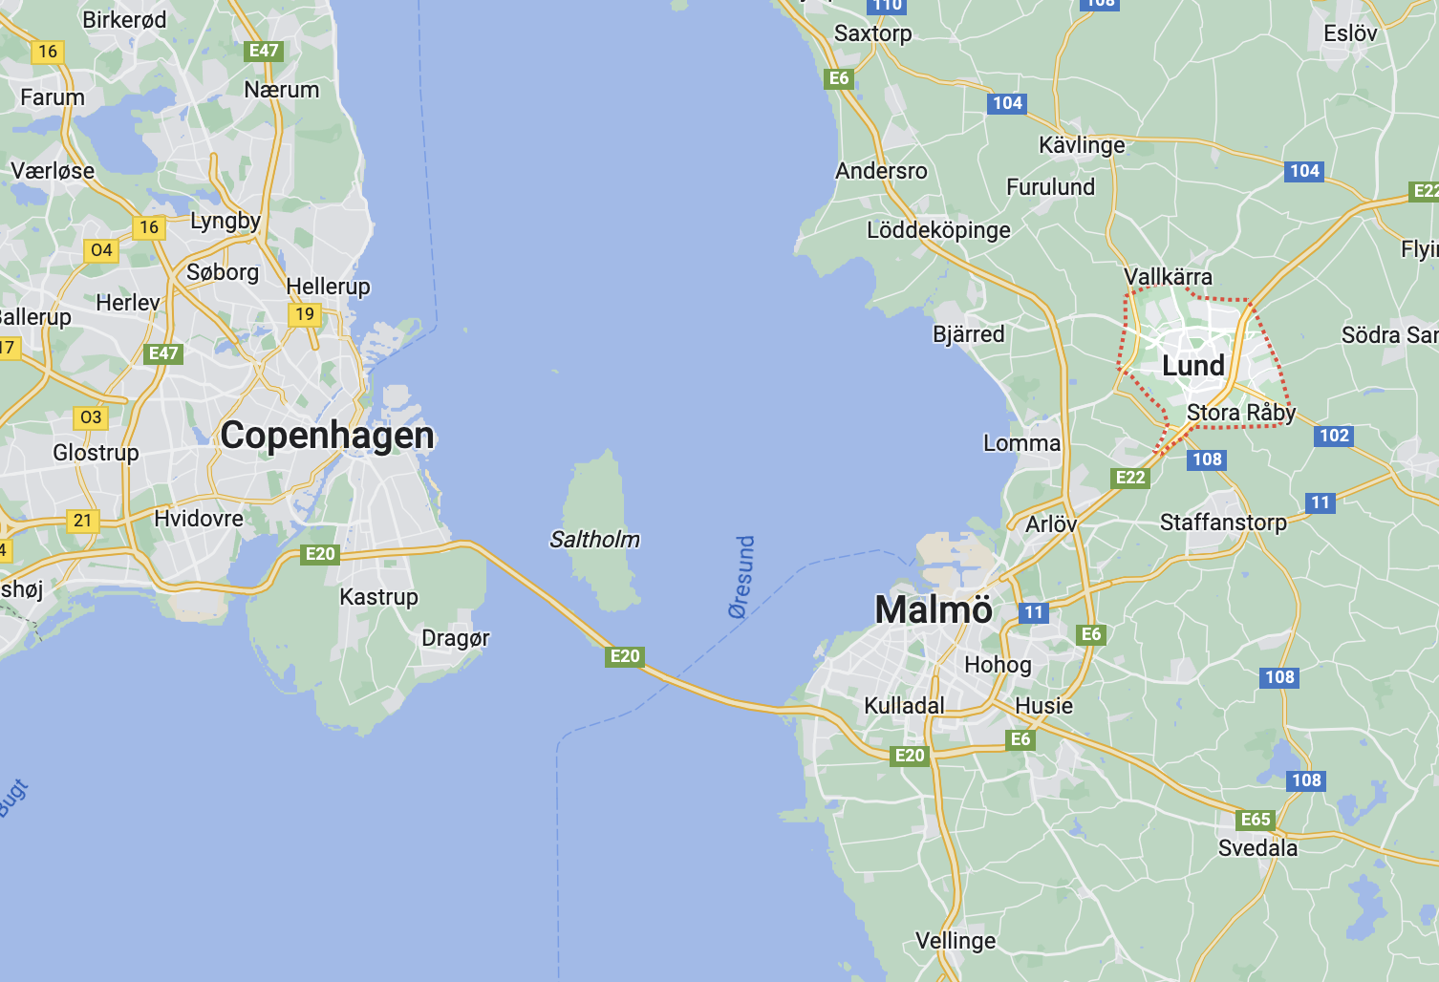
Lund
Lund is a small town more than 1000 years old with about 100 000 people
Located 20 km from Malmö, the third largest city in Sweden
Lund University has about 40 000 students
Many go by bike or walk to their destinations, or use the tram

Slide 4
Traveling to/from Lund
The closest major airport is Copenhagen Airport (CPH), about 50km from Lund
Train from CPH to Lund takes 40 minutes
Leaves every 20 minutes (except during some hours at night)
Costs 15 USD one-way
When going to Berlin, the simplest way is to fly from CPH, first taking the train from Lund to CPH

Slide 5
Where to stay?
Ericsson is located 7 minutes by tram from the central station
You can stay close to the Ericsson office (and take the tram to the city center in the evening) or
You can stay in the city center and take the tram to Ericsson
Or you can stay in between
I believe it is nicer to stay in the city center, some options on the following pages

Slide 6
Hotels
Grand Hotel https://www.grandilund.se/en
Classic hotel, more expensive, around 200 USD
100m from the train station
200m from the tram station
10+ restaurants & bars within 200m
Motel L https://ligula.se/en/motel-l/motel-l-lund/
New hotel 50m from Ericsson, around 100 USD
150m from tram station
Elite Hotel https://elite.se/en/hotels/lund/hotel-ideon/?utm_source=google&utm_medium=organic&utm_campaign=google-local&utm_content=lund
5-10 minutes walk to Ericsson, around 120 USD
300 m to tram station

Slide 7
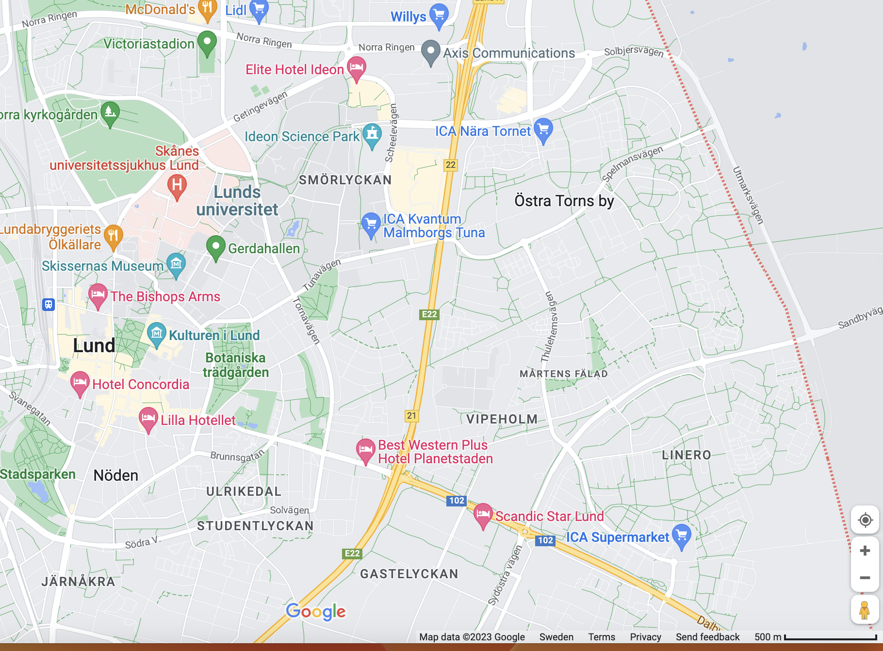
Ericsson location
Elite Hotel
Ericsson
Motel L
Tram station
Train station
Grand Hotel

Slide 8
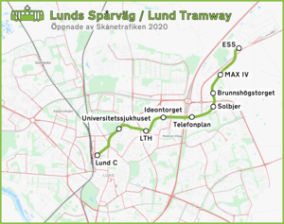
Getting around by tram
Elite Hotel
Ericsson
Telefonplan is the stop when going to Ericsson or to Motel L
Ideontorget is the stop for Elite Hotel
Lund C is the stop for Grand Hotel
Lund C- Telefonplan takes 7 minutes
Motel L
Leif Wilhelmsson, Ericsson

