Slide 1
TGbi – Anonymizing frames and A1 filtering
Date: 2023-03-11
Authors:
Name | Affiliations | Address | Phone | email
A. De la Oliva | InterDigital, UC3M | Avda. De la Universidad 30, Leganes, Madrid, Spain | +34 91 6248803 | aoliva@it.uc3m.es
J. Levy | Interdigital

Slide 2
Abstract
Some works in IEEE 802.11bi propose anonymizing A1 and A2 addresses by rotating the transmitting and receiving MAC addresses.
  DCN 2021/1539r0
  DCN 2023/133r0
Such a mechanism have implications on how a STA performs A1 filtering, since the A1 may change, some challenges discussed are:
  An A1 MAC address is only used as receiver address for a period of time
  When an A1 MAC address changes, retransmissions my use the “previous” MAC address.
  How is are the MAC address transitions coordinated between the transmitter and the receiver.
This document proposes a mechanism enabling A1 filtering in such a scenario
  Proposal includes discussion on the anonymization/de-anonymization block

Slide 3
Background
A1 address filtering is done right after CRC validation
  Some implementations may do Block Ack Scoreboarding right after
The process itself is not defined in the spec
It considers filtering based on:
  MAC address of the receiving STA
  dot11GroupAddressesTable

Slide 4
Proposal
Use a solution similar to what is used for dot11GroupAddressesTable
A list of the A1 and A2 addresses allows for different addresses to be used each direction of the communication
Proposal
  Each STA keeps a structures associated to transmitting/receiver aaMAC addresses pairs
    For a given aaMAC_pSTA (peer) and aaMAC_STA (this STA)
      Rx Active MAC Address Set → Set of receiving addresses used by STA for receiving from peer STA
      → Set of transmitting addresses used by peer STA for transmitting to STA
      Tx Active MAC Address Set → Set of receiving addresses used by pSTA for receiving from STA
      → Set of transmitting addresses used by STA for transmitting to pSTA
      STA Tx Active MAC Address Set corresponds to peer STA Rx Active MAC Address Set
      STA Rx Active MAC Address Set corresponds to peer STA Tx Active MAC Address Set
  At any time, a STA can use any of the addresses in the Tx/Rx Active MAC Set

Slide 5
Explanation
STA B Rx Active MAC Address Set – A1
From A to BFrom A to B
STA B Rx Active MAC Address Set – A2
STA A Rx Active MAC Address Set – A1
From B to AFrom A to B
STA A Rx Active MAC Address Set – A2

Slide 6
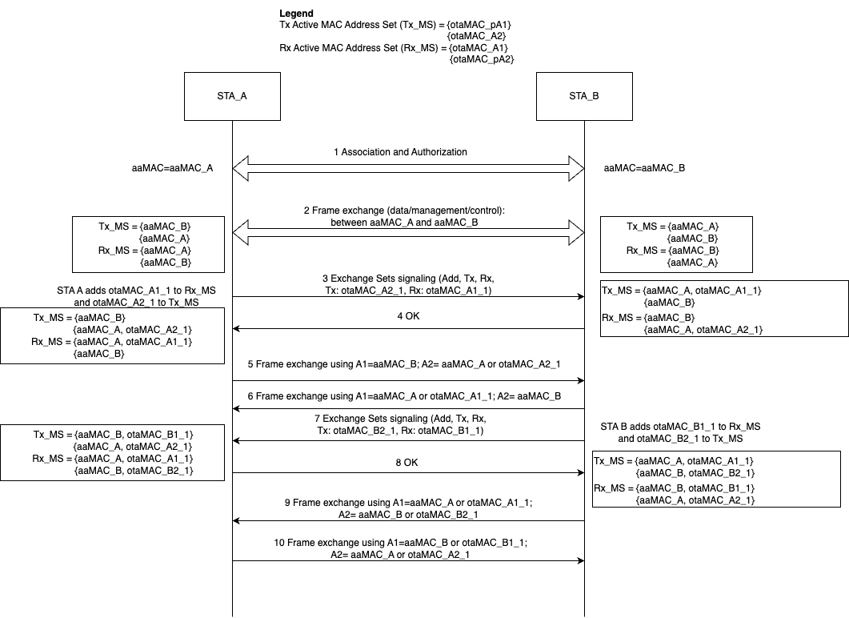
Example

Slide 7
Anonymization process
The transmitting process starts by the anonymization process of the frame, by the STA processing a MDPU to be transmitted.
It first compares the Rx (A1) address on the MPDU with the aaMAC_pSTA stored in the different Tx Active MAC Address Sets.
Once found, the transmitting STA may choose among all the otaMAC_pA1 addresses and all the otaMAC_A2 addresses in the identified Tx Active MAC Address Set.
The MPDU is then modified, exchanging the A1 and A2 addresses by the newly selected otaMAC_pA1 and otaMAC_A2 and MPDU processing continues using the current 802.11 process to transmit the frame.
Note: if this process is coupled with the CCMP encapsulation process proposed in DCN 2023/416r0. Then the anonymization process can be done decoupled from the CCMP encapsulation

Slide 8
A1 filtering/De-anonymization/reception process
The receiving process starts by the STA receiving a unicast frame and performing A1 filtering.
The receiving STA compares the A1 address in the received frame to the list of otaMAC_A1 addresses stored in all the Rx Active MAC Address Sets (these sets include all otaMAC address for the receiving STA as well as all group addresses).
If found, processing can continue, otherwise the frame should be discarded.
After checking A1, the EP receiving STA checks for the A2 address, comparing it to the otaMAC_pA2 addresses stored in the Rx Active MAC Address Set (note the receiving STA already knows the aaMAC_pSTA due to step above).
If found, the frame is modified, exchanging the A1 address by the aaMAC_pSTA of the transmitting STA (stored in the Rx Active MAC Address Set) and the A2 by the receiving aaMAC_STA (locally known).
Note: if this process is coupled with the CCMP de/capsulation process proposed in DCN 2023/416r0. Then the de-anonymization process can be done decoupled from the CCMP decapsulation

Slide 9
Benefits/drawbacks of the approach
The proposal enables communication between two STAs that use anonymized MAC addresses for A1 and A2 in each direction of the communication → high level of ofuscation
Proposed used of address sets reduce the complexity of managing the addresses, it reduces non steady state periods and allows for retransmissions
MAC addresses can be added/removed any time, retransmitions should not modify addresses, a STA can decide to stop using an address, signal its removal and actually take it out from the set considering enough time to not face problems.
May require increased memory space → this can be bounded by setting a maximum size of the sets

Slide 10
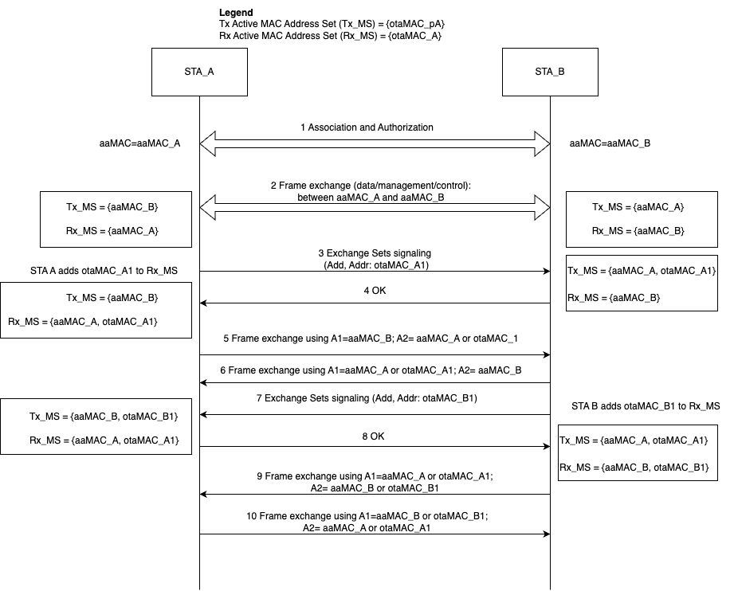
Possible simplification

Slide 11
Straw Poll
Do you agree on a solution where a set of addresses is used per STA to receive and transmit frames in order to improve their privacy?

Slide 12
Straw Poll
Do you prefer a solution splitting MAC addresses per direction of the communication (slide 5) or a solution using the same set of addresses for Rx and Tx (slide 9)?

