Slide 1
Study on AI CSI Compression
Date: 2023-07
Authors:

Slide 2
Abstract
In r1 [5], we introduced a new vector quantized variational autoencoder (VQVAE) method for CSI compression and discussed its performance.
In r2 [6], we have a follow-up discussion on
Further feedback overhead reduction and goodput improvement,
Model generalization under different channel conditions and different numbers of antennas/spatial streams，
Workflow of AI CSI compression using VQVAE.
In this revision (r3), we continue the study on
Model generalization under different bandwidths,
Lightweight encoder that reduces computation complexity and model deployment overhead.

Slide 3
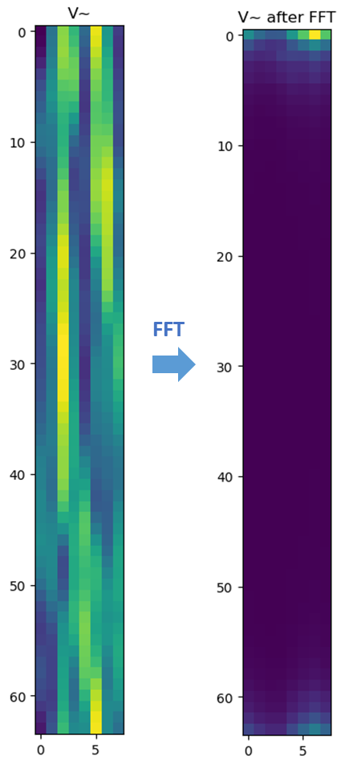
R1 - Background
The AP initiates the sounding sequence by transmitting the NDPA frame followed by a NDP which is used for the generation of V matrix at the STA.
The STA applies Givens rotation on the V matrix and feeds back the angels in the beamforming report frame.
The total feedback overhead is $N_{a}∗\frac{b_{φ}+b_{ψ}}{2}∗\frac{N_{sc}}{N_{g}}$. Larger bandwidth and number of antennas lead to significantly increased sounding feedback overhead, which increases the latency and limits the throughput gain.
Visualization of the precoding matrix after FFT shows its sparsity and compressibility.
Ntx=Nrx=Nss | BW=20MHz | BW=40MHz | BW=80MHz | BW=160MHz | BW=320MHz
2 | 0.12 (KBytes) | 0.24 | 0.50 | 1.00 | 1.99
4 | 0.73 | 1.45 | 2.99 | 5.98 | 11.95
8 | 3.39 | 6.78 | 13.94 | 27.89 | 55.78
16 | 14.52 | 29.04 | 59.76 | 119.52 | 239.04
20MHz, 8*2

Slide 4
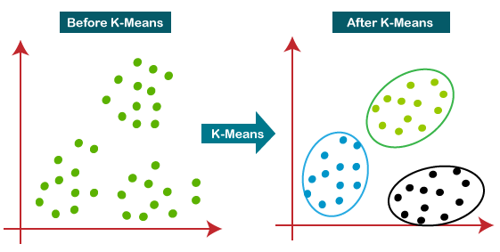
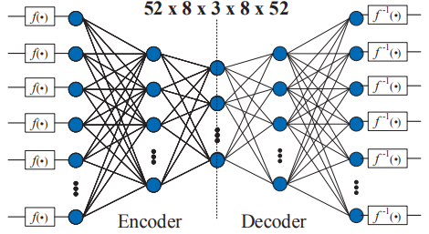
R1 - Existing Work on AI CSI Compression
ML solutions: no neural network
[1][2] adopted a traditional machine learning algorithm, i.e., K-means, to cluster the angle vector after Givens rotation
Beamformer and beamformee need to exchange and store the centroids
Only transmit the centroid index during inference
2dB PER loss, up to 50% goodput improvement
AI solutions: use neural network
[3] adopted two autoencoders to compress two types of angles after Givens rotation separately
Beamformer and beamformee need to exchange the store neural network models
Only transmit the encoder output during inference
Up to 70% overhead reduction and 60% throughput gain for 11ac system

Slide 5
R1 - Our Study on AI CSI Compression
Vector quantization variational autoencoder (VQVAE) [4] is proposed for CSI compression
Consists of encoder, codebook, decoder
Learn how to compress and quantize automatically from the data
Convolutional neural network (CNN) or transformer could be used for both the encoder and decoder.
Input of NN could be the V matrix or the angles after Givens rotation.
Beamformer and beamformee need to exchange and store the codebook and half of the NN model.
Only transmit the codeword index during inference.

Slide 6
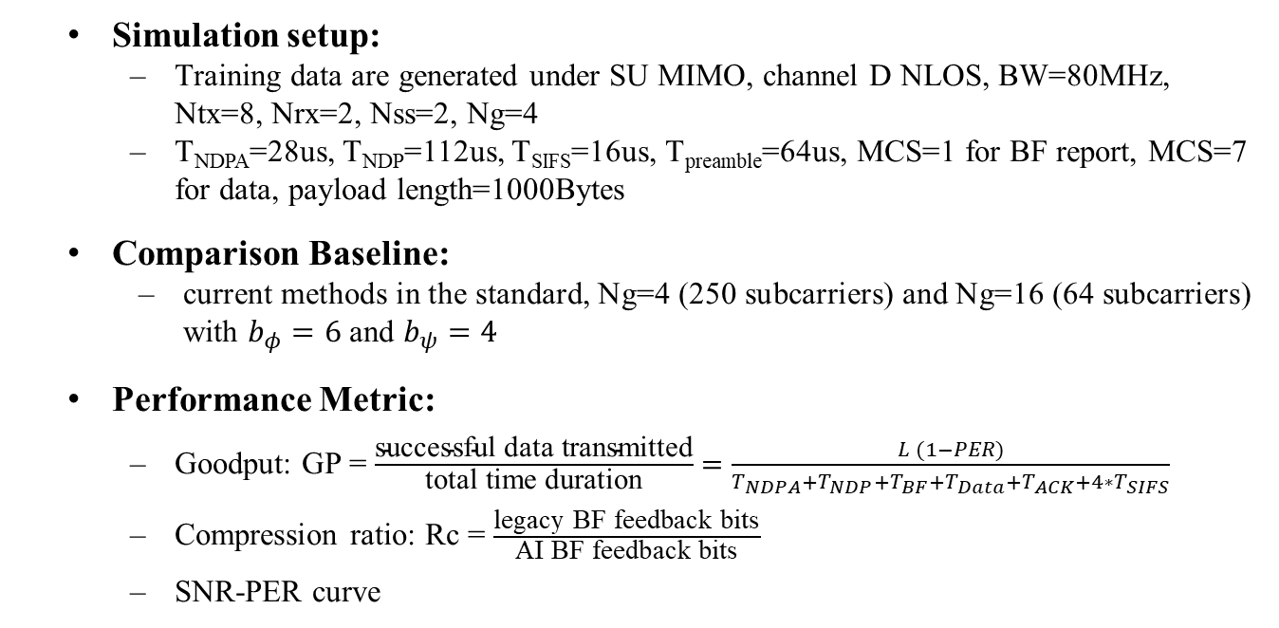
R1 - Performance Evaluation
Simulation setup:
Training data are generated under SU MIMO, channel D NLOS, BW=80MHz, Ntx=8, Nrx=2, Nss=2, Ng=4
T_{NDPA}=28us, T_{NDP}=112us, T_{SIFS}=16us, T_{preamble}=64us, MCS=1 for BF report, MCS=7 for data, payload length=1000Bytes
Comparison Baseline:
current methods in the standard, Ng=4 (250 subcarriers) and Ng=16 (64 subcarriers) with $b_{φ}=6$ and $b_{ψ}=4$
Performance Metric:
Goodput: GP = $\frac{\text{successful} \text{data} \text{transmitted}}{\text{total} \text{time} \text{duration}}=\frac{L (1−PER)}{T_{NDPA}+T_{NDP}+T_{BF}+T_{Data}+T_{ACK}+4∗T_{SIFS}}$
Compression ratio: Rc = $\frac{\text{l}\text{egacy} \text{BF} \text{feedback} \text{bits}}{\text{AI} \text{BF} \text{feedback} \text{bits}}$
SNR-PER curve
SIFS
SIFS
SIFS
SIFS
NDPA
NDP
Data
BF
ACK

Slide 7
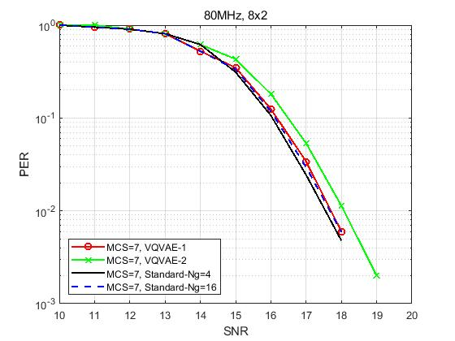
R1 - Performance Evaluation
, MCS=7
Rc=12 (CB size 1024)
Rc=25 (CB size 1024)
Method | overhead Ng=4 (bits) | overhead Ng=16 (bits) | overhead VQVAE (bits) | Rc vs Ng=4 | Rc vs Ng=16 | Loss @ 0.01 PER (dB) vs Ng=4 | loss @ 0.01 PER (dB) vs Ng=16 | GP Ng=4 (Mbps) | GP Ng=16 (Mbps) | GP AI (Mbps) | GP gain (%) vs Ng=4 | GP gain (%) vs Ng=16
VQVAE-1 | 32500 | 8320 | 2560 | 12.70 | 3.25 | 0.16 | 0 | 5.07 | 10.77 | 14.70 | 189.64 | 36.48
VQVAE-2 | 32500 | 8320 | 1280 | 25.39 | 6.50 | 0.5 | 0.4 | 5.07 | 10.77 | 16.00 | 215.20 | 48.53
Notes:
Train the VQVAE model based on generated V matrices
Apply the trained model to do precoding
Run PER curve under

Slide 8
Further Study in R2
Reduce the feedback overhead and improve the goodput
Different neural network architecture
Reduce codebook size and dimension
More complex scenarios
More simulations under different configurations
MU-MIMO scenarios
Increase model generalization
One neural network can exhibit robustness to different channel models
One neural network can exhibit robustness to different bandwidth
One neural network can exhibit robustness to number of antennas

Slide 9
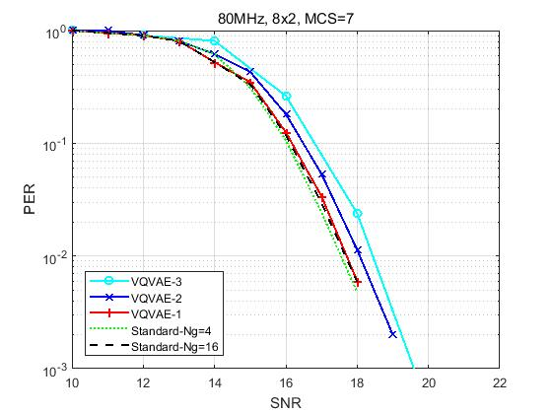
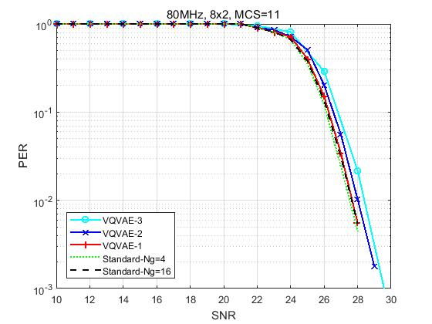

R2 - Feedback overhead reduction and goodput improvement
Simulation setup:
SU MIMO, channel D NLOS, BW=80MHz, Ntx=8, Nrx=Nss=2
Higher compression ratio and more MCS are considered
Comparison baseline：
Standard: Givens, Ng=4/16, $b_{φ}$=6, $b_{ψ}$=4
VQVAEs with different compression ratios achieve less than 1dB PER loss compared with standard method.
Rc=12 (CB size 1024)
Rc=25 (CB size 1024)
Rc=36 (CB size 128)

Slide 10
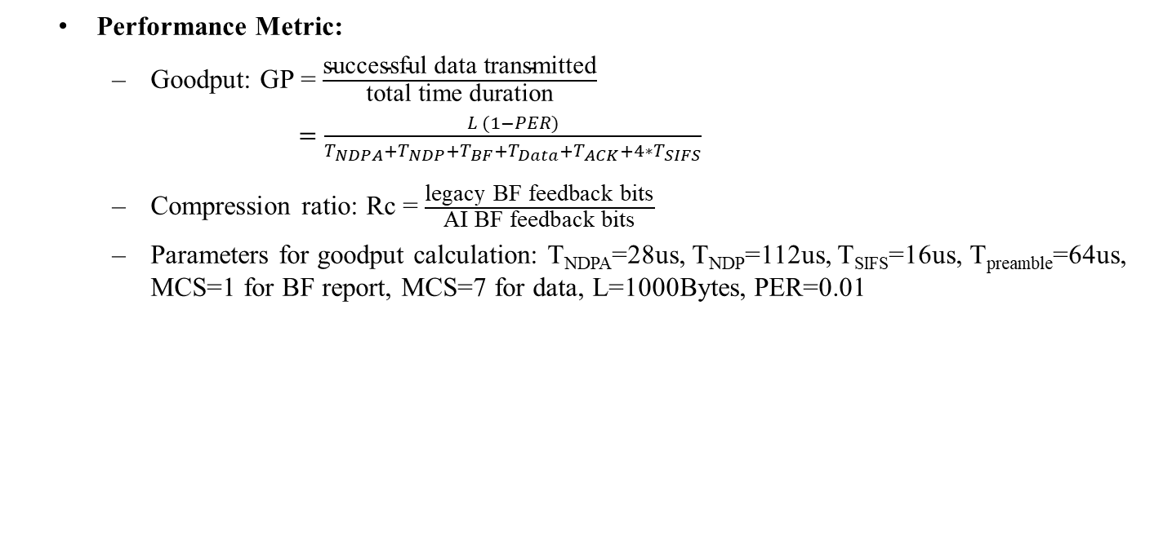
R2 - Goodput improvement and feedback overhead reduction
Performance Metric:
Goodput: GP = $\frac{\text{successful} \text{data} \text{transmitted}}{\text{total} \text{time} \text{duration}}$
$=\frac{L (1−PER)}{T_{NDPA}+T_{NDP}+T_{BF}+T_{Data}+T_{ACK}+4∗T_{SIFS}}$
Compression ratio: Rc = $\frac{\text{legacy} \text{BF} \text{feedback} \text{bits}}{\text{AI} \text{BF} \text{feedback} \text{bits}}$
Parameters for goodput calculation: T_{NDPA}=28us, T_{NDP}=112us, T_{SIFS}=16us, T_{preamble}=64us, MCS=1 for BF report, MCS=7 for data, L=1000Bytes, PER=0.01
SIFS
SIFS
SIFS
SIFS
NDPA
NDP
Data
BF
ACK
Method | VQ size | overhead Ng=4 (bits) | overhead Ng=16 (bits) | overhead VQVAE (bits) | Rc vs Ng=4 | Rc vs Ng=16 | Loss @ 0.01 PER (dB) vs Ng=4 | loss @ 0.01 PER (dB) vs Ng=16 | GP Ng=4 (Mbps) | GP Ng=16 (Mbps) | GP AI (Mbps) | GP gain (%) vs Ng=4 | GP gain (%) vs Ng=16
VQVAE-1 | 1024 | 32500 | 8320 | 2560 | 12.70 | 3.25 | 0.16 | 0 | 5.07 | 10.77 | 14.70 | 189.64 | 36.48
VQVAE-2 | 1024 | 32500 | 8320 | 1280 | 25.39 | 6.50 | 0.5 | 0.4 | 5.07 | 10.77 | 16.00 | 215.20 | 48.53
VQVAE-3 | 128 | 32500 | 8320 | 896 | 36.27 | 9.29 | 0.9 | 0.8 | 5.07 | 10.77 | 16.43 | 223.77 | 52.57

Slide 11
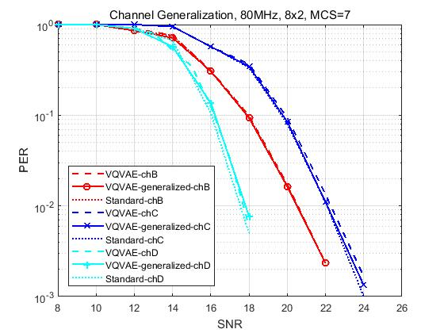
R2 - Generalization of different channel models
Simulation setup:
Training data are a combination of V matrices generated under channel model B, C, and D
The trained model is tested by data of channel B, C, and D, respectively
Comparison baseline：
VQVAE-chX: NN model is trained and tested using data of channel X
Standard-chX: Ng=4, $b_{φ}$=6, $b_{ψ}$=4
Compared with standard method, the generalized NN model has no PER loss for channel B and C, and 0.5dB PER loss for channel D.
A well-trained neural network model is robust to different channel conditions.
Legend | Train data | Test data
VQVAE-generalized-chB | B, C, D | B
VQVAE-chB | B | B
VQVAE-generalized-chC | B, C, D | C
VQVAE-chC | C | C

Slide 12
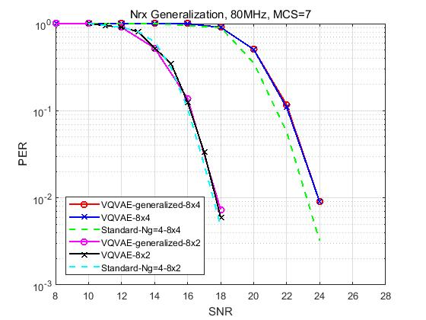
R2 - Generalization of different Nrx/Nss
Simulation setup:
Training data are a combination of V matrices of different Nrx (i.e., Nrx=2 and 4)
The trained model is tested by data of Nrx=2 and Nrx=4, respectively
Comparison baseline：
VQVAE: NN model is trained and tested using data of certain Nrx
Standard: Ng=4, $b_{φ}=6$, $b_{ψ}=4$
Compared with standard method, the generalized NN model has 0.2/0.8dB PER loss for Nrx=2/4.
A well-trained neural network model is robust to different number of receive antennas.
Legend | Train data | Test data
VQVAE-generalized-8x4 | 8x2 + 8x4 | 8x4
VQVAE-8x4 | 8x4 | 8x4
VQVAE-generalized-8x2 | 8x2 + 8x4 | 8x2
VQVAE-8x2 | 8x2 | 8x2

Slide 13
R2 - Workflow of AI CSI compression using autoencoder
AP
STA
AP
STA
Training and model sharing
NDP
Channel estimation, SVD, Givens rotation
V or$φ,ψ$
NDP
Train the encoder, codebook and decoder
Channel estimation, SVD
V
encoder and codebook
$$\tilde{V}$$
Decoder,
codebook
Index
Encoder,
codebook
NN model training and sharing
Infrequently: hours, days or even months
Original V can be feedbacked to facilitate training if possible
Standardize the encoder architecture; alternatively, negotiate encoder architecture using existing format such as NNEF[6] and ONNX[7]
beamforming
Data

Slide 14
Further Study in R3
For AIML based CSI compression, if one AIML model, e.g., a set of parameters, is required for one specific scenario, e.g., bandwidth, channel condition or spatial stream, it will bring challenges for the practical implementation.
AIML model generalization is one of the key factors need to be considered. In R2, we have studied the model generalization of different channel conditions and different number of spatial streams. In this version, we continue to study the model generalization of different bandwidths.
As discussed in [8][9], complexity reduction is discussed as another objective for CSI compression use case. In this contribution, we also introduce our study on lightweight encoders, which significantly reduces the computation complexity and model deployment overhead while maintaining the goodput performance.

Slide 15
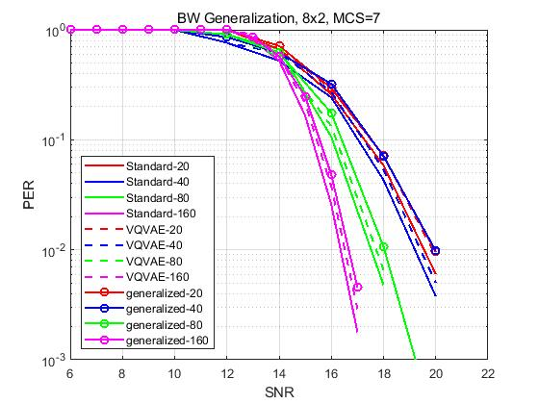
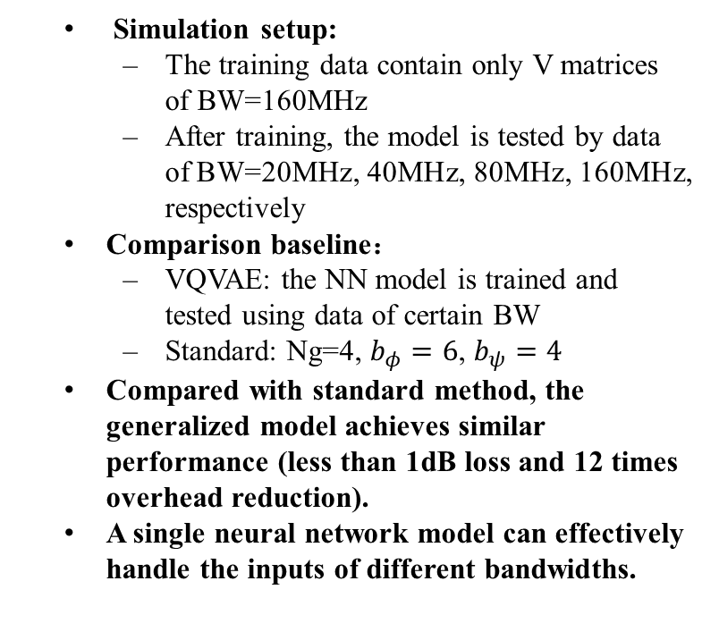
Generalization of different bandwidth
Simulation setup:
The training data contain only V matrices of BW=160MHz
After training, the model is tested by data of BW=20MHz, 40MHz, 80MHz, 160MHz, respectively
Comparison baseline：
VQVAE: the NN model is trained and tested using data of certain BW
Standard: Ng=4, $b_{φ}=6$, $b_{ψ}=4$
Compared with standard method, the generalized model achieves similar performance (less than 1dB loss and 12 times overhead reduction).
A single neural network model can effectively handle the inputs of different bandwidths.
Legend | Train data | Test data
generalized-20 | 160 MHz | 20 MHz
VQVAE-20 | 20 MHz | 20 MHz
generalized-40 | 160 MHz | 40 MHz
VQVAE-40 | 40 MHz | 40 MHz

Slide 16
Computation complexity and model deployment overhead reduction
AP
STA
AP
STA
Training and model sharing
NDP
Channel estimation, SVD, Givens rotation
V or$φ,ψ$
NDP
Train the encoder, codebook and decoder
Channel estimation, SVD
V
encoder and codebook
$$\tilde{V}$$
Decoder,
codebook
Index
Encoder,
codebook
beamforming
Efficient ways to reduce the overhead and computation complexity:
Lightweight encoder
Direct quantization without codebook
Data

Slide 17
Computation complexity and model deployment overhead reduction
Previous VQVAEs adopt symmetric encoder and decoder architecture and vector quantization (codebook-based).
A transformer-based decoder is used to enable lightweight encoder.
Codebook-based quantization is replaced by uniform quantization to reduce transmission overhead.
The number of encoder parameters (weight and bias) as well as the computation complexity are reduced by more than 1000 times.
ENC
codebook
codebook
DEC
LW-ENC
quantize
dequantize
DEC

Slide 18
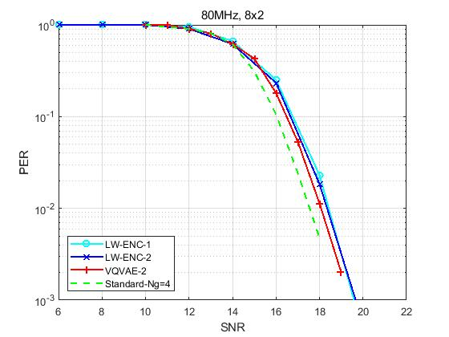
Computation complexity and model deployment overhead reduction
Two CNN-based lightweight encoders (LW-ENC) are studied
Reduce computation complexity and model and codebook sharing overhead significantly
Achieve same compression ratio and goodput performance compared to previous model
Method | Feedback overhead (bits) | Goodput (Mbps) | Codebook size | Codebook dimension | # params of codebook | # params of encoder | Computation complexity of encoder (MACs)
VQVAE-2 | 1280 | 16.00 | 1024 | 32 | 32768 | 5.0M | 2.2G
LW-ENC-1 |  |  | 0 | 0 | 0 | 3.9K | 0.7M
LW-ENC-2 |  |  | 0 | 0 | 0 | 2.9K | 1.6M
The overhead and goodput of standard method (Givens rotation, Ng=4, $b_{φ}=6$, $b_{ψ}=4$) are 32500bits and 5.07Mbps.
MACs: Multiply–accumulate operations

Slide 19
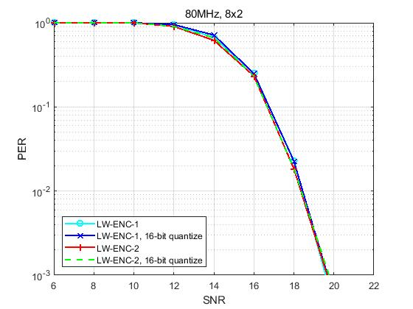
Computation complexity and model deployment overhead reduction
We discuss possible ways of encoder sharing the corresponding overhead.
If the encoder architecture is standardized, only need to share the parameters. For LW-ENC-1, the overhead is 7.8KBytes if 16-bit quantization is used. Simulation shows that there is no performance loss using 16-bit encoder for CSI feedback.
Alternatively, need to negotiate encoder architecture using existing format such as NNEF[6] and ONNX[7]. For LW-ENC-1, the overhead is 22KBytes if ONNX is used.
Other model deployment/quantization method can be further studied.
AP
STA
NDP
Channel estimation, SVD, Givens rotation
V or$φ,ψ$
Train the encoder, codebook and decoder
encoder

Slide 20
Summary
In this contribution, we showed performance enhancement for autoencoder-based CSI compression scheme proposed in [5], including
Model generalization under different bandwidths,
Lightweight encoder that reduces computation complexity and model deployment overhead by more than 1000 times, and maintains the goodput performance
Further Study
More complex scenarios, e.g., MU-MIMO
Other quantization methods for more efficient model sharing

Slide 21
References
[1] M. Deshmukh, Z. Lin, H. Lou, M. Kamel, R. Yang, I. Güvenç, “Intelligent Feedback Overhead Reduction (iFOR) in Wi-Fi 7 and Beyond,” in Proceedings of 2022 VTC-Spring
[2] 11-22-1563-02-aiml-ai-ml-use-case
[3] P. K. Sangdeh, H. Pirayesh, A. Mobiny, H. Zeng, “LB-SciFi: Online Learning-Based Channel Feedback for MU-MIMO in Wireless LANs, ” in Proceedings of 2020 IEEE 28th ICNP
[4] A. Oord, O. Vinyals, “Neural discrete representation learning,” Advances in neural information processing systems, 2017.
[5] 11-23-0290-01-aiml-study-on-ai-csi-compression
[6] The Khronos NNEF Working Group, “Neural Network Exchange Format”, https://www.khronos.org/registry/NNEF/specs/1.0/nnef-1.0.5.html
[7] Open Neural Network Exchange (ONNX), https://onnx.ai
[8] 11-23-0755-00-aiml-aiml-assisted-complexity-reduction-for-beamforming-csi-feedback-using-autoencoder
[9] 11-23-0906-02-aiml-proposed-ieee-802-11-aiml-tig-technical-report-text-for-the-csi-compression-use-case

