Slide 1
Study on AI CSI Compression
Date: 2023-05
Authors:

Slide 2
Abstract
In previous contribution (r0&r1) [5], we
reviewed some existing works on AI CSI compression,
introduced a new vector quantization variational autoencoder (VQ-VAE) method for CSI compression,
discussed the performance and possible future work.
In this updated version (r2), we have a follow-up discussion on the proposed VQVAE method, including
Feedback overhead reduction and goodput improvement,
Generalization of different channel models,
Generalization of different numbers of receive antennas.

Slide 3
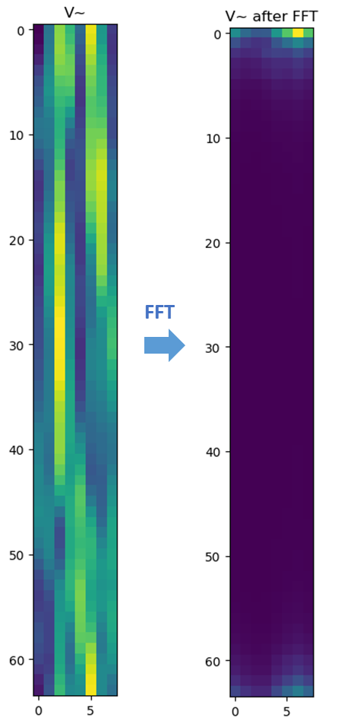
Background
The AP initiates the sounding sequence by transmitting the NDPA frame followed by a NDP which is used for the generation of V matrix at the STA.
The STA applies Givens rotation on the V matrix and feeds back the angels in the beamforming report frame.
The total feedback overhead is $N_{a}∗\frac{b_{φ}+b_{ψ}}{2}∗\frac{N_{sc}}{N_{g}}$. Larger bandwidth and number of antennas lead to significantly increased sounding feedback overhead, which increases the latency and limits the throughput gain.
Visualization of the precoding matrix after FFT shows its sparsity and compressibility.
Ntx=Nrx=Nss | BW=20MHz | BW=40MHz | BW=80MHz | BW=160MHz | BW=320MHz
2 | 0.12 (KBytes) | 0.24 | 0.50 | 1.00 | 1.99
4 | 0.73 | 1.45 | 2.99 | 5.98 | 11.95
8 | 3.39 | 6.78 | 13.94 | 27.89 | 55.78
16 | 14.52 | 29.04 | 59.76 | 119.52 | 239.04
20MHz, 8*2

Slide 4
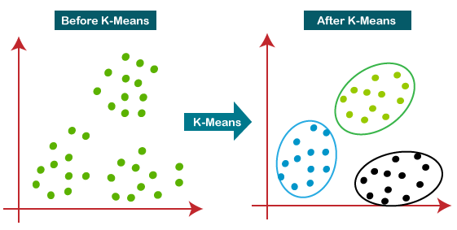
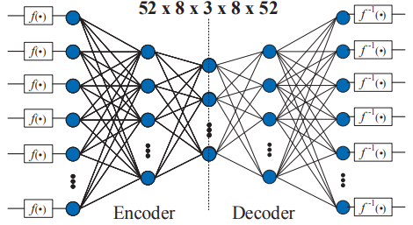
Existing Work on AI CSI Compression
ML solutions: no neural network
[1][2] adopted a traditional machine learning algorithm, i.e., K-means, to cluster the angle vector after Givens rotation
Beamformer and beamformee need to exchange and store the centroids
Only transmit the centroid index during inference
2dB PER loss, up to 50% goodput improvement
AI solutions: use neural network
[3] adopted two autoencoders to compress two types of angles after Givens rotation separately
Beamformer and beamformee need to exchange the store neural network models
Only transmit the encoder output during inference
Up to 70% overhead reduction and 60% throughput gain for 11ac system

Slide 5
Our Study on AI CSI Compression
Vector quantization variational autoencoder (VQVAE) [4] is proposed for CSI compression
Consists of encoder, codebook, decoder
Learn how to compress and quantize automatically from the data
Convolutional neural network (CNN) or transformer could be used for both the encoder and decoder.
Input of NN could be the V matrix or the angles after Givens rotation.
Beamformer and beamformee need to exchange and store the codebook and half of the NN model.
Only transmit the codeword index during inference.

Slide 6
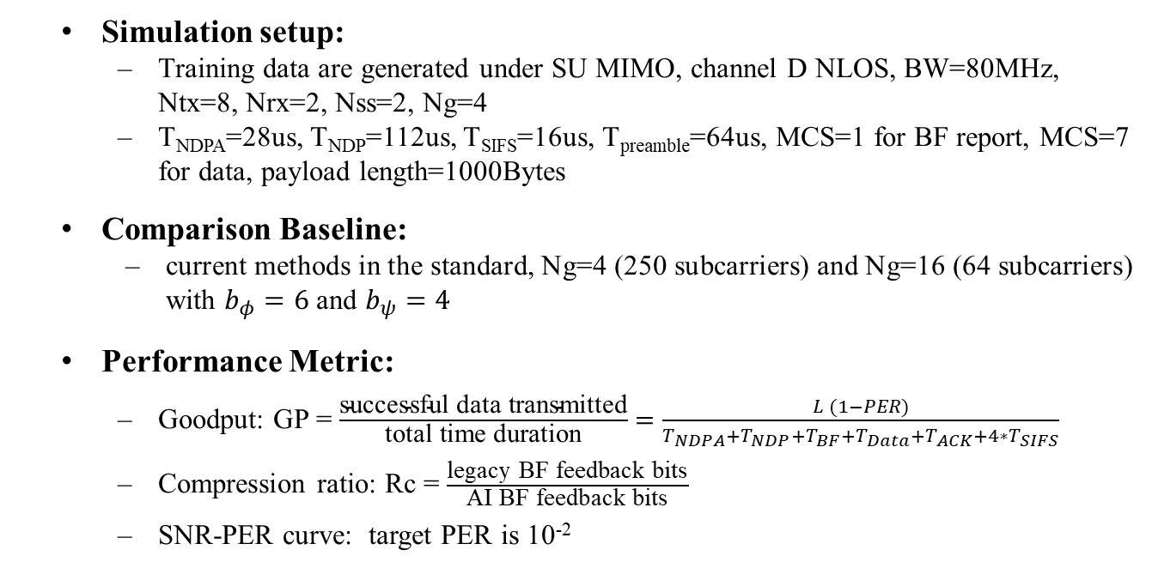
Performance Evaluation
Simulation setup:
Training data are generated under SU MIMO, channel D NLOS, BW=80MHz, Ntx=8, Nrx=2, Nss=2, Ng=4
T_{NDPA}=28us, T_{NDP}=112us, T_{SIFS}=16us, T_{preamble}=64us, MCS=1 for BF report, MCS=7 for data, payload length=1000Bytes
Comparison Baseline:
current methods in the standard, Ng=4 (250 subcarriers) and Ng=16 (64 subcarriers) with $b_{φ}=6$ and $b_{ψ}=4$
Performance Metric:
Goodput: GP = $\frac{\text{successful} \text{data} \text{transmitted}}{\text{total} \text{time} \text{duration}}=\frac{L (1−PER)}{T_{NDPA}+T_{NDP}+T_{BF}+T_{Data}+T_{ACK}+4∗T_{SIFS}}$
Compression ratio: Rc = $\frac{\text{l}\text{egacy} \text{BF} \text{feedback} \text{bits}}{\text{AI} \text{BF} \text{feedback} \text{bits}}$
SNR-PER curve: target PER is 10⁻²
SIFS
SIFS
SIFS
SIFS
NDPA
NDP
Data
BF
ACK

Slide 7
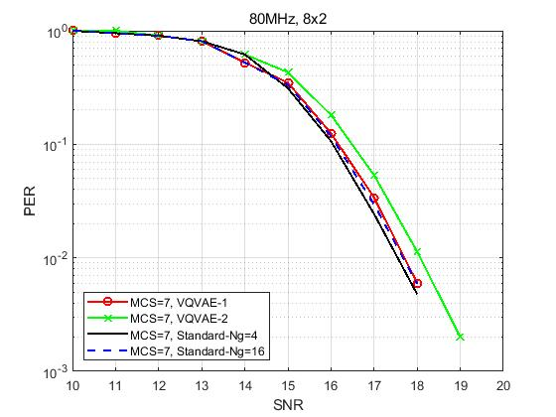
Performance Evaluation
Method | overhead Ng=4 (bits) | overhead Ng=16 (bits) | overhead VQVAE (bits) | Rc vs Ng=4 | Rc vs Ng=16 | Loss @ 0.01 PER (dB) vs Ng=4 | loss @ 0.01 PER (dB) vs Ng=16 | GP Ng=4 (Mbps) | GP Ng=16 (Mbps) | GP AI (Mbps) | GP gain (%) vs Ng=4 | GP gain (%) vs Ng=16
VQVAE-1 | 32500 | 8320 | 2560 | 12.70 | 3.25 | 0.16 | 0 | 5.07 | 10.77 | 14.70 | 189.64 | 36.48
VQVAE-2 | 32500 | 8320 | 1280 | 25.39 | 6.50 | 0.5 | 0.4 | 5.07 | 10.77 | 16.00 | 215.20 | 48.53
Notes:
Train the VQVAE model based on generated V matrices
Apply the trained model to do precoding
Run PER curve under

Slide 8
Further Study in r2
Reduce the feedback overhead and improve the goodput
Different neural network architecture
Reduce codebook size and dimension
More complex scenarios
More simulations under different configurations
MU-MIMO scenarios
Increase model generalization
One neural network can exhibit robustness to different channel models
One neural network can exhibit robustness to different bandwidth
One neural network can exhibit robustness to number of antennas

Slide 9
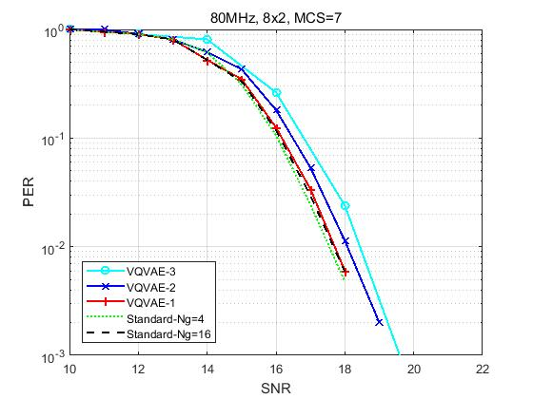
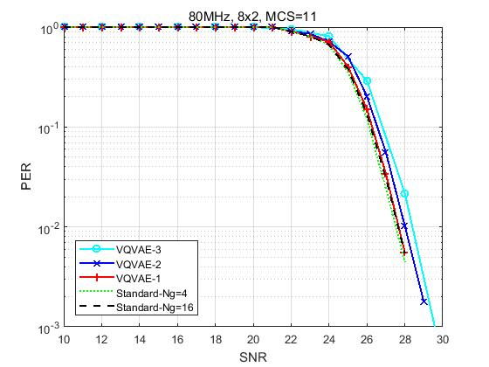

Feedback overhead reduction and goodput improvement
Simulation setup:
SU MIMO, channel D NLOS, BW=80MHz, Ntx=8, Nrx=Nss=2
Higher compression ratio and more MCS are considered
Comparison baseline：
Standard: Givens, Ng=4/16, $b_{φ}$=6, $b_{ψ}$=4
VQVAEs with different compression ratios achieve less than 1dB PER loss compared with standard method.
Rc=12 (CB size 1024)
Rc=25 (CB size 1024)
Rc=36 (CB size 128)

Slide 10
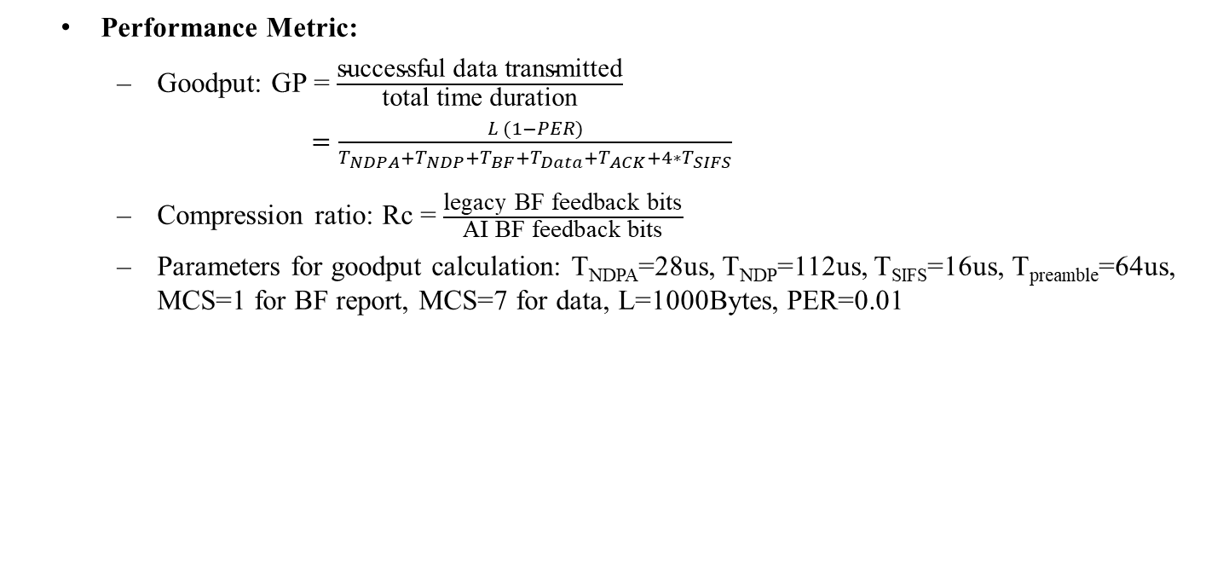
Goodput improvement and feedback overhead reduction
Performance Metric:
Goodput: GP = $\frac{\text{successful} \text{data} \text{transmitted}}{\text{total} \text{time} \text{duration}}$
$=\frac{L (1−PER)}{T_{NDPA}+T_{NDP}+T_{BF}+T_{Data}+T_{ACK}+4∗T_{SIFS}}$
Compression ratio: Rc = $\frac{\text{legacy} \text{BF} \text{feedback} \text{bits}}{\text{AI} \text{BF} \text{feedback} \text{bits}}$
Parameters for goodput calculation: T_{NDPA}=28us, T_{NDP}=112us, T_{SIFS}=16us, T_{preamble}=64us, MCS=1 for BF report, MCS=7 for data, L=1000Bytes, PER=0.01
SIFS
SIFS
SIFS
SIFS
NDPA
NDP
Data
BF
ACK
Method | VQ size | overhead Ng=4 (bits) | overhead Ng=16 (bits) | overhead VQVAE (bits) | Rc vs Ng=4 | Rc vs Ng=16 | Loss @ 0.01 PER (dB) vs Ng=4 | loss @ 0.01 PER (dB) vs Ng=16 | GP Ng=4 (Mbps) | GP Ng=16 (Mbps) | GP AI (Mbps) | GP gain (%) vs Ng=4 | GP gain (%) vs Ng=16
VQVAE-1 | 1024 | 32500 | 8320 | 2560 | 12.70 | 3.25 | 0.16 | 0 | 5.07 | 10.77 | 14.70 | 189.64 | 36.48
VQVAE-2 | 1024 | 32500 | 8320 | 1280 | 25.39 | 6.50 | 0.5 | 0.4 | 5.07 | 10.77 | 16.00 | 215.20 | 48.53
VQVAE-3 | 128 | 32500 | 8320 | 896 | 36.27 | 9.29 | 0.9 | 0.8 | 5.07 | 10.77 | 16.43 | 223.77 | 52.57

Slide 11
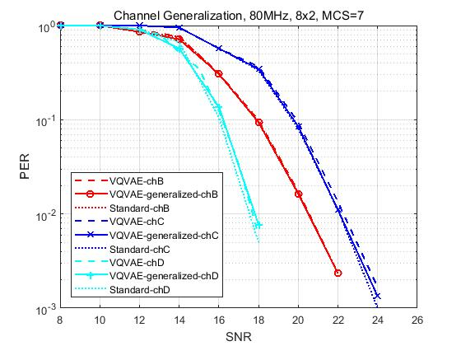
Generalization of different channel models
Simulation setup:
Training data are a combination of V matrices generated under channel model B, C, and D
The trained model is tested by data of channel B, C, and D, respectively
Comparison baseline：
VQVAE-chX: NN model is trained and tested using data of channel X
Standard-chX: Ng=4, $b_{φ}$=6, $b_{ψ}$=4
Compared with standard method, the generalized NN model has no PER loss for channel B and C, and 0.5dB PER loss for channel D.
A well-trained neural network model is robust to different channel conditions.
Legend | Train data | Test data
VQVAE-generalized-chB | B, C, D | B
VQVAE-chB | B | B
VQVAE-generalized-chC | B, C, D | C
VQVAE-chC | C | C

Slide 12
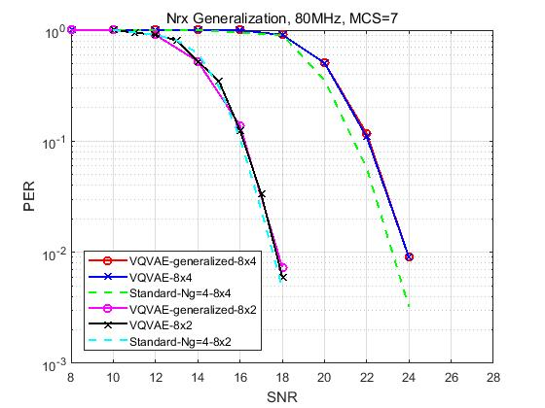
Generalization of different Nrx/Nss
Simulation setup:
Training data are a combination of V matrices of different Nrx (i.e., Nrx=2 and 4)
The trained model is tested by data of Nrx=2 and Nrx=4, respectively
Comparison baseline：
VQVAE: NN model is trained and tested using data of certain Nrx
Standard: Ng=4, $b_{φ}=6$, $b_{ψ}=4$
Compared with standard method, the generalized NN model has 0.2/0.8dB PER loss for Nrx=2/4.
A well-trained neural network model is robust to different number of receive antennas.
Legend | Train data | Test data
VQVAE-generalized-8x4 | 8x2 + 8x4 | 8x4
VQVAE-8x4 | 8x4 | 8x4
VQVAE-generalized-8x2 | 8x2 + 8x4 | 8x2
VQVAE-8x2 | 8x2 | 8x2

Slide 13
Workflow of AI CSI compression using autoencoder
AP
STA
AP
STA
Training and model sharing
NDP
Channel estimation, SVD, Givens rotation
V or$φ,ψ$
NDP
Train the encoder, codebook and decoder
Channel estimation, SVD
V
encoder and codebook
$$\tilde{V}$$
Decoder,
codebook
Index
Encoder,
codebook
NN model training
Infrequently: hours, days or even months
Original V can be feedbacked to facilitate training if possible
Standardize the encoder architecture; alternatively, negotiate encoder architecture using existing format such as NNEF[6] and ONNX[7]
beamforming
Data

Slide 14
Summary
In this contribution, we showed performance enhancement for VQVAE-based CSI compression scheme proposed in [5], including
Further feedback overhead reduction and goodput improvement,
NN model generalization of different channel models,
NN model generalization of different numbers of receive antennas.
We also presented the workflow of AI CSI compression using autoencoder.
Further study
Robustness to different bandwidths and number of transmit antennas
MU-MIMO scenarios
Complexity reduction

Slide 15
References
[1] M. Deshmukh, Z. Lin, H. Lou, M. Kamel, R. Yang, I. Güvenç, “Intelligent Feedback Overhead Reduction (iFOR) in Wi-Fi 7 and Beyond,” in Proceedings of 2022 VTC-Spring
[2] 11-22-1563-02-aiml-ai-ml-use-case
[3] P. K. Sangdeh, H. Pirayesh, A. Mobiny, H. Zeng, “LB-SciFi: Online Learning-Based Channel Feedback for MU-MIMO in Wireless LANs, ” in Proceedings of 2020 IEEE 28th ICNP
[4] A. Oord, O. Vinyals, “Neural discrete representation learning,” Advances in neural information processing systems, 2017.
[5] 11-23-0290-01-aiml-study-on-ai-csi-compression
[6] The Khronos NNEF Working Group, “Neural Network Exchange Format”, https://www.khronos.org/registry/NNEF/specs/1.0/nnef-1.0.5.html
[7] Open Neural Network Exchange (ONNX), https://onnx.ai

