Slide 1
Preemption for Low Latency Application
Date: 2023-03-13
Authors:

Slide 2
Introduction
Objectives of UHR SG [1]:
Improve reliability of WLAN connectivity
Reduce latency
Increase manageability
Increase throughput including at different SNR levels
Reduce device level power consumption
This contribution reviews one of the main challenges to reduce latency and discusses one general solution

Slide 3
Problem statement
How to enable low latency (LL) applications in 802.11 networks that are heavily loaded with other clients’ high throughput transmissions; while at the same time minimize the performance impact to the high throughput traffic?
In other words, how to reconcile the contradicting need:
to allow long and efficient TXOPs for high throughput traffic
to restrict TXOP limit for latency reduction

Slide 4
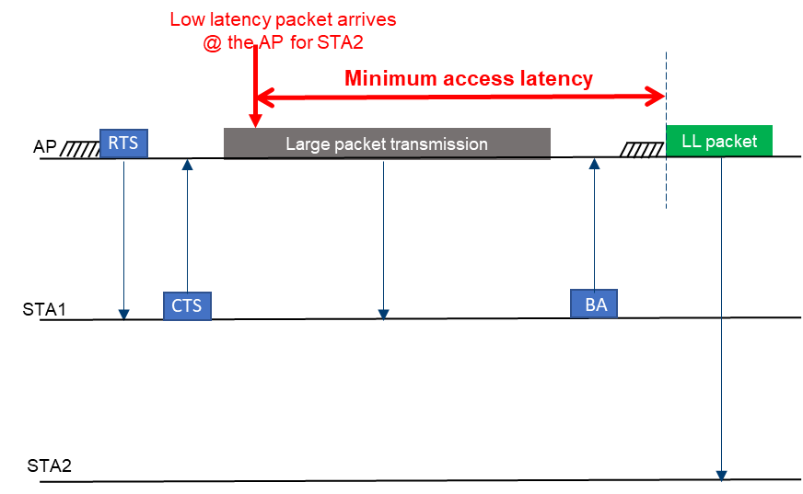
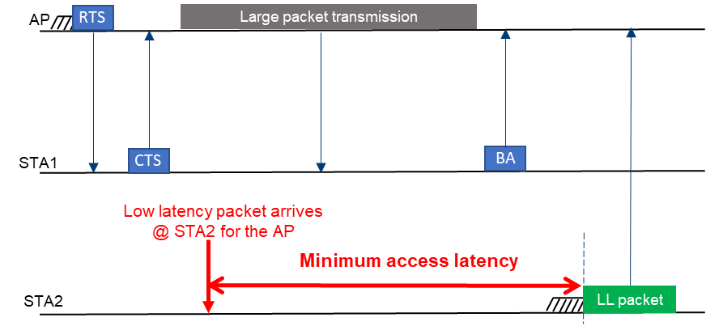
Two main cases with large delay due to large PPDU transmission in TXOP
Case A: LL transmitter is the TXOP holder [2-3]
Case B: LL transmitter is not the TXOP holder [4]:
DL TXOP →UL LL data; UL TXOP →DL LL data
UL TXOP →UL LL data

Slide 5

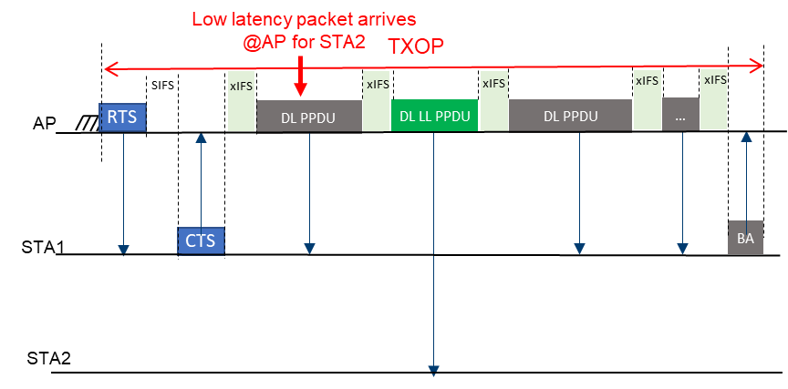
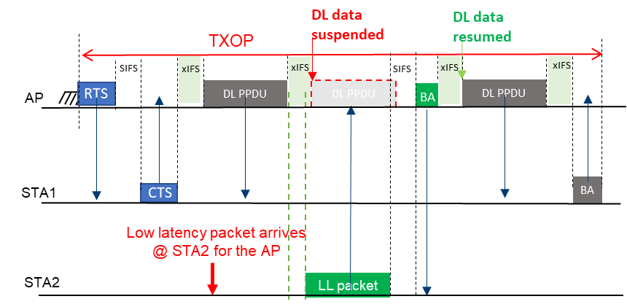
General solution for case A and case B (Event-based or periodic LL traffic with jitters)
Divide the large PPDU into small PPDUs with maximum length limitation and xIFS ( ) gaps to provide preemption opportunity for the LL transmitter
Case A: TXOP holder can insert DL LL packet within the TXOP
Case B: LL transmitter can preempt the on-going transmissions in a TXOP during a xIFS time
Further considerations: xIFS length; collisions and hidden node problem between multiple LL STAs
Case A: LL transmitter is the TXOP holder
Case B: LL transmitter is not the TXOP holder

Slide 6
Simulation results
Traffic information:
4 DL/UL non-LL streams to/from 4 STAs
Full buffer traffic
Priority : AC_BE
LL stream
160 bytes every 12ms to/from 1 LL STA
Priority : AC_VO
Comparison:
Legacy (TXOP=6ms):
LL transmitter has to wait until the end of an ongoing TXOP in any direction to do EDCA
Proposed solution (TXOP=6ms):
Maximum PPDU length = 1ms
In the DL, AP can insert the DL LL PPDU within DL TXOP
LL transmitter can use xIFS gaps between PPDUs to preempt the next PPDU transmission
 | Aggregated TPT(Mbps) | Throughput degradation
Legacy | 1215
Proposed | 1101 | -9%
The proposed solution can improve the latency performance with low throughput degradation to non-LL traffic while the LL traffic is not frequently generated
Notes:
proposed case: Almost does not use EDCA to transmit data as nearly all transmissions happen as a part of preemption.

Slide 7
Summary
It is challenging to support low latency applications in 802.11 while maintaining good performance for high throughput traffic.
In other words, how to reconcile the contradicting need:
to allow long and efficient TXOPs for high throughput traffic
to restrict TXOP limit for latency reduction
We propose a preemption technique to support low latency while there is a long TXOP transmission

Slide 8
References
[1] 11-22/0708r3, ‘Beyond be – Proposed Next Step’, Rolf de Vegt
[2] 11-22/1393r0, “uhr-latency-reduction-scheme-for-uhr”
[3] 11-22/1880r1, “Latency and Reliability enhancements for UHR”
[4] 11-23/0018r1, “uhr-low-latency-support-in-uhr”

