Slide 1
Considerations on Latency Improvement
Date: 2023-01-16
Authors:
Name | Affiliation | Address | Phone | Email
Insun Jang | LG Electronics | 19, Yangjae-daero 11gil, Seocho-gu, Seoul 137-130, Korea |  | insun.jang@lge.com
Jinsoo Choi
 |  |  |  | js.choi@lge.com
Sunhee Baek
 |  |  |  | sunhee.baek@lge.com
Yelin Yoon |  |  |  | yl.yoon@lge.com
Geonhwan Kim |  |  |  | geonhwan.kim@lge.com
Eunsung Park |  |  |  | esung.park@lge.com
Dongguk Lim |  |  |  | dongguk.lim@lge.com
Jinyoung Chun |  |  |  | jiny.chun@lge.com
Insik Jung |  |  |  | insik0618.jung@lge.com
HanGyu Cho |  |  |  | hg.cho@lge.com
Sanggook Kim |  | 10225 Willow Creek Rd, San Diego, CA, USA |  | sanggook.kim@lge.com

Slide 2
Introduction
Currently, in PAR (although approved not yet), we’re intending to improve (worst case) latency/jitter as the main goal in UHR
With the goal, several presentations [1]-[9] addressed in UHR SG have investigated
Classfication/Prioritization of low latency (LL) traffic [1]
Preemption of LL traffic [2], [3], [9]
Optimized Scheduling (considering the impact of OBSS) [4], [5]
Frame/PPDU Overhead Reduction (in TXOP) [6]-[8]
In this contribution, we share some considerations to improve the latency in UHR in terms of
Scheduling and Preemption of LL traffic

Slide 3
Requirements of Low Latency Traffic
Dedicated Scheduling
(Time-critical) LL traffic should be scheduled by assigning any dedicated resource/period without the contention with any other traffic
The scheduling would depend on its characteristics (e.g., service interval, delay bound)
To this end, we need to discuss how to classify LL traffic clearly
Preemption
(Time-critical) LL traffic should be scheduled by providing a priority and flexibility when incoming LL traffic has to be transmitted quickly
To this end, we need to discuss how to preempt LL traffic
We first observe baseline and then discuss some considerations for each one

Slide 4
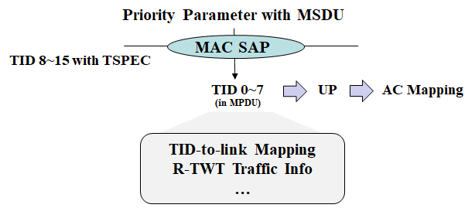
Observation on Baseline: Traffic Classification
In the current baseline, traffic is classified as TID per MSDU based on priority parameter from Higher layer/DS which is mapped to the user priority (UP) and the corresponding Access Category (AC)
Specially, TID 0-7 is used as TC while TID 8-15 is used as TS (e.g., in TSPEC)
Further, the traffic characteristics can be configured/described in addition to TID/UP during (Multi-link) SCS procedure (i.e., through QoS Characteristics IE)

Slide 5
Observation on Baseline: Scheduling
Based on the baseline, we can utilize TID-based scheduling to schedule low latency (LL) traffic flow, e.g.,
In terms of multi-link, TID-to-link Mapping (T2LM)
In terms of service period, restricted TWT (rTWT) through Traffic Info
If SCS negotiation exists, its requirements can apply the scheduling
However, we can have the following observations
Per TID, an STA may have LL traffic and non-LL traffic as the same priority and multiple LL traffic with different characteristics
It would be better for a specific LL traffic flow to be transmitted separately from non-LL traffic or another LL traffic with different characteristics on any dedicated resources
Different STAs may have LL traffic with similar or different characteristics
AP MLD has the global view of the traffic information (if negotiated) and can schedule LL traffic with similar characteristics on the same dedicated resources
The current baseline is not enough to resolve those observations

Slide 6
Consideration on LL Traffic Classification
We can classify LL traffic by enhancing the current one, e.g.,
Identifying LL traffic per TID by making sub_IDs, i.e., 2-tuple <TID, sub_ID (e.g., LLT ID)>
It maintains the current space of TID (0~7)
AP can assign the sub_ID depending on traffic characteristics (e.g., when SCS negotiated)
Extending available TID space (e.g., up to 15)
It would require the modifications on higher layers to support the assignment
By utilizing the classification
We can transmit the identified LL traffic only on any dedicated link, SP with enhanced identification, or Triggered UL in a TXOP
We can have an opportunity to access the channel or transmit quickly if a new queue/EDCA parameter set is introduced and applied

Slide 7
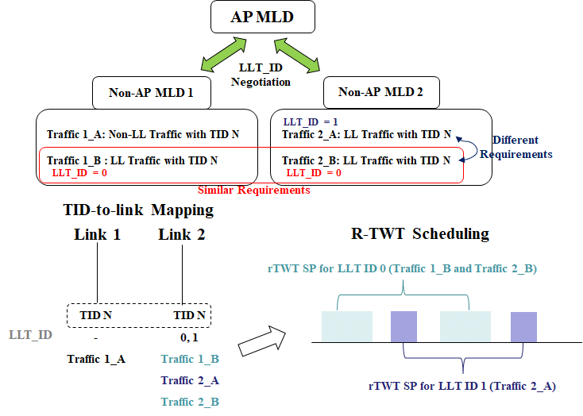
Example: TID-to-link Mapping & R-TWT Scheduling
Example assumes that TID N is mapped to link 1 and link 2

Slide 8
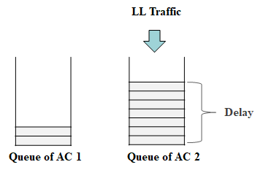
Observation on Baseline: AC Mapping
We use a fixed UP-to-AC Mapping based on a given TID
In other words, if a TID/UP is assigned to LL traffic is assigned, AC is determined based on the fixed table
We may want LL traffic to be assigned to other AC(s) not fixed one by experiencing the cases, e.g.,
LL traffic TX may be delayed due to head-of-line (HOL) blocking in the queue of AC corresponding to the LL traffic
There may be a chance to get a queue/AC which has almost no MSDUs queued or which has almost completed back-off to gain the channel access
Some LL traffic may need to be assigned to AC (e.g., with higher priority) than its another fixed AC

Slide 9
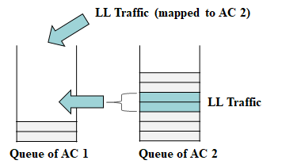
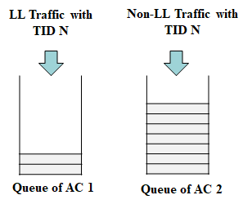
Consideration on AC Mapping for LL Traffic
For the preemption of LL traffic for quick TX, we can consider the change of AC mapping dynamically rather than the currently fixed one
It may be able to apply to incoming LL traffic or already queued LL traffic
One or more AC(s) may be mapped to LL traffic
Dynamic level and relevant parameters needs to be further investigated, e.g.,
Whether it can be applied to Per BSS, STA, or LL Traffic flow
How to apply EDCA parameters

Slide 10
Conclusion
In this contribution, we’ve shared high-level thoughts to improve the latency in UHR in terms of
Scheduling and Preemption of LL traffic
Specifically, we’ve investigated the classification of LL traffic for scheduling with dedicated resources and dynamic AC mapping for preemption of LL traffic,
We need to further investigate in terms of many aspects, e.g.,
Proper level for classification/preemption of various LL traffic
Complexity and Impact on existing implementation

Slide 11
References
[1] 22/1930r0, Layered QoS and multi-layer transmission
[2] 22/1880r1, Latency and Reliability enhancements for UHR
[3] 22/1393r0, Latency Reduction Scheme for UHR
[4] 22/1899r0, Multi-AP Operation for Low Latency Traffic Delivery - Follow up
[5] 22/1556r1, Multi-AP Coordination for Low Latency Traffic Delivery
[6] 22/1926r0, Challenges to achieve low latency
[7] 22/1923r1, Enhanced Trigger-Based Uplink Transmission
[8] 22/1939r0, PPDU Design for Short Frames
[9] 23/0018r1, Low latency support in UHR

