Slide 1
Low Latency Support in UHR
Date: 2023-02-05
Authors:

Slide 2
Introduction
Latency reduction is one of the main requirement to be improved in the UHR group as described in the approved motion for UHR SG formation.
Various UHR contributions were discussed for latency improvement with the following potential technical direction.
  Preemption [1], [2]
  AI/ML [3]
  M-AP coordination [4], [5]
  Overhead reduction [6]
In this contribution, we discuss potential UHR features for low latency support, and especially “preemption”.

Slide 3
R-TWT in UHR
R-TWT in 11be is a mechanism to protect and prioritize the low latency traffic by allocating R-TWT SPs and overlapping quiet intervals.
In 11be WG LB, we had many technical comments for R-TWT which were not reached the group consensus.
Some UHR contributions addressed potential improvement on R-TWT such as
  TWT Information sharing among neighboring APs and protection of neighbor AP’s R-TWT SP [4]
  Multi-AP coordinated resource reservation and protection for low latency traffic [5]
Improvement on R-TWT is quite straightforward to support low latency in UHR with the following technical items.
  R-TWT SP coordination among OBSSs
  R-TWT SP protection of neighbor APs
  R-TWT SP protection of other APs in the same Multiple BSSID set
  R-TWT SP extension
  Etc.

Slide 4
Preemption
For a deterministic low latency traffic,
  11be R-TWT and SCS can be used to support the deterministic low latency traffic.
  When R-TWT SPs are scheduled, the channel can be occupied by other STAs such as non-R-TWT STAs or OBSS STAs during the R-TWT SP.
For an event-based low latency traffic,
  The issue of non-deterministic low latency traffic was discussed in [2]
In UHR, an AP needs to schedule at any time an event-based and/or deterministic low latency traffic by preempting the ongoing transmission or the TXOP.
Preemption can be used;
  In case of long PPDU transmission, a TXOP holder can transmit the low latency frame before finishing the current transmission.
  → Preemption within a PPDU
  In case of low latency frame buffered at a non-TXOP holder, the low latency frame can be transmitted before finishing the current TXOP.
  → Preemption within a TXOP

Slide 5
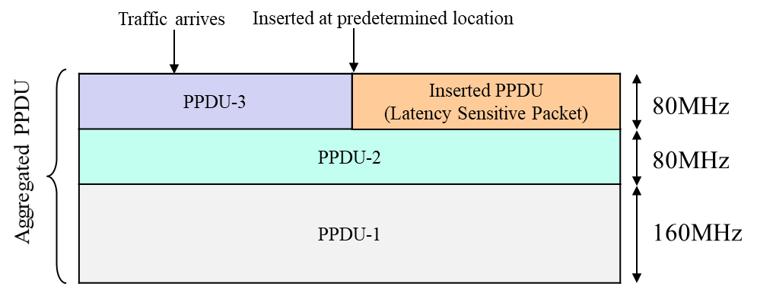
Preemption within a PPDU
Preemption by a TXOP holder
  TXOP holder is transmitting non-low latency traffic when the low latency traffic arrives.
  To reduce delay of low latency traffic, the low latency traffic can be sent by interrupting the current PPDU transmission.
Two types of preemption can be considered
  Aggregation in a PPDU being transmitted
    Two-dimensional resource-based preemption was introduced [1]
    High efficiency and high complexity
  Transmission in a separate PPDU [2]
    Relatively low efficiency and low complexity
Example of A-PPDU for preemption [1]
Example of a separate PPDU for preemption [2]

Slide 6
Preemption within a TXOP
During other STA’s TXOP, low latency data frame may be buffered at a non-TXOP holder.
A non-TXOP holder should be able to transmit a low latency data frame by interrupting the current TXOP.

Slide 7
Preemption within a TXOP – Possible Cases
Case 1: DL low latency data TX in a UL TXOP
  TXOP responder (AP) needs to preempt the UL TXOP.
Case 2: UL low latency data TX in a DL TXOP
  During a DL TXOP, an AP needs to transmit a Trigger frame for scheduling UL resource for UL low latency traffic
Case 3: UL low latency data TX in a UL TXOP
  A TXOP holder (non-AP STA) needs to allocate a time period for an AP to schedule a UL resource for UL low latency traffic.
Case 4: Low latency data TX in an OBSS TXOP
  Aggressive Spatial Reuse can be defined for an AP/non-AP STA to transmit a low latency frame during an OBSS TXOP.

Slide 8
Preemption within a TXOP – Coexistence
With SCS
  An AP may pre-empt a TXOP to schedule the periodic low latency traffic stream (DL/UL/Direct Link) which has been established between the AP and a non-AP STA using the SCS procedure.
With TWT
  An AP may pre-empt a TXOP during an individual and/or a broadcast TWT SP such as an R-TWT SP if a non-AP STA is a TXOP holder of the TXOP.

Slide 9
Further consideration
Max. PPDU length limitation for non-low latency traffic
Channel access with various IFSs applicable to low latency and non-low latency traffic
Time period reservation within a TXOP for low latency traffic
Etc.

Slide 10
Summary
Latency reduction is one of the main requirement in UHR.
Improvement on 11be R-TWT in UHR is straightforward.
For better support of low latency traffic, a TXOP can be preempted by a (non-)TXOP holder during the DL/UL/OBSS TXOP.

Slide 11
References
[1] 11-22/1393, Latency Reduction Scheme for UHR
[2] 11-22/1880, Latency and Reliability enhancements for UHR
[3] 11-22/1519, Requirements of Low Latency in UHR
[4] 11-22/1530, Multi AP coordination for next-generation Wi-Fi
[5] 11-22/1556, Multi-AP Coordination for Low Latency Traffic Delivery
[6] 11-22/1926, Challenges to achieve deterministic low latency in next generation 802.11

