Slide 1
Summary and recommendation for AMP IoT
November 2022
Doc.: IEEE 802.11-22/1960r1
Date: 2022-12-12
Authors:
Name | Affiliation | Address | Phone | Email
Yinan Qi | OPPO |  |  | v-qiyinan@oppo.com
Weijie Xu |  |  |  | xuweijie@oppo.com

Slide 2
Outline
November 2022
Doc.: IEEE 802.11-22/1960r1
Summary of the work in AMP TIG
Recommendations

Slide 3
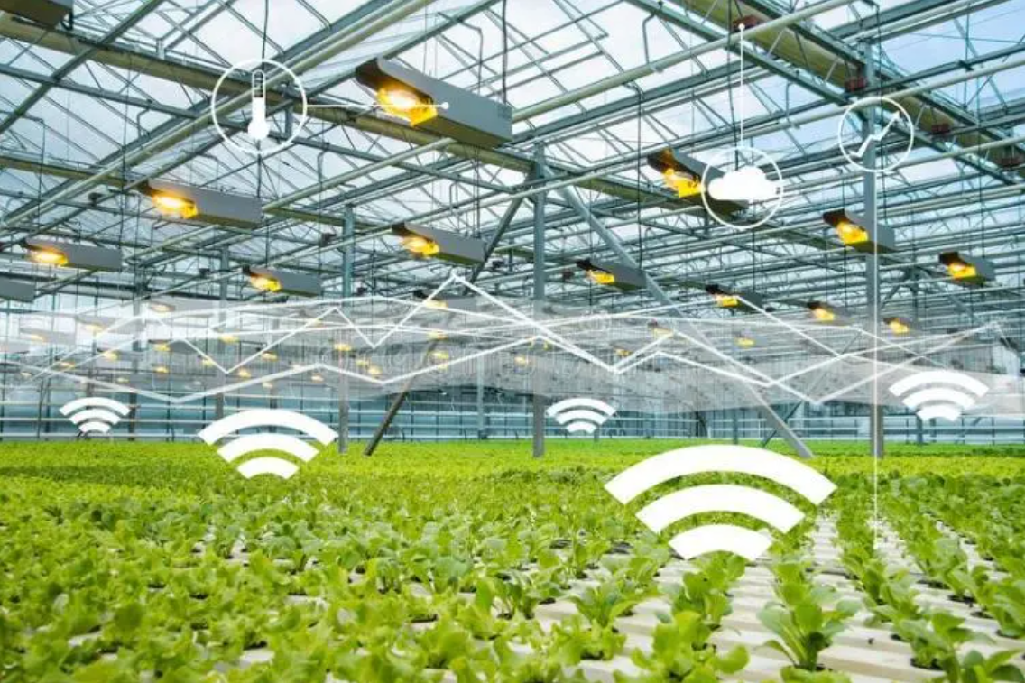
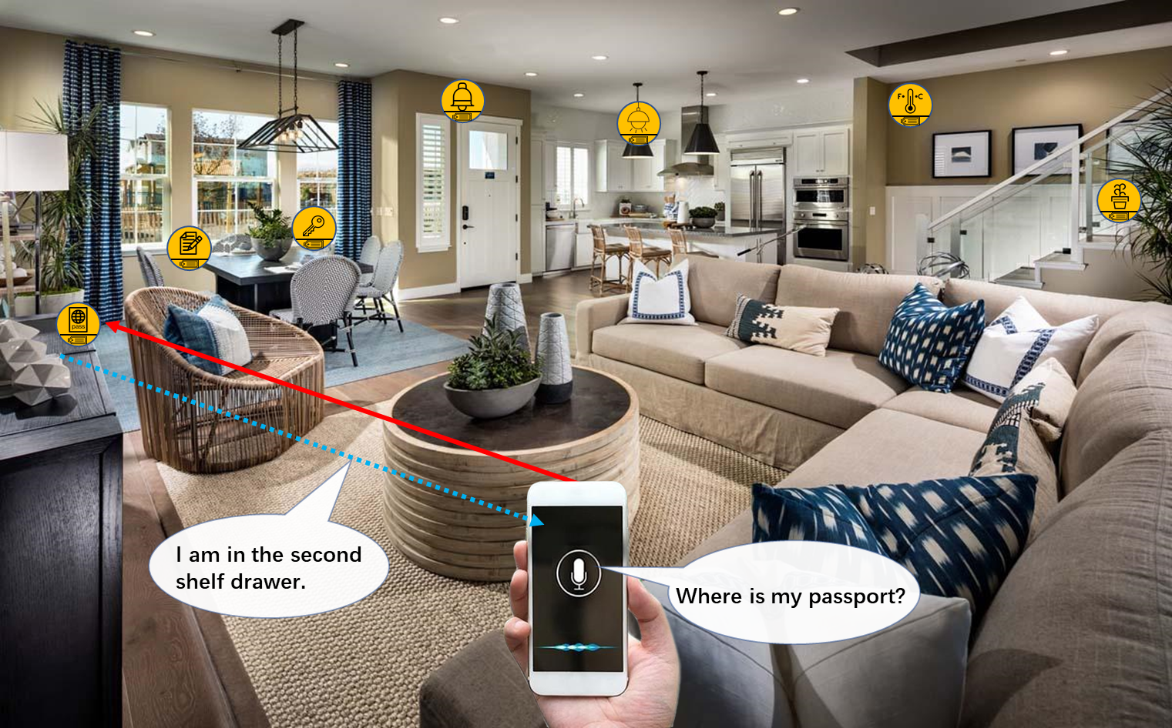
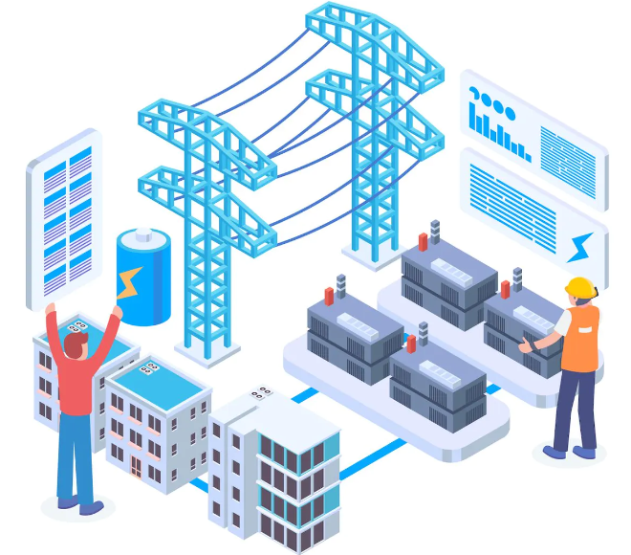
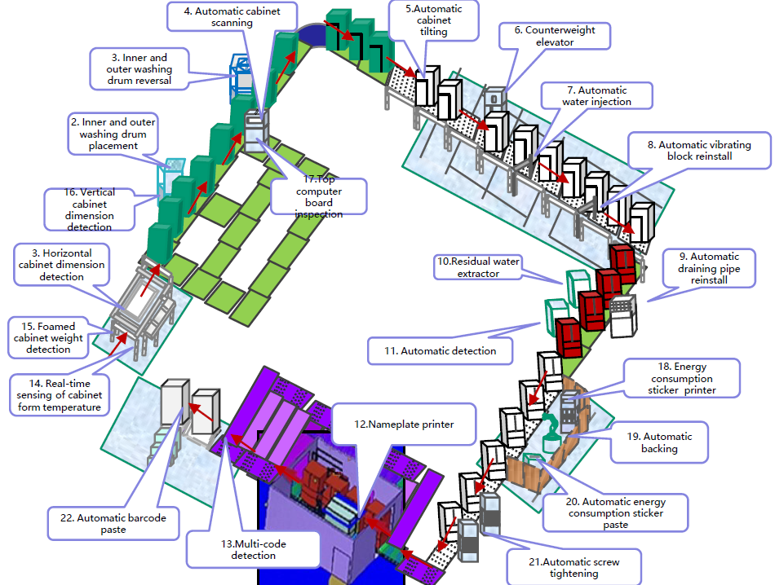
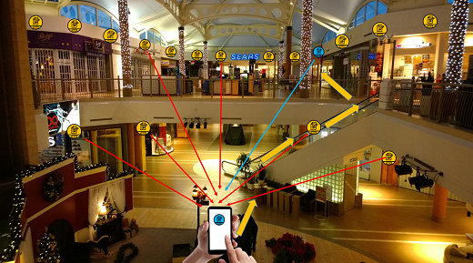
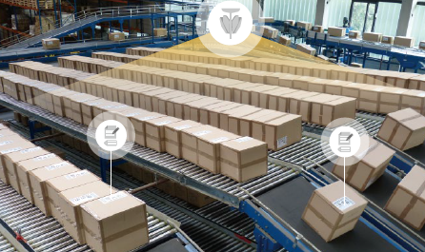
November 2022
Doc.: IEEE 802.11-22/1960r1
Summary(1): Use Cases
  Use case 1 Smart manufacturing: inventory, asset tracking/positioning, and environment/production line sensing and monitoring
  Use case 2 Data Center: environmental monitoring, facility monitoring and asset management
  Use case 3 Smart home: asset management, home environment monitoring and home security.
  Use case 4 Logistics and warehouse: goods tracking and inventory check
  Use case 5 Smart agriculture: monitoring of soil moisture, soil fertility, temperature, wind speed, plant growth etc., and controlling of the agricultural facilities
  Use case 6 Indoor positioning: positioning in giant shopping mall, factories, warehouses, etc.
  Use case 7 Smart Power Grid: Sensing of sound, heat, pressure, etc., smart meter to achieve awareness of device/equipment status
Slide 3
Weijie Xu (OPPO)

Slide 4
November 2022
Doc.: IEEE 802.11-22/1960r1
Summary(2): Requirements of the Use Cases
Use case | Coverage | Peak Data rate | Positioning accuracy | Other requirements
#1Smart manufacturing | 30m indoor 100m outdoor | 100kbps | 1~3 m Horizontal indoor | Battery-less Maintenance-free
#2 Data center | 30m indoor 100moutdoor | 100kbps | - | Battery-less Maintenance-free
#3 Logistics/Warehouse | 10-30 m for indoor case | - | 1~3 m Horizontal indoor | Battery-less, Maintenance-free 99.5% identification accuracy Ultra-low cost and ultra-small size
#4 Smart Home | 10m | - | 1~3 m Horizontal | maintenance-free Battery-less Long service life., e.g., more than 10 years Low complexity and small size
#5 Smart Agriculture | 30m indoor, 200m outdoor | - | - | Battery-less, Low complexity and small size, Processing (i.e., reading IDs) hundreds to thousands of devices per second
#6 Indoor positioning | 10-30 meters indoor | - | 1~3 m horizontal accuracy and 1~2 m vertical accuracy | Small size, maintenance-free, battery-free, and ultra-low-cost IoT devices; Moving speed: 1.5-2 m/s
#7 Smart Grid | 10-30 m indoor, up to 200 m outdoor | 20kbps for sub-station, 3kbps for high voltage transmission line. | - | Maintenance-free and battery-less
Slide 4
Weijie Xu (OPPO)

Slide 5
November 2022
Doc.: IEEE 802.11-22/1960r1
Summary(3): Gap analysis for the Use Cases
Use cases | Issues for state-of-the-art solutions | Benefits of AMP IoT
#1 Smart manufacturing #2 Data center #3Logistics/Warehouse | 1. Manual scanning of labels of barcode or RFID tags for inventory/attendance check 2. Massive deployment of readers due to short communication distance 3. Limited performance on communication distance, system efficiency | 1. Automatic scanning 2. Lower density deployment of APs 3. Improved performance in terms of communication distance, sensitivity and system efficiency 4. Battery-less and Maintenance free
#4 Smart Home | 1. Need to replace battery for many devices 2. High cost/ larger size for applications such as finding small items at home | 1. Battery-less and Maintenance free 2. Small size/low cost to support more applications 3. Support positioning 4. Enable communication between non-AP STA (e.g., smart phone) and AMP IoT devices
#6 Indoor positioning | 1. High deployment cost for indoor navigation and positioning systems 2. High maintenance cost | 1. Small size/low deployment cost 2. Enable positioning by non-AP STA (e.g., smart phone), with 1~3m horizontal positioning accuracy 3. Battery-less and Maintenance free
#5 Smart Agriculture #7 Smart Grid | 1. Power supply with wire cable or battery is needed for sensors 2. High maintenance cost 3. Inaccessible in case of and hazardous operation conditions | 1. Battery-less so that deployment of AMP IoT devices can be flexible and low deployment cost 2. Maintenance free 3. Lower device cost
Slide 5
Weijie Xu (OPPO)

Slide 6
November 2022
Doc.: IEEE 802.11-22/1960r1
Summary(4): Device types
    AMP-only IoT device
    Ultra-low complexity, ultra-power consumption, very small form factor
    Battery-less (i.e., not using conventional battery) and may not need power storage or has limited power storage only (e.g., a capacitor).
    AMP-assisted IoT device
    Higher power storage capability than AMP-only IoT device
    Similar as legacy 802.11 (e.g., 802.11n/11ah) device and can reuse the current PHY design but with enhanced MAC features to well adapt to operation with a specific kind of ambient power.
    Optimized for the power consumption and sustainability to adapt to ambient power usage and achieve maintenance-free
Slide 6
Weijie Xu (OPPO)

Slide 7
November 2022
Doc.: IEEE 802.11-22/1960r1
Summary(5) :Candidate Techniques
    Candidate Techniques
      Narrow bandwidth operation
      Simpler waveform/modulation/coding scheme: OOK/FSK, Manchester coding, etc.
      Backscattering
      Light-weight MAC protocol design and enhanced power saving/management:
      Coexistence schemes with legacy devices
    Potential Techniques combinations:
      AMP-only IoT devices: Ultra-low power receiver + Backscattering/Ultra-low power active transmitter + Simplified MAC+ Enhance power saving
      AMP-assisted IoT devices: Legacy PHY design with MAC enhancement
Slide 7
Weijie Xu (OPPO)

Slide 8
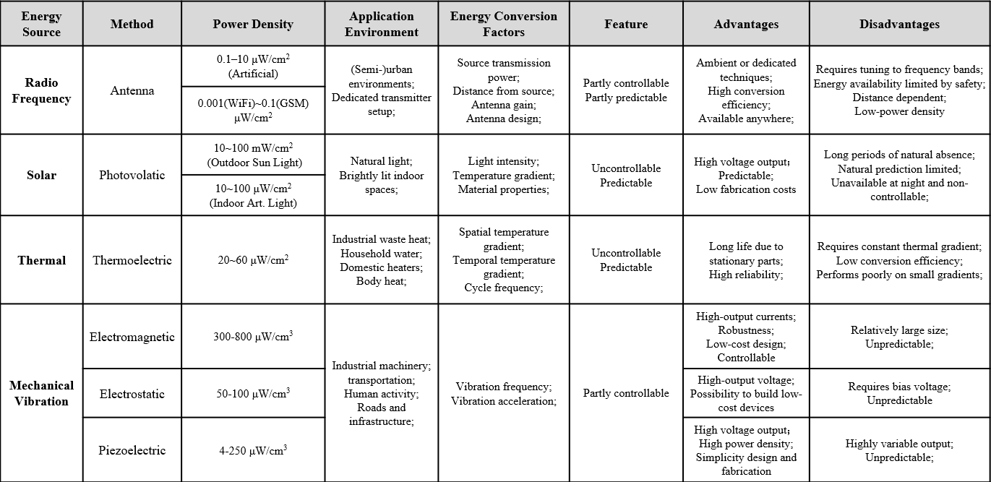
November 2022
Doc.: IEEE 802.11-22/1960r1
Summary(6): Ambient Power and Energy Storage
    Ambient power
      RF
      Solar
      Thermal
      Vibration
    The ambient power lacks of stability and the power density is limited.
      Energy storage element is needed for some AMP IoT devices.
    Capacitor and solid-state battery can be considered as the possible energy storage elements.
Slide 8
Weijie Xu (OPPO)

Slide 9
November 2022
Doc.: IEEE 802.11-22/1960r1
Summary(7): Feasibility of support AMP IoT in WLAN
    Link budget for different AMP IoT device types
      Communication distance of up to 180 meters can be achieved in S1G and up to 50 meters for 2.4GHz
    Co-existence with legacy 802.11 systems
      AMP device can well coexist with legacy devices in both S1G and 2.4Ghz
    Carrier generation for backscattering
      Wideband carrier signal spanning the whole channel bandwidth, e.g., the signal spanning across the 20MHz channel bandwidth at 2.4GHz
Slide 9
Weijie Xu (OPPO)

Slide 10
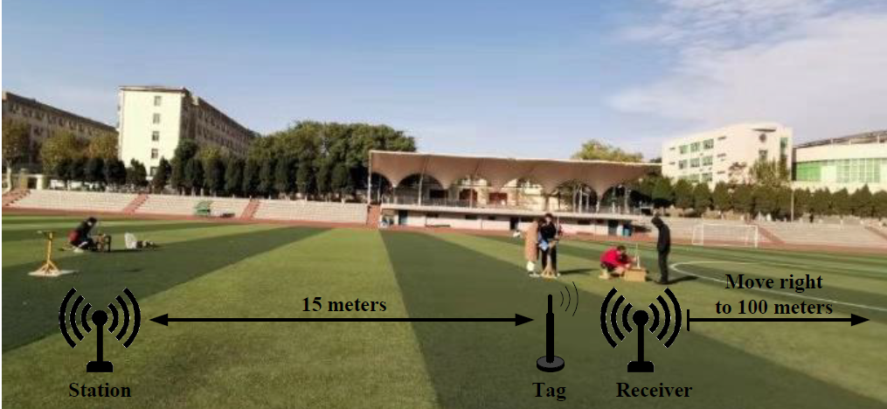
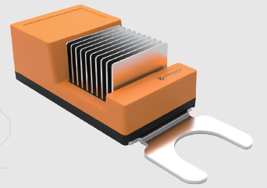
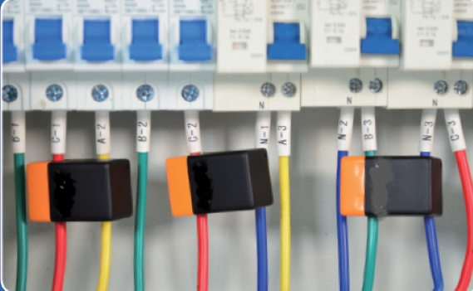
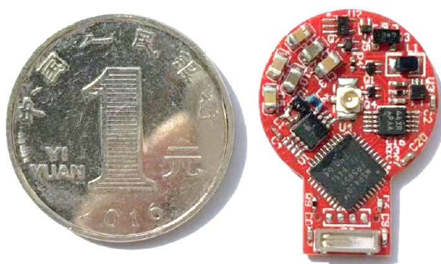
Summary(8): Prototype Presentation
November 2022
Doc.: IEEE 802.11-22/1960r1
  Several prototypes are collected to show the potential communication techniques, the applicable ambient powers and the achieved performance.
    Prototype using RF power and backscattering
    (Figure 2)
    Prototype using thermal energy (Figure 3)
    Prototype using induced current (Figure 4)
    Figure 3 Figure 4
Figure 2

Slide 11
November 2022
Doc.: IEEE 802.11-22/1960r1
Recommendations(1): The target of the study
 | RFID | AMP IoT | Existing WLAN IoT(e.g. 802.11 ah)
Coverage | <10 m | 10m~30m (RF power); Up to 200m(other ambient power) | >=1000m
Power Source | RF power only | Various ambient power | Battery
Techniques | RF power harvesting Backscattering | Backscattering/Active transmitter WUR receiver Enhanced power saving Power management | OFDM Narrow bandwidth Relaxed processing eDRX(TWT) PS-Poll Energy limited operation
Power Consumption | 1uw~10uw | <1mw | 100x mw
Device Cost (Relatively) | Low | Medium | High
Maintenance/operation cost | Labor cost for operation | Maintenance-free Automated operation | Replace/Recharge the battery/Automated operation
Slide 11
Weijie Xu (OPPO)

Slide 12
November 2022
Doc.: IEEE 802.11-22/1960r1
Recommendations(2): Study scope for AMP IoT SG(1)
  To support an ultra-low-power-consumption AMP device in WLAN, e.g. peak power consumption for transmission and reception is lower than 1mw.
    PHY: WUR(100x uw) + Simplified UL PHY (10x uw~100x uw)
      In the DL, WUR(802.11ba) similar design as the starting point.
        Reuse legacy design as much as possible, such as OOK, channel structure, waveform, PPDU formats, etc.
        Some re-design may be necessary if AMP in WLAN is implemented in frequency band other than 2.4GHz, e.g., S1G.
        Note: Other schemes are not precluded.
      In the UL, specify OOK/FSK for the UL PHY.
        Both Active OOK/FSK transmitter and backscattered OOK/FSK can be supported.
          The carrier for backscattering shall be specified considering the regulation requirement
            Carrier signal of narrow bandwidth or wide bandwidth
            Carrier signal using the existing signal can also be considered
          Note: PSK is not precluded.
Slide 12
Weijie Xu (OPPO)

Slide 13
November 2022
Doc.: IEEE 802.11-22/1960r1
Recommendations(2): Study scope for AMP IoT SG(2)
    MAC: Simplified MAC + Enhanced power saving/ power management(Note2)
  Note 1: Energy harvesting(except RF power) is based on implementation and can be transparent to specification. For RF power, TBD.
  Note 2: Enhanced power saving/ power management mechanism can be extended to existing WiFi devices.
  Note 3: Support S1G, and 2.4GHz/5GHz frequency band can be considered
Slide 13
Weijie Xu (OPPO)

Slide 14
Summary
November 2022
Doc.: IEEE 802.11-22/1960r1
This submission summarize the work of AMP IoT, including:
  Use cases and the requirements
  Gap analysis of the use cases and benefits from AMP IoT
  Device types
  Candidate techniques and the feasibilities
  Prototype presentations
  Based on the above work, it is recommended to form a study group (SG) to further study AMP IoT and develop the PAR and CSD documents

Slide 15
Reference
November 2022
Doc.: IEEE 802.11-22/1960r1
IEEE 802.1122/1339r0, Use Cases of smart manufacturing
IEEE 802.1122/1341r1, Use Cases of Data Center Infrastructure Management.
IEEE 802.11-22/0963r0, Use Cases for AMP IoT Devices.
IEEE 802.11-22/1559, Updated Use Cases for AMP IoT Devices.
IEEE 802.11-22/0962r0, Potential Techniques to Support AMP IoT Devices in WLAN
IEEE 802.11-22/970r0, Feasibility of supporting AMP IoT devices in WLAN
IEEE 802.11-22/1560r0, Ambient powers and energy storage
IEEE 802.11-22/1561r0, Further discussion on feasibility of supporting AMP IoT devices in WLAN
IEEE 802.11-22/1799r0, On energy harvesting and the differentiation with RFID
IEEE 802.11-22/1800r0, New Use Case for AMP IoT Devices: Smart Grid
IEEE 802.11-22/1961r0, Prototype presentations for AMP IoT
IEEE 802.11-22/1562r3, Draft Technical Report on support of AMP IoT devices in WLAN
Slide 15
Weijie Xu (OPPO)

