Slide 1
Follow-up on Latency Reduction with Machine Learning Techniques
Date: 2022-11
Authors:

Slide 2
Introduction
In previous UHR meetings, we discuss the latency sensitive use cases and latency reduction methods using machine learning techniques, especially distributed channel access using neural network [1].
In this contribution, we have a follow-up discussion on this topic and focus on three aspects:
  Introduce a deep reinforcement learning (DRL)-based channel access scheme
  Show the effectiveness of DRL-based channel access on latency reduction
  Discuss on possible standard impacts

Slide 3
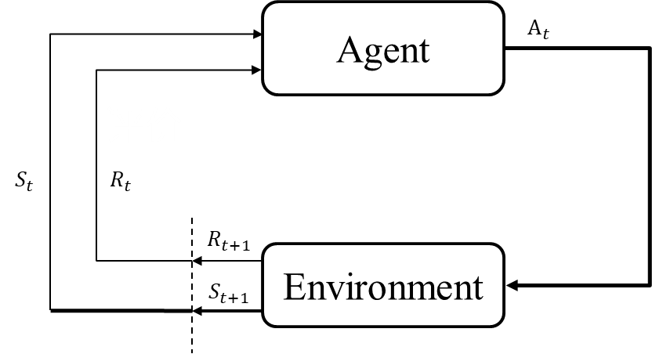
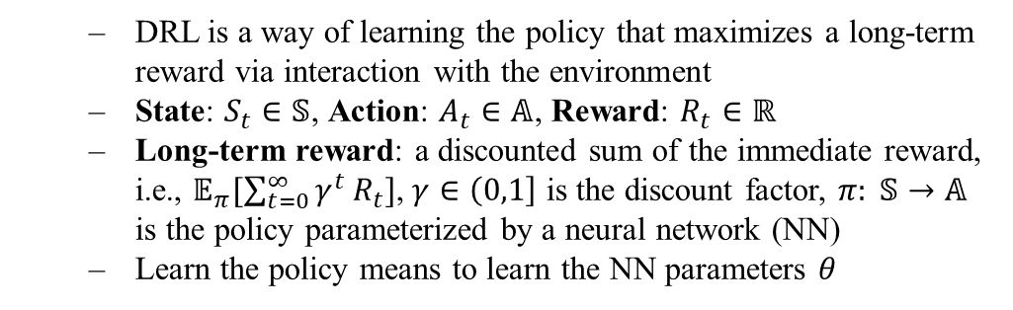
DRL-based Channel Access (1)
Basics of DRL:
A DRL-based channel access was proposed in [2], called QLBT (QMIX-advanced Listen-Before-Talk)
States: a sequence of historical CCA results (busy or idle), transmission actions (transmit or wait) and time duration since last successful transmission
Action: transmit or wait
  DRL is a way of learning the policy that maximizes a long-term reward via interaction with the environment
  State: $S_{t}∈𝕊$, Action: $A_{t}∈𝔸$, Reward: $R_{t}∈ℝ$
  Long-term reward: a discounted sum of the immediate reward, i.e., $𝔼_{π}[\sum_{t=0}^{∞}{γ^{t}}R_{t}]$, $γ∈\left(0,1\right]$ is the discount factor, $π: 𝕊→𝔸$ is the policy parameterized by a neural network (NN)
  Learn the policy means to learn the NN parameters $θ$
Historical Observation
Neural Network (NN)
Transmit or Wait

Slide 4
DRL-based Channel Access (2)
Details of training and inference in [2]
  Training phase@AP: AP trains the NN model in a centralized manner using the DRL algorithm—QMIX. It may need training data reported from non-AP STAs.
  Inference phase@non-AP STA: each non-AP STA decides to transmit or wait independently based on the local observations and the NN parameters received from AP.
database
DRL algorithm
AP
AP
NN model
NN parameters
Training data
STA 1
STA 3
STA 1
STA 3
STA 2
STA 2
Training phase
Inference phase

Slide 5
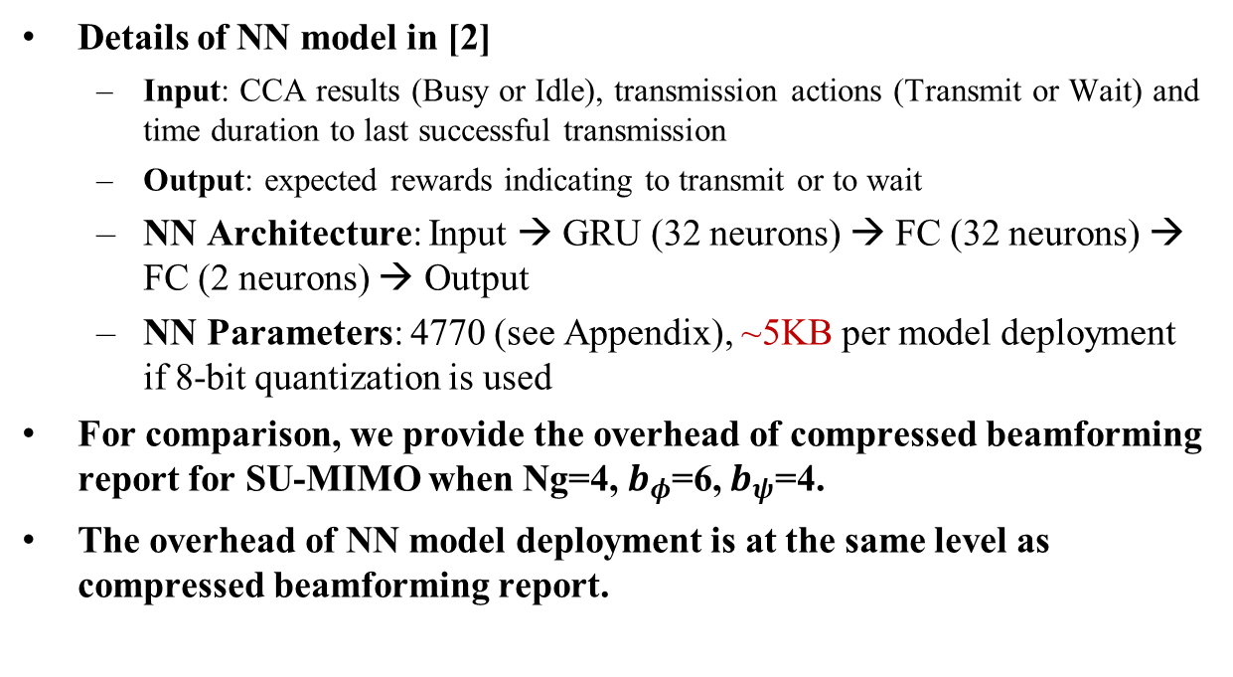


DRL-based Channel Access (3)
$$a_{t}$$
Details of NN model in [2]
  Input: CCA results (Busy or Idle), transmission actions (Transmit or Wait) and time duration to last successful transmission
  Output: expected rewards indicating to transmit or to wait
  NN Architecture: Input → GRU (32 neurons) → FC (32 neurons) → FC (2 neurons) → Output
  NN Parameters: 4770 (see Appendix), ~5KB per model deployment if 8-bit quantization is used
For comparison, we provide the overhead of compressed beamforming report for SU-MIMO when Ng=4, $b_{φ}$=6, $b_{ψ}$=4.
The overhead of NN model deployment is at the same level as compressed beamforming report.
FC 2
FC 32
GRU 32
$$s_{t}$$
NN Architecture
BW(MHz) | Ntx | Nrx | Overhead (KB)
80 | 8 | 2 | 4.06
80 | 8 | 4 | 6.88
160 | 8 | 2 | 8.13
160 | 8 | 4 | 13.75
320 | 8 | 2 | 16.25
320 | 8 | 4 | 27.50

Slide 6
Performance Evaluation (1)
Performance evaluation under full buffer traffic model [2]
  Compared with WLAN DCF, QLBT achieves higher channel efficiency, lower latency and lower jitter.
AC | CWmin | CWmax
AC_BE | 31 | 1023
AC_VI | 15 | 31
AC_VO | 7 | 15

Slide 7
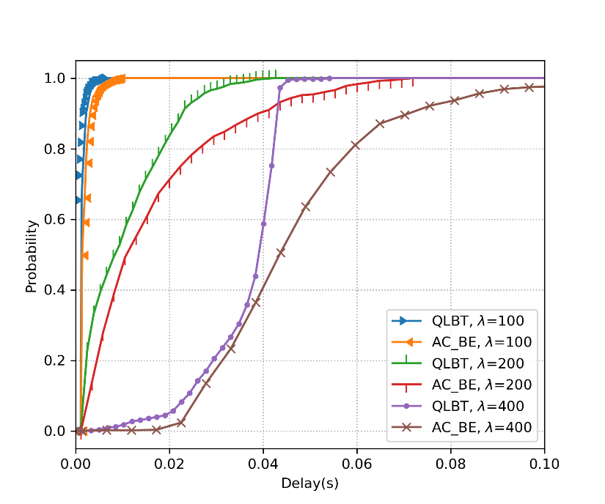
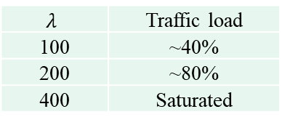
Performance Evaluation (2)
Performance evaluation under burst Poisson traffic model [2]
  QLBT reduce latency under different traffic loads.
n = 4
$$λ$$ | Traffic load
100 | ~40%
200 | ~80%
400 | Saturated

Slide 8
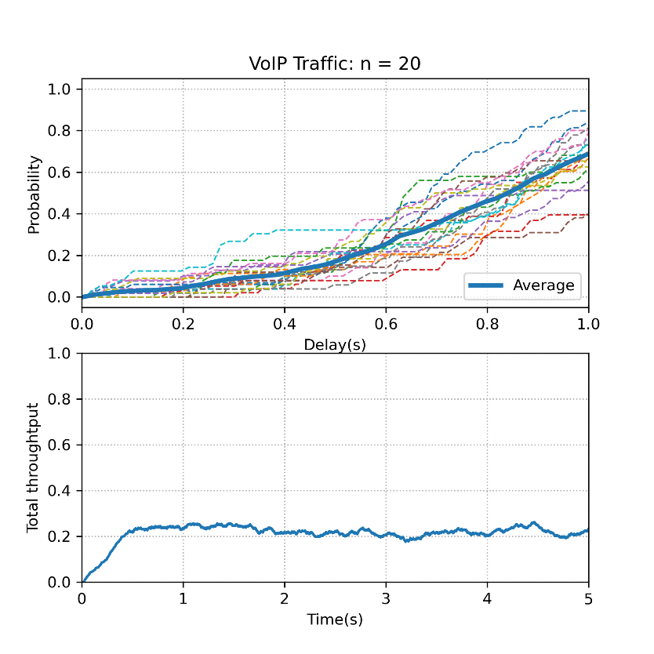
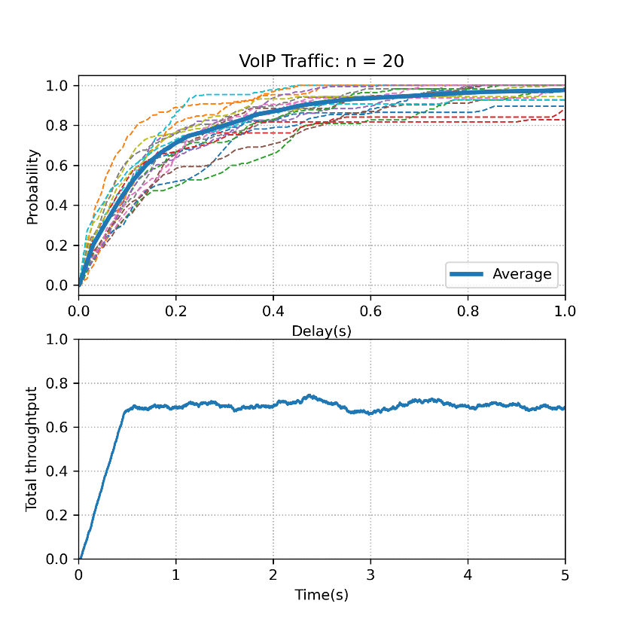
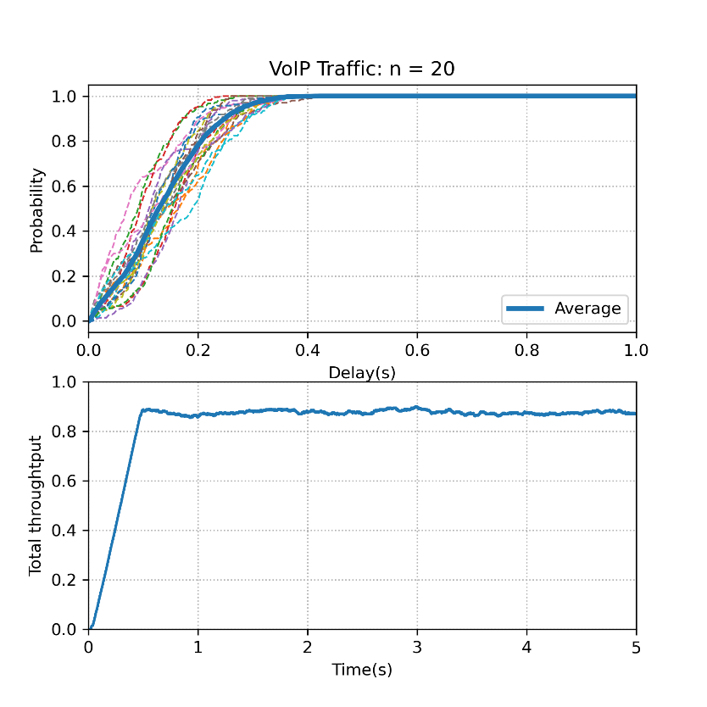
Performance Evaluation (3)
Performance evaluation under delay-sensitive traffic model [2]
  For VoIP traffic, generating packet at fixed interval (20ms), QLBT can significantly reduce latency and improve network throughput compared with using AC_VO and AC_BE.
AC_VO
AC_BE
QLBT

Slide 9
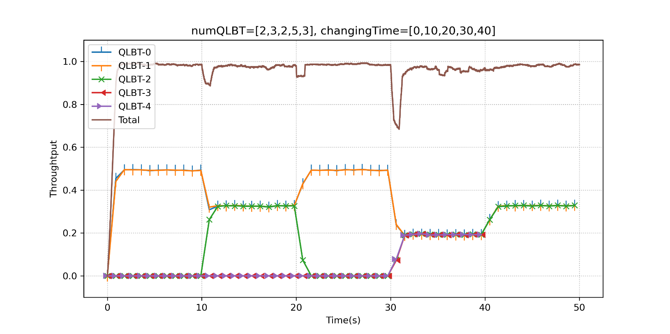
Performance Evaluation (4)
Performance evaluation when the number of associated STAs changes [2]
  The change in the number of associated STAs does not affect the performance if the model is updated properly
  In practice, pre-storing NN models or online training can be employed
n=2
n=3
n=2
n=5
n=3

Slide 10
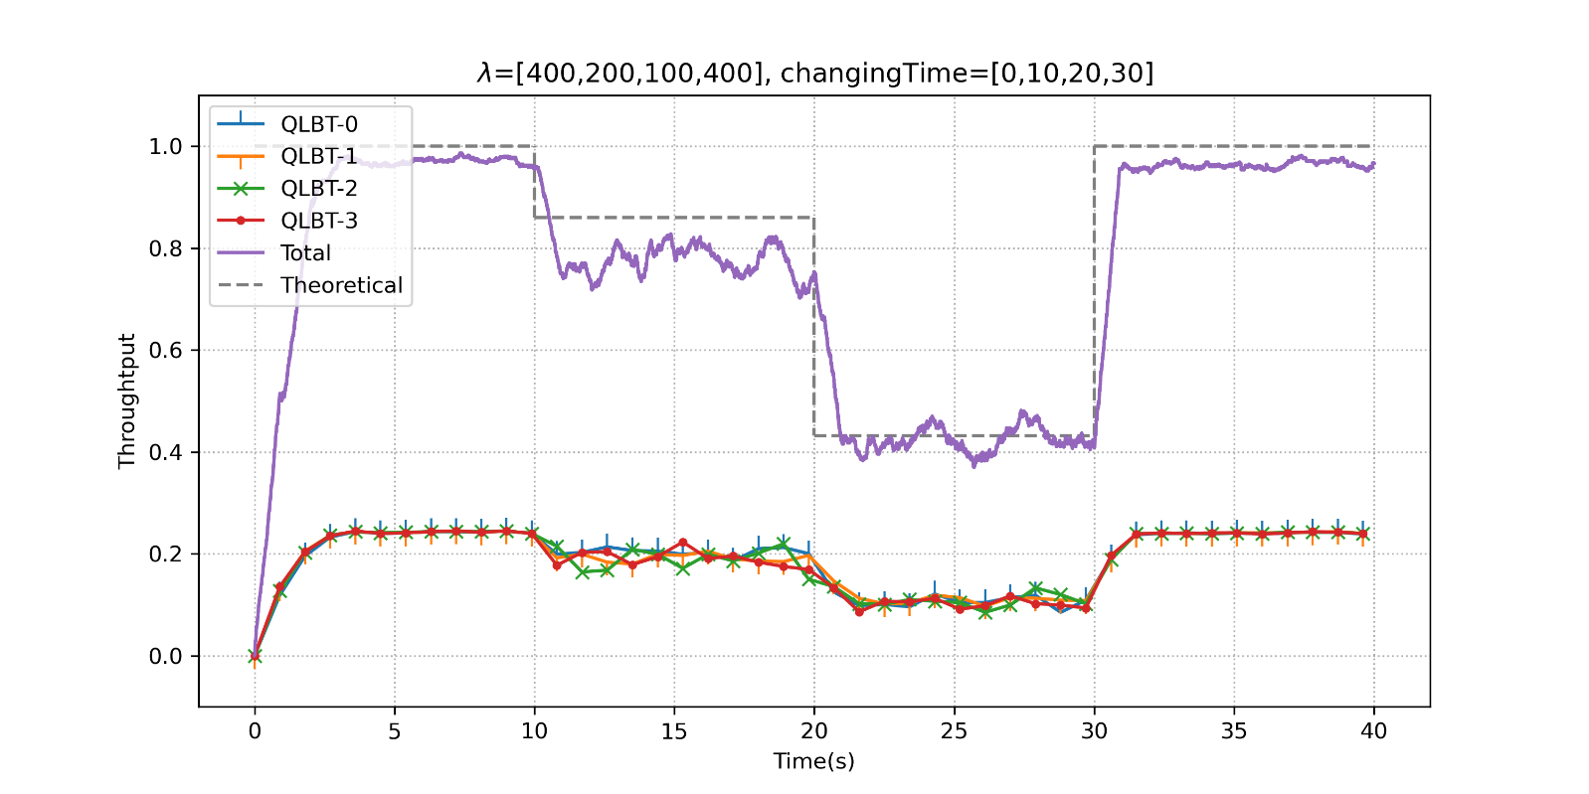
Performance Evaluation (5)
Performance evaluation under dynamic traffic load [2]
  QLBT can accommodate dynamic traffic loads.

Slide 11
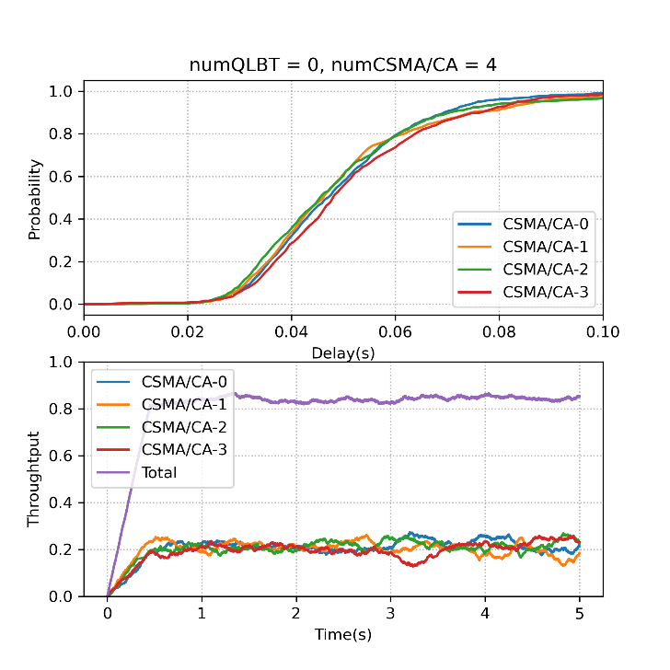
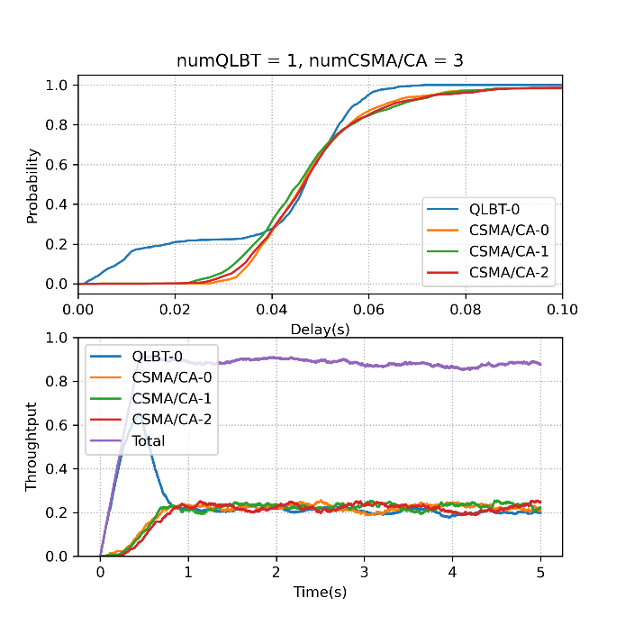
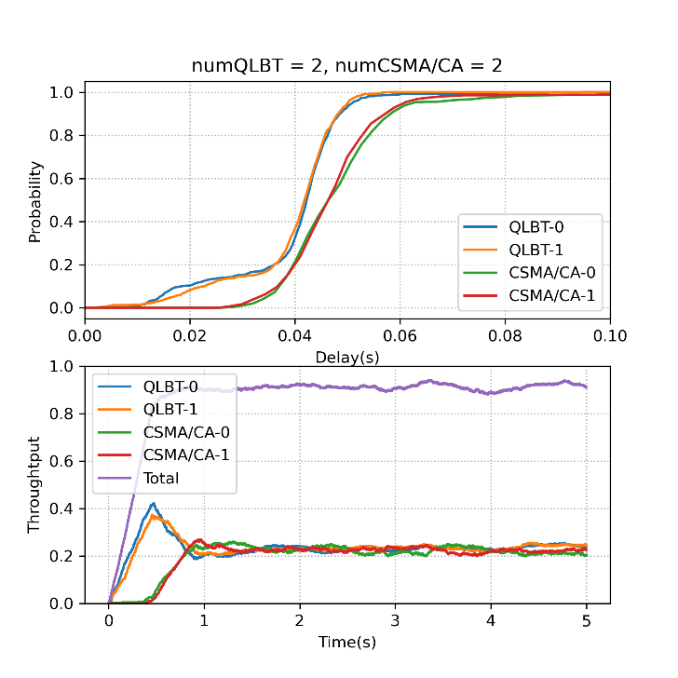
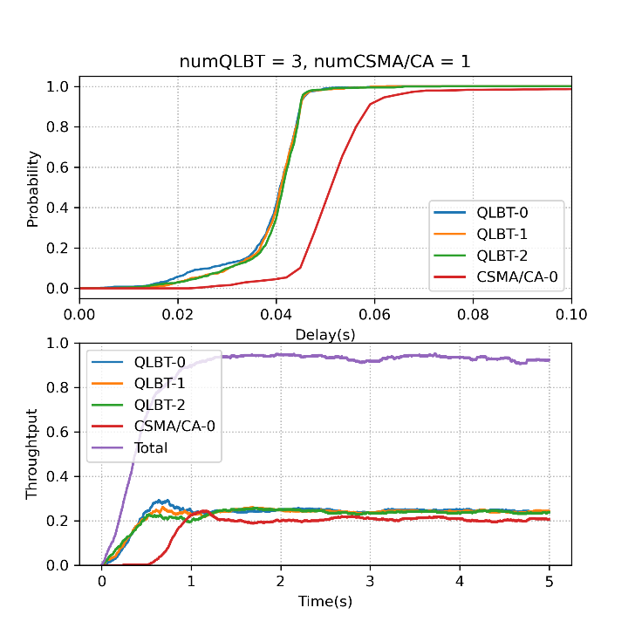
Performance Evaluation (6)
Performance evaluation under coexistence scenario with “legacy” devices [2]
  QLBT is able to guarantee fairness [3], i.e., the performance of the remaining WLAN nodes will not be degraded when some nodes in the network are replaced with AI nodes.
  Better latency and total throughput can be achieved for coexistence scenarios.

Slide 12
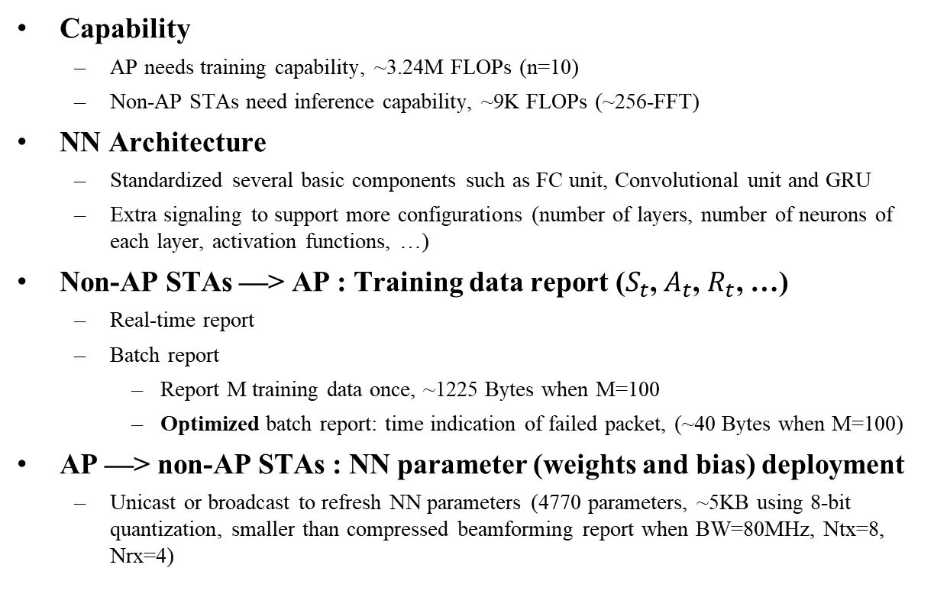
Standard Impact of QLBT
Capability
  AP needs training capability, ~3.24M FLOPs (n=10)
  Non-AP STAs need inference capability, ~9K FLOPs (~256-FFT)
NN Architecture
  Standardized several basic components such as FC unit, Convolutional unit and GRU
  Extra signaling to support more configurations (number of layers, number of neurons of each layer, activation functions, …)
Non-AP STAs —> AP : Training data report ($S_{t}$, $A_{t}$, $R_{t}$, …)
  Real-time report
  Batch report
    Report M training data once, ~1225 Bytes when M=100
    Optimized batch report: time indication of failed packet, (~40 Bytes when M=100)
AP —> non-AP STAs : NN parameter (weights and bias) deployment
  Unicast or broadcast to refresh NN parameters (4770 parameters, ~5KB using 8-bit quantization, smaller than compressed beamforming report when BW=80MHz, Ntx=8, Nrx=4)
Training@AP
Data report
AP
Model deployment
STA 1
STA 3
STA 2
Inference@STA

Slide 13
Summary
In this contribution, we introduce a DRL-based channel access scheme (QLBT), show its effectiveness on latency reduction and discuss the possible standard impacts.

Slide 14
Reference
[1] 11-22-1519-00-0uhr-requirements-of-low-latency-in-uhr
[2] Z. Guo, et al. "Multi-agent reinforcement learning-based distributed channel access for next generation wireless networks." IEEE Journal on Selected Areas in Communications 40.5 (2022): 1587-1599.
[3] 3GPP, "Study on NR-based access to unlicensed spectrum; study on NR-based access to unlicensed spectrum (Release 16)," 3rd Generation Partnership Project (3GPP), Tech. Rep. 38.889, Dec. 2018, V16.0.0.

Slide 15







Appendix
$$a_{t}$$
GRU layer:
  6 weight matrices (W, U) and 3 bias vectors (b)
  160, 1024, 32 parameters for each W, U, b
FC layer:
  1 weight matrices (W) and 1 bias vectors (b)
  FC32: 1024 and 32 parameters for W and b
  FC2: 64 and 2 parameters for W and b
FC 2
$$a_{t}=f\left(W_{ha}h_{t}+b_{a}\right)$$
64 + 2
$$y_{t}$$
$$y_{t}=f\left(W_{ha}h_{t}+b_{a}\right)$$
1024 + 32
FC 32
$$h_{t}$$
$$z_{t}=σ\left(W_{sz}s_{t}+U_{hz}h_{t−1}+b_{z}\right)$$
$$r_{t}=σ\left(W_{sr}s_{t}+U_{hr}h_{t−1}+b_{r}\right)$$
$${\tilde{h}}_{t}=tanh(W_{sh}s_{t}+U_{hh}\left(r_{t}⨀h_{t−1}\right)+b_{h})$$
$$h_{t}=\left(1−z_{t}\right)⨀h_{t−1}+z_{t}⨀{\tilde{h}}_{t}$$
( 160 + 1024 + 32 ) * 3
GRU 32
$$s_{t}$$
(160+1024+32)*3 + 1024 + 32 + 64 + 2 = 4770

