Slide 1
Ambient Power Enabled IoT Technologies
November 2022
Doc.: IEEE 802.11-22/1893r0
Date: 2022-11-14
Authors:
Name | Affiliation | Address | Phone | Email
Hao Min | Shanghai Quanray Electronics | ShangHai China |  | Hao.min@quanray.com

Slide 2
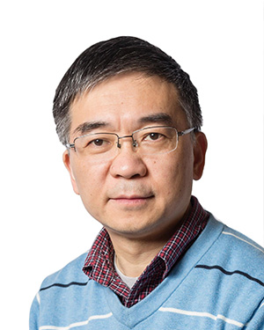
Prof. Hao Min
November 2022
Doc.: IEEE 802.11-22/1893r0
Research director of the AUTO-ID Lab of Fudan University, Shanghai China
Director of the State Key Laboratory of ASIC & System, Fudan University 1998~2005
Co-founder of Shanghai Quanray Electronics focusing on RFID products and applications
Research focuses on IoT technologies:
  High energy efficiency wireless transceiver,
  Backscattering communication systems,
  High efficiency large dynamic range power management, etc.

Slide 3
Outline
November 2022
Doc.: IEEE 802.11-22/1893r0
Background and motivation for AMP IoT
Network and device Architecture for AMP IoT
Key Chip Technologies for AMP IoT
  Energy Harvester
  Backscattering Communication
  Reflection Amplifier
  Low Power Low Cost Transceiver
  Low Power Sensor Data Acquisition
Summary
Prototype

Slide 4

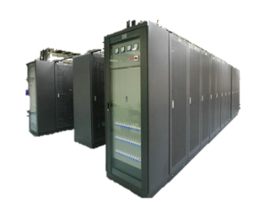
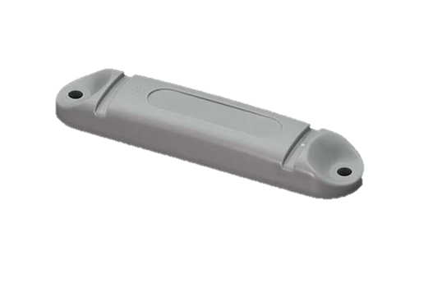


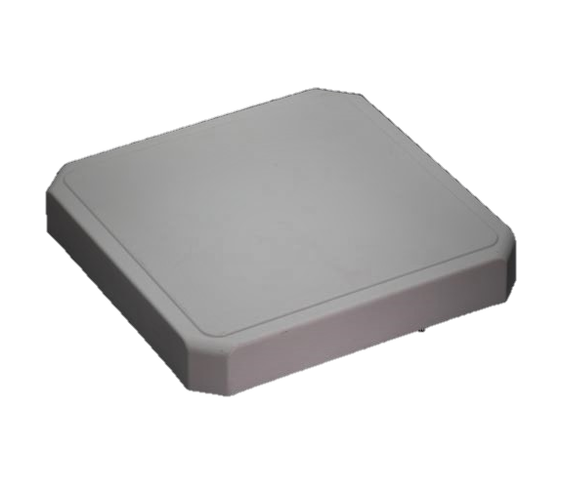
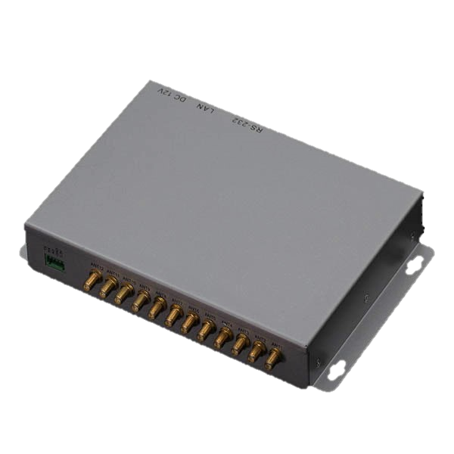
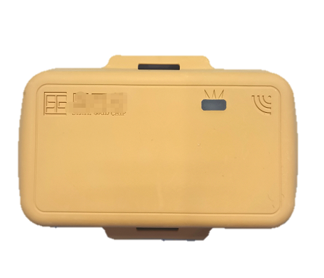
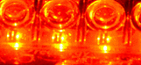
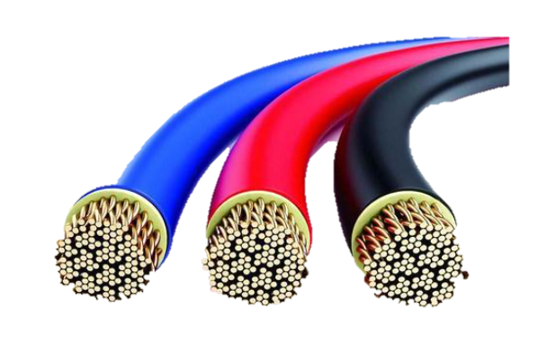

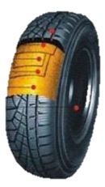

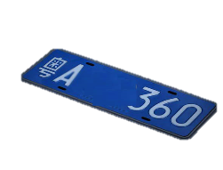
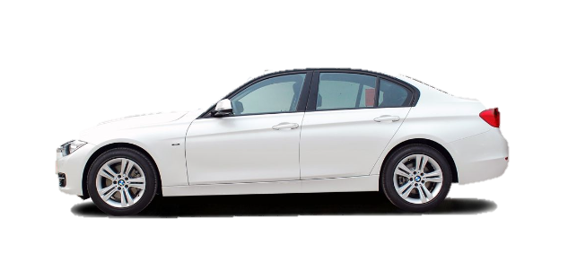
Everything Connected
November 2022
Doc.: IEEE 802.11-22/1893r0
Who？
Where from？
Where to？
Healthy？
ID
Temperature
Clone in Cloud
5G
4G
ID
Authentication
ID
Position
ID
Pressure

Slide 5
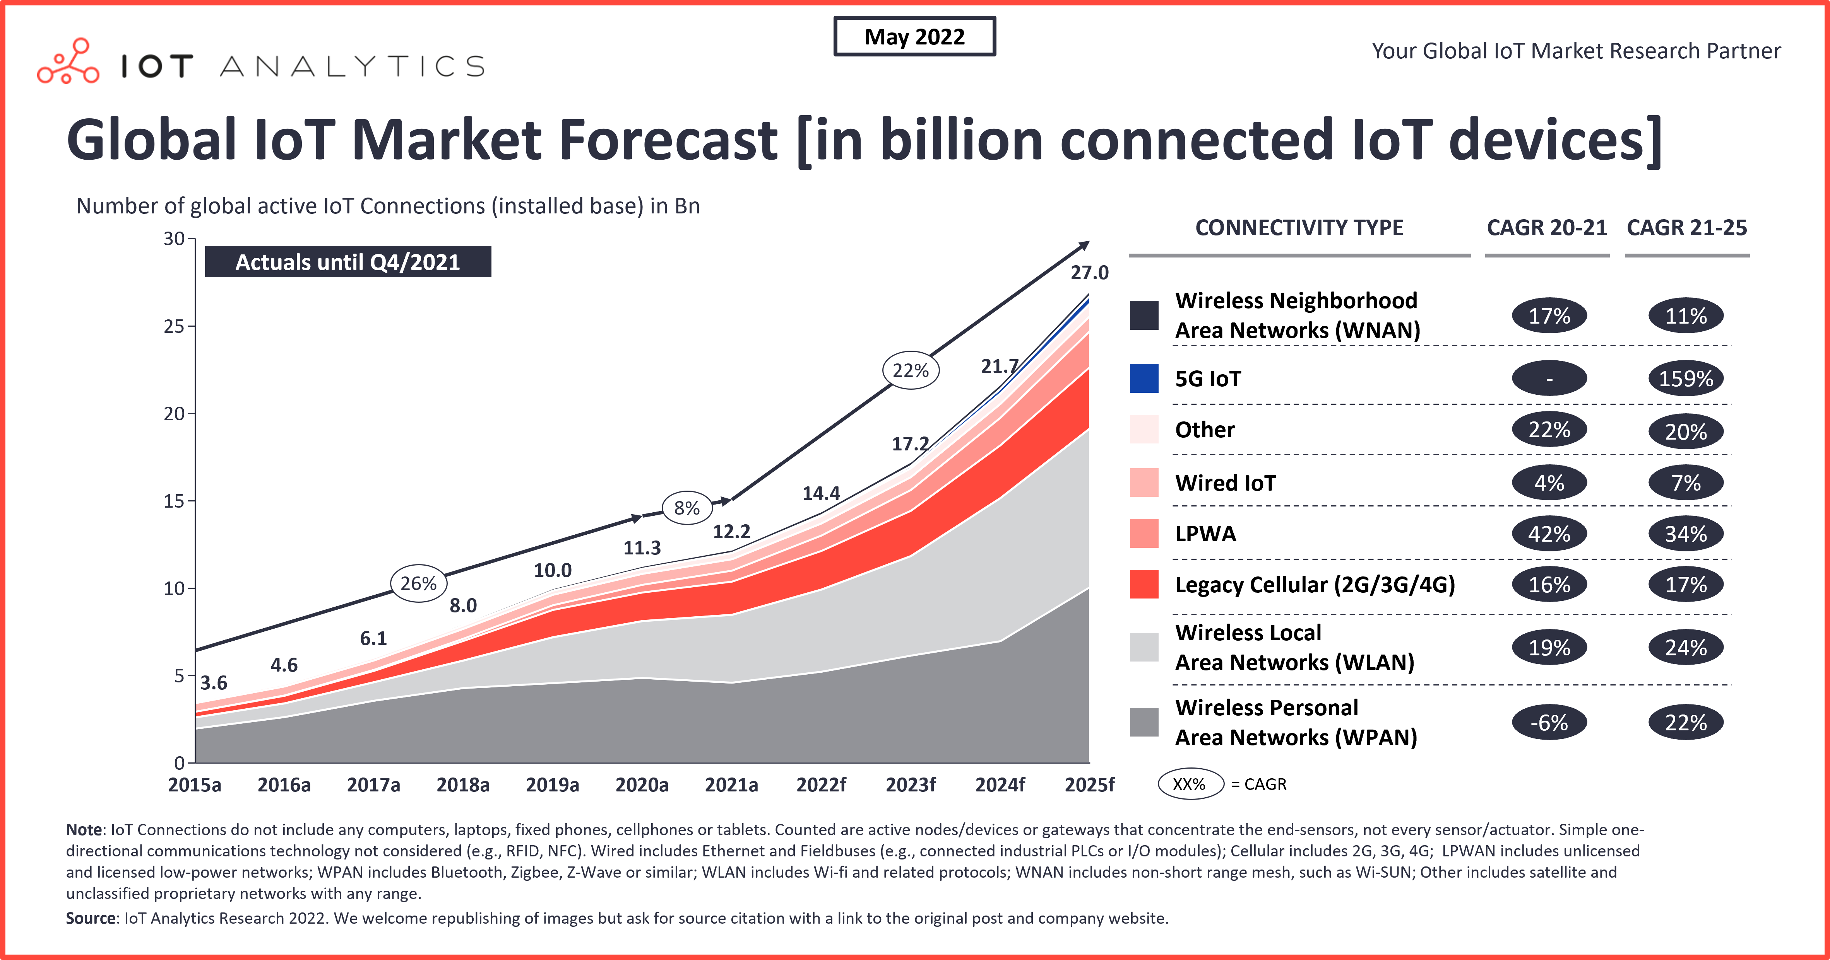
November 2022
Doc.: IEEE 802.11-22/1893r0
Sources: https://iot-analytics.com/number-connected-iot-devices/

Slide 6
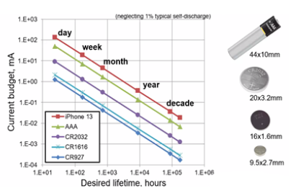
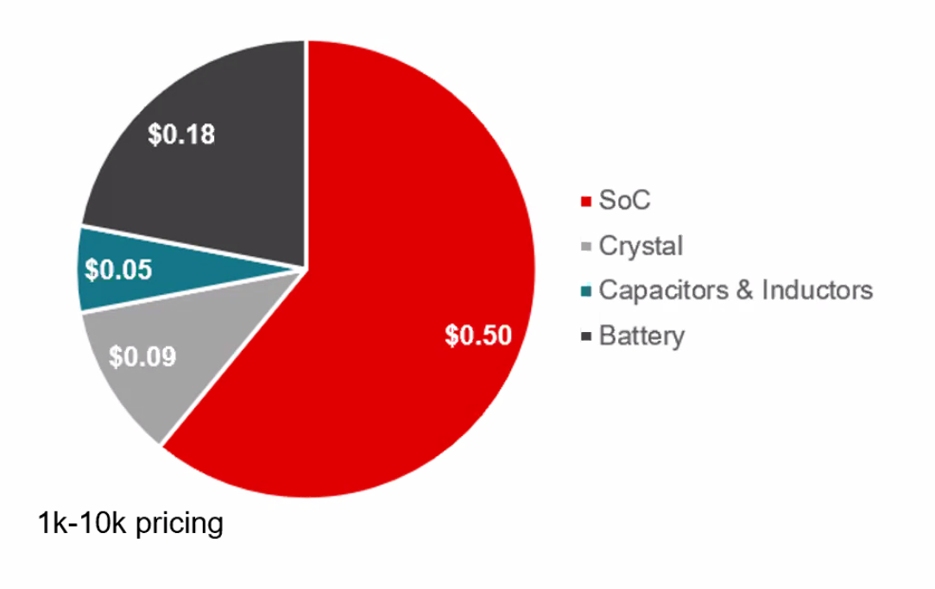
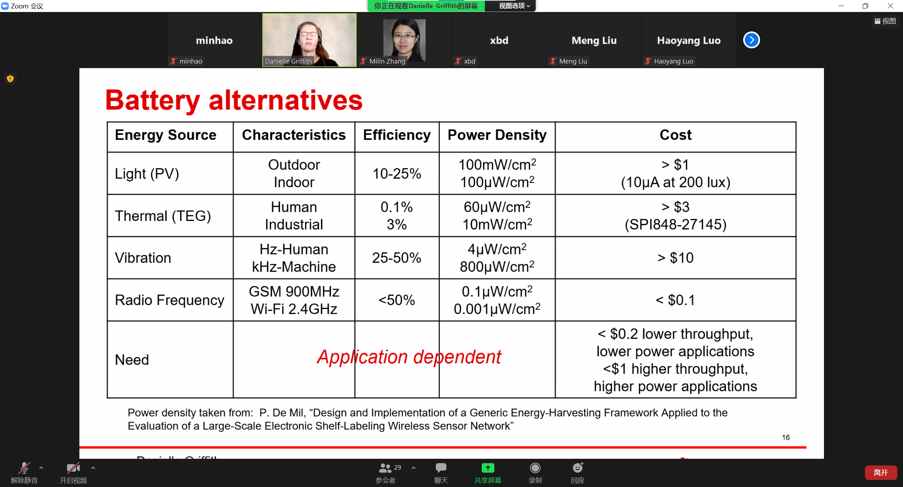
Why AMP IoT is needed?
November 2022
Doc.: IEEE 802.11-22/1893r0
Drawbacks with conventional batteries
    High cost
    Life cycle < 5 years，high cost for replacement
    Low performance in low temperature
    Explosive in high temperature
    Pollution
Alternatively, Ambient power can be used:

Slide 7
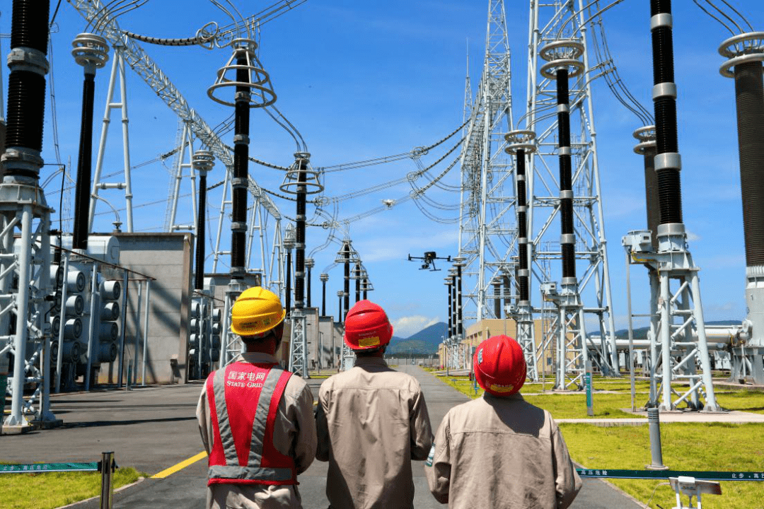
Evolution of IoT Technologies
November 2022
Doc.: IEEE 802.11-22/1893r0
P2P
WLAN
WAN
BLE, WiFi，LoRa
User builds infrastructure
Asset tracking, Logistics
4G/5G/6G WAN
Mobile internet, directly connect to cloud
Operators provide infrastructure
RFID, reader talks to tags
Supply chain management
Notes:
用图，3代，分别用图代表结构。
G1：RFID手持机扫
G2：蓝牙通信，可参考wiliot的图
G3：与基站，可用HW的图

Slide 8
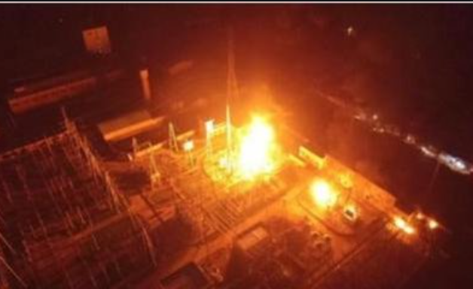


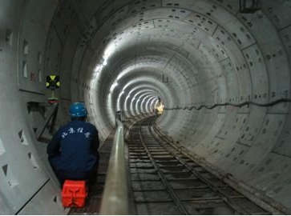

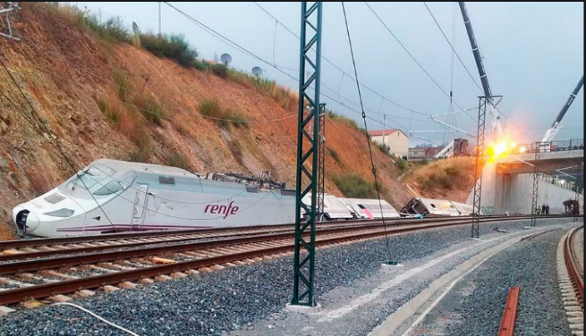
Applications
November 2022
Doc.: IEEE 802.11-22/1893r0
Power station
Cold chain tracking
Smart factory
IoT Platform
Tunnel monitor
Asset management

Slide 9
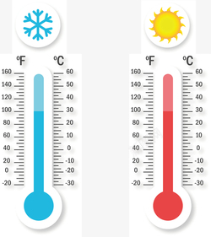

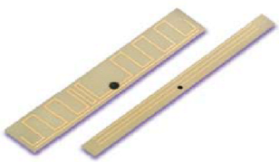
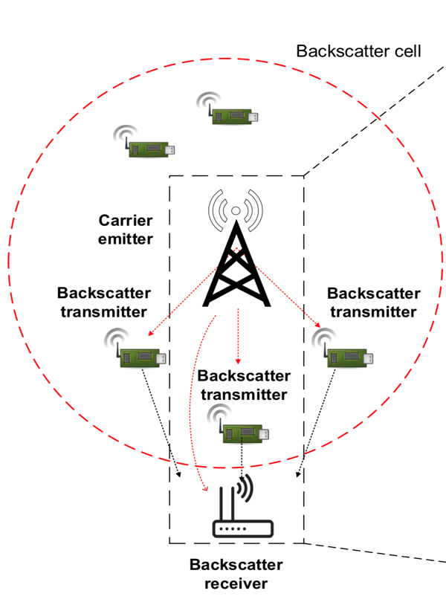


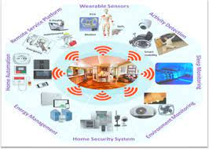
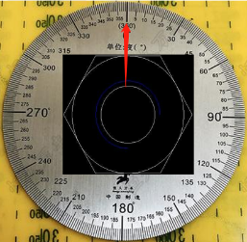
Network Architecture for AMP IoT
November 2022
Doc.: IEEE 802.11-22/1893r0
Talk to station
Update status in cloud
Sensing
Temperature and humidity
Cloud access
Network connection
Position and angle
Sensing tag
Energy harvest
Wireless communication

Slide 10
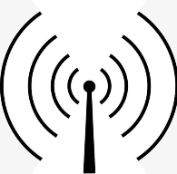



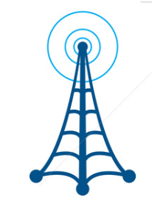
Potential AMP IoT device Architecture
November 2022
Doc.: IEEE 802.11-22/1893r0
Energy
Energy Harvest
Power Management
Data Acquisition
Light
Solar
MPPT
Boost
DC-DC
Tranceiver
TEG
电
MCU
WuR
Heat
Antenna
Rect
Bulk
DC-DC
NVM
R
Radio
SPI
T
Mechanical
Piezo
电
Energy Storage
Sensor

Slide 11
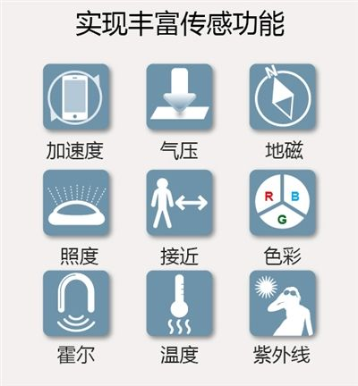
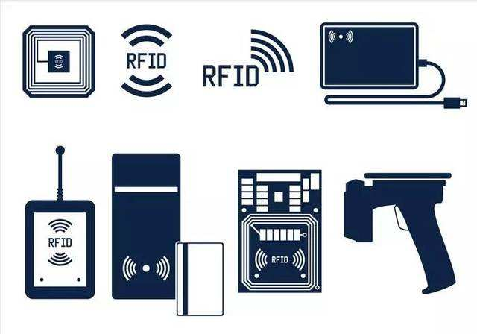
Key Chip Technologies for AMP IoT
November 2022
Doc.: IEEE 802.11-22/1893r0
Sensor data acquisition
Transceiver
RF energy harvester
MCU and memory
Low power
High sensitivity
High precision
High reliability
Small footprint
Low power
Low voltage
Low leakage
Power management
Fast start
High reliability
Low cost
Low power
Low voltage
High sensitivity
Low cost
Low threshold
High dynamic range
High power conversion efficiency
Low leakage power storage

Slide 12
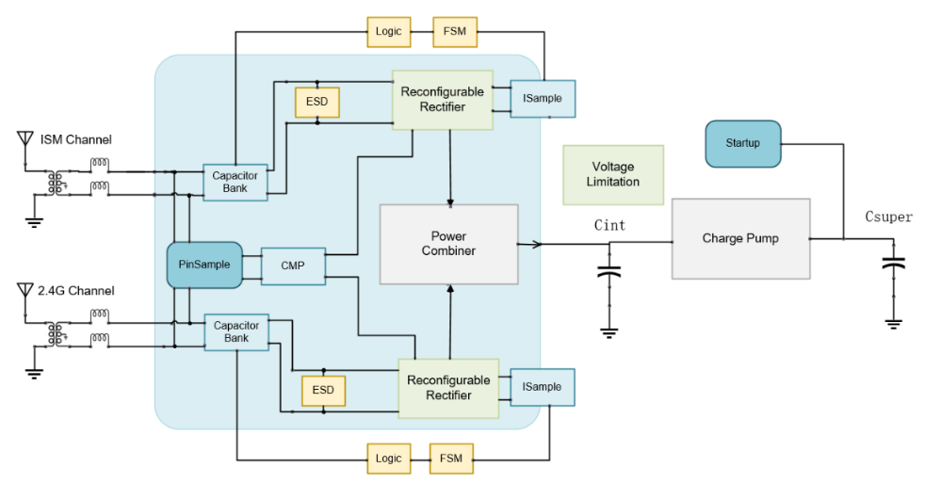
RF Energy Harvester
November 2022
Doc.: IEEE 802.11-22/1893r0
900M/2.4G dual band
Sensitivity reaches -30 ~ -35dbm
Output power > 1mW
Efficiency >30%
100m from mobile station

Slide 13
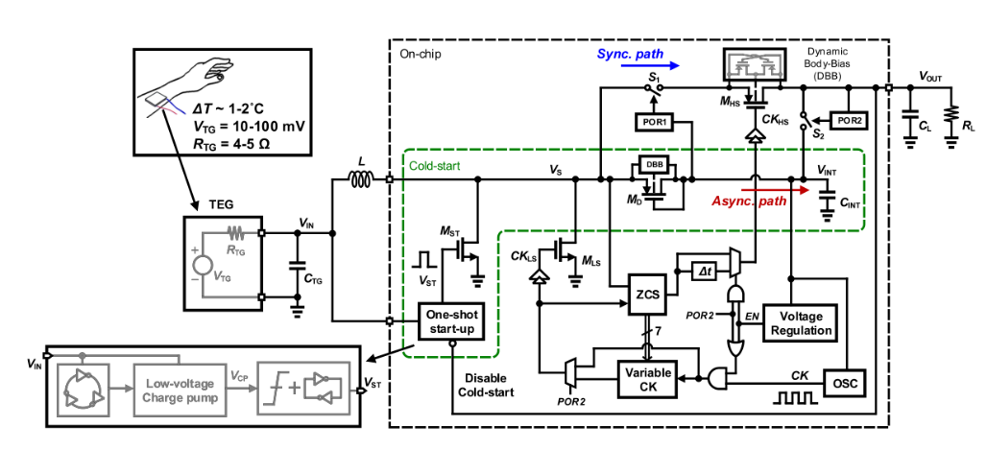
Energy harvesting from Heat
November 2022
Doc.: IEEE 802.11-22/1893r0
Output: 200nA@1V
Workable on body skin

Slide 14
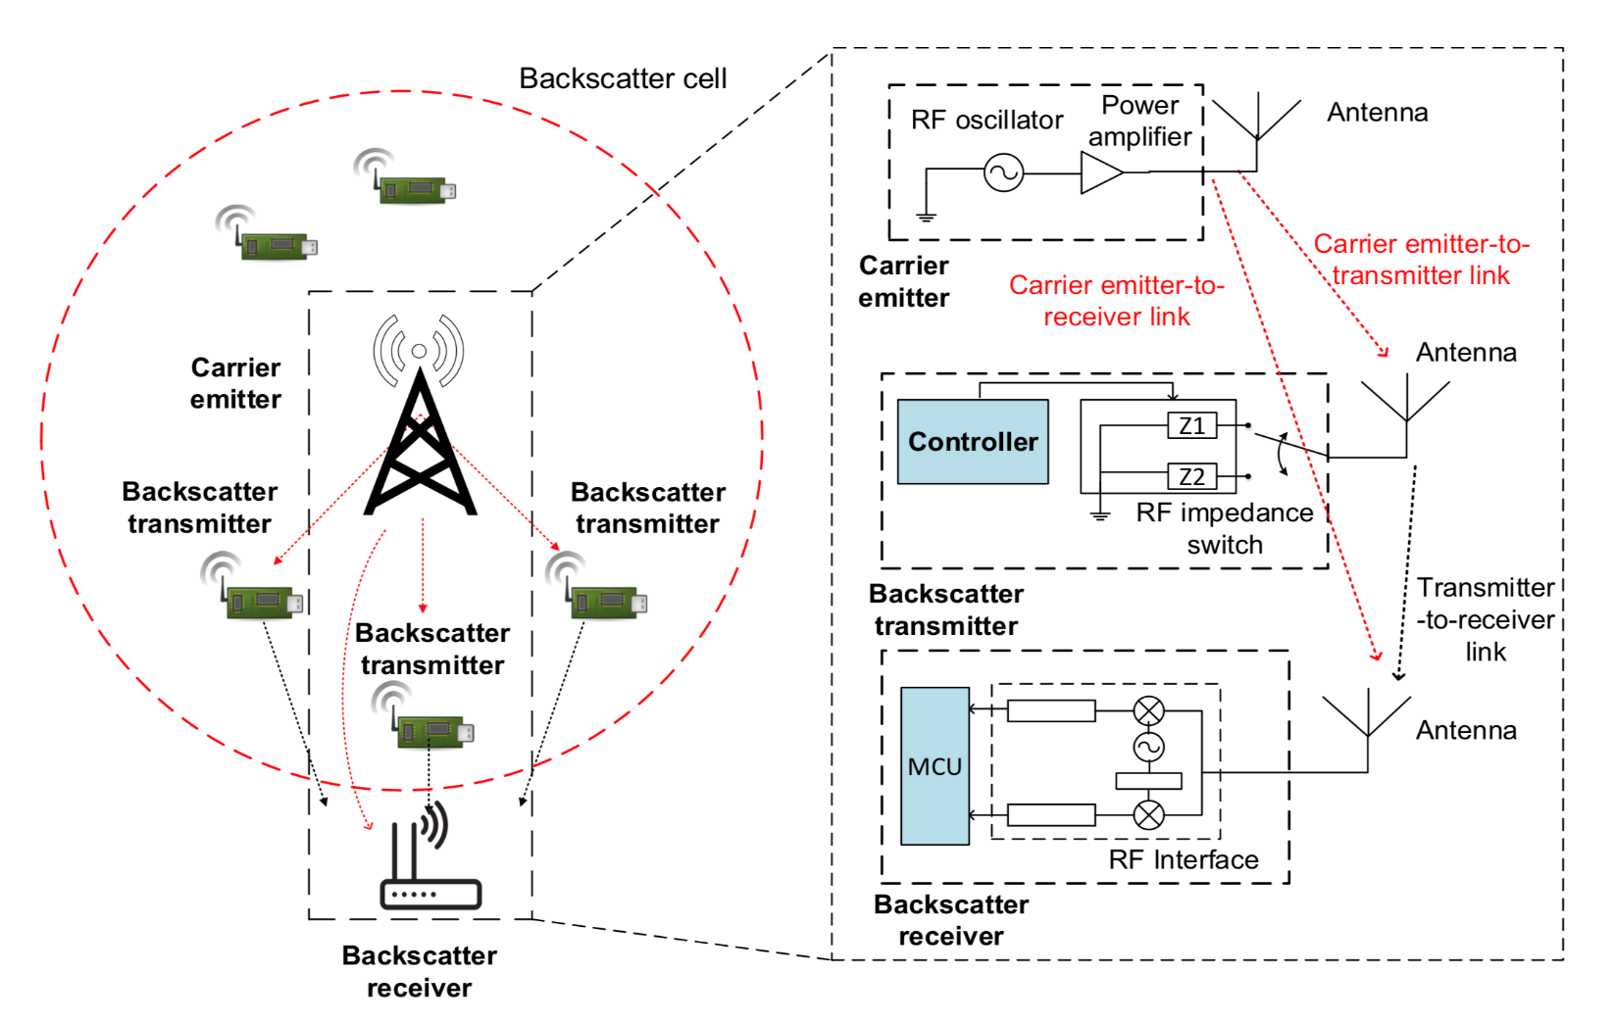
Backscattering Communication
November 2022
Doc.: IEEE 802.11-22/1893r0
Passive device
Ultra-low power
Output power > 1mW
Communication range:
up to 300m

Slide 15
Reflection Amplifier
November 2022
Doc.: IEEE 802.11-22/1893r0
15dB gain
@900MHz
Power consumption:100uw

Slide 16
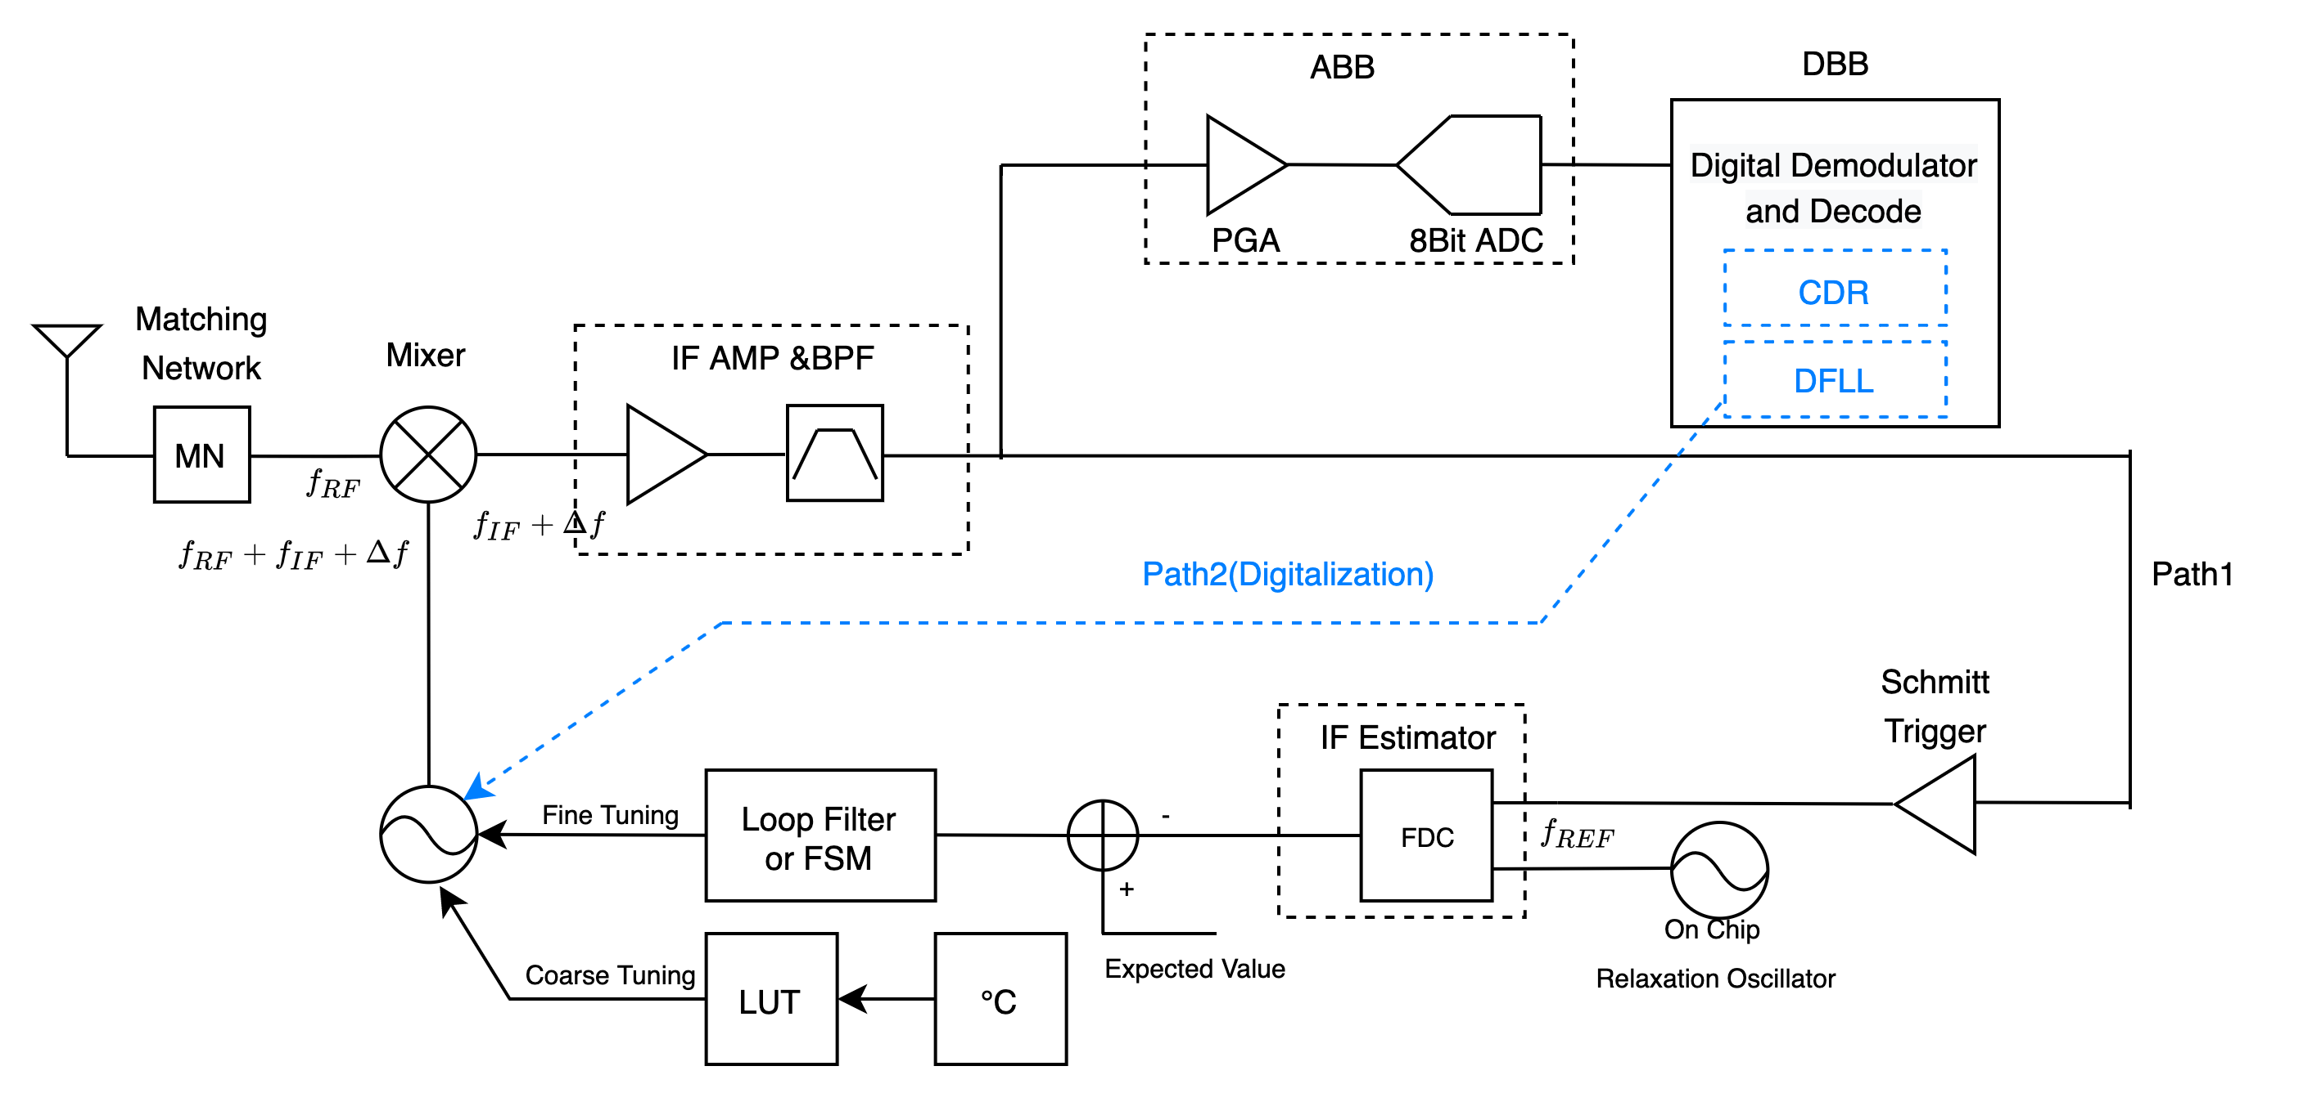
Low Power Low Cost Transceiver
November 2022
Doc.: IEEE 802.11-22/1893r0
Sensitivity：-75dbm
Data rate：125 kbps
Power consumption：300uW
Hardware: no crystal, no battery

Slide 17
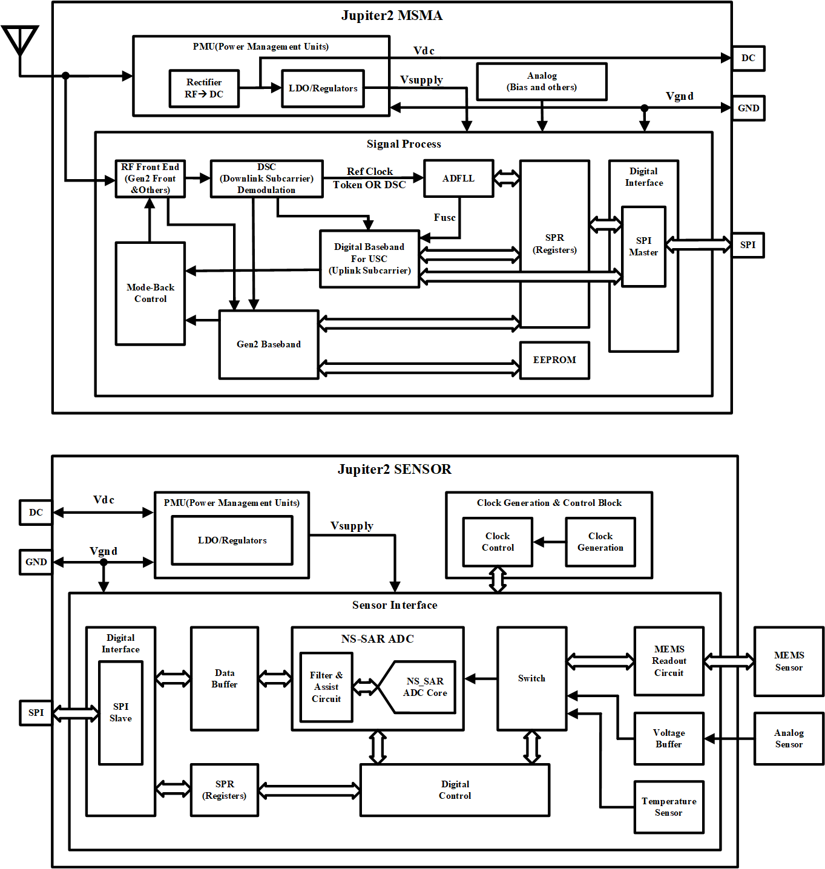
Low Power Sensor Data Acquisition
November 2022
Doc.: IEEE 802.11-22/1893r0
Temperature
3x accelerate meter
Capacity sensor
14bits 1KSPS
Power consumption: 10uw

Slide 18
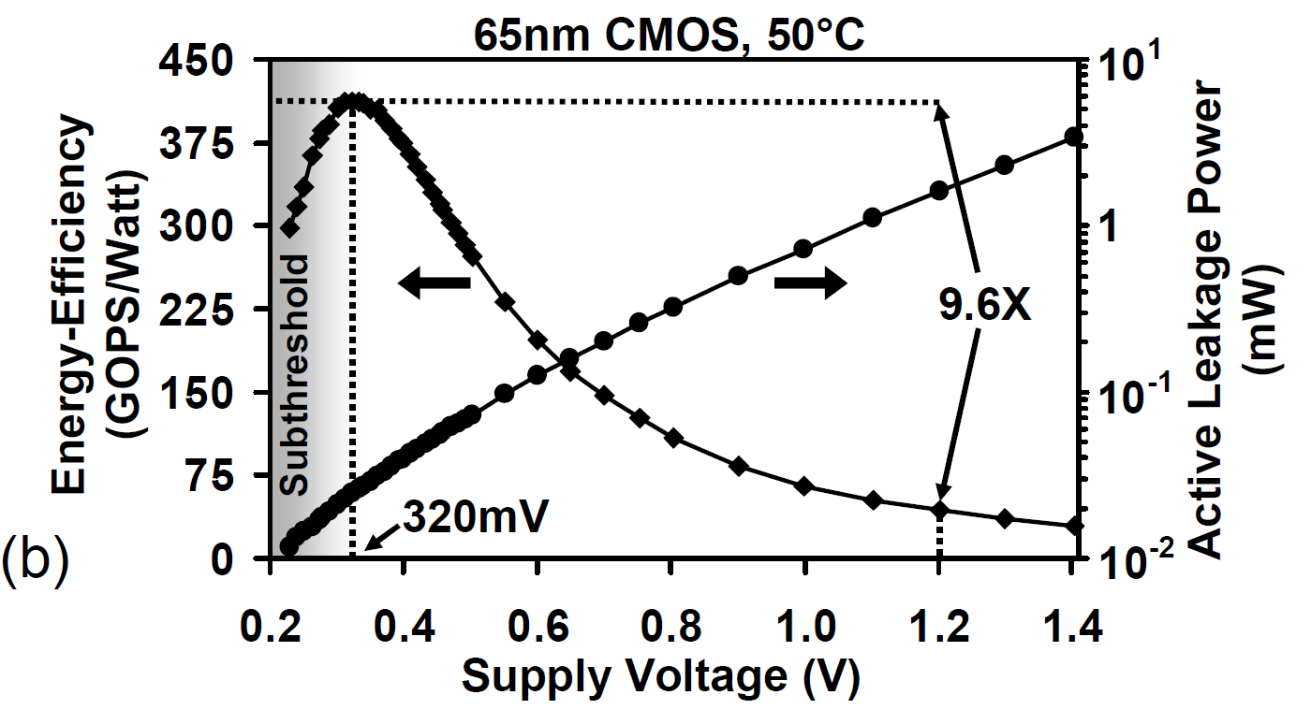
Near Threshed Digital Circuits
November 2022
Doc.: IEEE 802.11-22/1893r0
Highest energy efficiency while VDD is close to threshed voltage
Circuit speed is low in high energy efficiency but no problem for low speed system
Energy efficiency keeps growing while transistor size shrinking

Slide 19
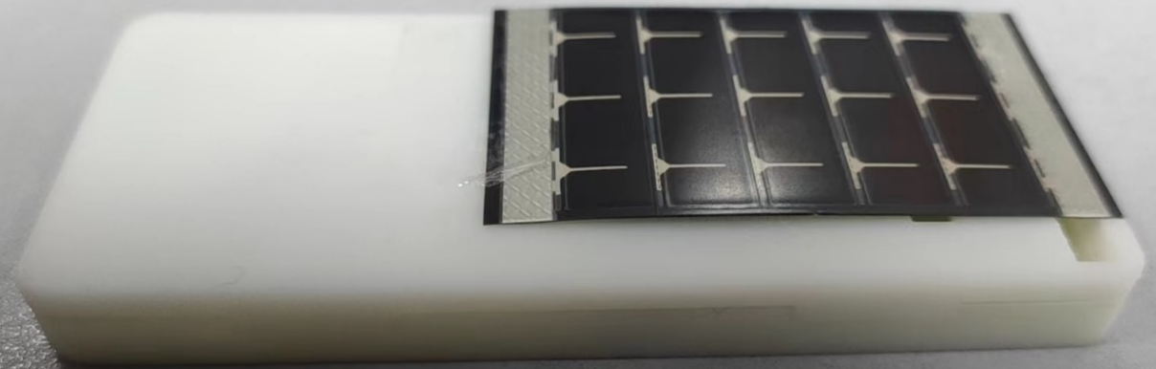
One prototype for AMP IoT device
November 2022
Doc.: IEEE 802.11-22/1893r0
No battery, powered by solar cell
Low power backscatter communication
Communication distance: up to 300 meters
Successfully communicated with commercial cellular station
Integrated with temperature, humidity, accelerate sensors
Trial run at year end

Slide 20
Summary
November 2022
Doc.: IEEE 802.11-22/1893r0
This submission presents
  AMP IoT will extend and enable more and more vertical applications
  Low power low cost device connecting to WLAN and WAN is the key for AMP IoT
  Ambient power harvesting can enable battery-less IoT device
  It is possible by only using harvested power for low power sensor data acquisition
  It makes AMP IoT possible with advanced semiconductor technology

