Slide 1
Follow up on the low power listening mode
Date: 10/31/22
Authors | Affiliations | Address | Email
Xiaogang Chen | ZEKU | 2479 E Bayshore Road, Suite 260. Palo Alto, CA | Xiaogang.chen@zeku.com
Ivan Yu
Bo Wang
Yanchao Xu
Yi-Hsiu Wang

Slide 2
Outline
More data to answer/clarify questions from the last F2F regarding the proposal of low power listening in [1].
The differentiations with implementation-based solution.
Summary

Slide 3
Power consumptions of the connectivity module in smart phone
Modules\APPs | Streaming | Shopping | News | Indoor Positioning | Gaming
Connectivity (Wi-Fi) | 5.53% | 3.23% | 3.98% | 10.37% | 6.86%
CPU | 35.31% | 23.91% | 29.14% | 30.02% | 38.98%
GPU | 1.97% | 1.18% | 1.49% | 1.26% | 5.33%
LCD | 23.03% | 51.20% | 41.92% | 34.98% | 16.33%
Memory | 12.28% | 6.08% | 7.23% | 6.54% | 12.24%
Audio | 4.73% | 0.05% | 1.37% | 0.95% | 2.19%
Miscs | 17.14% | 14.35% | 14.86% | 15.89% | 18.06%
Observations:
The power consumption of Wi-Fi module varies from ~3% to ~10% depends on the apps;
Compare with other modules, Wi-Fi module can be considered as a major source of power drain.
The measurement is conducted for smartphone. Power draw for connectivity maybe larger for IoT device.
Power consumptions are always benchmarked for each individual module including connectivity.

Slide 4
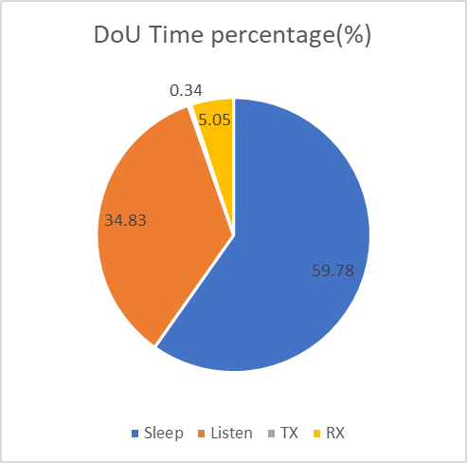
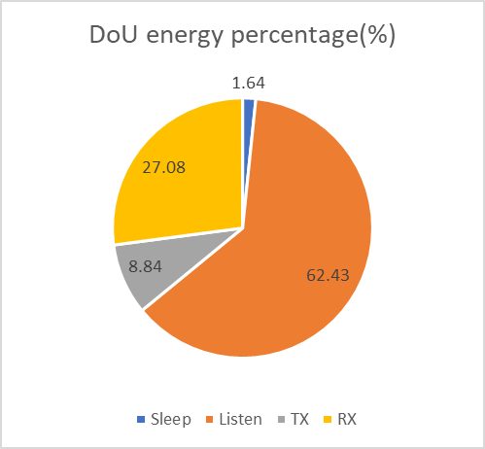
Clarifications on the power consumption
Figure on the bottom right is the energy consumption accumulating over time.
Order of the power consumption: sleeping < listening < Rx < Tx;
Order of the time duration: Tx < Rx < listening < sleeping;
Energy consumption (accumulating over time) of Listening is higher than sleeping/Tx/Rx.

Slide 5
Considerations on implementation-based LPL (1/2)
HP ramp up always needs XXus to settle depends on implementation;
HP ramp up based on packet detection will introduce false trigger;
Intro-PPDU LP to HP switch is not free…
Need a slot to switch while the Pre-EHT portion needs to be received;
Difficult to reuse the Phase tracking during the Pre-EHT portion.

Slide 6
Considerations on implementation-based LPL (2/2)
The initial frame provides flexibility for implementation on the listening operation.
Different implementations can choose their preferred alternative to leverage the initial frame and trade off.

Slide 7
Summary
Given the analysis in the slides, [1] and the agreements upon the formation of the UHR SG (recapped below), it is highly recommended to include “Reducing device level power consumption” in the PAR.
The Study Group will investigate technology which may improve reliability of WLAN connectivity, reduce latencies, increase manageability, increase throughput including at different SNR levels, and reduce device level power consumption…

Slide 8
Reference
[1] 11-22-1414-01-0uhr-LPL.

Slide 9
Backup: Power consumptions break down (copied from [1])
If LPL (Low Power Listening) module is introduced in RF, the power consumption will be scaled down as in the table below:
Significant amount of power consumption can be saved in RF with a dedicated LPL mode.
 | 160MHz HP | 20MHz HP | 20MHz LP
 | 2 Chain | 2 Chain | 1 Chain
PLL | 100% | 100% | 7%
ADC | 100% | 19% | 3%
Others | 100% | 66% | 14%
Total | 100% | 63% | 9%
Note: Normalized per row based on 160MHz HP

