Slide 1
Faster S1G+
Date: 2022-11-08
Authors:
Name | Affiliation | Address | Phone | email
Surendra Raju | Morse Micro |  |  | surendra.raju@morsemicro.com
David Halasz | Morse Micro |  |  | dave.halasz@morsemicro.com
Dave Goodall | Morse Micro |  |  | dave@morsemicro.com
Farhad Mighani | Adapt-IP |  |  | farhad@adapt-ip.com
Straff Wentworth | Adapt-IP |  |  | straff@adapt-ip.com
Dejan Đumić | Methods2Business |  |  | dejan@methods2business.com

Slide 2
Abstract
The Sub 1 GHz PHY was based on IEEE 802.11ac. Newer PHYs have introduced functionality which would be beneficial to Sub 1 GHz operation.

Slide 3
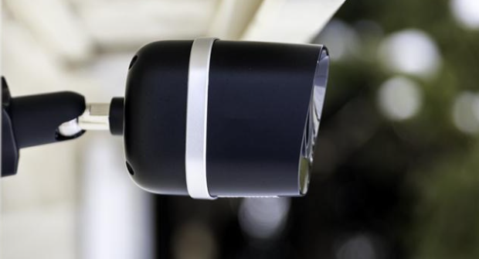
Faster Use Case
Camera & Video Use Case
IEEE 802.11ah useful for low power cameras and video.
Higher rates will enable higher resolution and more streams

Slide 4
Increased throughput for 802.11ah
IEEE 802.11ah based on IEEE 802.11ac
Use features brought in post IEEE 802.11ac to improve throughput
1024 QAM was added in IEEE 802.11ax

Slide 5
Increased throughput for 802.11ah
Usage of 1024 QAM
- rate ¾
- rate ⅚
- same puncturing patterns as for other rates
- Interleaver parameters aligned for 1024 QAM
Parameter | 1MHz | 2MHz | 4MHz | 8MHz
Ncol | 8 | 13 | 18 | 26
Nrow | 3*10 | 4*10 | 6*10 | 9*10
Nrot | 2 | 11 | 29 | 58
MCS mapping
- Constellation mapping borrowed from 802.11ax (section 26.3.11.8)
- SIG field has 4 bit MCS
- MCS11 → rate ¾ 1024-QAM
- MCS12 → rate ⅚ 1024-QAM

Slide 6
Increased throughput for 802.11ah
Theoretical rates achieved
MCS | Spatial Streams | Modulation Type | Coding rate | Data Rate (Mbps)
 |  |  |  | 1 MHz Bandwidth |  | 2MHz Bandwidth |  | 4MHz Bandwidth |  | 8Mhz Bandwidth
 |  |  |  | 8 𝝁sec GI | 4 𝝁sec GI | 8 𝝁sec GI | 4 𝝁sec GI | 8 𝝁sec GI | 4 𝝁sec GI | 8 𝝁sec GI | 4 𝝁sec GI
MCS11 | 1 | 1024-QAM | 3/4 | 4.5 Mbps | 5.0Mbps | 9.75 Mbps | 10.833Mbps | 20.25 | 22.5 | 43.875 | 48.75
MCS12 | 1 | 1024-QAM | 5/6 | 5 Mbps | 5.55Mbps | 10.833 Mbps | 12.03 Mbps | 22.5 | 25 | 48.75 | 54.1667
TX EVM requirement
< -35 dB

Slide 7
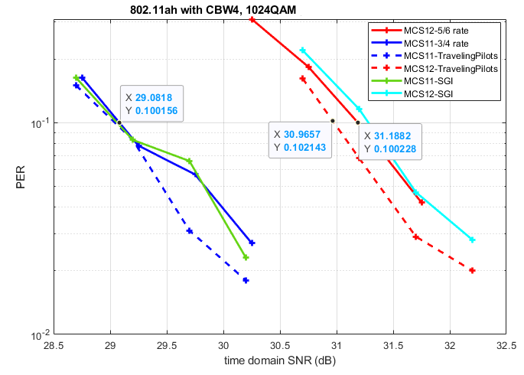
1024 QAM ¾ and ⅚ rates (shown as MCS11 & MCS12)
LGI, SGI, Travelling, Fixed pilot modes

Slide 8
Traffic typically in the uplink direction
Uplink Multi User MIMO was added in IEEE 802.11ax
Cameras, sensors using UL MU-MIMO will increase system level performance

Slide 9
Sub 1 GHz typically operating in areas with other systems
Preamble puncturing was added in IEEE 802.11ax and then extended in IEEE 802.11be.
Preamble puncturing allows some bandwidth to be skipped
Interference or adjacent cell
Punctured Bandwidth
Channel Bandwidth

Slide 10
Straw poll
Do you agree to the formation of a Study Group to develop a PAR and CSD for addition of functionality from existing PHYs, such as 1024-QAM, Uplink MU-MIMO and puncturing to Sub 1 GHz operation, to enable increased throughput operation?

Slide 11
References

