Slide 1
Polarization switching for WLAN sensing
Date: 2022-12-12
Name | Affiliation | Address | Phone | Name
Rui Du | Huawei Technologies Co. Ltd | F3, Huawei Base, Shenzhen, China |  | ray.du@huawei.com
Naren
Mengshi Hu

Slide 2
Outline
Abstract
Polarization switch for WLAN sensing
Validation of polarization in WLAN sensing at 2.4 GHz
Validation of polarization in WLAN sensing at 5 GHz
Validation of polarization in WLAN sensing at 60 GHz
How to support it in 11bf ?
Summary
References
SP

Slide 3
Abstract
Polarization switching has been adopted in 11 ay for LOS assessment.
In this contribution, the idea of sensing with different polarization information is discussed and some experimental measurements are shown.

Slide 4
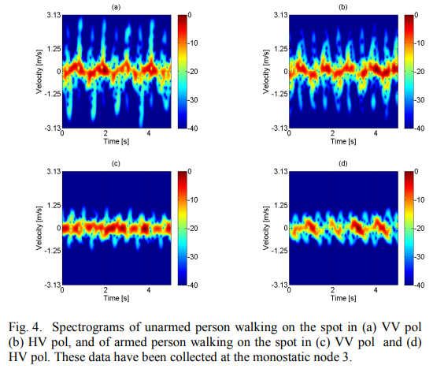
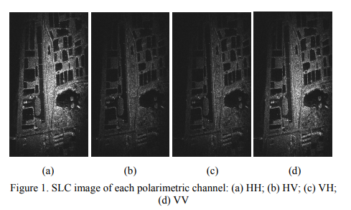
Polarization for WLAN sensing
Polarization is important for device free target sensing. The scatter properties with different polarizations are different and could provide more information for sensing[1, 2].

Slide 5
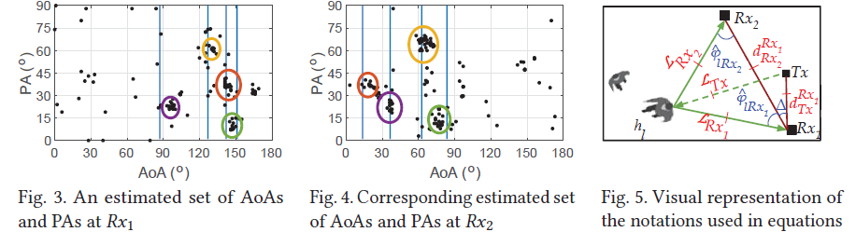
Polarization for WLAN sensing
In [3], polarization angle is adopted to provide additional information for multi targets association. With the introduction of PA, multiple targets localization can be realized with only angle information.

Slide 6
Validation of polarization in WLAN sensing at 2.4 GHz
Wi-Fi PPDUs are transmitted with vertical polarization at the transmitter, and received with horizontal and vertical polarization simultaneously. The power of received PPDUs with different polarizations are shown above. The result are quite different and both of them could be used for sensing.

Slide 7
Validation of polarization in WLAN sensing at 5 GHz
Wi-Fi PPDUs are transmitted with vertical polarization at the transmitter, and received with horizontal and vertical polarization simultaneously. The power of received PPDUs with different polarizations are shown above. The result are quite different and both of them could be used for sensing.

Slide 8
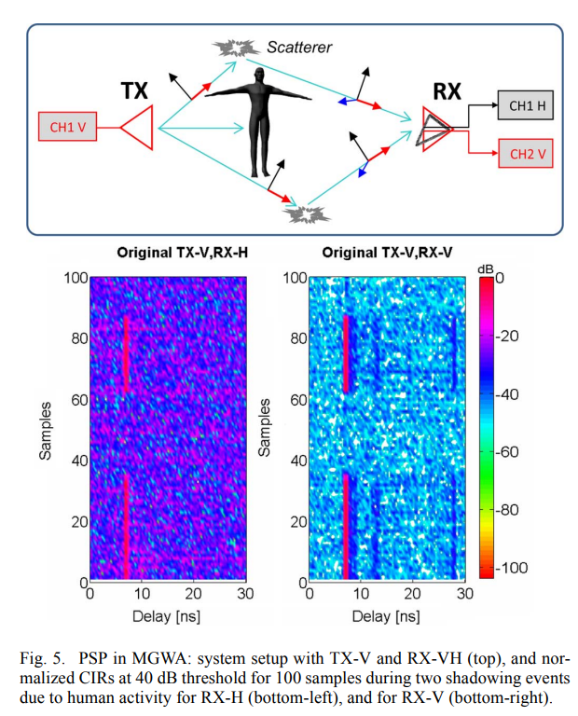
Validation of polarization in WLAN sensing at 60 GHz
The left figure provide a experimental test at 60GHz [4].
In the experimental, signal is transmitted vertically, received horizontally and vertically simultaneously. The results of V-H and VV are quite different (which could provide different sensing information) and both of them could be used for sensing processing.

Slide 9
How to support it in 11bf ? (1)
To support this in 11bf DMG sensing.
The polarization supported capabilities should be exchanged in DMG capabilities element.
The polarization information should be contained in the beam descriptor in beam descriptor element. An example is shown in the following figures.
In this example,
the bit HP (Horizontal Polarization) could be set to 1 if the beam contained in this beam descriptor is horizontal polarized,
the bit VP (Vertical Polarization) could be set to 1 if the beam contained in this beam descriptor is vertical polarized,
the bits LHCP (Left Hand Circular Polarization) and RHCP (Right Hand Circular Polarization) are used in similar way.
if the station is not able to provide polarization information, all of these bits shall be set to reserved.

Slide 10
How to support it in 11bf ? (2)
With the polarization information in all the beam descriptors, the sensing initiator is able to have all the polarization information of Tx beams and Rx beams.
For (coordinated) bistatic DMG sensing and multistaitc DMG sensing, sensing initiator could fulfill the polarization sensing by properly setting Tx Beam List subelement and Rx Beam List subelement.
For coordinated monostatic DMG sensing (only Tx Beam List sublememt presents in DMG Measurement Setup element), sensing initiator could realize the polarization sensing with an extra indication in DMG Measurement Setup element.

Slide 11
Summary
Polarization switching has been adopted in 11 ay for LOS assessment.
This capability could be introduced in 11bf DMG sensing to provide co-polarization sensing results(e.g. H-H, V-V) and cross-polarization results(e.g. H-V, V-H) for sensing performance enhancement.

Slide 12
References
[1] F. Fioranelli, M. Ritchie and H. Griffiths, "Analysis of polarimetric multistatic human micro-Doppler classification of armed/unarmed personnel," 2015 IEEE Radar Conference (RadarCon), 2015, pp. 0432-0437, doi: 10.1109/RADAR.2015.7131038.
[2] P. Wang, C. Ma, X. Wu and S. Li, "An Experimental Study on Airborne Full Polarimetric SAR Calibration," 2018 China International SAR Symposium (CISS), 2018, pp. 1-4, doi: 10.1109/SARS.2018.8552014.
[3] H. Venkatnarayan, Raghav, et al. "Leveraging Polarization of WiFi Signals to Simultaneously Track Multiple People." Proceedings of the ACM on Interactive, Mobile, Wearable and Ubiquitous Technologies 4.2 (2020): 1-24.
[4] A. P. Garcia Ariza et al., "60 GHz Ultrawideband Polarimetric MIMO Sensing for Wireless Multi-Gigabit and Radar," in IEEE Transactions on Antennas and Propagation, vol. 61, no. 4, pp. 1631-1641, April 2013, doi: 10.1109/TAP.2013.2243398.

Slide 13
SP 1
Do you support to include polarization sensing (described as follows) in 11bf DMG sensing ?
Polarization supported capabilities should be exchanged in DMG capabilities element.
Polarization Information of each beam is contained in its Beam descriptor.
For coordinated monostatic DMG sensing, an indication is used to indicate the polarization sensing.
Yes
No
Abs

