Slide 1
RR-TAG mmWave Spectrum Survey
Date: 2022-09-13
Authors:
Notes:
September 2012

Slide 2
Abstract
IEEE 802.11 is considering mmWave bands for the UHR project to supplement the bands currently in use. IEEE 802.18, the Radio Regulatory Technical Advisory Group has experts and experience in spectrum use. This presentation is an introduction to what this group will be doing, and what it plans to deliver to the UHR SG/TG. This information will also be useful for other IEEE wireless groups, specifically 802.15.
Notes:
September 2012
doc.: IEEE 802.11-09/0301r1
March 2009
Stephen McCann, RIM
Page 2

Slide 3
The Bands Being Studies (and Why)
45 GHz band
Potentially 5.5 GHz available (42.5 – 48 GHz)
Preferred in China over 60 GHz
Europe has an SRD standard encompassing the band (EN 305 550-1)
60 GHz band
Potentially 14 GHz available (57 – 71 GHz)
IEEE 802.11 has long experience with this band
ETSI has a standard that could be modified to support UHR (EN 303 753)

Slide 4
Parallel Project For Information Only
Work will be conducted independent of the UHR SG/TG
The group will provide updates either periodically or upon request
Once the SG/TG makes a spectrum determination, this group will shift its focus to support

Slide 5
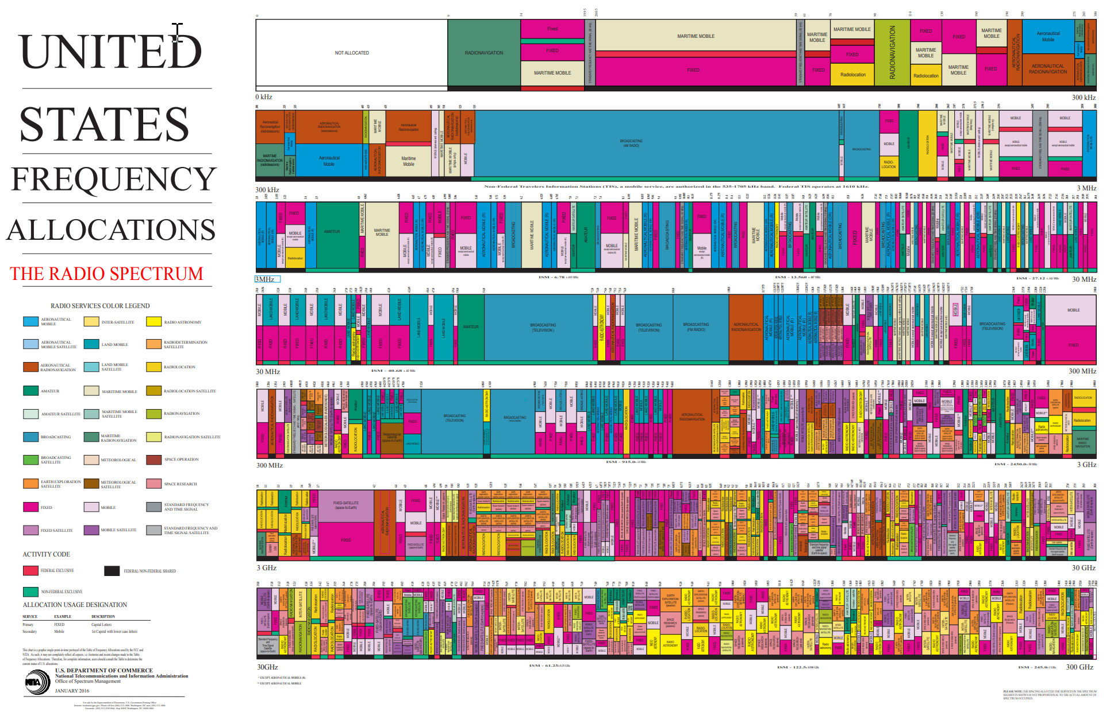
The Art of Spectrum Complexity
6GHz
45GHz
60GHz

Slide 6
Spectrum Study Plan
Review all the relevant documents and online information
ITU-R Radio Regulations [and all the footnotes!]
European Table of Frequency Allocations
ECO Frequency Information System
US FCC Table of Frequencies
All other applicable and available regulatory domain regulations
Review existing applicable standards
E.g. ETSI EN 305 550-1, EN 303 753
Request information where clarifications are necessary

Slide 7
What the Information Supplied Will Contain
Spectrum availability
Parts or all of the proposed bands
Incumbent protection expectations
Historic spectrum sharing successes with similar incumbents
Global expectations for success with any required regulatory changes

Slide 8
What the Group Will Not Do
Formal requests for regulatory changes are beyond the resource capacity of this ad hoc group
Information will be the primary work product
Advocate for a spectrum preference

Slide 9
References
ITU-R Radio Regulations
https://www.itu.int/pub/R-REG-RR
European Table of Frequency Allocations
https://docdb.cept.org/download/2ca5fcbd-4090/attachments/2013_ERCRep025.pdf
ECO Frequency Information System (cept.org)
US FCC Table of Frequencies
https://transition.fcc.gov/oet/spectrum/table/fcctable.docx

