Slide 1
TGbi, Protection against Spoof AP
Date: 2022-08
Authors:
Name | Company | Address | Phone | email
Graham Smith | SRT Group | Sunrise , FL |  | gsmith@srtrl.com
Rev 1 – Edited text on final slide

Slide 2
Back to the beginning
Presentations were given in WNG back in 2014
These give insight as to the problems that needed solving and as to why RCM happened.

Slide 3
Wi-Fi Privacy Concerns
Seattle Police Deactivate Wi-Fi Spy Grid After Privacy Outcry (Nov 2013)
A DHS and Seattle police network collecting location information
CreepyDOL WiFi surveillance project debuts at Blackhat/DEFCON (Aug 2013)
DIY surveillance with low-cost Wi-Fi based sensors that capture MAC addresses
Wi-Fi Trashcans Now Silently Tracking Your Smartphone Data (Aug 2013)
... the company boasted that the cans, which included LCD advertising screens, "provide an unparalleled insight into the past behavior of unique devices"—and hence of the people who carry them around
"Technopanic" mounts over Google's Wi-Fi Privacy violations (Mar 2013)
A DHS and Seattle police network collecting location information

Slide 4
Privacy Threats
Source of Threats:
Hackers, private investigators, stalkers, paparazzi
Marketing firms and retail outlets
Police, Government Agencies
Non-threats:
Marketing firms and retail outlets (with user approval)
Personal home automation (of home user)
... Etc.
It is very important to identify ways to enable tracking when it is a “service”, but prevent unauthorized tracking

Slide 5
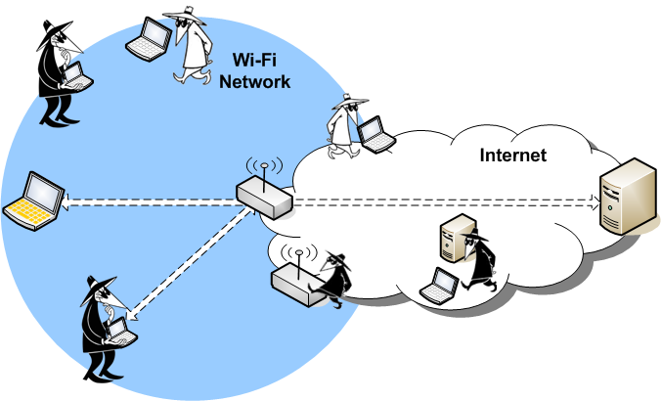
Passive Scanning and Monitor APs
The primary scenarios to consider that are a “threat” and not “services” are passive monitoring and APs used for monitoring

Slide 6
Original “privacy” concerns
Source of Threats:
Hackers, private investigators, stalkers, paparazzi)
Marketing firms and retail outlets (User may Opt-In)
Police, Government Agencies
“Big” Example was paparazzi tracking Jennifer Lopez (“J Lo”)
The “J Lo” attack was simple, “look for J Lo’s MAC Address”
RCM was thought to be the solution BUT….

Slide 7
The new “J Lo Attack”
Dastardly people can set up APs that spoof the “home BSS” of the target X
If X’s mobile, STA X, comes in range, it will attempt to Associate
It does not matter what MAC Address STA X is using, the mere fact it sent an Association Request exposes that it (or someone from X’s home) is present.
Originally RCM stopped simple MAC tracking, but now spoof AP can be used.
Can be expanded to other BSSs/ESSs, e.g., corporate sites.
TASK - Is it possible to know that the AP is the “real deal” BEFORE attempting to Associate?

Slide 8
Proposal for Requirements Document
11bi shall define at least one mechanism that will allow a non-AP STA to verify the identity of a known AP prior to transmission of any pre-association PPDUs to the AP.
Agree to add this case to the Requirements Document 21/1848?

