Slide 1
Use Cases of indoor positioning in shopping centre
August 2022
Doc.: IEEE 802.11-22/1338r0
Date: 2022-08-16
Authors:
Name | Affiliation | Address | Phone | Email
Weijie Xu | OPPO |  |  | xuweijie@oppo.com
Yinan Qi
Shengjiang Cui
Zhisong Zuo
Chuanfeng He

Slide 2
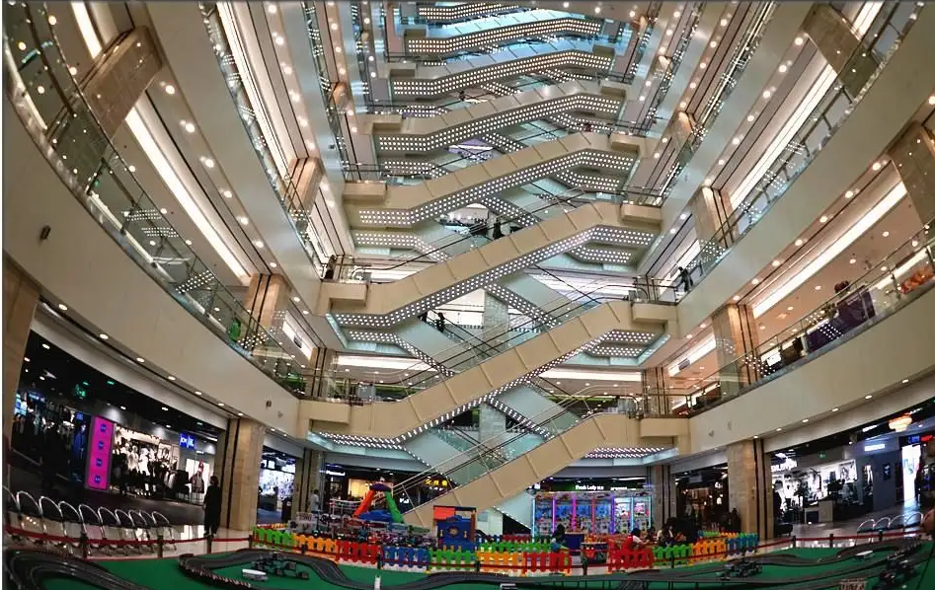
August 2022
Doc.: IEEE 802.11-22/1338r0
Background（1）
Shopping has always been an important part of our daily life
A shopping centre offers a wide range of services and products, including large supermarkets, a collection of retail stores, restaurants, banks, theatres, fitness and leisure facilities, underground parking areas, professional offices and other establishments
Many giant shopping centres have been established all over the world, each can occupy an area of tens to hundreds of thousands m2, composed of one or multiple buildings, each of which has multiple storeys both over and underground.
While enjoy various services, people often have the following troubles in a shopping centre.
Taking long time to find a vacant parking spot
Forget where his/her car has been parked
Taking long time to find a target place
Taking long time to find the target item she/he want to buy in a supermarket/shop
Slide 2
Weijie Xu(OPPO)

Slide 3
August 2022
Doc.: IEEE 802.11-22/1338r0
Background（2）
The global Indoor Positioning and Navigation market was valued at $6.92 billion in 2020 and is projected to grow to $23.6 billion in 2025 at a CAGR of 27.9%[1].
Unlike the outdoor use cases where Global Navigation Satellite System can be used, it calls for much more efficient indoor positioning and navigation technologies for indoor use cases.
It shall be easily deployed
The deployment cost shall be low enough
It can be easily used by the verticals and individual customer
Slide 3
Weijie Xu(OPPO)

Slide 4
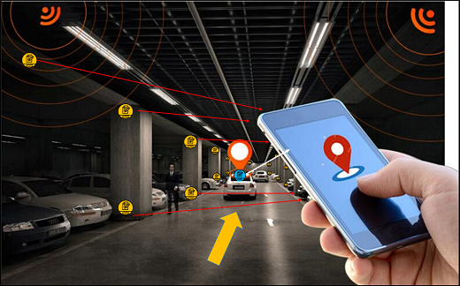
August 2022
Doc.: IEEE 802.11-22/1338r0
Use Case 1: Indoor positioning for parking
Usually, the parking area in a shopping centre is located in the underground storeys. There are hundreds of to thousands of parking spots in the parking area.
AMP IoT devices can be used to build an indoor positioning and navigation system. It can help people to find the vacant parking spot and find where the car has been parked.
The AMP IoT devices are evenly distributed with 2-meter intervals within the entire parking area, from the entrance to the exit.
Indoor positioning can be enabled by an AP in the car or a handheld STA (e.g., smartphone), which can communicate with and position the AMP IoT devices.
Typical requirement:
Communication range: 10~30m
Positioning accuracy: 1~3 m horizontal accuracy
Slide 4
Weijie Xu(OPPO)

Slide 5
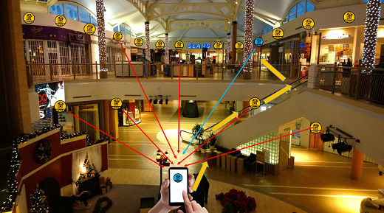
August 2022
Doc.: IEEE 802.11-22/1338r0
Use Case 2: Indoor positioning for shopping
AMP IoT devices can be used to build an indoor positioning and navigation system. It can easily help people to position himself/herself and find a target place(e.g., a retail store or a restaurant ) within a giant shopping centre.
The AMP IoT devices are evenly distributed with 2-meter intervals within the entire shopping centre, in each floor and each room.
Indoor positioning can be enabled by a handheld STA (e.g., smartphone), which can communicate with and position the AMP IoT devices.
Typical requirement:
Communication range: 10~30m
Positioning accuracy: 1~3 m horizontal accuracy and 2m vertical accuracy (i.e., can locate the specific storey)
Slide 5
Weijie Xu(OPPO)

Slide 6
Summary
July 2022
Doc.: IEEE 802.11-22/1338r0
This submission presents
A typical use case which requires indoor positioning
It can enable indoor positioning by using AMP IoT devices and there are following advantages:
Easily to be deployed and ultra-low deployment cost
Battery-free thus maintenance-free
Achieve positioning in vertical dimension
Handheld WiFi equipment can be used thus easily used for verticals and individual customers
The typical requirements are:
Coverage: 10-30 meters for indoor
Positioning accuracy: 1~3 m horizontal accuracy and 1~2 m vertical accuracy
Slide 6

Slide 7
Reference
July 2022
Doc.: IEEE 802.11-22/1338r0
https://www.researchandmarkets.com/reports/4531980/indoor-positioning-and-navigation-market

