Slide 1
802.11bb Light Communications
Light Communications (LC)
Ability to re-use existing HT, VHT and HE PHY/MAC
Use Cases:
Industrial wireless applications
Medical environments
Enterprise
Home
Backhaul
Vehicle to Vehicle Communication
Underwater Communication
Gas Pipeline Communication
Key additions :
Uplink and downlink operations in 800 nm to 1000 nm band
Minimum single-link throughput of 10 Mb/s
Interoperability among solid state light sources with different modulation bandwidths.
1

Slide 2
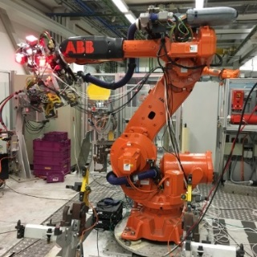
802.11bb usage model 1: Industrial wireless
Pre-Conditions
Devices may experience unstable radio frequency (RF) connection due to Electro-Magnetic Interference (EMI) in factories. LC is deployed to provide reliable wireless connectivity for industrial wireless networks.
Environment
All communications are within a large metal building, industrial or automated work cell. The area of these environments range from tens to thousands of square meters, equipped with industrial robot and other equipment. The environment has high levels of EMI. Lighting level of 150 lux is recommended (1500 lux for dedicated work).
Applications
Ultra-high-definition (UHD) video streaming for surveillance or production monitoring (quality control) applications, for video collaboration for team, customer, and supplier meetings. Lightly compressed Video: ~ 1Gbps, delay < 5 ms, 1x10⁻⁸ PER, 99.9% reliability. Fully connected factory—for real-time communications, application execution, and remote access.Distance between LC APs ranges from 2~20 meters.
Traffic Conditions
Both uplink and downlink traffic is using LC.
High levels of OBSS interference between LC access points (APs) expected due to very high density deployment.
Potential non-LC interference from surrounding environments such as artificial-light.
Multiple LC modules are deployed on the robot/equipment and on the ceiling/walls to provide multiple light links for a robust connectivity in case a single line-of-sight (LOS) link is blocked.
Use Case
An industrial robot is powered on and ready for operation.
Operating instructions are transmitted to the robot via LC.
The robot is working (e.g., movement) according to the instructions and provides real-time feedback information and/or video monitoring data for quality control to control center also via LC. Upon command, the robot finishes the task and is ready for the next one.
2

Slide 3
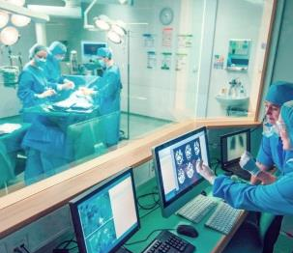
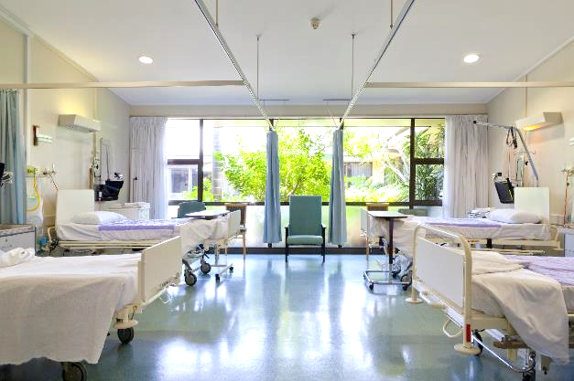
802.11bb usage model 2: Wireless access in medical environments
Pre-Conditions
IEC 60601-1-2 standard recommends the minimum separation distance between medical electrical (ME) equipment and RF wireless communications equipment (e.g., wireless local area network (WLAN)) be 30 cm to avoid performance degradation of the ME equipment. LC is deployed to ensure the performance of all ME equipment.
Environment
The size of a operating theater and MRI room ranges from 30~60 m². Multiple LC-APs are deployed on the ceiling to provide specialized illumination. The central illuminance of the operating light: 160k and 40k lux. The size of a four beds ward is about 60 m², light level: 300 lux on the bed and >100 lux between the beds and in the central area.
Applications
LC-WLAN is used to allow wireless data exchange in medical environments with ME equipment or system.
Medical multimedia and diagnostic information can be transmitted to provide telemedicine services; ME equipment can also be wirelessly controlled via LC.
Provide Intranet/ Internet access, audio or video call for doctors, nurses and patients using LC-based devices.
Traffic Conditions
No interference caused by RF radiation.
Both uplink and downlink traffic is are using LC.
High Quality of Service (QoS) and high reliability are required.
Potential non-LC interference from surrounding environments such as artificial-light.
Use Case
Doctors enter an operating theater, turn on the LC enabled LED lights and ME equipment. Doctors can interact with the remote doctors and share information using LC. ME equipment connectivity is also supported by LC. Doctors finish the treatment, then turn off the lights and medical equipment.
A patient is monitored by ME equipment which communicate with the nurses/doctors in control room via LC.
© vm
Operating theater
Hospital ward
3

Slide 4
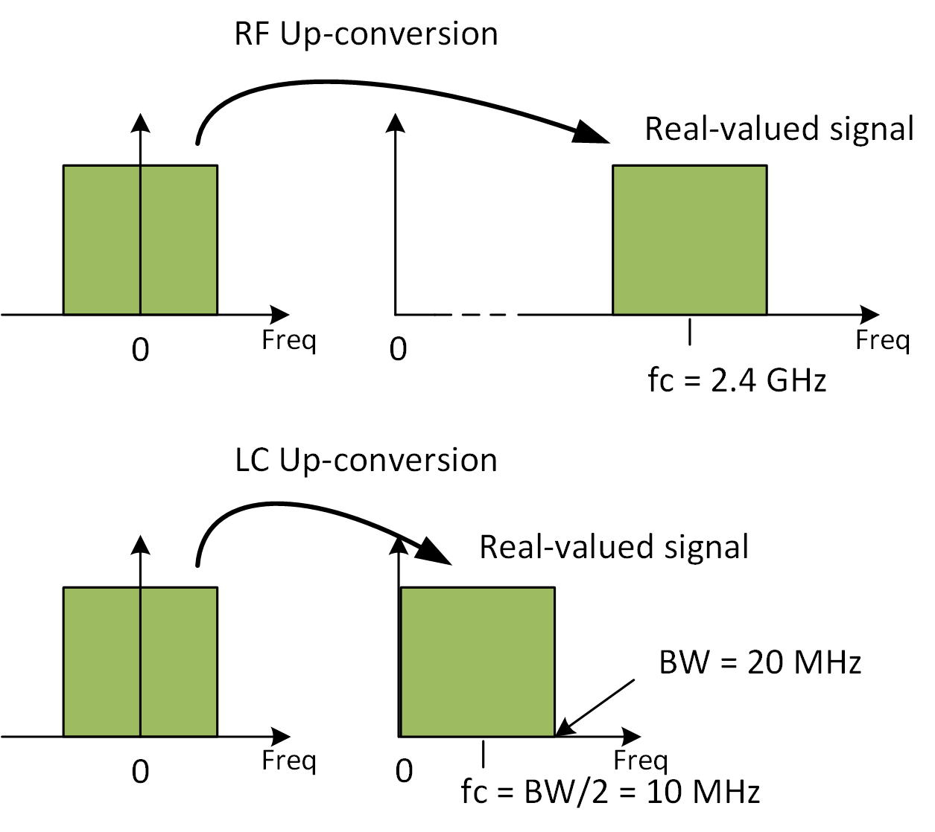
802.11bb uses light spectrum and existing technological capabilities
RF frontend up-converts baseband signals onto e.g. f_{c}= 5 GHz.
LC frontend up-converts baseband onto low IF e.g. f_{c}= BW/2 + Δ.
Δ is specified in the existing draft of TGbb for various channel bandwidths.
In this manner, LC re-uses the existing HT, VHT and HE PHY/MAC specifications.
5 GHz
BW/2 + Δ MHz

Slide 5
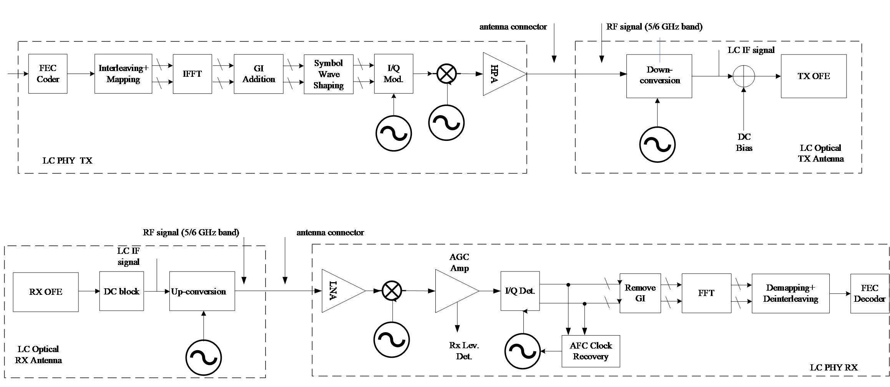
802.11bb uses light spectrum and existing technological capabilities
Example implementation of TGbb using up- and down-conversion of existing 5 GHz or 6 GHz chipsets
Interfacing the LC PHY to light emitter and receiver.

