Slide 1
Resolutions for Figures
Date: 2022-06-14
Authors:

Slide 2
Abstract
This presentation is proposed resolutions for figures.

Slide 3
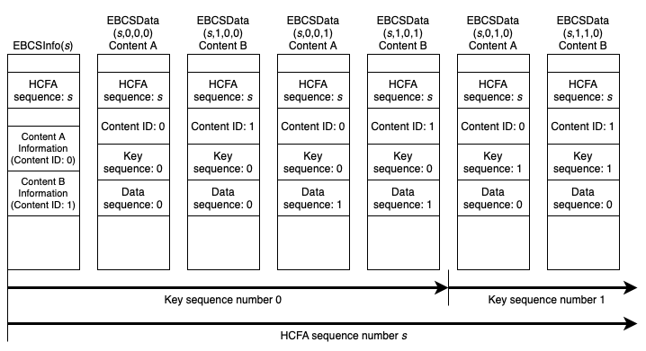
Figure 12-55e (CID 3119)

Slide 4
Table 9-397b
Value | Algorithm | Certificate Present
0 | None | No
1 | Pre-negotiated | No
2 | Digital Signature | Yes
3-255 | Reserved | -

