Slide 1
Wi-Fi and TSN enabling deterministic wireless for time-sensitive applications
Date: 2022-01-12
Authors:

Slide 2
Introduction
Growing interest in wireless for time-sensitive applications
  Factory/process automation, robotics, XR are a few examples
  A wide range latency/reliability KPIs, but “determinism” is a common need
  Time-sensitive and other types of applications need to work in a converged network
  Interoperability/standards-based connectivity is needed for practical/wide scale adoption
Wi-Fi with TSN capabilities is a solution for time-sensitive applications in managed enterprise/industrial networks
This presentation will discuss
  Time-sensitive application requirements
  Existing Wi-Fi capabilities including Wi-Fi 6/6E and TSN support
  Evolution of Wi-Fi capabilities (802.11be/Wi-Fi 7)
  Examples/demonstrations of Wi-Fi enabling industrial applications

Slide 3




Application Classes
Monitoring & Analytics
Connected Workers
Closed-loop Control Systems
Autonomous & Mobile Robots
Delay-Tolerant
Soft or Firm Real-Time
Time/Safety-Critical
(Hard Real-Time & Isochronous)

Slide 4
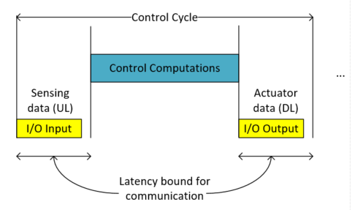



Time synchronization and timeliness requirements for Isochronous applications
https://www.iiconsortium.org/pdf/IIC_TSN_Testbed_Traffic_Whitepaper_20180418.pdf
ISOCHRONOUS TRAFFIC: The applications in each device are synchronized to a common time, which is strictly monotonic and steadily increasing, without jumps or leaps. Devices synchronously sample inputs and apply outputs by exchanging data at a defined periodic rate or cycle.
Control
Sensing
Actuation
Isochronous Industrial Control
Applications need trusted time with quantified accuracy
Distributed applications also depend on information delivered within deadlines

Slide 5
Use cases and requirements (802.11 RTA TIG Report)
Use cases |  | Intra BSS latency/ms | Jitter variance/ms [4] | Packet loss | Data rate/ Mbps
Real-time gaming [2] |  | < 5 | < 2 | < 0.1 % | < 1
Cloud gaming [15] |  | < 10 | < 2 | Near-lossless | <0.1 (Reverse link) >5Mbps (Forward link)
Real-time video [3] |  | < 3 ~ 10 | < 1~ 2.5 | Near-lossless | 100 ~ 28,000
Robotics and industrial automation [1] | Equipment control | < 1 ~ 10 | < 0.2~2 | Near-lossless | < 1
 | Human safety | < 1~ 10 | < 0.2 ~ 2 | Near-lossless | < 1
 | Haptic technology | <1~5 | <0.2~2 | Lossless | <1
 | Drone control | <100 | <10 | Lossless | <1 >100 with video
Ref: https://mentor.ieee.org/802.11/dcn/18/11-18-2009-06-0rta-rta-report-draft.docx

Slide 6
Use cases and requirements (5G ACIA White Paper)
Ref: https://5g-acia.org/wp-content/uploads/5G-ACIA_WP_5G-for-Connected-Industries-and-Automation-Second-Edition_SinglePages.pdf

Slide 7
Leading Use Cases and Requirements (Avnu Alliance WTSN Working Group)
 | Mobile Robots | Live Events | Closed loop Control | AR/VR
Typical area of service | Small/medium/large | Medium/large | Small/medium/large | Small/Medium
End stations per area of service | 100 | 100-500 | 50 | <5 devices/group
Traffic Profile | Cyclic and Event | Continuous stream | Cyclic and Isochronous | Cyclic (UL), video (DL)
Time Synchronization Accuracy | ~1 µsec | 1 µsec or better | 1 µsec or better | ~1 µsec
Bounded Latency | 10 – 1msec (cyclic) 100 – 10 msec (events) | 1msec | 10 – 1 ms (Cyclic) 10 – 100 ms (Events) | 3 to 10 msec
Reliability | 99.9 to 99.99% | 99.9 to 99.99% | 99.9 to 99.9999% | 99.9 to 99.99%
Security | Authentication, integrity and resilience to DOS/Interference | Authentication, privacy, resilience to DOS/Interference | Auth., integrity and resilience to DOS and time/QoS attacks | Auth., integrity and resilience to DOS.
Ref: https://avnu.org/wirelessTSN/

Slide 8
Requirement considerations
Wide range of latency/reliability KPIs
  Many use cases in the 1 to 50 msec latency range
  Some use cases (e.g., motion control) need even lower latency 10’s to 100’s microsecs
Most (industrial) applications that need “deterministic” service have predictable behavior
  Devices need service at periodic intervals for a fixed amount of data (known a priori)
  Time-critical data needs to be delivered within a deadline
Practical scenarios are managed enterprise/industrial Wi-Fi networks
  Networks are carefully planned and managed, including coverage tools, frequency planning, admission control policies, etc.

Slide 9
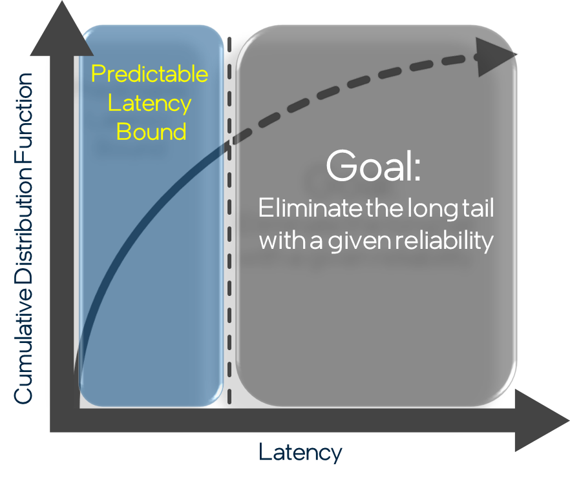
Deterministic Wi-Fi
Enablers
6 GHz
Multi-radio clients/ APs
Core Capabilities
QoS management
Wi-Fi 6: OFDMA, Triggered access
Wi-Fi 7: MLO,320 MHz, Restricted TWT
Deterministic
Wi-Fi Enabling
Tools
Wireless TSN
Time synch (.1AS)
Time-aware scheduling (.1Qbv)
Redundancy (.1CB)
Network
E2E wireless-wired integration
Management & scheduling

Slide 10










Wi-Fi 6E: Wi-Fi 6 in 6 GHz
6 GHz benefits are not for all Wi-Fi 6 devices
  (Wi-Fi 6E = Device differentiation & backwards compatibility)
Wi-Fi 6E Highlights
Wi-Fi 6
2.4 GHz + 5 GHz
Wi-Fi 6E
2.4 GHz + 5 GHz + 6GHz
Huge contiguous clean spectrum
  Up to 1200 MHz
Ideal for deterministic, low latency operation
  Many more gigabit Wi-Fi options (more channels)
Exclusive to Wi-Fi 6E and beyond products
No legacy Wi-Fi 4 or 5 devices
*
*
Wi-Fi 6E: new spectrum brings the Wi-Fi 6 promise to reality, with compatibility to legacy Wi-Fi
* Not actual WFA Wi-Fi 6E logo

Slide 11
Unlicensed 6 GHz Worldwide Regulatory Status
Costa Rica,
Guatemala,
Honduras
Taiwan
Jordan, Qatar, Oman
1200 MHz
1200 MHz Consultation
500 MHz
500 MHz Consultation
TBD (early in process)
No formal activity yet
The 48 CEPT countries individually implement the European Commission’s final decision to open spectrum for unlicensed. Some will proceed by consultations, while others will adopt the decision by an administrative change.
The 27 European Union Member States, all of which are also CEPT members, will implement the European Commission’s final decision to open spectrum for unlicensed on or before December 1st, 2021.
African Telecommunications Union (ATU) recommended regulation close to that CEPT. African countries started adoption or considering.

Slide 12
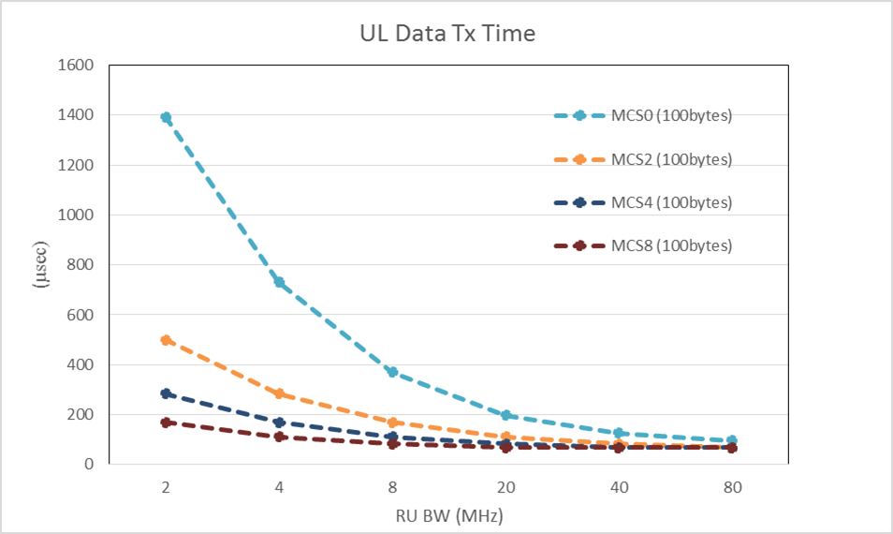
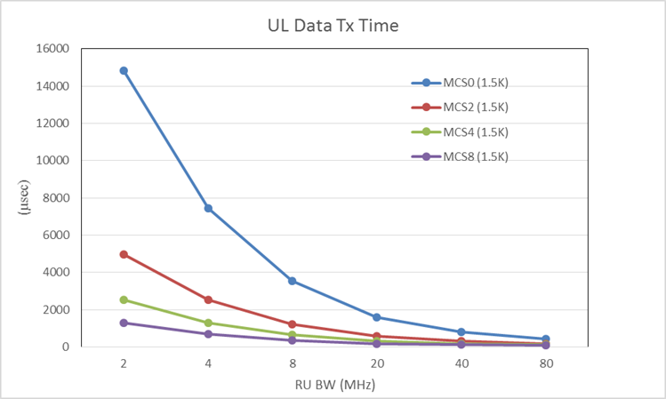
A simple 802.11 latency analysis
PPDU tx times as a function of RU* size and MCS
  802.11 over the air latency can be very low for various bandwidth/MCS configurations
  latency vs. reliability tradeoffs are possible considering channel conditions
* Resource Units (RU)s smaller than 20 MHz only with 802.11ax (Wi-Fi 6/6E)

Slide 13
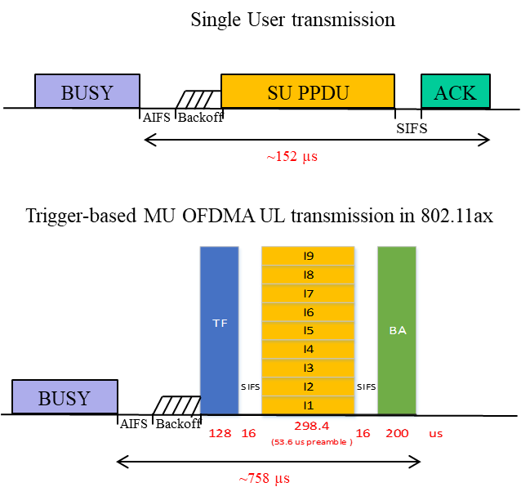
Latency and predictability enhanced with 802.11ax scheduled access
Scheduled (Trigger-based) OFDMA mode in 802.11ax avoids contention between clients enabling predictable access with higher efficiency/lower latency
Single User transmission
(1 STA)
Single user transmission from 9 STAs will take ~ 1.3 msec
Assuming: 802.11ac, 20 MHz BW, AC_VO (default parameters), average backoff (31µs), A-MPDU size (256 bytes), MCS 8 with SISO transmission
With 802.11ax trigger-based Multi-User UL transmissions, the same amount of data will take approximately 758 µs.
Dave Cavalcanti, Intel

Slide 14
TSN “toolbox” and 802.11 (Wi-Fi) support
Time-Sensitive Networking (TSN) = deterministic data delivery with bounded latency without loss due to congestion or errors. Standards defined by the IEEE 802.1 TSN Task Group.
Example TSN tools (not a complete list) enabled by 802.11 and relevant 802.11 capabilities
Time synchronization (802.1AS profile of IEEE 1588)
TSN toolbox
Redundancy (802.1CB)
Redundant time (802.1AS-Rev)
…
Synchronization
802.1AS over 802.11 TM, FTM
Reliability
802.11be Multi-link
Time-aware scheduling (802.1Qbv)
…
Bounded Latency
TSN Config (802.1Qcc)
Stream reservation (802.1Qat)
…
Resource Mgmt
Scheduling (802.11ax)
Low latency Enhancements (802.11be)
802.1Q bridging (802.11ak)

Slide 15
Time Synchronization (802.1AS) & Time-Aware Shaping (802.1Qbv) over 802.11
802.1AS synchronization across wired-wireless TSN
802.1Qbv time-aware scheduling
Queues/Traffic Classes
AP
T
T
T
T
Shared medium
T
T
T
T
T
T
T
T
Talker
Listener
STA 1
STA 2
  802.11 defined MAC specific support for 802.1AS:
    Fine Timing Measurement (FTM) – IEEE802.11-2016
  A time-aware (Qbv) scheduler defines when gates open/close to ensure time-sensitive frames are not delayed by other traffic
  Wi-Fi 6 triggered access can be used to provide deterministic latency

Slide 16
802.1Qbv Scheduling over Wi-Fi 6
Schedule configuration: the CNC delivers a schedule to the 802.11ax AP (supporting TSN)
The AP uses the trigger-based mode to deliver the data according to the worst-case latency and reliability
Low latency/high reliability and capacity tradeoffs can be achieved
(Simulation Results)
Simulation Assumptions:
20 MHz channel, SISO, 100 Bytes packets, Channel model E, STAs randomly distributed in a 50 m radio, latency-optimized scheduling strategy, managed network (no OBSS).

Slide 17

Network Configuration & Management
CUC
UNI
End Station Configuration
CNC
TSN-CS
WTSN-CS
End Station Configuration
Wired-TSN
Stream Data
End Station Configuration
Talker End Stations
TSN Bridges
Listener End Stations
(3) Hybrid Model
WTSN domain can be physical or logical
CNC is aware of WTSN domain via WTSN-CS (Configuration and Scheduling)
The CNC can discover wireless-specific parameters and manage/configure end-to-end TSN resources
End Station Configuration
Stream Data
AP
AP
Stream Data
Stream Data
Wireless Talker End Stations
Wireless Listener End Stations
Wireless-TSN
Notes:
1) Wireless and Wired share the same TSN Reference Stack
2) Logical is similar to 5G
Add notion of I/F Translator similar to 5G

Slide 18
Wi-Fi 7 enhancements for low latency & TSN
MLO (Multi-Link Operation)
Potential features for deterministic low latency
Data
QoS provisioning for low latency traffic streams
Restricted TWT service periods for low latency traffic
Time-Aware (Qbv) scheduled access aligned with the 802.11 MAC protected service periods
Multi-link device A (AP)
AP₁
AP₂
AP₃
Link 1
(Channel X, Band Y)
Link 2
(Channel L, Band M)
Multi-link device (STA)
STA₁
STA₂
STA₃
Data
Enables lower latency and redundancy at the 802.11 MAC
New tools to avoid congestion delay

Slide 19



Wi-Fi and TSN Evolution
…
2019
2021
2023
…
…
…
Wi-Fi 5 TSN
Wi-Fi 6/6E TSN
Wi-Fi 7 TSN
Time Synchronization
Traffic shaping over
EDCA
Traffic shaping and bounded latency with scheduled OFDMA operation
Deterministic low latency enhancements
TSN Enabling Capabilities
Redundancy over MLO
Redundancy over multi-NiC
TSN Configuration and management
Wi-Fi and TSN will continue to evolve and introduce new TSN tools

Slide 20
Examples and Demonstrations of Wi-Fi enabling Industrial Applications

Slide 21
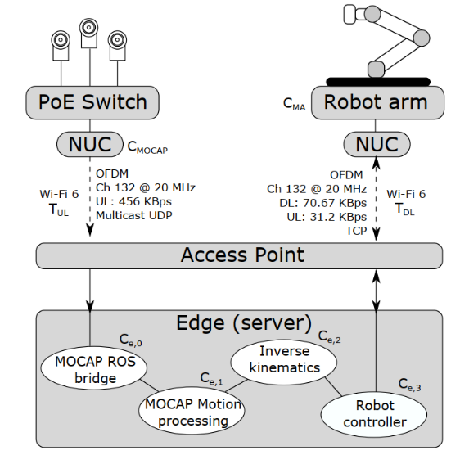
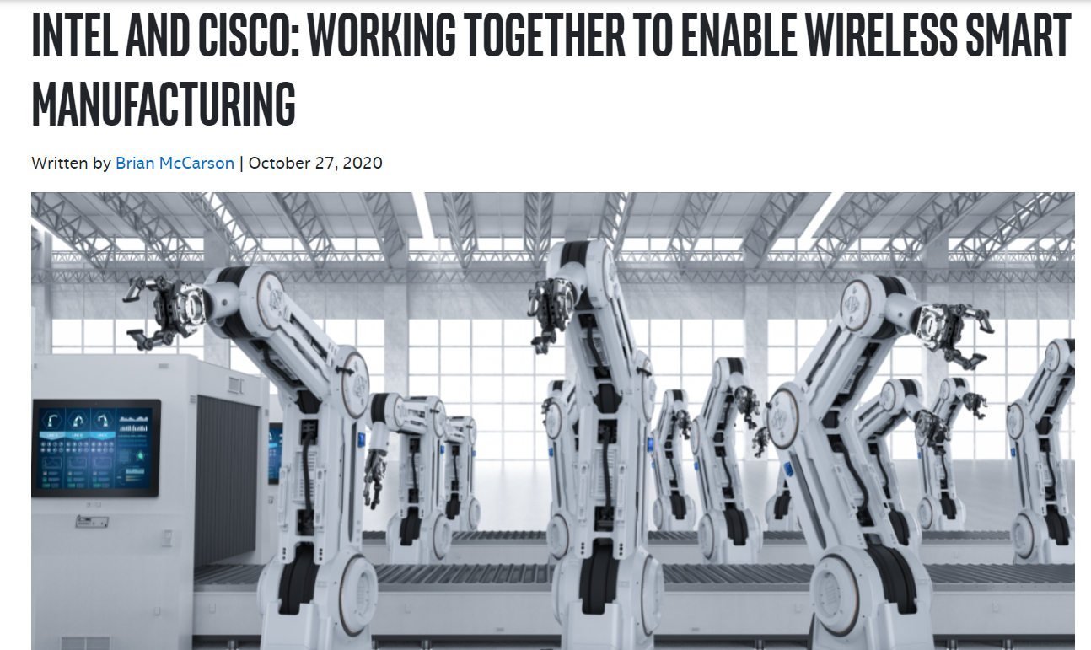

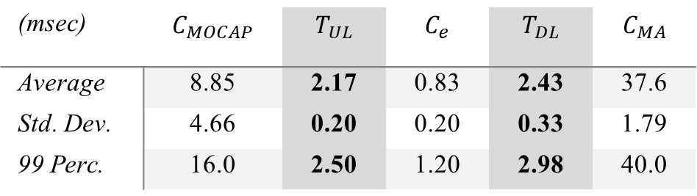
Wi-Fi 6 in Industrial IOT
Network latencies (T_{UL}, T_{DL}) with Wi-Fi 6
(msec) | $$C_{MOCAP}$$ | $$T_{UL}$$ | $$C_{e}$$ | $$T_{DL}$$ | $$C_{MA}$$
Average | 8.85 | 2.17 | 0.83 | 2.43 | 37.6
Std. Dev. | 4.66 | 0.20 | 0.20 | 0.33 | 1.79
99 Perc. | 16.0 | 2.50 | 1.20 | 2.98 | 40.0

Slide 22
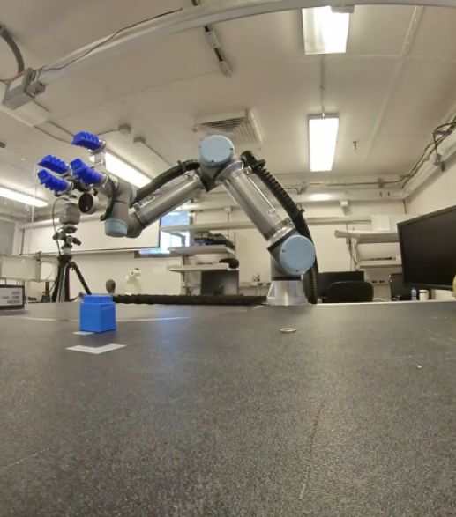
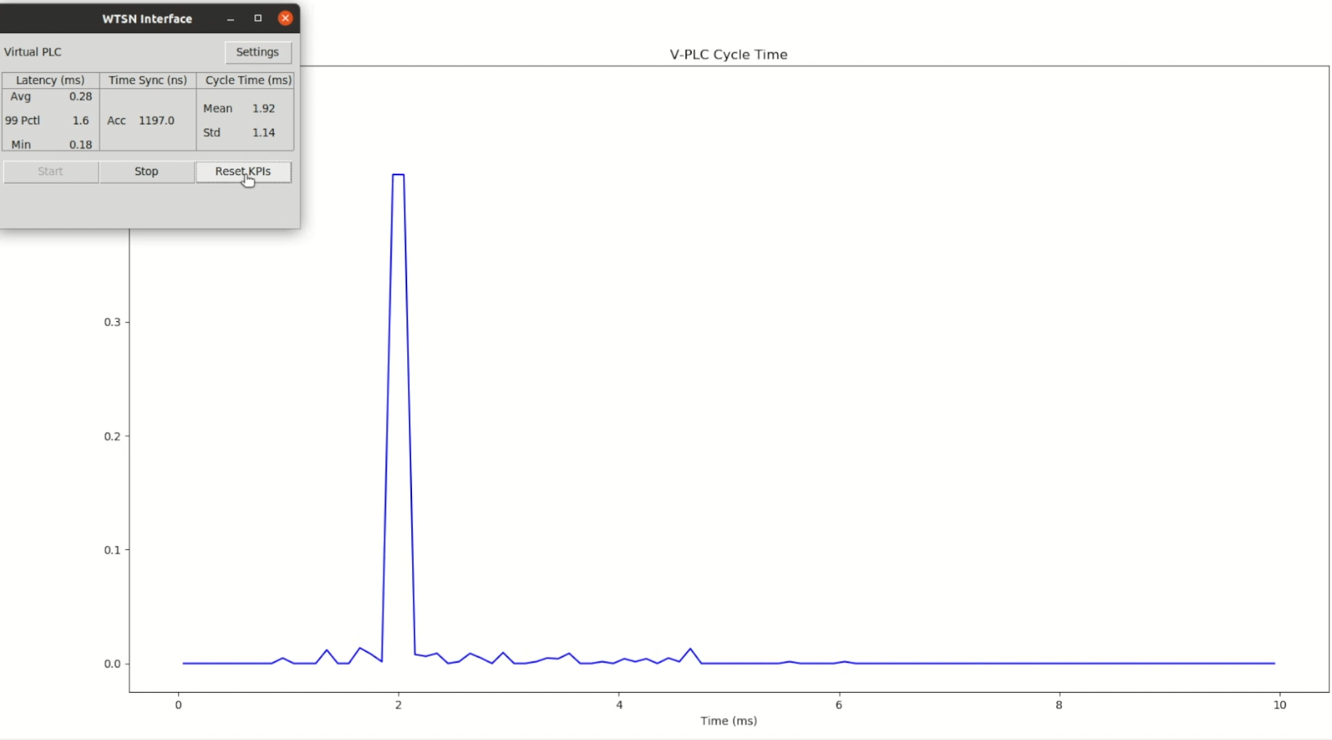
Fine manipulation over Wi-Fi
* Robotic application demo provided by the Intel Labs Human & AI Robotics and Wireless Systems teams
(20 MHz Channel, 5 GHz)

Slide 23


Ecosystem activities in WBA and Avnu Alliance
Workgroup launched Feb. 2021 - https://wballiance.com/wi-fi-6-6e-for-industrial-iot/
Continue the IIOT work :
https://wballiance.com/resource/wi-fi-6-trial-report-industrial-manufacturing/
https://www.mettisgroup.com/wifi6/
Wireless TSN WG
https://avnu.org/wirelessTSN/
Defining use cases, market requirements and TSN capability testing specifications
https://avnu.org/wireless-tsn-paper/

Slide 24
Conclusions
802.11 is already used as connectivity solution in enterprises/industrial networks
New capabilities (Wi-Fi 6/6E and TSN) are enabling support for time-sensitive applications
  Can meet isochronous communication requirements
  802.11be (Wi-Fi 7) is introducing new deterministic low latency and reliability enhancements
  Next generation Wi-Fi will continue improving latency/reliability/efficiency
Wi-Fi 6 TSN trials, testing and deployments are in progress (WBA and Avnu Alliance)

