Slide 1
Beacon Frame and Group Frames information
Date: 2021-10-26
Authors:

Slide 2
Abstract
An AP may transmit Beacon and group addressed frames in many frame types. The frame type and MCS impact to the BSS range and to the transmission rate. For instance, BSS range may be limited by transmitting Beacons in higher rate.
This submission proposes out-of-band signalling for Beacon and group frames to help:
- Scanning STAs to determine the BSS range
- Associated non-AP MLDs to select a link for group addressed frames reception

Slide 3
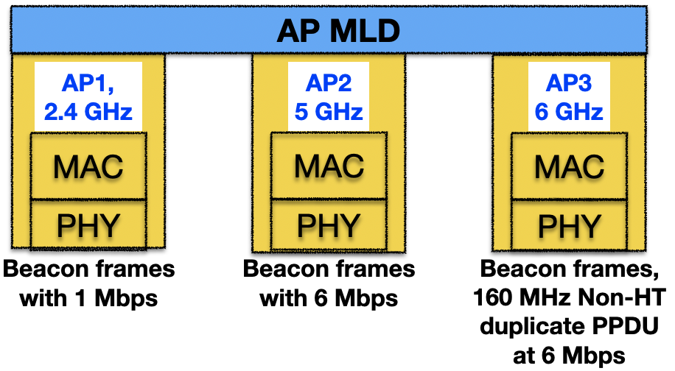
Motivation: Beacon frame type
The PPDU type and MCS of the beacon and group addressed frames have many impacts:
Scanning/receiving STA may need to receive complicated frames which may impact STA power consumption
AP may shorten BSS range by using higher transmission rates or lower transmission power
802.11ax allows APs at 6 GHz to transmit beacons in the non-HT Duplicate PPDUs format with larger than 20 MHz transmission bandwidth to enlarge BSS range
A scanning STA can receive beacons on a long range, if the scanning STA receives with larger RX bandwidth
Example of AP MLD with maximized BSSs ranges

Slide 4
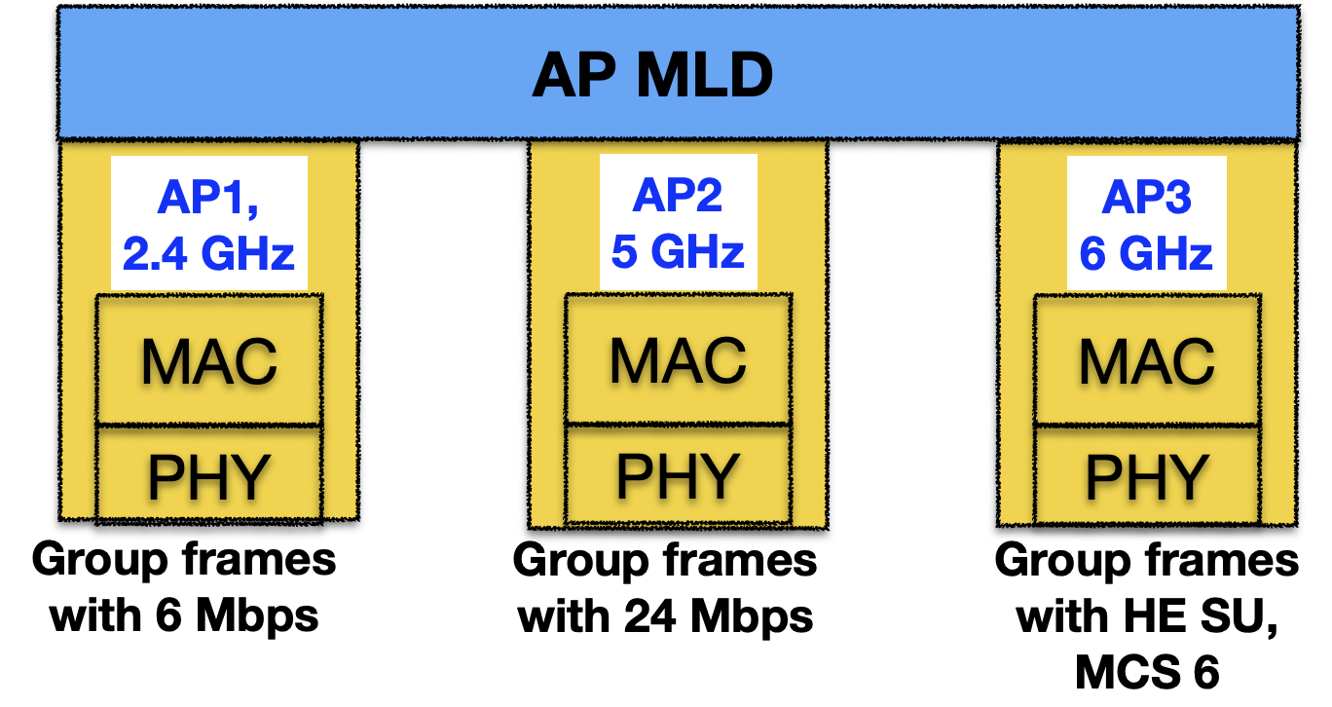
Motivation: Group addressed frames type
Example of AP MLD with different BSS ranges
The group addressed frames transmission parameters signaling may help the associated non-AP MLD to:
Receive group addressed frames from an affiliated AP that has the most suitable transmission rate:
Reliable reception
Short receive time to save power
Optimize receive mode for the transmitted group addressed frames
Detect group addressed frames transmission rate changes

Slide 5
Background: Different Beacon Frames Transmission Alternatives
Currently, the Beacon frame transmission parameters can be detected only by receiving a Beacon frame

Slide 6
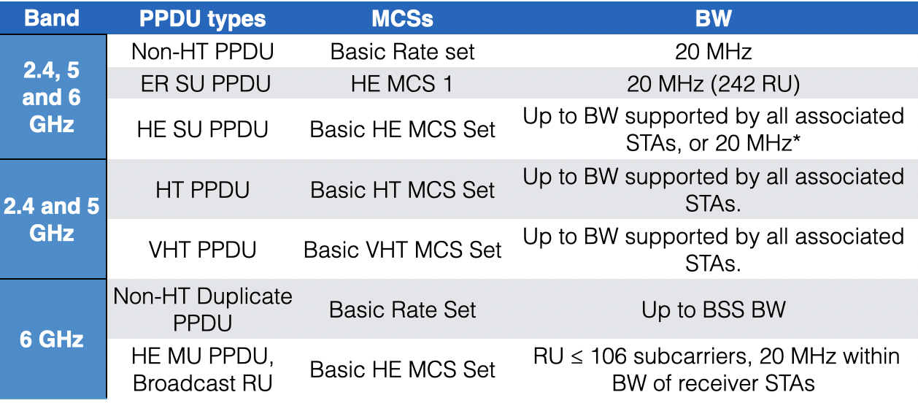
Background: Different Transmission Alternatives for Group Addressed Frames
* 20MHz if any STA is in PS-mode or frame targeted to non-associated STA

Slide 7
Proposals
The Beacon and group frames transmission information is added to Reduced Neighbor Report (RNR) or to ML element
RNR provides only minimum information of the Beacon frames
ML element provides detailed information of Beacon and Group frames transmission
RNR is present in all Beacons and Probe Responses
ML element is present in ML Probe Response and Association Response frames

Slide 8
Proposal: Add signaling to Reduced Neighbor Report element
Figure 9-632b—MLD Parameters subfield format
The Beacon Type subfield is set to 0, if the Beacon is transmitted as non-HT or non-HT Duplicate PPDU and the transmission rate is ≤ 24 Mbit/s, otherwise the subfield is set to 1

Slide 9
Proposal: Add Beacon and Group Frames Information to the STA Profile
The Beacon and group Frame Transmission Info fields are provided in STA Profile of the Multi-link element

Slide 10
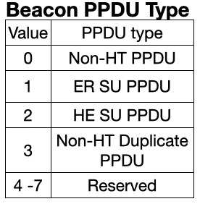
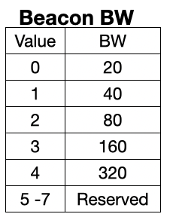
Proposal: Beacon Frame Transmission Info Subfield
The Beacon Frame Transmission Info Subfield indicates the Beacon frame transmission parameters for the reported AP
The Beacon PPDU Type subfield indicates the PPDU type that carries the Beacon frames
The Beacon MCS subfield specifies the MCS for the Beacon PPDU type
The Beacon BW subfield indicates the BW of the Beacon PPDU
The Beacon TX Power Difference represents 2s complement signed integer in dB. It carries difference in Beacon transmission power (Expressed in EIRP) and normalized in 20 MHz BW

Slide 11
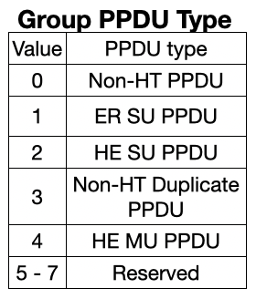
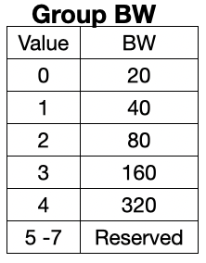
Proposal: Group Frames Transmission Info Subfield
The Group Frames Transmission Info Subfield indicates the group frames transmission parameters for the reported AP
The Group PPDU Type subfield indicates the PPDU type that carries group frames
The Group MCS subfield indicates the MCS for the PPDU type
The Group BW subfield indicates the BW of the transmitted group frames
The Group TX Power Difference represents 2s complement signed integer in dB. It carries difference in group frames transmission power (Expressed in EIRP) and normalized in 20 MHz BW

Slide 12
Proposal: The Beacon and group frame transmission mode change detection
The Change Sequence Counter should be increased to notify all associated STAs:
If AP sends beacons in different MCS, BW, PPDU type or transmission power
If AP sends group frames in different MCS, BW, PPDU type or transmission power

Slide 13
Summary
This submission proposes to add Beacon Frame Transmission Info and Group Frames Transmission Info fields to the Reduced Neighbor Report and to STA Profile of the Basic-variant Multi-Link element
The added information helps scanning STAs to determine BSS range, optimize scanning and discover the AP reliably
The associated non-AP MLD can optimize its power consumption and group frames reception reliability by knowing the group frames transmission formats and by receiving the group frames from the most efficient link

Slide 14
Straw poll:
Are you in favor of adding to the IEEE802.11be:
- Beacon Type subfield to the Reduced Neighbor Report element
- Beacon Frame Transmission Info subfield and Group Frames Transmission Info subfield to the Per-STA Profile subelement of the Multi-Link element as described in the submission 11/1737r0?

