Slide 1
AANI SC Agenda September 2021 Interim
Date: 2021-09-13
Authors:

Slide 2
Abstract
Agenda for:
802.11 AANI SC (Advanced Access Network Interface Standing Committee)
September Interim 2021
Chair: Joseph Levy (InterDigital)
Vice Chair: Open
Secretary: Open
r0: First draft of the Agenda
r1: As modified during the Monday 13 September 2021 19:00 – 21:00 h ET

Slide 3
Registration for the September 802.11 electronic interim session
This meeting is part of the September 802.11 interim session
You must pay the registration fee in order to attend
If you have not already done so, you can register here or follow the registration link for this session here https://www.ieee802.org/11/Meetings/Meeting_Plan.html
If you do not intend to register for this session you must leave this meeting and, if you have logged attendance on IMAT, email the 802.11 chair or vice chairs to have your attendance cancelled

Slide 4
Reminders and Rules
Call for Secretary
Reminders to attendees:
Please record your attendance: https://imat.ieee.org/sp7200043/attendance-log?p=3632200005&t=47200043
Please mute yourself, unless you wish to speak
No recordings
AANI SC Operating Rules:
Anyone present can:
Participate in discussions
Provide and present contributions (please notify the Chair)
Vote on straw polls and motions
Motions are in order for this teleconference, as it is during an 802.11 Interim meeting.

Slide 5
Agenda
Monday 13 September 2021 19:00-21:00 h ET
Call for Secretary
Administrative: Reminders, Rules, Guidelines, Resources, Participation [5 min]
Approval of Minutes
Status [5 min.]
Contributions/Discussion:
Discussion on 11-20-0013r15
Straw Poll on audience
Document review
Straw Polls/Motions
Discussion on the 802.11 reply LS to WBA
Tuesday 15 September 2021 11:15-13:15 h ET
Friday 17 September 2021 9:00-11:00 h ET
Future Sessions Planning [5 min.]

Slide 6
Guidelines for IEEE-SA Meetings
All IEEE SA standards meetings shall be conducted in compliance with all applicable laws, including antitrust and competition laws.
Don’t discuss the interpretation, validity, or essentiality of patents/patent claims.
Don’t discuss specific license rates, terms, or conditions.
Relative costs of different technical approaches that include relative costs of patent licensing terms may be discussed in standards development meetings.
Technical considerations remain the primary focus
Don’t discuss or engage in the fixing of product prices, allocation of customers, or division of sales markets.
Don’t discuss the status or substance of ongoing or threatened litigation.
Don’t be silent if inappropriate topics are discussed. Formally object to the discussion immediately.
---------------------------------------------------------------
For more details, see IEEE-SA Standards Board Operations Manual, clause 5.3.10 and Antitrust and Competition Policy: What You Need to Know at http://standards.ieee.org/develop/policies/antitrust.pdf

Slide 7
Resources – URLs
Link to IEEE Disclosure of Affiliation
https://standards.ieee.org/faqs/affiliation.html
Links to IEEE Antitrust Guidelines
https://standards.ieee.org/content/dam/ieee-standards/standards/web/documents/other/antitrust.pdf
Link to IEEE Code of Ethics
https://www.ieee.org/about/corporate/governance/p7-8.html
Link to IEEE Code of Conduct
https://www.ieee.org/content/dam/ieee-org/ieee/web/org/about/ieee_code_of_conduct.pdf
Link to IEEE Patent Policy
http://standards.ieee.org/develop/policies/bylaws/sect6-7.html#6
Notes:
September 2012

Slide 8
IEEE SA Copyright Policy
By participating in this activity, you agree to comply with the IEEE Code of Ethics, all applicable laws, and all IEEE policies and procedures including, but not limited to, the IEEE SA Copyright Policy.
Previously Published material (copyright assertion indicated) shall not be presented/submitted to the Working Group nor incorporated into a Working Group draft unless permission is granted.
Prior to presentation or submission, you shall notify the Working Group Chair of previously Published material and should assist the Chair in obtaining copyright permission acceptable to IEEE SA.
For material that is not previously Published, IEEE is automatically granted a license to use any material that is presented or submitted.

Slide 9
IEEE SA Copyright Policy
The IEEE SA Copyright Policy is described in the IEEE SA Standards Board Bylaws and IEEE SA Standards Board Operations Manual
IEEE SA Copyright Policy, see Clause 7 of the IEEE SA Standards Board Bylaws https://standards.ieee.org/about/policies/bylaws/sect6-7.html#7 Clause 6.1 of the IEEE SA Standards Board Operations Manual https://standards.ieee.org/about/policies/opman/sect6.html
IEEE SA Copyright Permission
https://standards.ieee.org/content/dam/ieee-standards/standards/web/documents/other/permissionltrs.zip
IEEE SA Copyright FAQs
http://standards.ieee.org/faqs/copyrights.html/
IEEE SA Best Practices for IEEE Standards Development
http://standards.ieee.org/develop/policies/best_practices_for_ieee_standards_development_051215.pdf
Distribution of Draft Standards (see 6.1.3 of the SASB Operations Manual)
https://standards.ieee.org/about/policies/opman/sect6.html

Slide 10
Participants in the IEEE-SA “individual process” shall act independently of others, including employers
The IEEE-SA Standards Board Bylaws require that “participants in the IEEE standards development individual process shall act based on their qualifications and experience”
This means participants:
Shall act & vote based on their personal & independent opinions derived from their expertise, knowledge, and qualifications
Shall not act or vote based on any obligation to or any direction from any other person or organization, including an employer or client, regardless of any external commitments, agreements, contracts, or orders
Shall not direct the actions or votes of other participants or retaliate against other participants for fulfilling their responsibility to act & vote based on their personal & independently developed opinions
By participating in standards activities using the “individual process”, you are deemed to accept these requirements; if you are unable to satisfy these requirements then you shall immediately cease any participation

Slide 11
Approval of Minutes
Minutes from the May 2021 Interim Telecons: 11-21/1135r0 “AANI SC Teleconference 07 July 2021 Minutes”
Comments?
Moved: Stuart Kerry
Second: Ben Rolfe
Objections to approving the minutes by unanimous consent? Approved by unanimous consent
Minutes from AANI SC Teleconferences:
11-21/1429r0 “AANI SC Teleconference Minutes 10 August 2021”
11-21/1430r0 “AANI SC Teleconference Minutes 24 August 2021”
Moved: Ben Rolfe
Second: Stuart Kerry
Objections to approving the minutes by unanimous consent? Approved by unanimous consent

Slide 12
AANI SC Status/Activity
Topics:
The WBA LS (11-21-0170r0) - specifically, addressing 802.11ax or other 802.11-2020 capabilities that can be used to meet the use cases identified in the LS.
Contributions:
11-21/0616 “802.11ax Features and Applicability to 5G and Wi-Fi Convergence” Osama Aboul-Magd (Huawei Technologies) - presented 13 April 2021. (additional input requested)
11-21/0865 “Draft Reply LS from 802.11 to WBA regarding the WBA 5G & Wi-Fi RAN Convergence Paper” Joseph Levy (InterDigital)
11-21/0953 - “Proposed QoS response to WBA”, Thomas Derham (Broadcom)
11-21/1198r1 – “Draft LS Response to WBA QoS material”, Thomas Derham (Broadcom)
Contributions related to the "Draft technical report on interworking between 3GPP 5G network and WLAN" (11-20/0013).
Discussion continued during the July Plenary meeting and the AANI teleconferences.
The technical report was updated to 11-20/0013r14, All technical issues seem to be resolved
Tailoring the Introduction and Conclusion for the target audience is still open.
Discussed: 11-21/1410r0 “Possible Edits to11-20-0013r14” – 11-20/0013 updated.

Slide 13
Way Forward the Technical report (11-20/0013r15):
Review possible updates/modification to the Introduction and Conclusion to address the audience
Review reflector discussion
Proposed target audience is: 3GPP with CC to WFA and WBA
Further discussion on target audience
Discuss/modify the technical report: 11-20/0013r15 based on 11-21/1410r0 “Possible Edits to11-20-0013r14”
Straw Polls
Motion – dependent on Straw Polls

Slide 14
Straw Poll from 10 Aug: Target Audience for 11-20/0013
Question: 11-20/0013 – should be:
Shared with 3GPP
Shared with WBA
Shared with WFA
Used as an internal 802.11 report – only
Results:

Slide 15
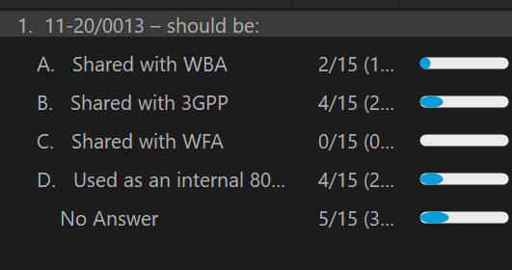
Straw Poll
Rerunning the target audience SP with the current participates:
Question: 11-20/0013 – should be:
Shared with WBA
Shared with 3GPP
Shared with WFA
Used as an internal 802.11 report – only
Results:

Slide 16
Technical Report Discussion/Contributions
11-20/0013r15
??

Slide 17
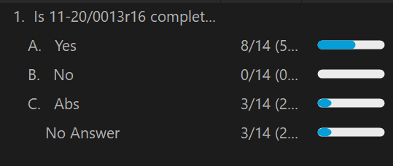
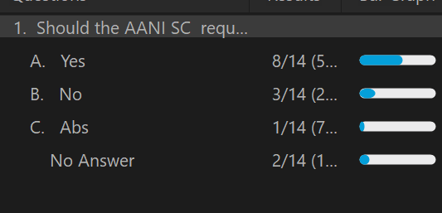
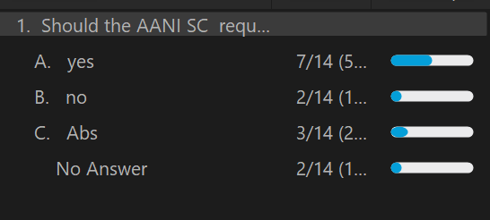
Straw Polls
Is 11-20/0013r16 complete and ready to be submitted to the 802.11 WG?
Yes
No
Abs
Should the AANI SC request that the 802.11 WG approve and send to 3GPP with CC to WBA and WFA: 11-20/0013r16?
Yes
No
Abs
Should the AANI SC request that the 802.11 WG note 11-20/0013r16 and use it for internal 802.11 purposes?
Yes
No
Abs

Slide 18
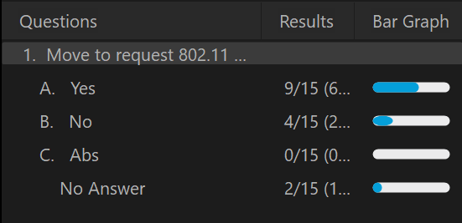
Motion
Move to request 802.11 WG approve 11-20/0013r16 the “Draft technical report on interworking between 3GPP 5G network & WLAN” and send to 3GPP with CC to WBA and WFA, with editorial privileges given to the WG Chair.
Moved: Ben Rolfe
Second: Marco Hernandez
Result: Y: N: A: DNV:
69.2% yes

Slide 19
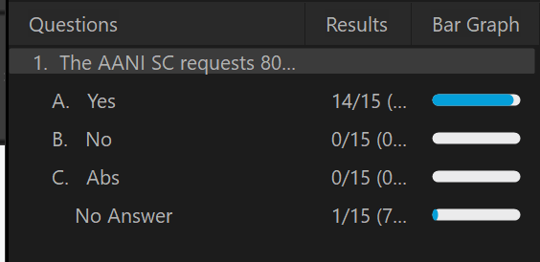
Motion
The AANI SC requests 802.11 WG to review and consider the completed report in 11-20/0013r16 the “Draft technical report on interworking between 3GPP 5G network & WLAN”.
Moved: Stuart Kerry
Second: Marco Hernandez
Result: Y: N: A: DNV:

Slide 20
Way Forward – To Complete the WBA reply LS
For the WBA reply LS (11-21/1198r1, 11-21/0865r6, 11-21/0953r0 11-21/0616r0)
There was no AANI reflector discussion on the reply LS, the following are open for discussion:
Adding text to reference the Technical report (11-20/0013)
Providing edits to existing text
Adding additional content / Removing existing content

Slide 21
Future Sessions Planning
802.11 WG November Plenary Meeting: AANI SC - to be confirmed
Propose 2 teleconferences:
Tuesday 9 Nov 11:15-13:15 ET
Wednesday 10 Nov 19:00-21:00 ET
Teleconferences TBD:
No additional teleconferences prior to the November Plenary?
WBA Report/LS 11-21-0170r0 request – 802.11ax or 802.11-2020 related contributions
Contributions on 802.11ax capabilities addressing specific challenges identified in the WBA Report/LS
Contribution on 802.11-2020 capabilities addressing specific challengers identified in the WBA Report/LS
Discussion/contributions reply LS text proposals
Technical Report related contributions

