Slide 1
ETSI 6GHz Narrow Band Status
Date: 2021-May-10
Authors:

Slide 2
Abstract
- These slides gives a status of the Narrow Band activities post the BRAN109e meeting

Slide 3
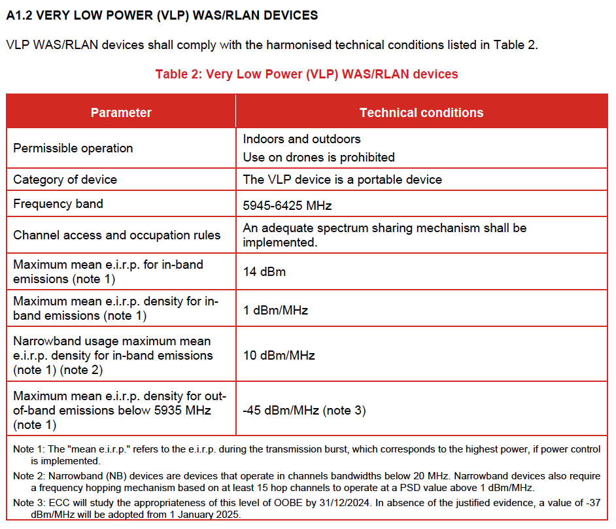
Background
In November 2020 the regulations [1] were amended to include Narrow band systems operating in the VLP category. An extract of the draft regulations is below:

Slide 4
Summary of Technical Submissions to BRAN109e
[BRAN(21)109e003r1]
Document proposing inclusion of AFH Non LBT DAA based upon lab test of coexistence between 80MHz Wi-Fi system and Narrow Band Bluetooth protocol-based system (Narrow Band BW 4MHz)
[BRAN(21)109e004]
This document discusses non-adaptive and adaptive frequency hopping for very low power (VLP) devices and requests decisions for the proposals contained herein
[BRAN(20)109e008]
This document contains simulations of a Wi-Fi-BT test setup

Slide 5
BRAN(21)109e003r1
The context of this document was demonstration by measurement of a NB Bluetooth based protocol system (Non LBT DAA) with AFH deliberately disabled and the impact to Wi-Fi system under two narrow band scenarios: (Tested in 5150 – 5250MHz, 80MHz Wi-Fi Channel, 80MHz Narrow Band Hopping) :
BW=4MHz, High Duty Cycle 83%, Tx Power 7dB’s > Wi-Fi
BW=1MHz, Low duty cycle 18%, Tx Power 7dB’s > Wi-Fi
Conclusions:
Low Duty Cycle - no impact on Wi-Fi systems, even without AFH
High Duty Cycle - In corner cases some degradation to Wi-Fi, however it’s only seen in short distance situations and only when AFH is not deployed
Narrow band will need AFH to be able to remove narrow band transmission channels due to Wi-Fi interferers in all scenarios.

Slide 6
BRAN(21)109e004
Non-Adaptive Frequency Hopping
Proposal 1: Duty cycle is limited according to equation, where MU shall be less than 10%
DC = min[MU × 25 mW/P_{out}; 50] %
Proposal 2: Requirements concerning duty cycle, Tx-sequence and Tx-gap requirements are applicable to non-adaptive NB FH equipment irrespective of operating transmit power.
Proposal 3: The maximum Tx-sequence time shall be 5 ms.
Proposal 4: The minimum Tx-gap time shall be 5 ms.
Adaptive Frequency Hopping
Proposal 5: For adaptive frequency hopping DAA mode, the maximum frequency dwell is 40 ms
Proposal 6: For adaptive frequency hopping LBT mode, the maximum frequency dwell is 60 ms
Transmission Type | P_{out} (mW) | Duty cycle (%) | Interference Quotient
LBE/FBE SCS | 100 | 5 | 500
Non-adaptive NB FH | 25 | 10 | 250
Non-adaptive NB FH | 2.5 | 50 | 125

Slide 7
BRAN(20)109e008
This proposal was a late submission, aiming to replicate through simulation the real measurements from contribution BRAN(21)109e003r1
Conclusions:
There are some clear differences between simulations and the real measurements, but this simulation suggests that NB frequency hopping can cause major throughput and latency degradation for Wi-Fi links under some conditions. FHSS without LBT does not provide an adequate sharing mechanism and NB needs further study

Slide 8
Discussion
Lots of discussion around all the proposals
Differences between simulations and measurements that need to be understood
User cases
No DAA or LBT systems
Requests for additional measurements
Wi-Fi impacting Narrow band
Need to agree an adequate solution for narrow band
Avoid the “free for all” via notified body route
Reduce the scope of narrow band allowances

Slide 9
Next Steps
Study updates
Full buffer measurements, additional MCS rates
Minimum COT times needed
Ad-hoc meetings
Two specific sessions defined before BRAN110 (18-25th June 2021)

Slide 10
References
[1] ECC Decision (20)01, On the harmonised use of the frequency band 5945-6425 MHz for Wireless Access Systems including Radio Local Area Networks (WAS/RLAN), Approved 20 November 2020

