Slide 1
Parental Control Examples
Date: 2021-05-10
Authors:

Slide 2
Abstract
In 802.11bh meeting on 04/12/2021, the case for parental control based on MAC address was examined.
Members wondered if this case was real, i.e. existing in the real world, or was just a theoretical issue, or a glitch in some poorly-designed outlier brand of home router.
It was suggested that providing a few real-world examples of such “Parental control based on MAC address” configuration structure would be useful to solidify the use case.
This submission proposes such examples.

Slide 3
Finding Summary
Parental control based on MAC address is massively present in the market
Most home-brand ‘wireless routers’ offer the function
Most Service providers offer the function in their OEM ‘wi-fi routers’
Most Enterprise-class AP vendors offer the function, typically more for classrooms than home contexts
Software vendors are also present, USD 1 Billion market in 2919 (USA), CAGR 9.54%

Slide 4
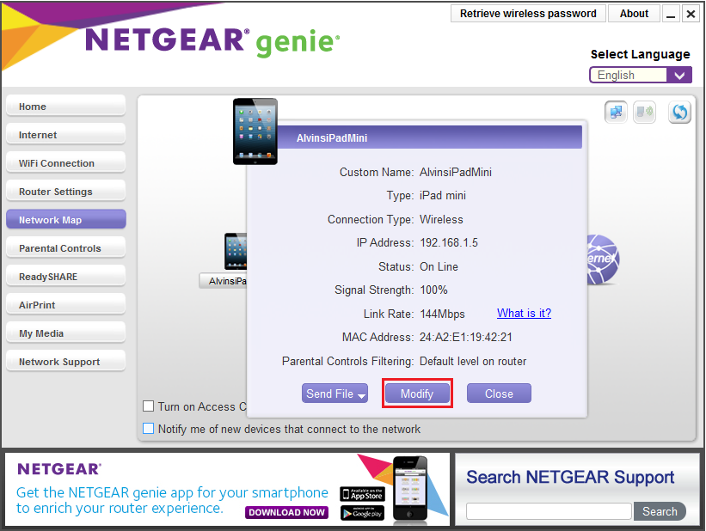
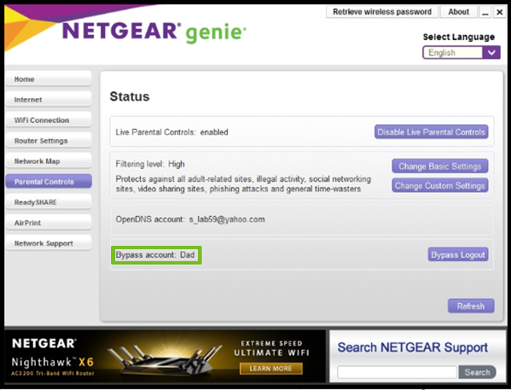
Parental Control Example, Home Brand
From a Network Map view, on can set controls on a device (authorized URL list, time slices) Control is based on the MAC address
Default is Control off - Netgear represents 21.9% of the home WiFi ‘router’ market*
*https://seekingalpha.com/article/4133274-this-wi-fi-company-is-potential-hit-for-2018

Slide 5
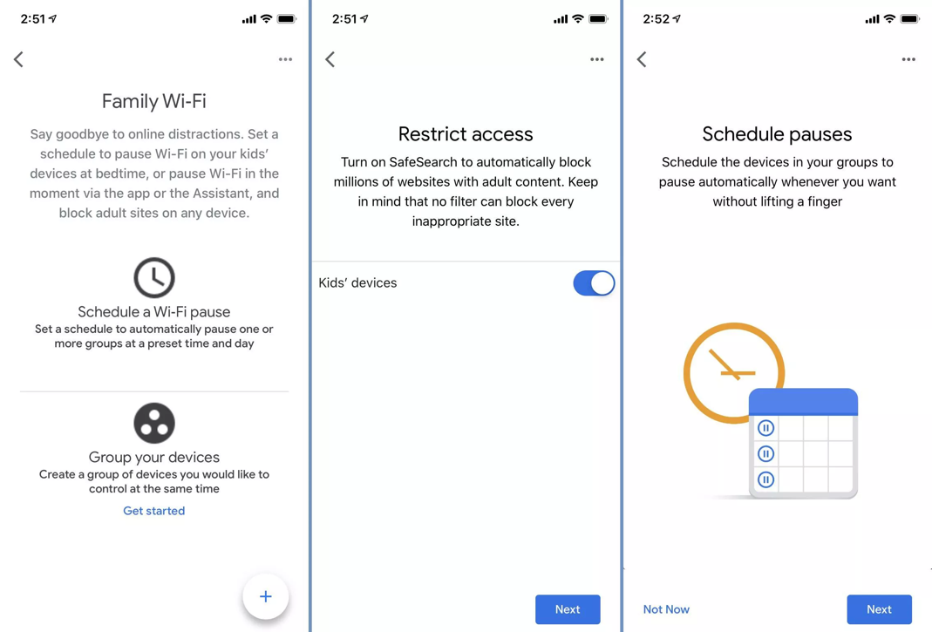
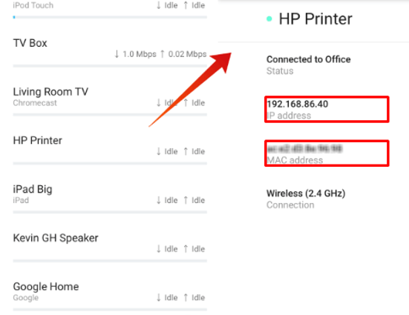
Parental Control Example, Home Brand
Google Nest Wi-Fi app
(for control of Google WiFi points)

Slide 6
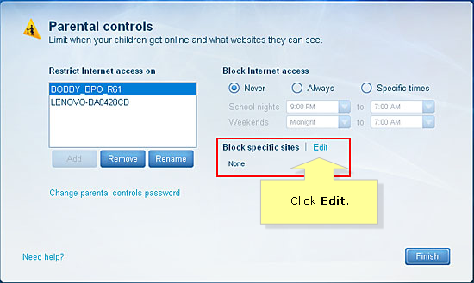
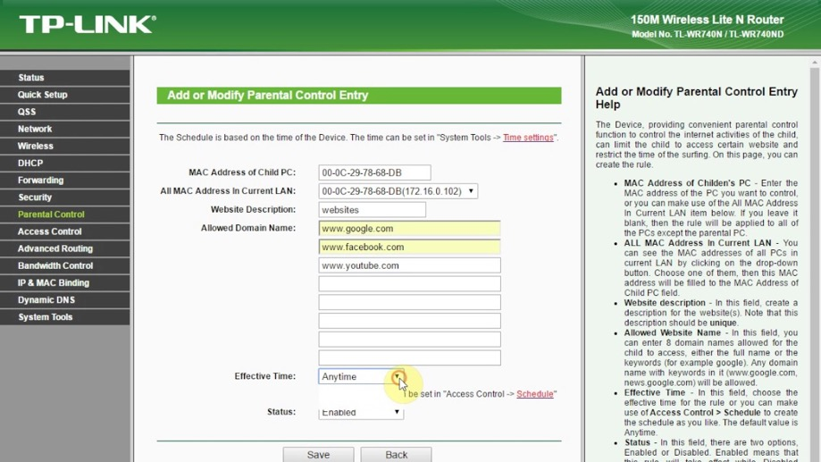
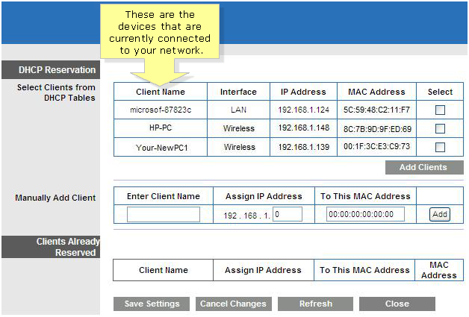
Parental Control Examples, Home Brands
Linksys Wi-Fi routers
TP-Link Wi-Fi routers
Clients have ‘names’ (DHCP option 12, Hostname), but the classifier is the MAC address

Slide 7
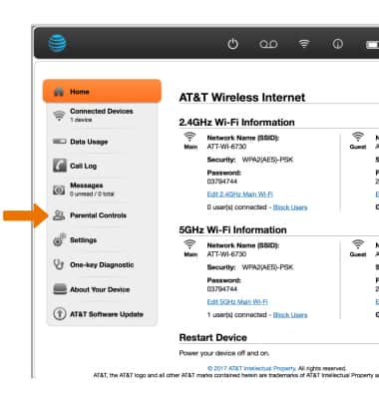
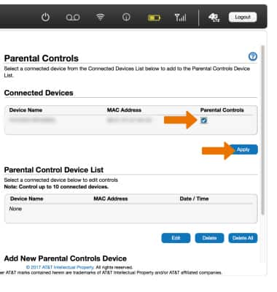
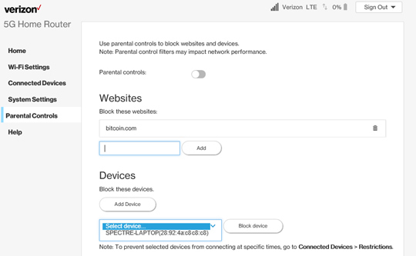
Parental Control Examples, SPs / OEM
AT&T MF279 (ZTE base)
Verizon (G3100)

Slide 8
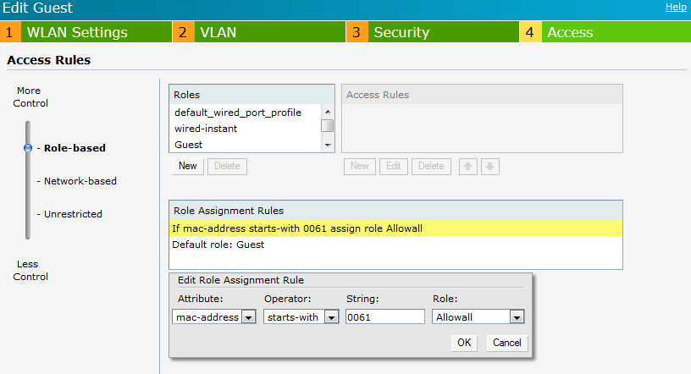
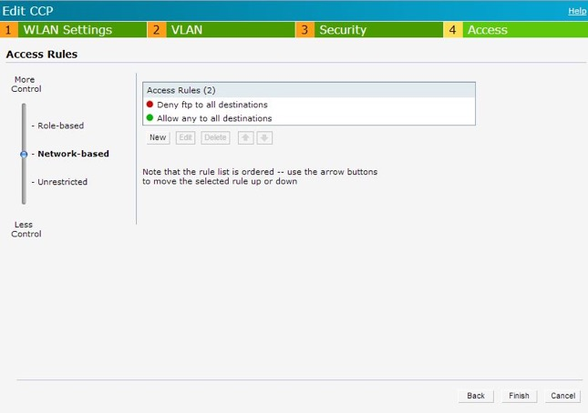
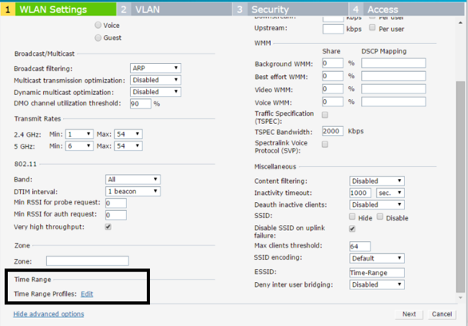
Parental Control Examples, Enterprise Brands
HPE Aruba Instant
Features are usually richer, e.g. user role based on single MAC or range, then allowed time slots or URL targets based on role
Target is more typically small businesses / schools

Slide 9
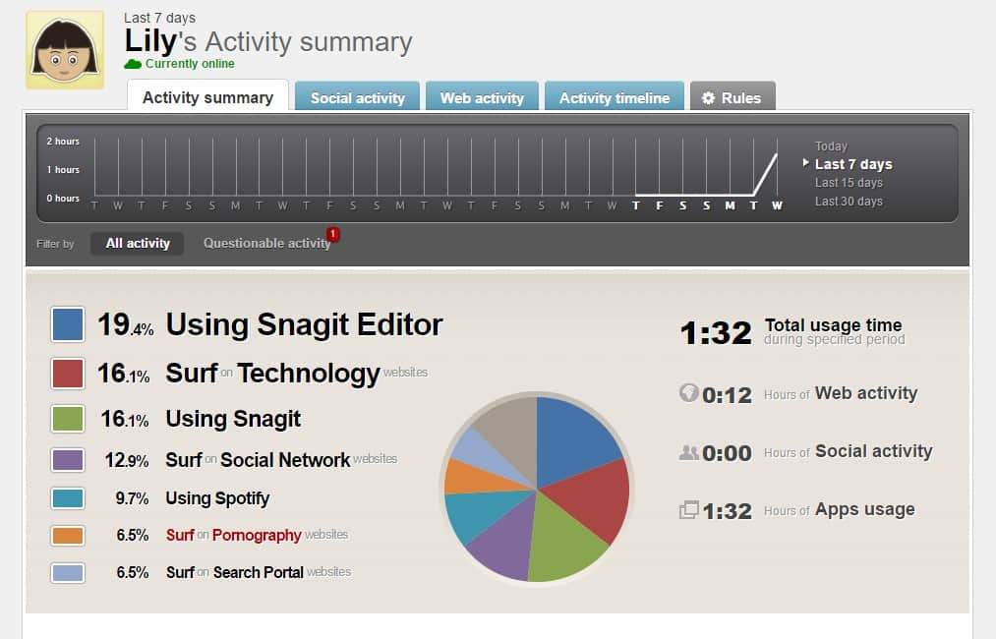
Parental Control Examples, Applications
Requires a client on the child’s device, a management part on the parent’s device
Not based on MAC (client calls to the management tool)
Qustodio

Slide 10
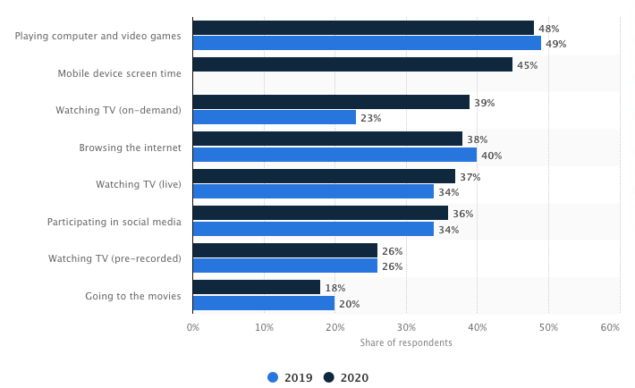
Parental Control Adoption
US numbers*
In the U.K: 45%**
Numbers seem consistent worldwide
Clearly, some will use an app on the children’s devices (MAC address may not be needed, but there is always the challenge of disabling the app) MAC-based parental control seems to be popular
Source: * https://www.statista.com/statistics/232345/parental-control-over-childrens-media-consumption-in-the-us/
** https://www.ofcom.org.uk/__data/assets/pdf_file/0023/190616/children-media-use-attitudes-2019-report.pdf

Slide 11
MAC-Based vs. app-based parental control
Disclaimer: anecdotal, gathered from parental, SP support, and app vendor forums
App-based
Pros: granular control, easy to setup
Cons: expensive, needs a client on each device, risk of start/stops
Network-based (MAC-based)
Pros: Usually free, easy to setup
Cons: often more basic, easy to circumvent

Slide 12
Straw Poll
Do you support keeping this general scenario as one of our use cases (with possible rewording):
Consider a parent with children of ages 10 and 7 years. The parent wants to block access to the home 802.11 network and control access to Internet content based on the user of various devices. For example, the parent has a laptop and a smartphone, and the children each have an age-appropriate laptop and the older child has a smartphone. The parent wants all these devices to be recognized when attaching to the 802.11 network, without launching an application or using a portal. And, this needs to use a method that the kids can’t hack and circumvent. When one of the childrens’ friends visits, their device(s) should be given only very limited access (if any at all) to the 802.11 network and Internet; thus unknown devices need to be distinguishable from one of the family’s devices. Parental control offered in 802.11 routers is usually based on the MAC address of the device.
Straw poll results:
Yes
No
Abstain
Notes:
Possible variation for last sentence: “many 802.11 routers provide capabilities to restrict network access based on the MAC address of the device”

