Slide 1
Discussion on Sensing Setup Procedure
Date: 2021-04-13
Authors:
Name | Affiliation | Address | Phone | Email
Pei Zhou | OPPO |  |  | zhoupei1@oppo.com
Lei Huang |  |  |  | huang.lei1@oppo.com
Chaoming Luo
Liuming Lu

Slide 2
Background
A sensing session is composed of one or more of the following phases: setup phase, measurement phase, reporting phase, and termination phase. [1][2]
In the setup phase, a sensing session is established, and operational parameters associated with the sensing session are determined and exchanged between STAs. [1][2]
More than one sensing responder may participate in the measurement phase and reporting phase of a sensing session. [1] Therefore, WLAN sensing should consider setup with multiple responders.
In this contribution, we highlight some issues about setup with multiple responders and proposes potential solution.

Slide 3
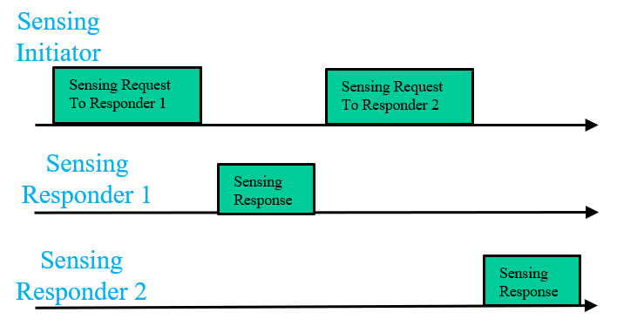
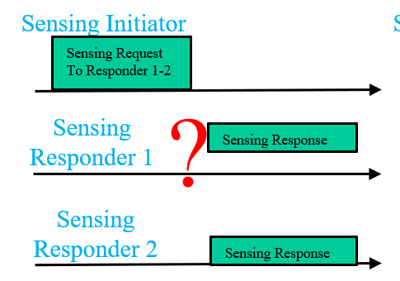
Recap: Setup (Negotiation) with multiple responders [1]
For multiple responders, sensing initiator needs to negotiate with all of them.
The sensing initiator could perform negotiation with each of them individually and separately.
This would lead to larger overhead and is not a scalable solution.
If we define the Sensing Request frame as a Control frame, say, a variant of Trigger frame, then it is possible to design simultaneous responses.
This option may be feasible if the sensing initiator is an AP STA.
individually and separately
simultaneously
Fig. 1 Two different kinds of sensing setup with multiple responders .

Slide 4
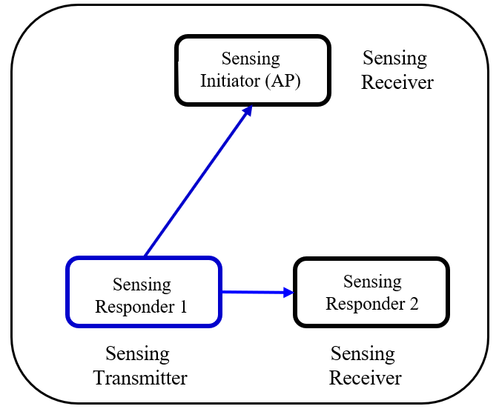
Issue
Considering the sensing scenario shown in Fig. 2 [3], Sensing Initiator (AP) has to setup the following bursts (or sensing session) with Sensing Responders:
Sensing transmitter (Sensing Responder 1) -> Sensing receiver (Sensing Initiator)
Sensing transmitter (Sensing Responder 1) -> Sensing receiver (Sensing Responder 2)
For the individually and separately setup (negotiation)
Sensing Initiator transmits Sensing Request frame to Sensing Responder 1 to setup:
Sensing transmitter (Sensing Responder 1) -> Sensing receiver (Sensing Initiator)
Sensing transmitter (Sensing Responder 1) -> Sensing receiver (Sensing Responder 2)
Sensing Responder 1 transmits Sensing Response frame to Sensing Initiator to accept the setup.
Sensing Initiator transmits Sensing Request frame to Sensing Responder 2 to setup:
Sensing transmitter (Sensing Responder 1) -> Sensing receiver (Sensing Responder 2)
If Sensing Responder 2 transmits Sensing Response frame to Sensing Initiator to reject the setup.
Fig. 2 Configurations of sensing setup with multiple responders.
However, Sensing Responder 1 doesn’t know Sensing Responder 2 rejected the corresponding burst (or sensing session), it will still transmits measurement signal to Sensing Responder 2, which will waste time and power.

Slide 5
Issue
For the simultaneously setup (negotiation)
Sensing Initiator transmits Sensing Request frame to Sensing Responder 1 and Sensing Responder 2 simultaneously to setup:
Sensing transmitter (Sensing Responder 1) -> Sensing receiver (Sensing Initiator)
Sensing transmitter (Sensing Responder 1) -> Sensing receiver (Sensing Responder 2)
Sensing Responder 1 and Sensing Responder 2 transmits Sensing Response frames to Sensing Initiator simultaneously.
If Sensing Responder 1 decides to reject, but Sensing Responder 2 accepts the following setup :
Sensing transmitter (Sensing Responder 1) -> Sensing receiver (Sensing Responder 2)
However, Sensing Responder 2 doesn’t know Sensing Responder 1’s decision, it will still wait for the measurement signal from Sensing Responder 1 in the corresponding burst (or sensing session), which will waste time.
If Sensing Responder 1 accepts, but Sensing Responder 2 decides to reject the following setup :
Sensing transmitter (Sensing Responder 1) -> Sensing receiver (Sensing Responder 2)
However, Sensing Responder 1 doesn’t know Sensing Responder 2’s decision, it will still transmits measurement signal to Sensing Responder 2 in the corresponding burst (sensing session), which will waste time and power.
Fig. 2 Configurations of sensing setup with multiple responders.

Slide 6
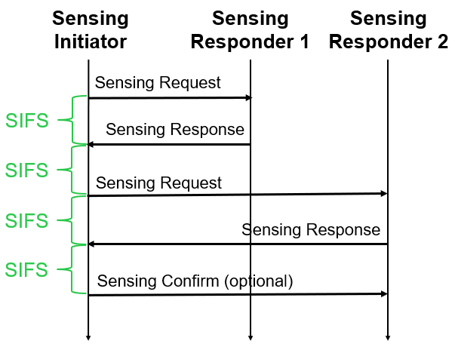
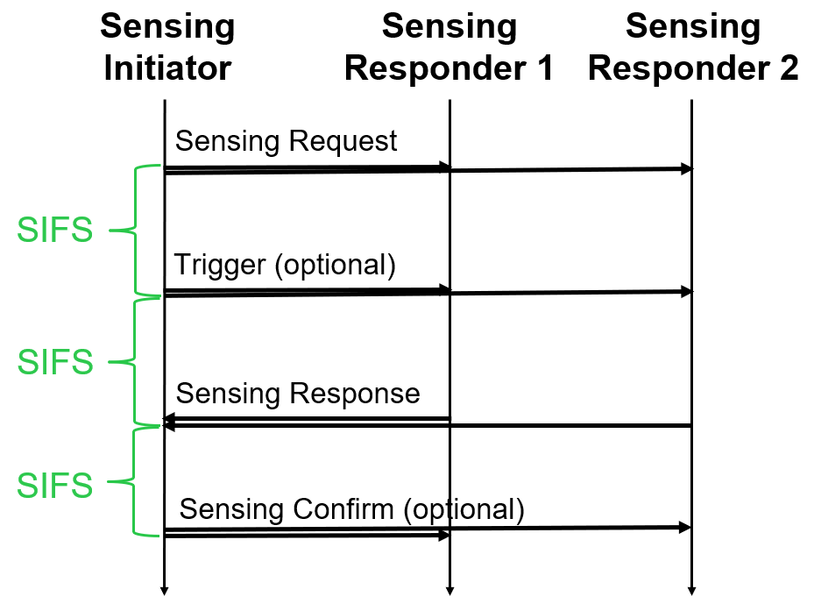
Proposal: Sensing Setup Confirmation
If Sensing Initiator performs sensing setup with multiple responders, it can transmit Sensing Confirm frame(s) to responders to confirm the accepted setup (in sensing session).
Note 1: The presence of Sensing Confirm frame can be indicated in Sensing Request frame.
Note 2: The format of Sensing Confirm frame is TBD.
There are two examples:
individually and separately
simultaneously
Fig. 3 Two examples of sensing setup confirmation with multiple responders .

Slide 7
Summary
WLAN sensing considers setup with multiple responders.
Sensing setup confirmation procedure should be considered in the setup with multiple responders.

Slide 8
SP 1
Do you support that 802.11bf amendment shall define sensing confirm frame for sensing setup?
Note: the format of sensing confirm frame is TBD.
Y/N/A

Slide 9
Reference
11-21-0370-01-00bf-considerations-of-sensing-negotiation
11-20-1851-04-00bf-overview-of-wi-fi-sensing-protocol
11-21-0145-05-00bf-collaborative-wlan-sensing-follow-ups

