Slide 1
Agenda for IEEE 802.11 Coexistence SC virtual meeting in May 2021
12 May 2021
Authors:
Name | Company | Phone | email
Andrew Myles | Cisco | +61 418 656587 | amyles@cisco.com

Slide 2
Welcome to the 6th virtual plenary meeting of the Coex SC in May 2021
IEEE 802.11 PDED ad hoc
1 | Warsaw | Sep 2016
2 | San Antonio | Nov 2016
3 | Atlanta | Jan 2017
4 | Vancouver | Mar 2017
5 | Daejeon | May 2017
IEEE 802.11 Coexistence SC
9 | Bangkok | Nov 2018
10 | St Louis | Jan 2019
11 | Vancouver | Mar 2019
12 | Atlanta | May 2019
13 | Vienna | Jul 2019
14 | Hanoi | Sep 2019
15 | Hawaii | Nov 2019
16 | Irvine | Jan 2020
17 | Virtual 1 | Jul 2020
18 | Virtual 2 | Sep 2020
19 | Virtual 3 | Nov 2020
20 | Virtual 4 | Jan 2021
21 | Virtual 5 | Mar 2021
22 | Virtual 6 | May 2021
IEEE 802.11 Coexistence SC
1 | Berlin | July 2017
2 | Hawaii | Sep 2017
3 | Orlando | Nov 2017
4 | Irvine | Jan 2018
5 | Chicago | Mar 2018
6 | Warsaw | May 2018
7 | San Diego | July 2018
8 | Hawaii | Sep 2018

Slide 3
Coex SC minutes today will be kept by our permanent SC secretary
  It is important to keep proper minutes of all Coexistence SC meetings
  Fortunately, Guido Hiertz (Ericsson) agreed in Berlin (way back in July 2017 when we actually saw each other F2F) to be appointed the IEEE 802.11 Coexistence SC’s permanent Secretary
  Please remember to register you attendance using IMAT
    https://imat.ieee.org/attendance

Slide 4
Meetings shall be conducted in compliance with all applicable laws, including antitrust & competition laws
Approved slide
  Don’t discuss the interpretation, validity, or essentiality of patents/patent claims
  Don’t discuss specific license rates, terms, or conditions
    Relative costs of different technical approaches that include relative costs of patent licensing terms may be discussed in standards development meetings
      Technical considerations remain the primary focus
  Don’t discuss or engage in the fixing of product prices, allocation of customers, or division of sales markets
  Don’t discuss the status or substance of ongoing or threatened litigation
  Don’t be silent if inappropriate topics are discussed … do formally object
  For more details, see IEEE-SA Standards Board Ops Man, 5.3.10 and Antitrust and Competition Policy: What You Need to Know available here
  If you have questions, contact the IEEE-SA Standards Board Patent Committee Administrator at patcom@ieee.org

Slide 5
Participant behavior in IEEE-SA activities is guided by the IEEE Codes of Ethics & Conduct
Approved slide
  All participants in IEEE-SA activities are expected to adhere to the core principles underlying the:
    IEEE Code of Ethics
    IEEE Code of Conduct
  The core principles of the IEEE Codes of Ethics & Conduct are to:
    Uphold the highest standards of integrity, responsible behavior, and ethical and professional conduct
    Treat people fairly and with respect, to not engage in harassment, discrimination, or retaliation, and to protect people's privacy.
    Avoid injuring others, their property, reputation, or employment by false or malicious action
  The most recent versions of these Codes are available at
    http://www.ieee.org/about/corporate/governance

Slide 6
Participants in the IEEE-SA “individual process” shall act independently of others, including employers
Approved slide
  The IEEE-SA Standards Board Bylaws require that “participants in the IEEE standards development individual process shall act based on their qualifications and experience”
  This means participants:
    Shall act & vote based on their personal & independent opinions derived from their expertise, knowledge, and qualifications
    Shall not act or vote based on any obligation to or any direction from any other person or organization, including an employer or client, regardless of any external commitments, agreements, contracts, or orders
    Shall not direct the actions or votes of other participants or retaliate against other participants for fulfilling their responsibility to act & vote based on their personal & independently developed opinions
  By participating in standards activities using the “individual process”, you are deemed to accept these requirements; if you are unable to satisfy these requirements then you shall immediately cease any participation

Slide 7
IEEE-SA standards activities shall allow the fair & equitable consideration of all viewpoints
Approved slide
  The IEEE-SA Standards Board Bylaws (clause 5.2.1.3) specifies that “the standards development process shall not be dominated by any single interest category, individual, or organization”
    This means no participant may exercise “authority, leadership, or influence by reason of superior leverage, strength, or representation to the exclusion of fair and equitable consideration of other viewpoints” or “to hinder the progress of the standards development activity”
  This rule applies equally to those participating in a standards development project and to that project’s leadership group
  Any person who reasonably suspects that dominance is occurring in a standards development project is encouraged to bring the issue to the attention of the Standards Committee or the project’s IEEE-SA Program Manager

Slide 8
IEEE SA Copyright Policy
Approved slide
  By participating in this activity, you agree to comply with the IEEE Code of Ethics, all applicable laws, and all IEEE policies and procedures including, but not limited to, the IEEE SA Copyright Policy.
    Previously Published material (copyright assertion indicated) shall not be presented/submitted to the Working Group nor incorporated into a Working Group draft unless permission is granted.
    Prior to presentation or submission, you shall notify the Working Group Chair of previously Published material and should assist the Chair in obtaining copyright permission acceptable to IEEE SA.
    For material that is not previously Published, IEEE is automatically granted a license to use any material that is presented or submitted.

Slide 9
IEEE SA Copyright Policy
Approved slide
  The IEEE SA Copyright Policy is described in the IEEE SA Standards Board Bylaws and IEEE SA Standards Board Operations Manual
    IEEE SA Copyright Policy, see:
      Clause 7 of the IEEE SA Standards Board Bylaws
      Clause 6.1 of the IEEE SA Standards Board Operations Manual
  IEEE SA Copyright Permission
  IEEE SA Copyright FAQs
  IEEE SA Best Practices for IEEE Standards Development
  Distribution of Draft Standards (see Clause 6.1.3 of the SASB Operations Manual)

Slide 10
The Coex SC will meet twice during the virtual
IEEE 802.11 WG interim meeting in May 2021
  Wednesday, 12 May 2021
  @ 4-6pm ET
  Webex details:
    https://ieeesa.webex.com/ieeesa/j.php?MTID=m4c08703523d6096ecea41deb1b4d8e27
    Meeting number: 173 037 6074
  Monday, 17 May 2021
  @ 4-6pm ET
  Webex details:
    https://ieeesa.webex.com/ieeesa/j.php?MTID=m29a15120e8f9b558996a8f7054300c1e
    Meeting number: 173 492 9294

Slide 11
The Coex SC will consider a proposed agenda for its virtual meeting in May 2021
Proposed Agenda
  Bureaucratic stuff
    Scope of IEEE 802.11 Coexistence SC (a reminder)
    Approve minutes
  What is happening this week? (in no particular order)
    Discussion of 60 GHz coexistence issues
    Review of ETSI BRAN activities
      EN 303 687 issues (6 GHz)
        Including a discussion of NB FH in 6 GHz
      EN 301 893 issues (5 GHz)
        Including status of compromise on adaptivity
    Discussion of how 802.11ax/be could respond to adaptivity rules in Europe
      Scheduled for Monday, 17 May 2021
    Plans for next meeting
    Other business
Mostly scheduled for Wednesday, 13 May 2021 but may run into
Monday, 17 May 2021

Slide 12
  Scope of IEEE 802.11 Coexistence SC

Slide 13
The Coex SC scope was revised in Sept 2020
IEEE 802.11 Coex SC Scope
  The Coex SC shall promote, within the 802.11 WG and externally, an environment that enables IEEE 802.11 technologies to have equitable access to unlicensed spectrum globally
  The Coex SC should focus particularly on coexistence of 802.11ax & 802.11be with LAA & NR-U in the 5 GHz & 6 GHz bands globally
  The Coex SC may consider coexistence with other technologies and in other bands as directed by the Chair of the 802.11 WG
IEEE 802.11 Coex SC close down criteria
  802.11 WG Chair has authority to close down SC

Slide 14
The scope of the Coex SC was expanded during the March 2021 plenary to include 60 GHz
  It was noted during the March 2021 plenary that ETSI BRAN is working on 60 GHz Harmonised Standards that may impact IEEE 802.11ay coexistence
  Subsequently, the 802.11 Chair directed the Coex SC to consider 60GHz coexistence within scope
    At today's WG11 Opening Plenary, the comment was made that ETSI BRAN is also considering operational and coexistence requirements related to 57-71 GHz (60GHz) spectrum, relevant of course to 802.11ad and 11ay
    The scope of the Coex SC focuses on, "coexistence of 802.11ax & 802.11be with LAA & NR-U in the 5 GHz & 6 GHz bands globally". However, it "may consider coexistence with other technologies and in other bands as directed by the Chair of the 802.11 WG". So the Coex SC can consider 60 GHz issues if directed by the WG Chair
    I have directed the Coex SC to additionally consider coexistence topics for 60GHz operation

Slide 15
  Minutes

Slide 16
The Coex SC will consider the approval of its virtual meeting minutes from March 2021
  The draft minutes for the Coex SC at the virtual meeting in March 2021 are available on Mentor:
    See 11-21-0624-00
  Motion:
    The IEEE 802 Coex SC approves 11-21-0624-00 as the minutes of its virtual meeting in March 2021
    Moved:
    Seconded:
    Result:

Slide 17
Key messages

Slide 18
There are few key message for the Coex SC that arise out of today’s session
Key messages from today’s session …
  Discussion about 60 GHz coexistence is just starting in the Coex SC
    … so no news yet!
  The need for coexistence between Wi-Fi & LAA is real
    … with more contributions required to help understand/resolve potential issues
  In Europe, a stable draft of EN 303 687 (6 GHz) includes the previously agreed compromise for ED-only @ -72 dBm
    … but the NB FH issue is open and hot!
    … and work is needed to refine/enable 802.11ax/be operation
  In Europe, a stable draft of EN 303 687 (6 GHz) includes newly agreed compromise that requires 802.11be to use an EDT @ -72 dBm
    … which means we now need to worry about 802.11ax/be coexistence
… you can leave if you are not interested in the details ☺

Slide 19
  Agenda items
  60 GHz coexistence

Slide 20
The Coex SC Chair requests assistance in putting together 60 GHz material for the May 2021 meeting
  At the Coex SC meeting in Mar 2021 a submission was presented that provided the status of 60 GHz work in ESTI BRAN
    See 11-21-0430-00
  The Coex SC Chair requested assistance in putting together material for this meeting
  The author (Assaf Kasher) of 11-21-0430-00 was requested to assist …. and has responded ☺
    Assaf comments, “we are planning to have a presentation related to coexistence between radar and 60GHz communication devices”

Slide 21
The FCC TAC has highlighted questions related to 60 GHz of potential interest to Coex SC
  In April 2021, the 802.11 WG Chair noted an FCC TAC Future of Unlicensed Operations Q4 2020 Report related to the topic of 60GHz coexistence between radars & communication systems.
    See https://www.fcc.gov/sites/default/files/tac-presentations-1-14-21.pdf
  She particularly noted that slide 13 contains questions for potential discussion & contributions in the Coex SC
    Should FCC rules allow greater radiated power for radar applications than currently permitted?
    Should the parameters for Google Soli, for which other entities have filed “me too” requests, be included in the rules?
    What changes to the recent waiver parameters are needed to improve sharing with communications applications?
    Should the FCC require communications applications (and radar applications) to use a contention based protocol?
    Should radar applications that perform LBT be allowed to use the same power levels as communications applications in this band?

Slide 22
The Coex SC will discuss contributions related to
60 GHz coexistence
Contributions so far ...
  11-21-0796-00: Coexistence between radars and communication systems in the 60GHz band
    Authors: Alecsander Eitan (Qualcomm), Assaf Kasher (Qualcomm), Bin Tian (Qualcomm), Alan Norman (Facebook), Claudio Da Silva (Intel)
    Time requested: 30 min

Slide 23
  Agenda items
  Unlicensed LTE deployment

Slide 24
The number planned/testing & deployed LAA networks globally is currently steady
Tech | Stage | GSMA¹ (July ‘18) | GSA² (Oct ‘18) | GSA³ (Jan ‘19) | GSA⁴ (Jul ‘19) | GSA⁵ (Nov ‘19) | GSA⁶ (Dec ‘19) | GSA⁷ (Mar ‘20) | GSA⁸ (Aug ‘20)
LAA | Trials/plans | 23 | 22 | 26 | 29 | 30 | 29 | 29 | 28
 | Deployed | 4 | 6 | 6 | 8 | 8 | 8 | 9 | 9
eLAA | Trials/plans | ? | 1 | 1 | 1 | 1 | ? | 0 | 1
 | Deployed | ? | 0 | 0 | 0 | 0 | ? | 1 | 0
LWA | Trials/plans | ? | 2 | 2 | 2 | 2 | 2 | 2 | 2
 | Deployed | ? | 1 | 1 | 1 | 1 | 1 | 1 | 1
LTE-U | Trials/plans | ? | 8 | 8 | 8 | 8 | 9 | 9 | 9
 | Deployed | ? | 3 | 3 | 3 | 3 | 3 | 3 | 3
GSMA (July 2018)
GSA: Evolution from LTE to 5G: Global Market Status (Nov 2018)
GSA: LTE in unlicensed and shared spectrum (Jan 2019)
GSA: Evolution from LTE to 5G: Global Market Status (Aug 2019)
GSA: LTE Unlicensed - LTE in Unlicensed and Shared Spectrum (Nov 2019
GSA: LTE and 5G Market Statistics (Dec 2019)
GSA: LTE in Unlicensed Spectrum and Shared Spectrum (Mar 2020)
GSA: LTE and 5G in Unlicensed Spectrum: Trials, Deployments & Devices (Aug 2020)

Slide 25
The number of devices supporting LAA globally is more than 200
Tech | Stage | GSA⁹ (Oct ’20) | GSA¹⁰ (Jan ’21) | GSA¹¹ (Feb ’21) | GSA^{12, 13} (Mar ’21)
LAA | Trials/plans | 27 | 27 | 27 | 27
 | Deployed | 9 | 9 | 9 | 9
 | Devices |  |  |  | 247
LWA | Trials/plans | 2 | 2 | 2 | 2
 | Deployed | 1 | 1 | 1 | 1
 | Devices |  |  |  | 26
LTE-U | Trials/plans | 9 | 9 | 9 | 9
 | Deployed | 3 | 3 | 3 | 3
 | Devices |  |  |  | 46
A new data series, focused on client devices rather than operators
GSA: LTE and 5G Market Statistics (Oct 2020)
GSA: LTE and 5G Market Statistics (Jan 2021)
GSA: Networks, Technologies & Spectrum Snapshot: LTE and 5G Market Statistics (Feb 2021)
GSA: LTE Ecosystem Status (Mar 2021)
GSA: LTE 5G Market Statistics (Mar 2021)

Slide 26
The number planned/testing & deployed LAA networks globally is currently steady

Slide 27
In at least in Chicago, there was a significant LAA deployment in Jan 2020 …
No change from Sept 2020
Chicago LAA deployment (Jan 2020)
  A recent study in Chicago shows a significant LAA deployment, that is expanding rapidly
  In Jan 2020, AT&T mostly used channel 149 & Verizon mostly used channel 36
  See Measurement-based coexistence studies of LAA & Wi-Fi deployments in Chicago by Vanlin Sathya, Muhammad Iqbal Rochman, & Monisha Ghosh (Uni of Chicago)
AT&T
Verizon
T-Mobile

Slide 28
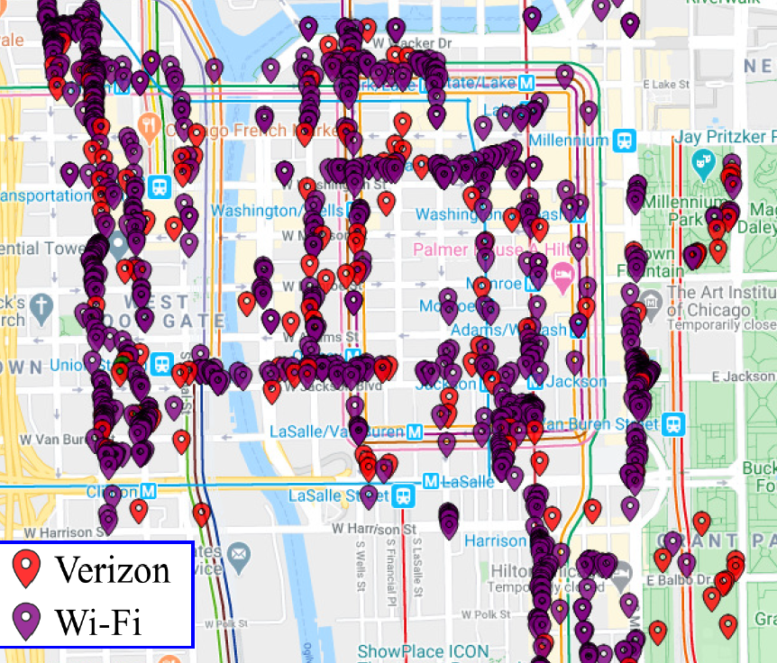
… suggesting that the need for coexistence between Wi-Fi & LAA is real … not just theoretical
No change from Sept 2020
  A recent study in Chicago shows a significant overlap between Wi-Fi & LAA
  The overlap is shown for channel 36
    Wi-Fi using 20 MHz, 40 MHz & 80 MHz channels, from mostly indoor locations
    LAA mostly using 60 MHz channels, from mostly outdoor locations

Slide 29
  Agenda items
  Unlicensed LTE deployment
  Real measurements

Slide 30
The Coex SC heard about an LAA/Wi-Fi coexistence study in Chicago in Jan 2021
Refined from
Mar 2021
  One of concerns with many of the conclusions drawn in relation to coexistence is that they are based on simulation studies …
  … which have been used over the years to provide evidence for just about any conclusion one might want to draw
  A good complement to simulation studies is measurements of actual deployments …
  … recognising they also have limitations
  In Jan 2021, the Coex SC heard from one of the authors of the Chicago Wi-Fi deployment study noted in previous meetings
    See 11-20-1973

Slide 31
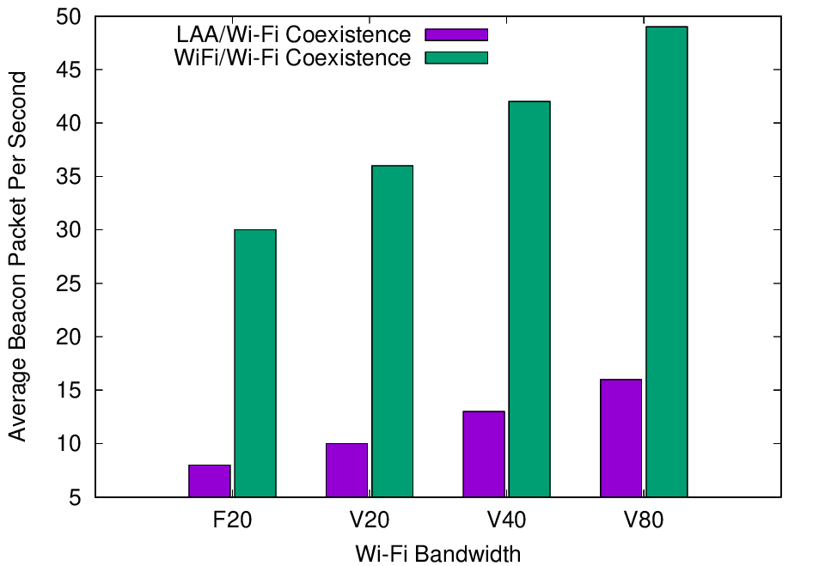
Experiments with deployed systems show LAA has a significant impact on Wi-Fi Beacon success
Refined from
Mar 2021
  The University of Chicago study investigated the effect of LAA on Wi-Fi operation in various typical configurations, including hidden node
  The work showed that LAA
  caused significant interference
  to Beacons in the tested
  configuration
    Probably because LAA is:
      Using ED @ -72 dBm
      Rather than PD @ - 82 dBm
    Also because LAA typically uses
    long TxOPs (~8 ms)
Addition of a single LAA system to five Wi-Fi systems causes successful Beacon rate to reduce by > 75%
Pushing Wi-Fi APs into the same channel also causes successful Beacon rate to reduce, but by less than LAA

Slide 32
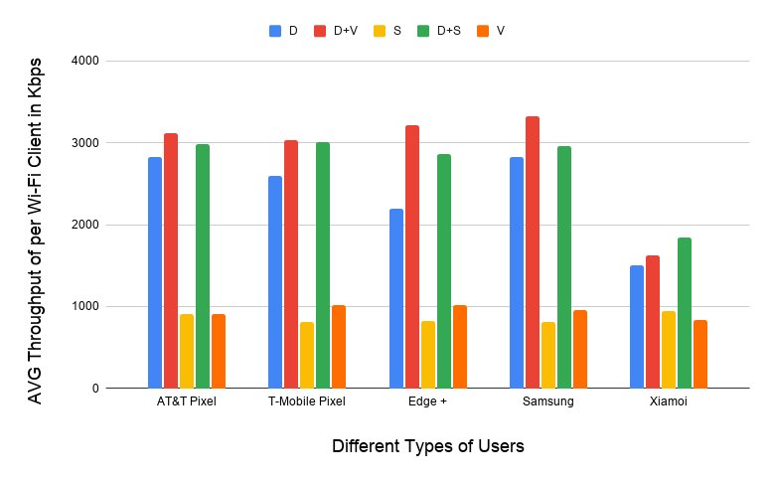
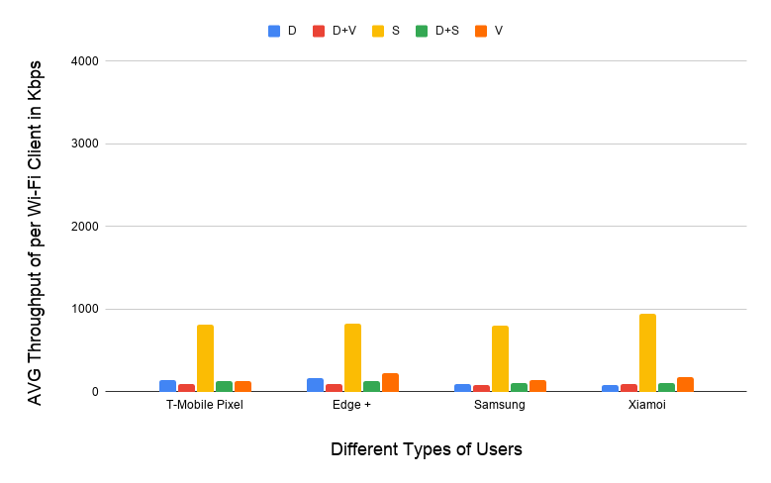
Experiments with deployed systems show LAA has a significant impact on Wi-Fi data success
Refined from
Mar 2021
  The work showed that LAA caused significant interference to data traffic in the tested configuration
    Probably because LAA is:
      Using ED @ -72 dBm
      Rather than PD @ - 82 dBm
    Also because Wi-Fi’s hidden station mitigation mechanisms based on RTS/CTS have no effect on LAA
5 Wi-Fi APs on one channel, no LAA
5 Wi-Fi APs on one channel, one LAA
11-20-1973 slide 16
All client close
to Wi-Fi APs
Addition of LAA caused all Wi-Fi traffic to collapse …
… except streaming because LAA uses licensed for streaming

Slide 33
The previous discussions suggested a need to discuss the Uni of Chicago results in more detail
  There was some limited discussion on the Uni of Chicago results in January 2021 … but not much since
  In January 2021 …
    There were questions & concerns about test setup & realism from some …
    … but others drew the conclusion that this is a typical scenario and Wi-Fi is significantly impacted by a single LAA (from draft minutes)
  In March 2021 …
    Do the results represent something of concern to Wi-Fi operators/users?
    Is there an understanding of the causes of these results?
    Are there additional testing/monitoring that should occur?
    Is there anything that should/could be done to mitigate the risk?
  In May 2021 …
    Are there any further thoughts?
    Volunteers for future submissions?

Slide 34
  Agenda items
  ETSI BRAN issues

Slide 35
Note that ESTI BRAN documents are available to IEEE 802.11 WG members
  Today’s material references many ETSI BRAN documents
  They are (or should be) available in the IEEE 802.11 WG members area
    See http://www.ieee802.org/11/private/ETSI_documents/BRAN

Slide 36
  Agenda items
  ETSI BRAN 6 GHz issues

Slide 37
A stable draft of EN 303 687 includes the previously agreed 6 GHz compromise for ED-only @ -72 dBm
Document status as of BRAN#109
  Draft EN 303 687 v0.0.12 (stable draft) – 12 Mar 2021
Discussion as of BRAN#109
  All agreements are included in EN 303 687 v0.0.12, including:
    ED-only at -72 dBm (reflecting previously discussed compromise)
    Contention based FBE (tweaks are ongoing)
    Variety of editorial issues & issues with less relevance to coexistence
  A variety of issues without agreement after BRAN #108 are not incorporated into EN 303 687 v0.0.12, including:
    Synchronous access
    Wideband access
    LBT mechanisms
    NB FH access

Slide 38
  Agenda items
  ETSI BRAN 6 GHz unresolved issues
  (other than NB FH)

Slide 39
There was no progress on the question of synchronous access in EN 302 687 at BRAN#109
Refined from
Mar 2021
  Access for Load Based Equipment (LBE) in EN 303 687 is based on using LBT for asynchronous access
  There has been discussion in ETSI BRAN about using LBT for synchronous access for a long time
    Qualcomm made the first proposal (BRAN(19)104018) in 2019
    Wi-Fi, as currently defined, does not make use of this mechanism … but it could
  In BRAN#108 there was a continuation of the discussion about synchronous access, but no consensus was reached
    Qualcomm claimed synchronous access had important benefits for VLP devices, and showed how it could be added to EN 303 687
    Intel claimed there is no clear benefit to synchronous access, and asserted it should not be incorporated into EN 303 687
  There were no contributions or discussion at BRAN#109 related to synchronous access … and so nothing happened

Slide 40
There was no progress on the question of wideband LBT in EN 302 687 at BRAN#109
Refined from
Mar 2021
  It has previously been proposed to allow the use of a wideband EDT as an alternative to the current multi-channel mechanisms in EN 303 687
    eg Use EDT of -69 dBm for 40 MHz channel …
    … rather than -72 dB for 20 MHz in primary & secondary channels
  In BRAN#108, the discussion was inconclusive:
    Huawei asserted Wi-Fi/NR-U coexistence is not adversely affected
    Ericsson asserted is already allowed, but Qualcomm disagreed
    Cisco observed that Wi-Fi may need this to enable checking the secondary channels for PIFS … although it is a very complex part of the 802.11 spec
  In Jan 2021, the Coex SC was asked whether the Wi-Fi community would have an objection to enabling wideband EDT
    No reaction so far … does anyone have a perspective they could share?
  There were no contributions or discussions at BRAN#109 related to wideband LBT … and so nothing happened

Slide 41
There was no progress on the question of LBT changes in EN 302 687 at BRAN#109
Refined from
Mar 2021
  In BRAN#108, Mediatek proposed that EN 303 687 (6 GHz) drop many of the adaptivity mechanisms from EN 301 893 (5 GHz) based on assertions they do not work, eg
    Traffic classes should be removed because there are no associated rules
    High priority should be removed because it blocks low priority completely
    CW_{max} is too low
    Broadcast should use CW_{max}
    CW should not reset after successful tx
  There was very little support for these proposals, with opposition from Broadcom, Qualcomm, Cisco, Ruckus & Ericsson
  There were no contributions to BRAN#109 related to Mediatek’s proposal … … and so nothing happened
    It is possible the proposals are dead?

Slide 42
  Coex SC
  ETSI BRAN 6 GHz issues
  NB FH update

Slide 43
Many believe NB FH systems represent a potential threat to coexistence in the 6 GHz band in Europe
From
Jan 2021
  In Nov 2020, the Coex SC were made aware of two PSD limits being discussed for VLP devices in Europe:
    Default: 1 dBm/MHz
    Narrowband (NB) devices: 10 dBm/MHz with FH across at least 15 hops, with NB defined as a BW of less than 20 MHz
  Many in the Wi-Fi/NR-U/LAA industries were concerned that these NB FH systems could have an adverse affect on these systems
    ie, they will randomly “stomp” on Wi-Fi (and LAA/NR-U) systems without LBT leading to poor coexistence ☹
  A number of proposals were made in BRAN before BRAN#108 to incorporate these new rules …
  … but it was agreed that the LS documenting the request from the ECC to ETSI BRAN to implement the rules was required first

Slide 44
The ECC decision that allows NB FH requires ETSI BRAN to agree on a spectrum sharing mechanism
From
Jan 2021
Table 2: Very Low Power (VLP) WAS/RLAN devices
(extract from ECC Decision (20)01)
Permissible operation | Indoors and outdoors
Category of device | The VLP device is a portable device
Frequency band | 5945-6425 MHz
Channel access and occupation rules | An adequate spectrum sharing mechanism shall be implemented.
Maximum mean e.i.r.p. for in-band emissions (note 1) | 14 dBm
Maximum mean e.i.r.p. density for in-band emissions (note 1) | 1 dBm/MHz
Narrowband usage maximum mean e.i.r.p. density for in-band emissions (note 1) (note 2) | 10 dBm/MHz
Note 2: Narrowband (NB) devices are devices that operate in channels bandwidths below 20 MHz. Narrowband devices also require a frequency hopping mechanism based on at least 15 hop channels to operate at a PSD value above 1 dBm/MHz.
Requires an ETSI BRAN defined spectrum sharing mechanism
Maybe it will be based on LBT?
Allows NB FH at 10 dBm/MHz

Slide 45
In BRAN#108 there were two proposals on how to implement the ECC decision related to NB FH
Refined from
Jan 2021
Submissions to BRAN#108 (Dec 2020)
  BRAN(20)108014: Initial Integration of NB requirements into EN 303 687 as per EC Regulation (Apple)
  BRAN(20)108038: 6GHz VLP Narrowband (Qualcomm et al)
  BRAN(20)108039 NB Analysis (Qualcomm)
Summary of presentations at BRAN#108
  BRAN(20)108014 from Apple copies the three FH mechanisms in EN 300 328 V2.2.2 (2.4 GHz) into EN 303 687 (6 GHz)
  BRAN(20)108038 from Qualcomm et al provided an alternative mechanism for including NB FH into EN 303 687 that requires a COT be obtained using LBE or FBE in the normal way before transmission
  BRAN(20)108039 from Qualcomm explains why the three FH mechanisms proposed by Apple lead to poor coexistence

Slide 46
There were many objections & some support in BRAN#108 for the NB FH proposal from Apple
Refined from
Jan 2021
Summary of presentations at BRAN#108
  There were many objections to the proposal from Apple
    Microsoft: lack of support studies; 6 GHz has a higher bar than 2.4 GHz (ISM); this new and unknown technology should not get a free pass
    Quorvo: use of EN 300 328 inappropriate in 6GHz; where are the studies?
    Facebook: concerned about coexistence, especially in wider channels
    Cisco: lack of supporting studies
    Qualcomm/Facebook: coex in 6 GHz between Wi-Fi/LAA/NR-U is result of many years of work; similar work is required for NB FH before it can be accepted
    OFCOM: 6 GHz is not like 2.4 GHz and some sort of LBT is probably needed
    Qualcomm/Facebook/Microsoft/Intel: – see BRAN(20)108038
  There was some support for the proposal from Apple
    Ericsson/BMWi: new technology deserves same access to the spectrum and it is natural to use 2.4 GHz based schemes; RLAN stakeholders need to prove a problem

Slide 47
There was agreement at BRAN#108 that there was an ECC decision but nothing more …
Refined from
Jan 2021
  There was agreement at BRAN#108 that BRAN had a task to perform based on the ECC decision allowing NB FH …
  … but there was no agreement on how to perform that task!
  One of the problems for many people is that:
    This NB FH proposal by Apple seemed to come from nowhere …
    … and does not seem to be based on any standard

Slide 48
There have been numerous submissions to ETSI BRAN on NB FH in 6 GHz since BRAN#108
From
Jan 2021
Submissions since BRAN#108
  BRAN(21)108a008, “EN 303 687 NB Discussion Points”, Apple
    Requested feedback on Apple’s proposal
  BRAN(21)108h003r1, “Proposed way forward for the introduction of VLP devices”, Nokia
    Adopt a “Adaptative Frequency Hopping using NB LBT” mechanism derived from EN 300 328 (2.4 GHz), while investigating other approaches in parallel
  BRAN(21)108h004, “NB Frequency Hopping in 6 GHz”, Ericsson
    No concerns about using EN 300 328 (2.4 GHz) as baseline
  BRAN(21)108h006, “Facebook comments to NB Frequency Hopping in 6 GHz”, Facebook
    Major concerns without proper studies

Slide 49
There have been numerous submissions to ETSI BRAN on NB FH in 6 GHz since BRAN#108
From
Jan 2021
Submissions since BRAN#108
  BRAN(21)108h007, “Summary of Responses to BRAN(21)108a008”, Apple
    Summarized feedback on Apple’s proposal, suggesting no compromise yet
  BRAN(21)109025, “Non-Adaptive Frequency Hopping in 6 GHz”, Ericsson
    Suggests adopting non-adaptive frequency hopping as specified in EN 300 328 into EN 301 893 on basis that LBT does not work with hidden nodes
  BRAN(21)109036r1, “Comments on Narrowband VLP and document BRAN(21)109025”, Ruckus, HPE, Cisco
    Objects to suggestion in BRAN(21)109025 on basis risks have not yet been fully evaluated

Slide 50
The next steps to a resolution of the NB FH 6 GHz questions were unclear after BRAN #109
Refined from
Mar 2021
  It is well understood in ETSI BRAN that EN 303 687 probably needs to enable NB FH in 6 GHz in some form … eventually
    Because of the ECC Decision
  However, the lack of consensus before BRAN#109 meant:
    The form is unknown
    The timing is uncertain
  There was further discussion at BRAN#109 but the conclusion after each presentation of each contribution was:
    There is no agreement on the proposal. This contribution is noted

Slide 51
In BRAN#109e, there was no consensus on how to incorporate NB FH in EN 303 687 (6 GHz)
Submissions to BRAN#109e (Apr 2021)
  BRAN (21)109e003r1: EN 303 687 NB Inputs (Apple)
    No agreement for NB FH in 6 GHz to be based 2.4 GHz rules
  BRAN(21)109e007: Comments on EN 303687 NB Inputs document BRAN(21)109e003 (Facebook)
    Challenged the basis of Apple’s 6 GHz NB FH proposals
  BRAN(21)109e004: Frequency Hopping in 6 GHz (Ericsson)
    No consensus on Ericsson’s proposal for inclusion of refined FH NB in 6 GHz
  BRAN(21)109e008: Wi-Fi - BT Test Setup Simulations (Qualcomm)
    No consensus on Qualcomm’s evaluation of Wi-Fi/FH NB coex in 6 GHz

Slide 52
In BRAN#109e, Apple did not obtain agreement for NB FH in 6 GHz to be based 2.4 GHz rules
Summary of BRAN (21)109e003r1 from Apple
  BRAN (21)109e003r1 from Apple proposed that NB FH in EN 303 687 be based on NB FH rules in EN 303 328 (2.4 GHz)
    Investigated, using simulation, coex between Wi-Fi & Bluetooth-like systems in 5 GHz (with AFH disabled), and concluded:
      At moderate load, BT has no effect on Wi-Fi
      At higher loads, there is some effect but only when systems are close
      With AFH enabled, the adverse effect disappears
    Noted that the use of AFH and the many spare channels in 6 GHz means NB FH will practically have no adverse affect on Wi-Fi
  There was no agreement on Apple’s proposal

Slide 53
In BRAN#109e, Facebook challenged the basis of Apple’s 6 GHz NB FH proposals
Summary of BRAN (21)109e007 from Facebook
  BRAN (21)109e007 from Facebook challenged Apple’s investigation as the basis of their 6 GHz NB FH proposals
    Asserted coexistence between BT and Wi-Fi in 2.4 GHz is not equivalent to the NB interference to Wi-Fi in 6 GHz
    Claimed a proper study needs to include the NB scenarios for both adaptive & non-adaptive FHSS equipment with variety of the NB bandwidths with the Wi-Fi equipment(s) using at a minimum all MCSs & all Wi-Fi bandwidths
    Claimed the NB Draft text in EN 303687 is incomplete and needs further technical details substantiated by the study on coexistence with wideband WAS/RLAN devices
  There was not consensus on Facebook’s submission

Slide 54
In BRAN#109e, there was no consensus on Ericsson’s proposal for inclusion of refined FH NB in 6 GHz
Summary of BRAN (21)109e004r1 from Ericsson
  BRAN (21)109e004r1 from Ericsson generally supported the inclusion of NB FH mechanisms in EN 303 687 (6 GHz)
    Suggested adoption of NB FH mechanisms from EN 303 328 (2.4 GHz), but refined parameters more suitable for NB FH in 6 GHz
    Noted that a vendor can introduce NB FH to market by relying on a Notified Body, rather than anything in EN 303 687
  There was no consensus on Ericsson’s proposal

Slide 55
In BRAN#109e, there was no consensus on Qualcomm’s evaluation of Wi-Fi/FH NB coex in 6 GHz
Summary of BRAN (21)109e008 from Qualcomm
  BRAN (21)109e008 from Qualcomm concluded NB FH is not an adequate sharing mechanism, as required by ECC DEC(20)01
    Simulated BT/Wi-Fi coex in various load/interference scenarios, without AFH
    Asserted NB FH can cause major throughput & latency degradation to a wideband Wi-Fi link, mainly due to a lack of LBT
  There was no consensus on Qualcomm’s conclusions … after lots of discussion

Slide 56
The Coex SC will probably consider multiple submissions on the NB FH in 6 GHz issue
  The IEEE 802.11 WG should have an interest in how NB FH is specified by EN 303 687 for 6 GHz because some form of it is inevitable …
    ECC Decision (20)01 already allows it
  … and it may have a significant impact on Wi-Fi operation in at least some circumstances
  However, this is a relatively new issue and so more investigation and education is probably required
  Several WG members interested in the coexistence issues between Wi-Fi and NB FH in 6 GHz have volunteered to assist, with contributions:
    11-21-0814-00 – ETSI 6GHz Narrow Band Status - Stuart Thomas (Apple)
    11-21-yyyy-00 – Narrowband in 6 GHz - Menzo Wentink (Qualcomm)

Slide 57
  Coex SC
  ETSI BRAN 6 GHz issues
  Future work for TGbe

Slide 58
There is work required to enable good coexistence & operation in 6 GHz in the future
Refined from
Jan 2021
  The adaptivity compromise in EN 303 687 means both 802.11ax & 802.11be will need to operate using ED-only at -72 dBm in 6 GHz
  However, the current 802.11 standard effectively specify 802.11ax & 802.11be operate using PD/ED at -82/-72 dBm in 6 GHz (in Europe)
    Which may disadvantage 802.11ax & 802.11be when operating in the same
    6 GHz channel as LAA/NR-U using ED-only at -72 dBm
  TGbe might want to consider if & when 802.11ax & 802.11be should operate at ED-only at -72 dBm in 6 GHz
    A similar question could be applied to 5 GHz operation under EN 301 893
  TGbe may also need to propose revisions to for 6 GHz to enable new 802.11be features not envisaged when EN 303 687 was developed
    Similar revisions will be required for 5 GHz operation under EN 301 893
  Submissions are welcome …

Slide 59
  Agenda items
  ETSI BRAN 5 GHz issues

Slide 60
The stable draft of EN 301 893 (5 GHz) includes the newly agreed adaptivity compromise
Document status after BRAN#109 (post Feb 2021)
  Draft EN 301 893 v.2.1.43 (stable draft) – 30 Apr 2021
Discussion after BRAN#109
  Most/all ETSI BRAN agreements are included in EN 301 893 v2.1.43, including:
    Variety of editorial issues & issues with less relevance to coexistence
    Compromise for adaptivity (and associated testing), as agreed at BRAN#109
      802.11be will need to use an EDT of -72 dBm (scaled with tx power), whereas 802.11a/n/ac/ax conformantr devices will be allowed to use an EDT of -62 dBm
      Simple testing is used to show conformance with 802.11a/n/ac/ax, and thus allow the use of an EDT of -62 dBm

Slide 61
  Agenda items
  ETSI BRAN 5 GHz issues
  Adaptivity compromise

Slide 62
ETSI BRAN agreed on 5 GHz compromises in ~2016 & ~2018 that enabled 802.11ac/ax operation in Europe
Refined from
Jan 2021
A coex problem in Europe (& globally) was understood in ~2014
  How can different technologies detect each other and defer to each other in a way that enables equitable use of radio resources?
A compromise solution in ~2016 (EN 301 893 v2.1.1) enabled 802.11ac
  Use EDCA-like LBT, with detection using:
    PD/ED @ -82/-62 dBm for 802.11a/n/ac systems
    ED-only at -72 dBm (scaled) for any system
  Allowed 802.11ac to be placed on the European market
A new solution ~2018 (stable draft of EN 301 893) enabled 802.11ax
  Use EDCA-like LBT, with detection using:
    PD/ED @ -82/-62 dBm for any system
    ED-only at -72 dBm (scaled) for any system
  Allowed 802.11ax to be placed on the Euro market (using Notified Body)

Slide 63
In 2020, some stakeholders wanted to revisit the previous 5 GHz compromise, esp. in context of 802.11be
From
Jan 2021
  During 2020, some NR-U/LAA stakeholders expressed strong opposition to the compromise documented in the stable draft of EN 301 893 at the time
  Reasons were varied … some legitimate to some extent, others not so much … it is complicated!
    Claims testing generalised versions of PD/ED is complex
    Discovery that some Wi-Fi gear does not operate as expected
      eg need for more than 802.11a preamble for PD
      eg changing PDT in some situations
    Assertions Wi-Fi gear has a “10 dB advantage”
    Assertions secondary channel access is “not fair”
    Claims ED-only at -62 dBm is better for all
    Assertions Wi-Fi stakeholders reneged on a promise that 802.11ac (or 802.11ax) would be last to use PD/ED
    …

Slide 64
In BRAN#108, a compromise restricting 802.11be from using PD/ED @ -82/-62 dBm in 5 GHz was proposed
Refined from
Mar 2021
Submission to BRAN#108 (Dec 2020)
  BRAN(20)108008r1: Compromise on 5 GHz channel access mechanism (HPE, Ericsson, Broadcom, CableLabs, Cisco, Huawei, Intel, Nokia & Ruckus)
Summary of discussion at BRAN #108
  In the interests of making timely progress, many ETSI BRAN participants proposed a new compromise to ETSI BRAN for EN 301 892
  It was proposed the LBT mechanism in EN 301 893 be based on operation by devices (with multiple logical devices in a physical piece of equipment) in two categories
    Devices operating in conformance with 802.11a/n/ac/ax (including the use of PD/ED @ -82/-62 dBm) may use ED-only @ -62 dBm (status quo)
    Any other devices use ED-only @ -72 dBm (scaled with tx power) in all channels

Slide 65
In BRAN#108, not everyone agreed with restrictions on 802.11be using PD/ED @ -82/-62 dBm in 5 GHz
Refined from
Mar 2021
Summary of discussion at BRAN #108
  Generally, most stakeholders were happy that progress was being made towards a compromise … rather than the usual fights
  However, some (especially Qualcomm & Microsoft) were concerned that 802.11be devices will be unable to use an EDT at -62 dBm in 5 GHz
    Qualcomm asserted that 802.11be devices using ED-only @ -72 dBm or PD/ED @ -82/-72 dBm would suffer compared to 802.11ax devices using PD/ED
    @ -82/-62 dBm because most deferrals are based on an EDT @ -62 dBm
    In response, others noted one can’t claim it is fair for LAA/NR-U to use ED-only @ -72 dBm when coexisting with 802.11a/n/ac/ax but not for 802.11be
  These concerns were not resolved in BRAN#108 and so the compromise was not included in the stable draft EN 301 893 v2.1.41
    The stable draft still specifies any device can use PD/ED at -82/-62 dBm or
    ED-only at -72 dBm (tx scaled) … but with testing issues unresolved

Slide 66
There was only one submission to BRAN #109 in relation to adaptivity in 5 GHz …
Refined from
Mar 2021
Submissions to BRAN#109 (Feb 2021)
  BRAN(21)109027: 5 GHz Channel Access (Nokia)
Summary of submissions to BRAN #109
  Nokia highlights various alternatives for EN 301 893
    ED-only @ -72 dBm (a function of tx power) – the compromise
      … with 802.11a/n/ac/ax conformant devices allowed to use an EDT @ -62 dBm
    ED-only @ -72 dBm (possibly a function of tx power)
      … with no exceptions
    ED-only @ -62 dBm
      … with no exceptions
    ED-only @ -72 dBm OR PD/ED @ -82/-62 – the status quo
      … with detailed PD testing based on 802.11a preamble
    ED-only @ -72 dBm OR PD/ED @ -82/-62
      … with simple PD testing based on technology specific preamble

Slide 67
… with Nokia advocating adoption of the previously proposed compromise (with a refinement)
Updated from
Mar 2021
  Nokia advocated the adoption of the previously proposed compromise as a first step with the goal of breaking the current impasse
    ED-only at -72 dBm …
    … with an exception that allows IEEE 802.11a/n/ac/ax conformant devices to use EDT @ -62 dBm (and PD if desired)
    … but no exception for IEEE 802.11be conformant devices
  However, Nokia also advocated a second step that allows other choices to be considered in a future Work Item in ETSI BRAN
    Nokia particularly suggested consideration of the ED-only @ -72 dBm &
    ED-only @ -62 dBm alternatives
    … given they don’t support any use of PD (either using a common preamble or a technology specific preamble)
    … with any considerations based on future experience/knowledge
The refinement

Slide 68
Early discussions at BRAN#109 suggested there was no agreement on adaptivity in 5 GHz …
Refined from
Mar 2021
Alternative? | Qualcomm perspective | Nokia perspective | Others | General W-Fi perspective
The compromise ED-only @ -72 dBm … with 802.11a/n/ac/ax exception | Unacceptable, want 11be in | Acceptable 1st step | Acceptable 1st step | Acceptable 1st step
ED-only @ -72 dBm … with no exceptions allowed | Unacceptable | Possible 2nd step | ? | Unacceptable
ED-only @ -62 dBm … with no exceptions needed | Acceptable | Possible 2nd step | ? | Unacceptable
ED-only @ -72 dBm OR PD/ED @ -82/-62 dBm … with common 11a preamble | Acceptable | Unacceptable | ? | Acceptable but unlikely
ED-only @ -72 dBm OR PD/ED @ -82/-62 … with any preamble | Acceptable | Unacceptable | ? | Unacceptable

Slide 69
… but ultimately there was a compromise based on Nokia’s proposal
  Towards the end of BRAN#109, all stakeholders agreed (as documented in BRAN(21)109059) to adopt Nokia’s proposal in BRAN(21)109027
    Step 1:
      ED-only at -72 dBm …
      … with an exception that allows IEEE 802.11a/n/ac/ax conformant devices (but not 802.11be devices) to use EDT @ -62 dBm
      Note: there may be multiple logical devices in a physical piece of equipment
    Step 2:
      Allow other choices to be considered in a future Work Item in ETSI BRAN
      Note: the other choices are unlikely to include 802.11 based PD
  This agreement has now been incorporated into the EN 301 893 draft
    See EN 301 893 v.2.1.43 (stable draft) dated 30 Apr 2021

Slide 70
The 802.11 WG needs to start thinking about a 2nd step for 802.11be operation in 5 GHz …
Refined from
Mar 2021
  The question for the 802.11 WG now is what 2nd step mechanism should be defined to support 802.11be operation in 5 GHz?
    What is a desirable/acceptable 2nd step?
      Traditional PD/ED? (unlikely)
      Technology specific deferral?
      ED-only @ -62 dBm?
    Is a 2nd step even needed?
      Just keep ED-only @ -72 dBm?
  The answer probably needs to be agreed by the whole 802.11 WG …
    Focused on Coex SC, TGbe, TGme, ...
  … and will also need to be agreed by 3GPP and other stakeholders too
    Real evidence will be required to persuade the various parties to change the new status quo and not just the usual hand waving

Slide 71
… but in the meantime the 802.11 WG needs to focus on coexistence between 802.11ax & 802.11be
Refined from
Mar 2021
  Additional data is probably required to determine the optimal 2nd step in the short term from a Wi-Fi-only coexistence perspective, ie 802.11ax & 802.11be
  Suppose 802.11ax (using traditional PD/ED mechanisms) & 802.11be (subject to EDT @ -72 dBm) need to coexist in the 5 GHz band …
# | Description | Discussion
1 | Should 802.11be use ED-only @ -72 dBm? | Compatible with the compromise, but probably requires a change to 802.11 standard Previous work on LAA/Wi-Fi coexistence suggests this might be acceptable, given we forced LAA/NR-U to use ED-only @ -72 dBm in this case (a point made by Nokia)
2 | Should 802.11be use PD/ED @ -82/-72 dBm? | Compatible with the compromise, but may require a change to 802.11 standard Some preliminary work suggests this might result in better coexistence & spectrum use … for all!
3 | Should 802.11be use some other coex mechanism? | Likely incompatible with the compromise Evidence is required!

Slide 72
The 5 GHz discussion about the use of ED-only vs PD/ED could be applied to 6 GHz
Refined from
Mar 2021
  The context of the task on the previous slide is 5 GHz operation, but there is a similar question applicable to 6 GHz operation
    At least for operation in countries using the ETSI BRAN rules
  Given 6 GHz operation defined by EN 303 687 is ED-only @ -72 dBm, should 802.11ax/be use:
    ED-only @ -72 dBm; OR
    PD/ED @ -82/-72 dBm?
  Either choice may require changes to the 802.11 standards in
    TGme for 802.11ax operation
    TGbe for 802.11be operation

Slide 73
A number of submissions are expected discussing
802.11ax/be coexistence under ETSI BRAN rules
  Two members have promised submissions that examine 802.11be coexistence with 802.11ax under the BRAN rules …
    11-21-0705-00
      Simulation and Evaluation of the Impact of Varying ED Thresholds
      Gaurav Patwardhan (HPE), Eldad Perahia (HPE), Stuart Strickland (HPE)
    11-21-0xxx-00
      5 GHz ED Analysis
      Menzo Wentink (Qualcomm)
  These presentations will be considered by the Coex SC on Monday, 17 May 2021
  It unlikely anything will be agreed this week, but we need to start somewhere …

Slide 74
  Coex SC
  Future ETSI BRAN meetings

Slide 75
ETSI BRAN will probably meet virtually for most of 2021 … or not
Schedule for 2021
  BRAN#110
    18 Jun 2021 – 25 Jun 2021
    Virtual
  BRAN #111
    27 Sep 2021 – 1 Oct 2021
    Sophia-Antipolis?
  BRAN #112
    13 Dec 2021 – 17 Dec 2021
    Sophia-Antipolis?
A variety of additional ad hoc’s are also likely to be scheduled

Slide 76
ETSI BRAN has tentatively agreed its 2022 schedule
Meeting schedule for 2022
  BRAN #113
    4 Feb 2022 – 14 Feb 2022
    Sophia-Antipolis?
  BRAN #114
    30 May 2022 until 3 Jun 2022; OR
    3 Jun 2022 (electronic) AND 7 Jun 2022 until 11 Jun 2022
  BRAN #115
    29 Aug 2022 until 2 Sep 2022; OR
    5 Sep 2022 until 9 Sep 2022
  BRAN #116
    17 Oct 2022 until 21 Oct 2022
  BRAN #117
    5 Dec 2022 until 9 Dec 2022
A variety of additional ad hoc’s are also likely to be scheduled

Slide 77
  Coex SC
  Plans for next meeting

Slide 78
The Coex SC will continue its normal business in July 2021
Possible agenda items
  Review ETSI BRAN coex activities
    EN 301 893 (5 GHz)
    EN 303 687 (6 GHz)
      Main focus on NB FH
  Review 60 GHz
    ETSI BRAN
    Regulatory aspects
  Review 3GPP coexistence activities
    Any?
  …
Submissions are requested!

Slide 79
The IEEE 802.11 Coexistence SC virtual meeting in May 2021 is adjourned!

