Slide 1
REVmd Awards
Date: 2021-03-15
Authors:

Slide 2
Abstract
This presentation contains the list of awards for the P802.11REVmd project.

Slide 3
WG and TGmd Officer Awards
Name | Officer Position and contributions to TGmd
Dorothy Stanley | WG Chair, TGmd Chair
Jon Rosdahl | WG Vice Chair, TGmd secretary and comment resolution
Robert Stacey | WG Vice Chair
Stephen McCann | WG Secretary, 11u and 11aq contributions
Mark Hamilton | TGmd Vice Chair, significant MAC contributions
Michael Montemurro | TGmd Vice Chair, significant PHY and security resolution contributions
Emily Qi | TGmd Editor, significant editorial and technical comment resolutions
Edward Kwok Shum Au | TGmd Sub-editor, significant comment resolution contributor

Slide 4
TGmd Major Contributor Awards
Name | Contributions to TGmd
Dan Harkins | Security related contributions and comment resolution
Jouni Malinen | Security and MAC related contributions and comment resolution
Mark Rison | Significant and substantial MAC and PHY comment resolution
Menzo Wentink | Significant PHY and MAC comment resolution

Slide 5
TGmd Contributor Awards
Name | Contributions to TGmd
Tomo Adachi | PHY comment resolution
Gabor Bajko | Beacon Report and MAC comment resolution
Nehru Bhandaru | Security related contributions and comment resolution
Jiamin Chen | 11aj related comment resolution
Sean Coffey | 2.4 and 5GHz PHY operation and comment resolution
Thomas Derham | MAC and security related comment resolution
Peter Ecclesine | Regulatory and Operating Class comments
Marc Emmelmann | TGai comment resolution
Matthew Fischer | MAC contributions and comment resolution
David Goodall | S1G comment resolution
Chris Hansen | 11ad related comment resolution

Slide 6
TGmd Contributor Awards
Name | Contributions to TGmd
Jerome Henry | QoS and Neighbor Discovery contributions
Guido Hiertz | MAC comment resolution
Srinivas Kandala | BSS Max Idle Period enhancements
Assaf Kasher | 11ad and DMG comment resolution
Youhan Kim | PHY comment resolution
Yujin Noh | S1G related comment resolution
Abhishek Patil | Multiple BSSID and related comment resolutions
Kazuyuki Sakoda | Mesh operation comment resolution
Sigurd Schelstraete | PHY operation and comment resolution
Graham Smith | MAC and PHY comment resolution
Bo Sun | PHY comment resolution contributions

Slide 7
TGmd Contributor Awards
Name | Contributions to TGmd
Payam Torab | 11ad maintenance and comment resolution
Solomon Trainin | 11ad maintenance and comment resolution
Ganesh Venkatesan | Fine Timing Measurement comment resolution
Haiming Wang | 11aj related comment resolution

Slide 8
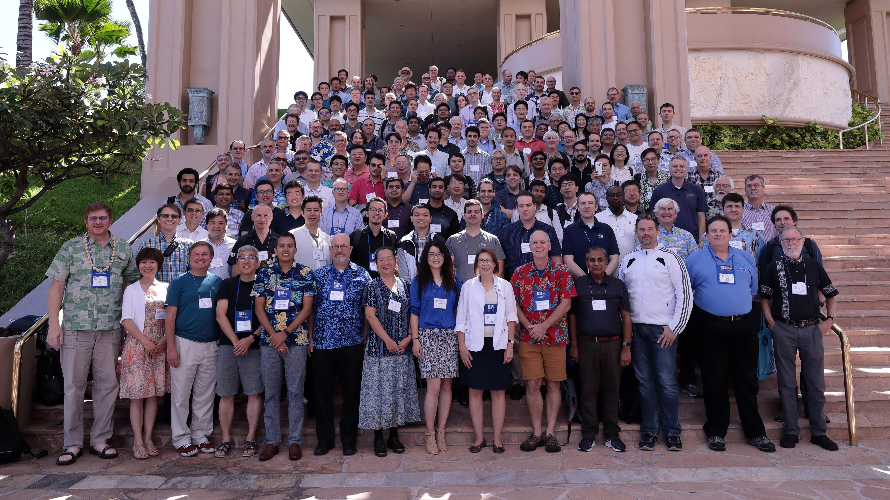
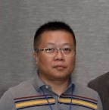
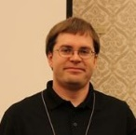
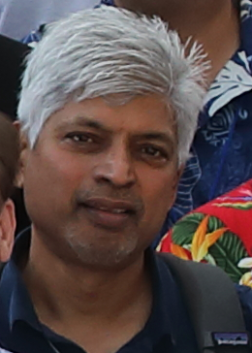


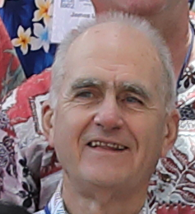
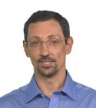
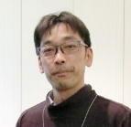
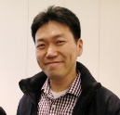
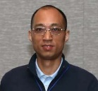
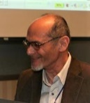
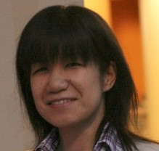
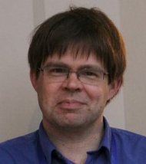
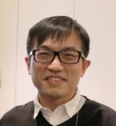
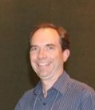
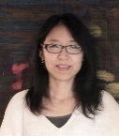
Kaz Sakoda
Stephen McCann
WG secretary
Dan Harkins
Sean Coffey
Payam Torab
Jiamen Chen
Jerome Henry
Bo Sun
Jouni Malinen
Thomas Derham
Nehru Bhandaru
Abhishek Patil
Youhan Kim
Peter Eccelsine
Haiming Wang
Ganesh Venkatesan
Mark Hamilton
TGmd vice-chair
Matthew Fischer
Solomon Trainin
Tomo Adachi
Mike Montemurro
TGmd vice chair
Mark
Rison
Edward Au
TGmd sub-editor
Sigurd Schelstraete
Chris Hansen
Menzo Wentik
Guido Hiertz
Graham Smith
Gabor Bajko
Jon Rosdahl
WG vice chair
TGmd secretary
Marc
Emmelmann
Yujin Noh
Assaf Kasher
Dorothy Stanley
WG chair
TGmd chair
Srinivas Kandala
Emily Qi
TGmd editor
Robert Stacey
WG vice chair

Slide 9
References

