Slide 1
Multi-Band WiFi Fusion for WLAN Sensing
Date: 2021-03-09
Authors:
Name | Affiliation | Address | Phone | Email
Pu (Perry) Wang | Mitsubishi Electric Research Laboratories (MERL) | 201 Broadway, Cambridge, MA 02139, USA | 617-621-7567 | pwang@merl.com
Jianyuan Yu
Toshiaki Koike-Akino
Ye Wang
Philip V. Orlik
Notes:
September 2012

Slide 2
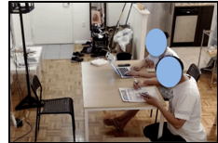
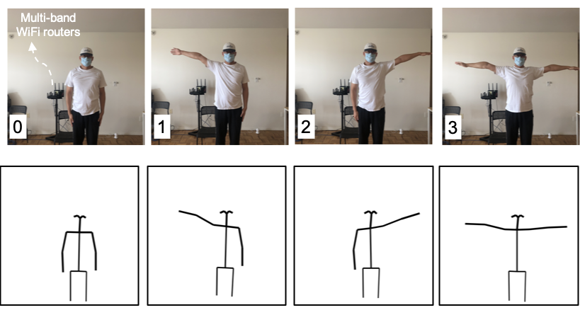
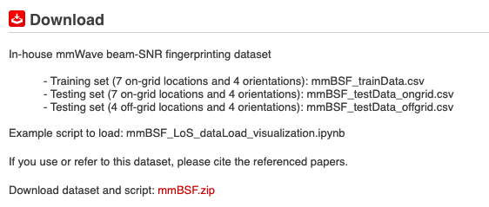
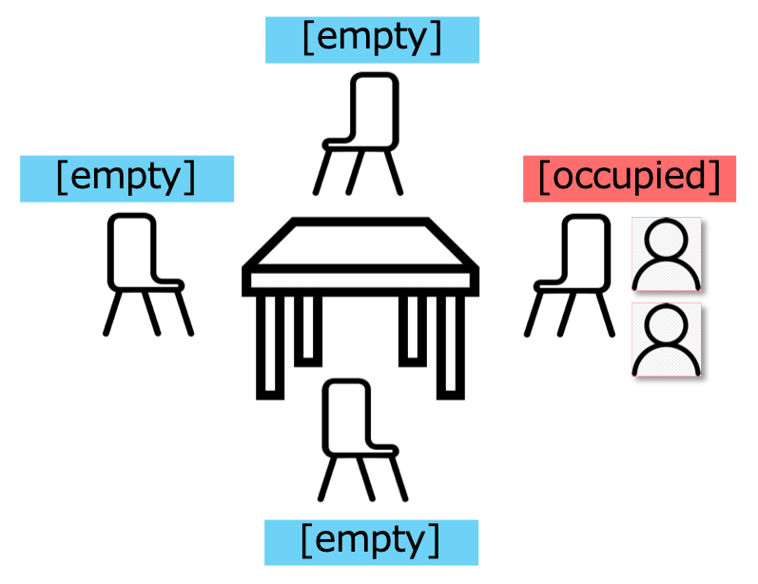
Abstract
This contribution is a continuation of
  20/1074r1 WLAN Localization and Sensing With Mid-Grained Channel Measurements
  20/1741r1 Feasibility study of human pose and occupancy classification using mmWave WiFi beam attributes
  which adopts mid-grained channel measurement – mmWave beam attributes (e.g., beam SNRs) for WLAN sensing as those measurements are already shared during mmWave beam training phase.
This contribution reports multi-band WiFi fusion for WLAN sensing
  Fine-grained CSI at sub-7 GHz (2.4 GHz and 5 GHz)
  Mid-grained beam SNR at 60-GHz
  Particularly, we aim to promote deep learning-based fusion among WiFi channel measurements at different frequency bands for WLAN sensing.
Occupancy Sensing
Open dataset for mid-grained WiFi channel measurements
Pose recognition
https://www.merl.com/demos/mmBSF

Slide 3
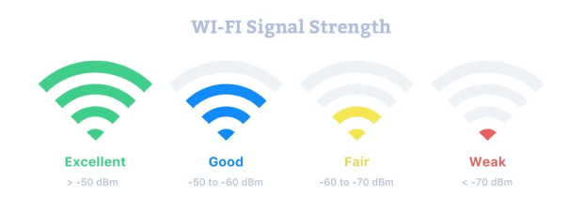
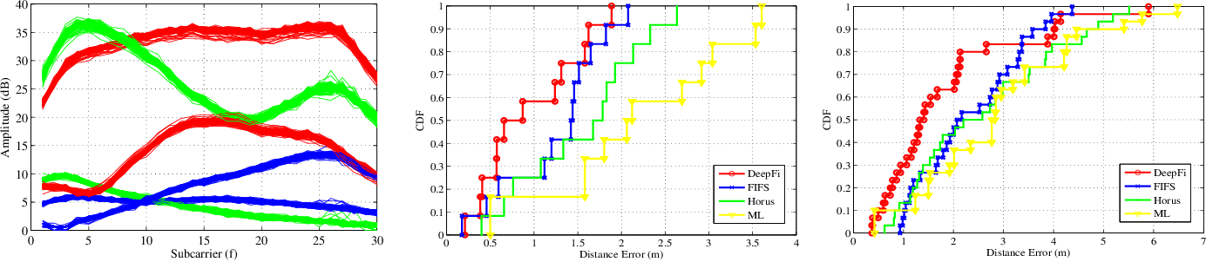
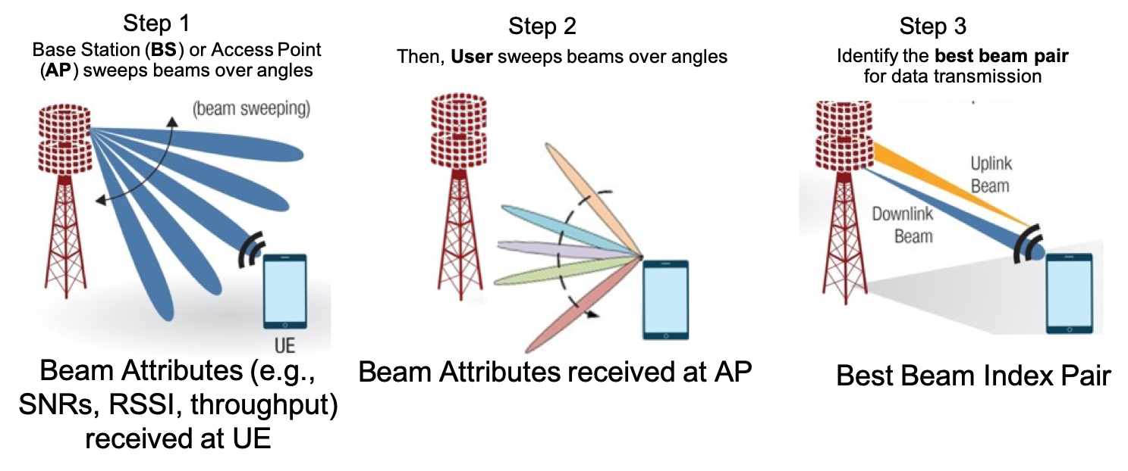
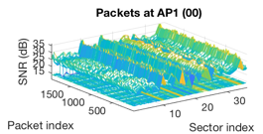
WiFi Channel Measurements
RSSI
WLAN sensing may consider the following WiFi channel measurements
  Coarse-grained RSSI (received signal strength indicator)
    In the unit of dBm, easy to access, coarse channel information
  Fine-grained CSI (channel state information) at sub-7 GHz
    Complex amplitudes at freq.-domain OFDM subcarriers (802.11g/n/ac at 2.4 & 5 GHz)
    WiFi CSI can be accessible from commercial WiFi devices in earlier 2010s
    The CSI-based fingerprinting outperforms the RSSI-based fingerprinting
    (DeepFi’16, PhaseFi’17, BiLoc’18, CSI-Net’19, Person-in-WiFi’19)
  Super-grained CSI at 45+ GHz
    Complex amplitudes at freq.-domain OFDM subcarriers (802.11ad at 60 GHz)
    Not easy to access using commercial WiFi devices
    Super-resolution in delay profile with huge overhead (access, storage, processing)
  Mid-grained beam attributes (e.g., beam SNRs)
    Data collection and exchange (between AP and User) are already defined in 802.11ad standards during beam training (therefore, minimal additional overhead)
    Spatial-domain channel measurements at mmWave bands, weighted by beam patterns
Picture source: https://www.netspotapp.com
CSI sequences for 2 Tx & 3 Rx
Picture sources: [7]
Reuse of WiFi channel measurement during (mmWave) beam training for WLAN Sensing
Picture copyright@MERL

Slide 4
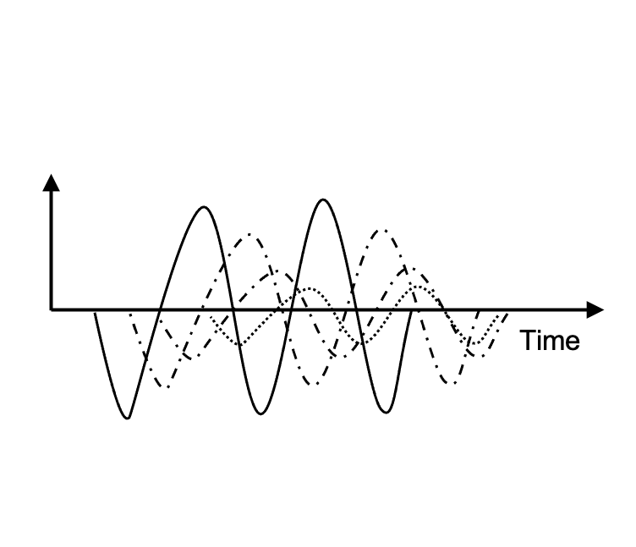
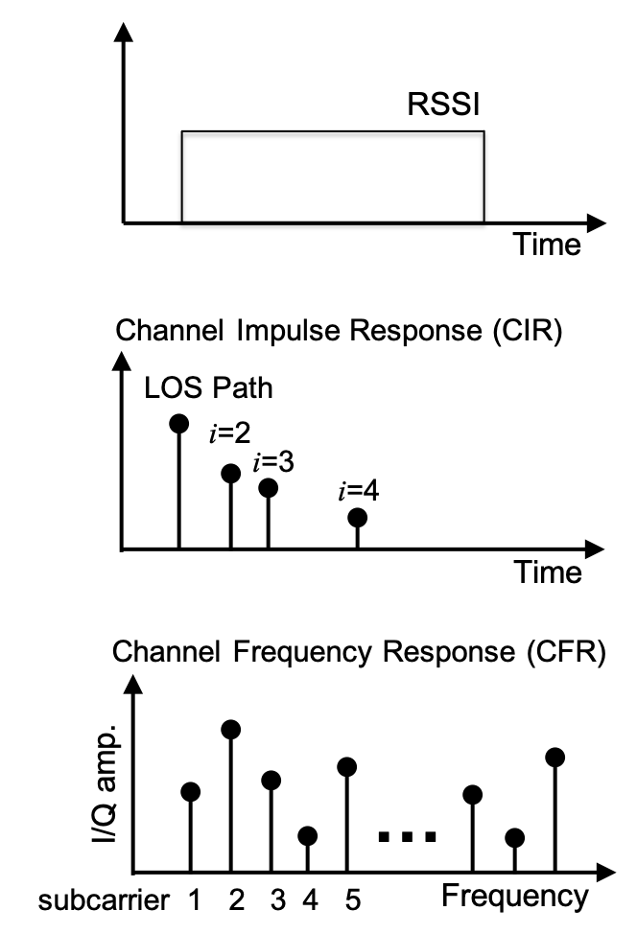
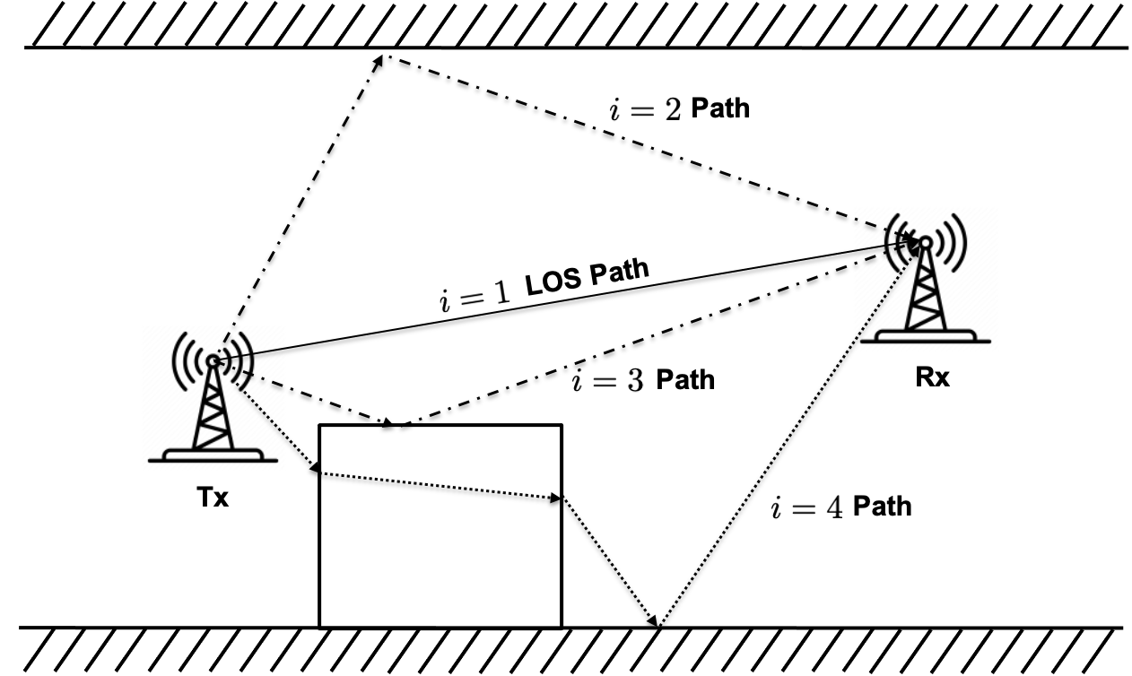
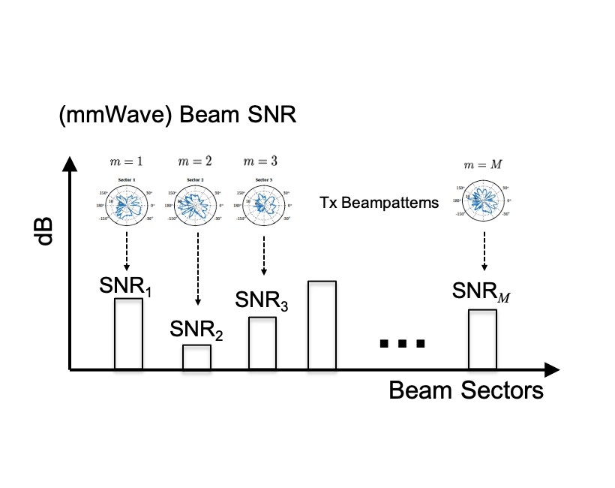
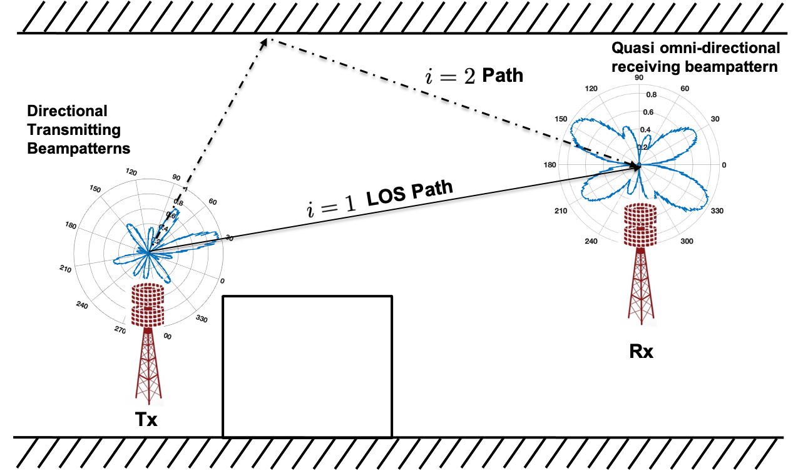
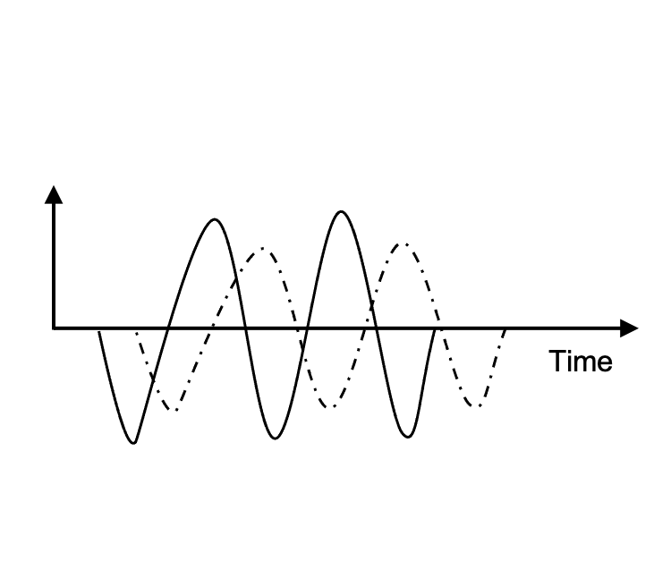
Multi-Band WiFi Fusion: Measurements (I)
We consider two complementary WiFi channel measurements for WLAN Sensing
  Fine-grained CSI: Complex amplitudes at freq.-domain OFDM subcarriers (802.11g/n/ac at sub-7 GHz)
  Mid-grained beam SNR: Spatial-domain channel measurements at mmWave bands, weighted by beam patterns
coarse-grained RSSI
fine-grained CSI
Delay profile
Multipath propagation at sub-7 GHz
Echo signals at sub-7 GHz
Channel Measurements at sub-7 GHz
mid-grained beam SNR
Echo signals at 45+ GHz
Channel measurements at 45+ GHz
(during beam training)
Multipath propagation at 45+ GHz
Pictures copyright@MERL

Slide 5
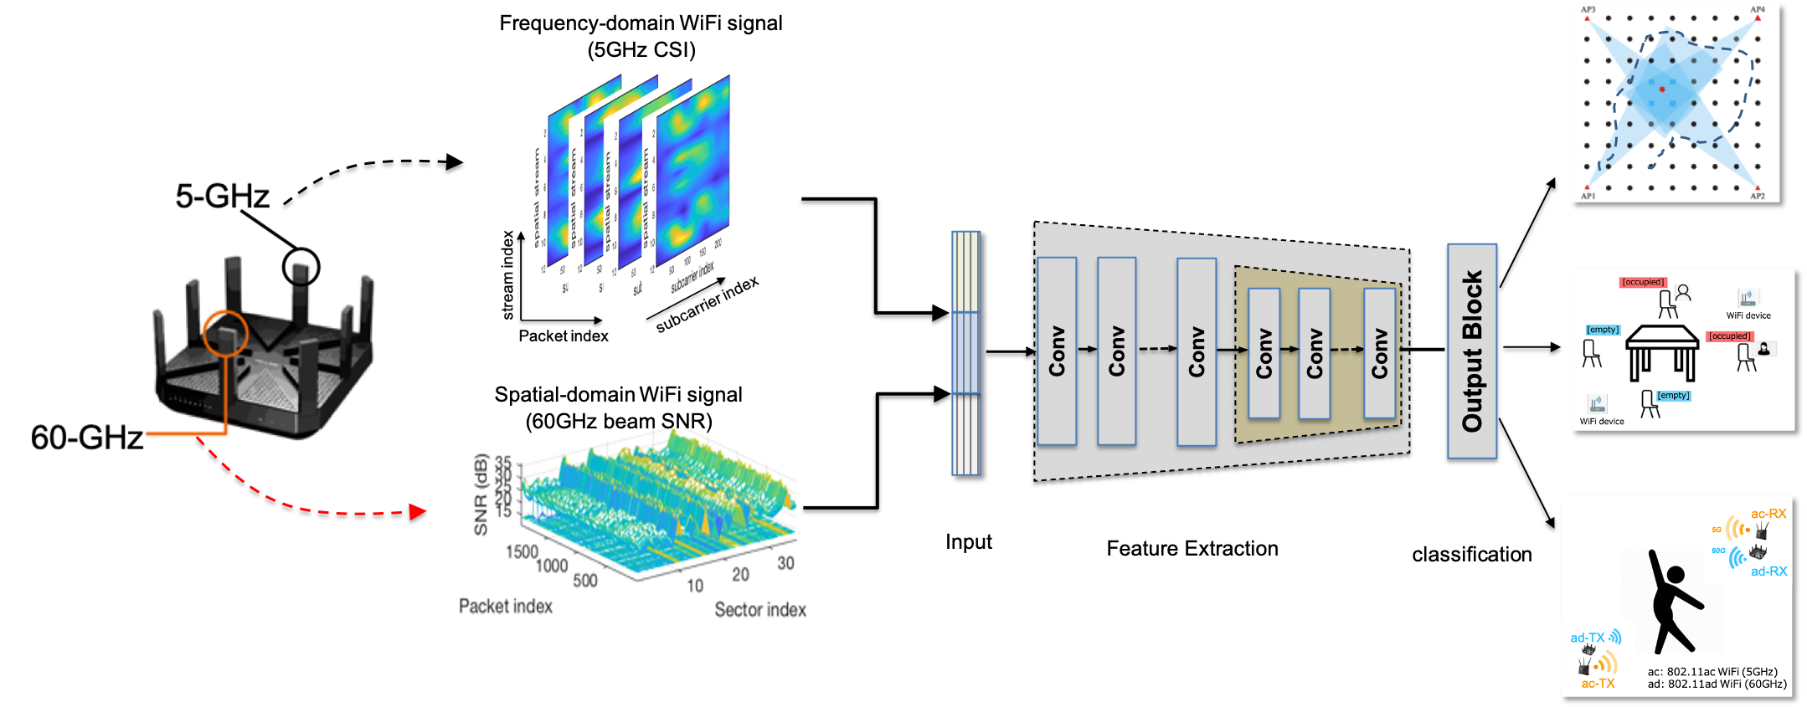
Multi-Band WiFi Fusion: Measurements (II)
We propose to fuse 1) Fine-grained CSI at sub-6 GHz from multiple spatial streams and 2) Mid-grained beam SNR at the mmWave band of 60 GHz
  CSI: frequency-domain/delay-domain power profile; beam SNRs: spatial-domain link quality over beams
  CSI: sensitive to small & large motions; beam SNRs: more sensitive to large motions/distinct patterns
  CSI: large propagation range (through walls); beam SNRs: small propagation range (blocked by walls)
  CSI: channel fading leads to inconsistent measurements; beam SNRs: more repeatable in the presence of disturbance
Pictures copyright@MERL

Slide 6
Multi-Band WiFi Fusion (I): Input Fusion/Concatenation
A simple way to combine the two measurements is to concatenate them together before being fed into a neural network or signal processing method for multi-task WLAN sensing applications.
Indoor Localization
(with-device)
Occupancy Sensing
(device-free)
Pose Recognition
(device-free)
Pictures copyright@MERL

Slide 7
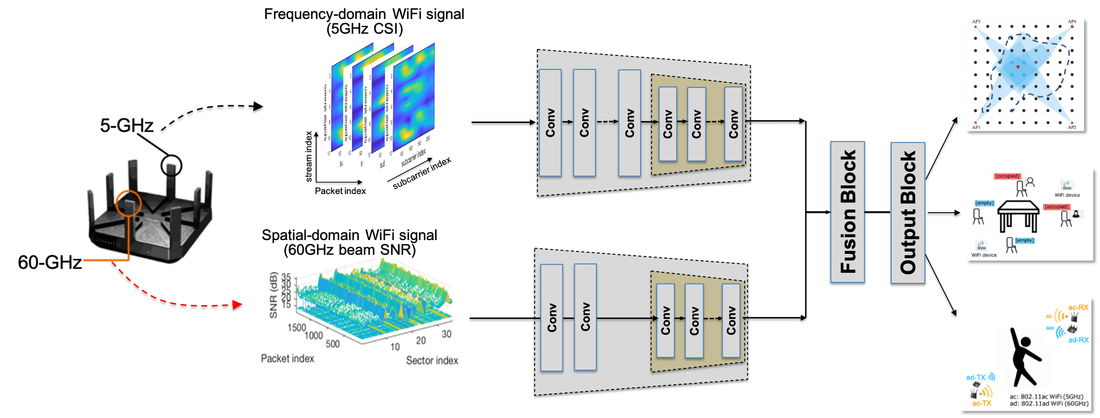
Multi-Band WiFi Fusion (II): Feature Fusion
Another popular choice is to use separate encoders for individual feature extraction and fuse the features in the latent space (final outputs of the two encoders), followed by a classifier network.
Pictures copyright@MERL

Slide 8
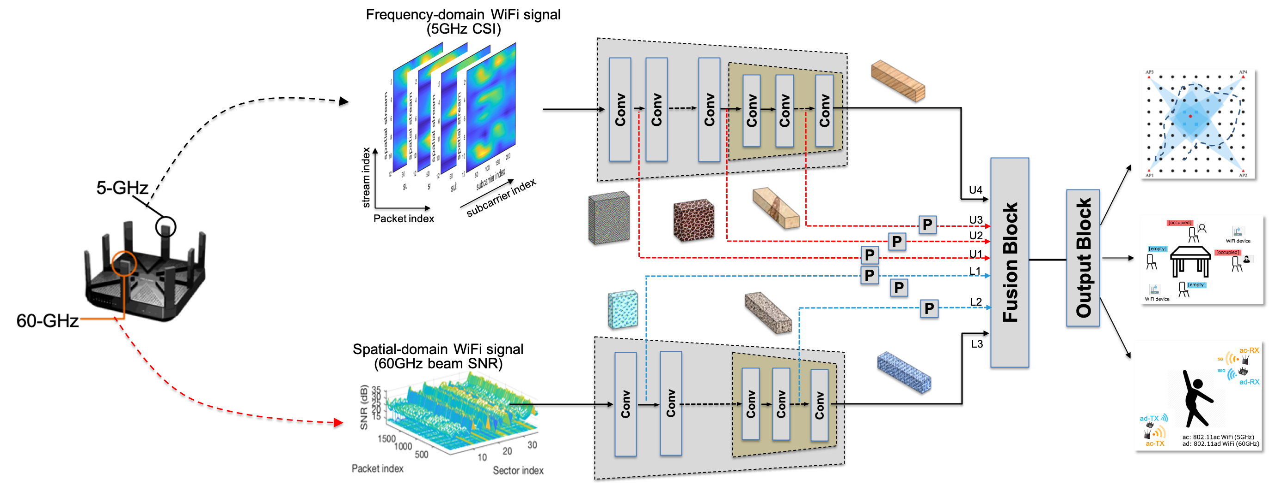
Multi-Band WiFi Fusion (III): Feature Permutation
It is known that the two considered measurements are with different granularity levels.
No consideration of feature granularity correspondence.
We further consider a feature permutation-based multi-band WiFi fusion.
Pictures copyright@MERL

Slide 9
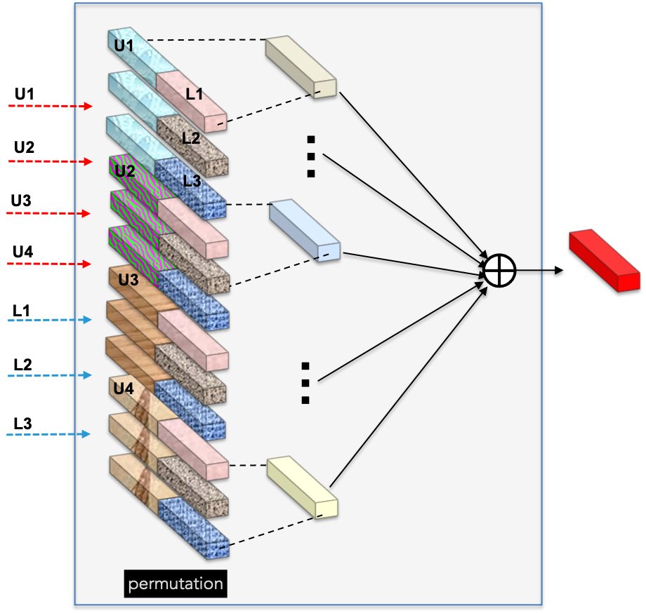
Multi-Band WiFi Fusion (III): Feature Permutation
The first stage is to permute the collected feature maps at selected layers from both encoders for CSI and beam SNR, respectively.
The second stage is to combine the permuted fused features to a single fused feature.
Pictures copyright@MERL

Slide 10
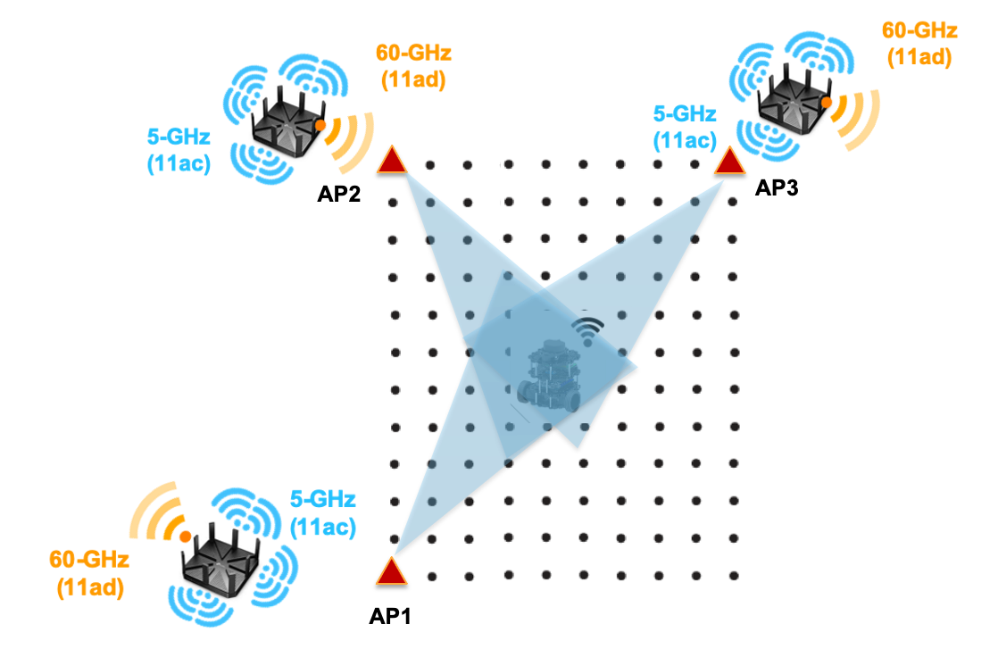
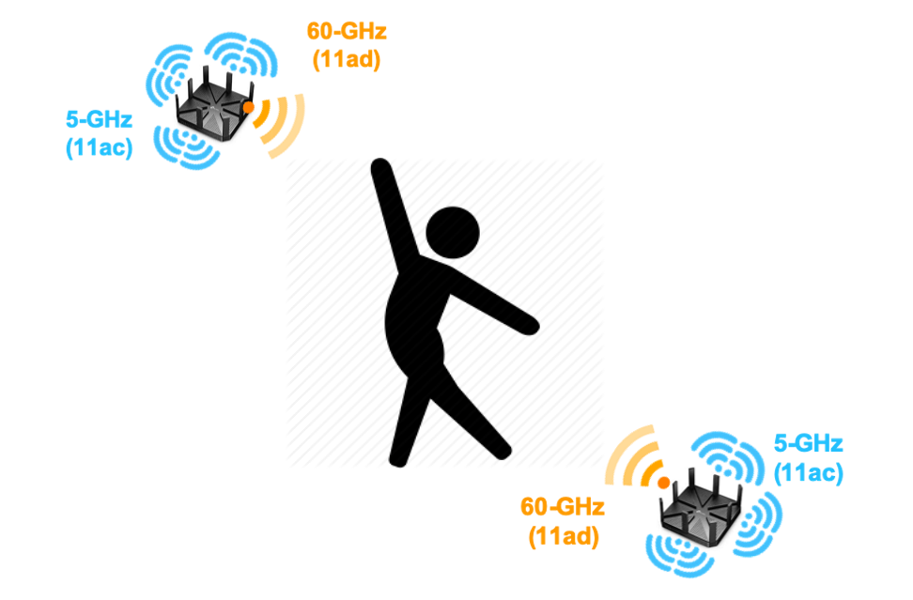
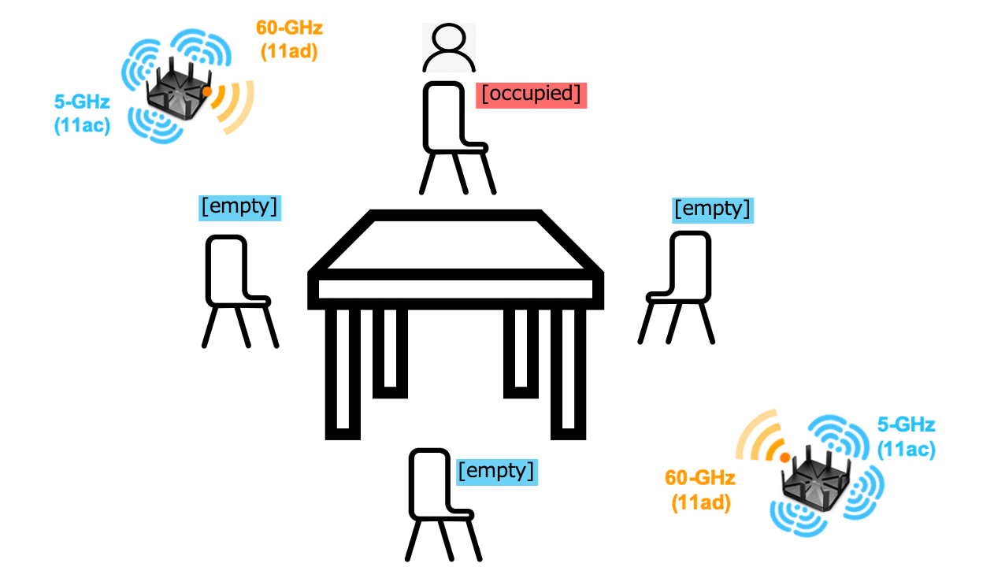
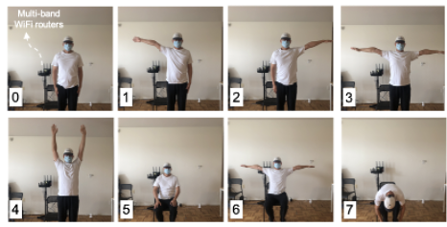
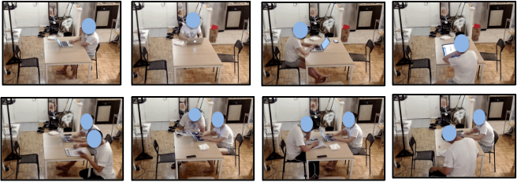
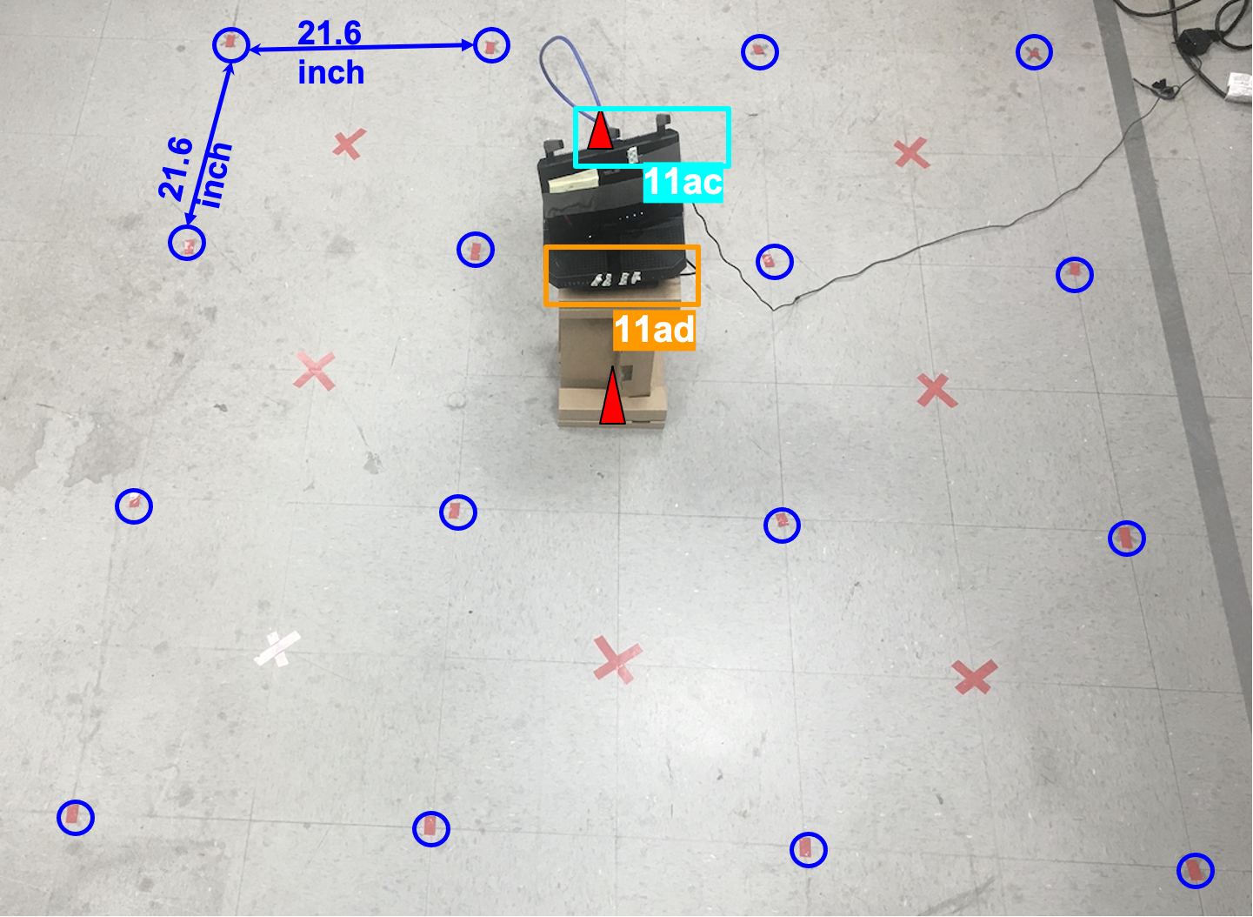
Multi-Task WLAN Sensing
Picture sources: MERL
Picture sources: MERL

Slide 11
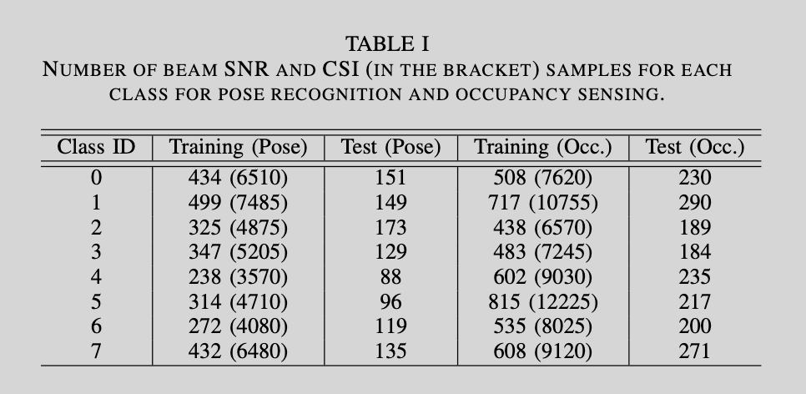
Testbed & Dataset
CSI from 802.11ac devices: We used ASUS RT-AC86U routers with 3 external and 1 internal antennas to extract the CSI measurements at 5 GHz and modified its firmware using the nexmon CSI Extractor Tool of [12].
Beam SNR from 802.11ad devices: We use TP-Link Talon AD7200 routers to collect beam SNRs at 60 GHz. This router implements Qualcomm QCA9500 transceiver that supports a single stream communication in 60 GHz range using analog beamforming over 32-element planar array [9-11]
For each sensing task, multiple (~7) independent data sessions for performance evaluation*
* As opposed to evaluation based on random splitting of a single-data-session data.

Slide 12
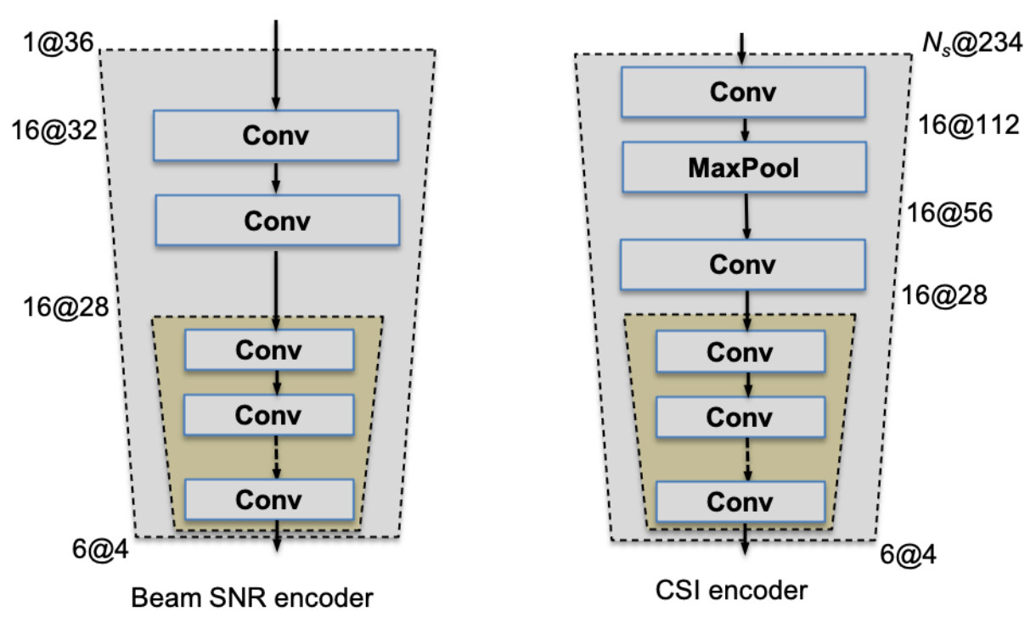
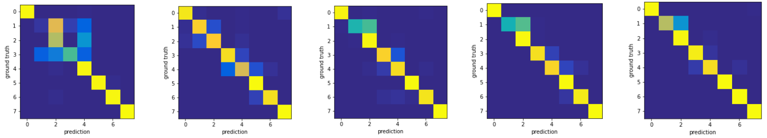
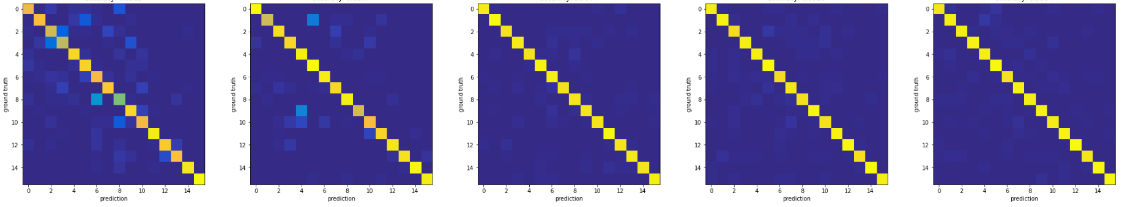
Results (I): Confusion Matrix
Pose Recognition (8 poses)
CSI-only
Beam SNR-only
IF: input fusion
FF: input fusion
FP: feature permutation
Indoor localization (4 x 4 grids)
CSI-only
Beam SNR-only
IF: input fusion
FF: input fusion
FP: feature permutation

Slide 13
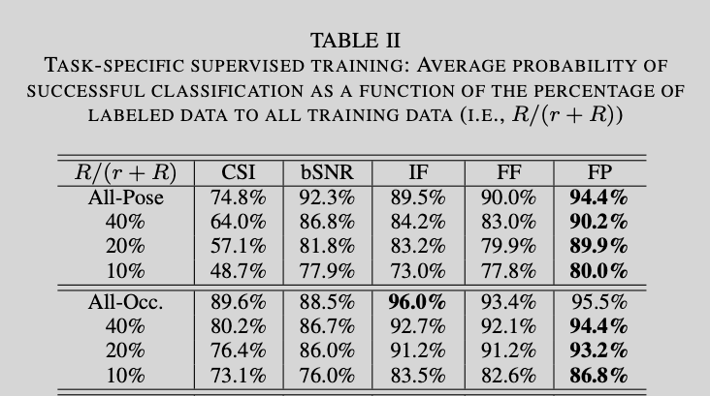
Results (II)

Slide 14
The Role of Fused Measurements
*
4
Fused channel
measurements
3
Mid-grained beam
measurements
WLAN sensing roles
Sensing initiator, sensing responder, sensing transmitter,
sensing receiver: mid-grained beam measurements, fused measurements at the sensing receiver
sensing processor: multi-band WiFi fusion can be done in the sensing processor.
Signals in the WLAN sensing
Illumination signal: existing OFDM pilots at sub-7 GHz and standard beam training signals at 60 GHz
Echo signal: standard subcarrier CSI at sub-7 GHz and beam attributes (e.g., beam SNRs) at 60 GHz
Measurement result in the WLAN sensing
Sensing measurement: the measurement of the area of interest
  raw CSI, received radar signal,
  mid-grained beam SNRs at mmWave bands,
  fused multi-band WiFi measurements/features at the sensing receiver.
Sensing result: the sensing result is the result after signal processing at the sensing processor
  compressed CSI,
  range-Doppler map,
  range-time map,
  fused multi-band WiFi result (from multiple sensing receivers) at the sensing processor
*The original figure is from IEEE 802.11-20/0147r3.

Slide 15
Conclusions
This contribution demonstrated the potential of fused results/measurements from multi-band WiFi signals for WLAN sensing.
Multi-band WiFi fusion enhances the capability of sensing receivers and processors with existing WiFi standards-compliant channel measurements
  Introduced learning-based fusion (with consideration of granularity correspondence) between various WiFi channel measurements at different frequency bands
  Fused measurements/features can be of a much smaller dimension (latent space dimension - 24) than raw WiFi channel measurements (no. of subcarriers, no. of spatial streams, high frame rate…)
  Noticeable performance improvements are verified with preliminary experimental datasets.
Multi-band WiFi fusion can further relax the requirement of extensive labeled training data, an issue in the post-deployment of WLAN sensing devices (will be introduced in a subsequent contribution).

Slide 16
References
[1] CSI-based Wi-Fi Sensing: Results and Standardization Challenges, IEEE 802.11-19/1769r1
[2] 802.11 sensing: Applications, feasibility, standardization, IEEE 802.11-19/1626r1
[3] Wi-Fi sensing in 60GHz band, IEEE 802.11-19/1551r1
[4] Wi-Fi sensing, IEEE 802.11-19/1164
[5] Wi-Fi sensing: cooperation and standard support, IEEE 802.11-19/1416
[6] “Spotfi: Decimeter Level Localization using WiFi”, Manikanta Kotaru, Kiran Joshi, Dinesh Bharadia, Sachin Katti
[7] X. Wang, L. Gao, S. Mao and S. Pandey, "DeepFi: Deep learning for indoor fingerprinting using channel state information," WCNC, New Orleans, LA, 2015, pp. 1666-1671
[8] "Towards Context-assisted Indoor Navigation", Ayyalasomayajula Roshan, Aditya Arun, Chenfeng Wu, Sanatan Sharma, Deepak Vasisht, Abhishek Sethi, Dinesh Bharadia
[9] D. Steinmetzer, D. Wegemer, M. Schulz, J. Widmer, and M. Hollick, ‘‘Compressive millimeter-wave sector selection in off-the-shelf IEEE 802.11ad devices,’’ in Proc. 13th Int. Conf. Emerg. Netw. EXperiments Technol., Nov. 2017
[10] D. Steinmetzer D. Wegemer and M. Hollick Talon Tools: The Framework for Practical IEEE 802.11ad Research 2018 [online] Available: https://seemoo.de/talon-tools/
[11] M. Schulz D. Wegemer and M. Hollick Nexmon: The C-Based Firmware Patching Framework 2017
[12] F. Gringoli, M. Schulz, J. Link, and M. Hollick, “Free your CSI: A channel state information extraction platform for modern Wi-Fi chipsets,” in Proceedings of the 13th International Workshop on Wireless Network Testbeds, Experimental Evaluation and Characterization, 2019, pp. 21–28.
[13] M. Pajovic, P. Wang, T. Koike-Akino, H. Sun and P. V. Orlik "Fingerprinting-based indoor localization with commercial mmWave WiFi—Part I: RSS and beam indices" GLOBECOM 2019, pp. 1-6, Dec. 2019.
[14] P. Wang, M. Pajovic, T. Koike-Akino, H. Sun and P. V. Orlik "Fingerprinting-based indoor localization with commercial mmWave WiFi—Part II: Spatial beam SNRs" GLOBECOM 2019, pp. 1-6 Dec. 2019.
[15] T. Koike-Akino, P. Wang, M. Pajovic, H. Sun and P. V. Orlik "Fingerprinting-based indoor localization with commercial mmWave WiFi: A Deep Learning Approach”, IEEE Access, Vol. 8, pp. 84879-84892, 2020.
[16] J. Yu, P. Wang , T. Koike-Akino, Y. Wang, and P. V. Orlik " Human Pose and Seat Occupancy Classification with Commercial mmWave WiFi”, GLOBECOM Workshop on JSAC, December, 2020.
[17] W. Wu, N. Cheng, N. Zhang, P. Yang, W. Zhuang, and X. Shen "Fast mmWave beam alignment via correlated bandit learning" IEEE Trans. Wireless Comm., vol. 18 no. 12 pp. 5894-5908 Dec 2019.

Slide 17
Straw Poll 1
Should 802.11bf TG consider the mid-grained beam measurements (e.g., beam SNRs) as one type of Sensing measurements for WLAN Sensing?
Yes:
No:
Abstain:
Pu (Perry) Wang, MERL

Slide 18
Straw Poll 2
Should 802.11bf TG consider the use of the fused measurements across multiple operating frequency bands as a valid type of sensing measurement?
Yes:
No:
Abstain:
Pu (Perry) Wang, MERL

