Slide 1
DirectVoteLive Test Meeting Lessons
Date: 2021-03-16
Authors:

Slide 2
Abstract
A DirectVoteLive virtual test meeting was run to validate the 802.11 voter database.
The goal was for all Voters/Potential Voters would sign-in and vote on 3 motions:
Motion 1:
I am able to provide a vote in the DirectVote tool.
Motion 2:
I plan to attend the 802.11 WG Opening Plenary Meeting Monday March 8, 2021 at 14:00 UTC (9:00 am ET).
Motion 3:
I plan to attend the 802.11 WG Closing Plenary Meeting Tuesday March 16, 2021 at 13:00 UTC (9am ET)

Slide 3
Participation Report
Attendance: 314 of 486 attendees invited participated by March 4.

Slide 4
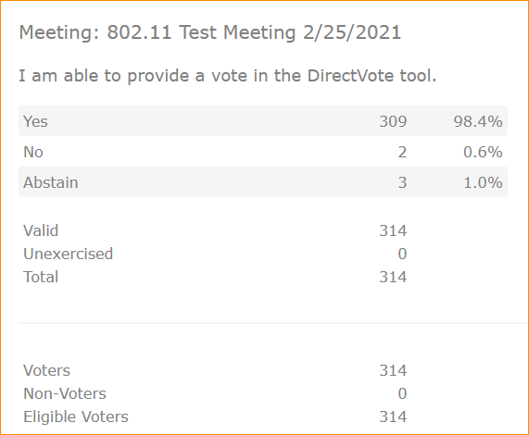
Motion 1

Slide 5
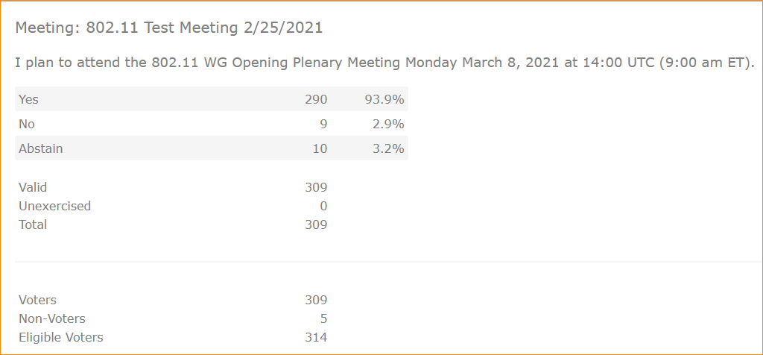
Motion 2

Slide 6
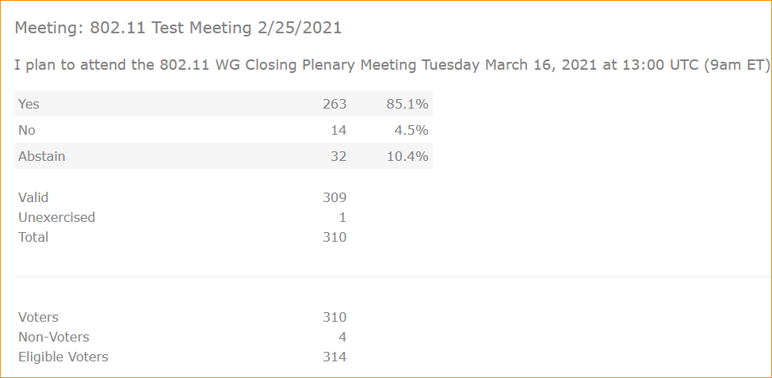
Motion 3

Slide 7
WARNINGS -
Use the link that was sent to you to be able to use the IEEE SSO to get into the tool at the right place.
Do not forward your mail to colleagues as they may not have been invited (i.e., non-voter).
The Email was sent to your 802.11 Voter email address of record. That may or may not be the email you get your listserv emails from.
Your DirectVoteLive and myProject email address (your IEEE Account Primary address) must be the same, or you will not be able to login. Case Sensitive

Slide 8
What we learned.
802.11 Voter Database has not consistently been updated when voters change email addresses.
The IEEE Account Main Email address and the DirectVoteLive Email address must match exactly.
Email address is case sensitive.
The User must use the invite link, even after logging in, must reuse the link as refreshing will take you to a DirectVoteLive login page that is not associated with IEEE and the SSO process.

Slide 9
Next Steps
Test Motion to be setup for March Plenary End of opening Plenary (March 8).
Run until the Closing Plenary (March 15) –
Post missing participant names from first Test in this deck. (next slides).
The Plan is to use DirectVoteLive in May Interim.

Slide 10
802.11 Voter/Potential Voters that did not participate in the DirectVoteLive Test
Adhikari, Shubhodeep | ElSherif, Ahmed |  | Jauh, Alan |  | Li, Jianhui
Agarwal, Peyush | feng, Shuling |  | Jeon, Eunsung |  | Li, Nan
Ahn, Woojin | Filippi, Alessio |  | Jia, Jia |  | Li, Qinghua
Aio, Kosuke | Fletcher, Paul |  | jiang, feng |  | Li, Yanchun
Andersdotter, Amelia | Foland, Jeremy |  | Jiang, Jinjing |  | Liang, dandan
Arokkiam, Jerome | Garcia Rodriguez, Adrian Jose |  | Jung, hyojin |  | Lin, Cheng-Hui
Asai, Yusuke | Gardner, James |  | JUNG, MYUNG CHEUL |  | Lin, Wei
Avrillon, Matthieu | Ghosh, Chittabrata |  | Kadampot, Ishaque Ashar |  | Lindskog, Erik
Baik, Eugene | Guntupalli, Lakshmikanth |  | Kang, Hyunduk |  | LIU, CHENCHEN
Banerjea, Raja | Gwak, Yongsu |  | KANG, Kyu-Min |  | Liu, Der-Zheng
Berner, Stephan | Hall, Robert |  | KANG, TEAG JIN |  | Liu, Jeff
Bober, Lennert | HAN, CHONG |  | Khan, Naseem |  | Liu, Jianhan
Calcev, George | Han, Zhiqiang |  | Kim, Jin Min |  | Lomayev, Artyom
Cepni, Gurkan | Hansen, Christopher |  | Kim, Myeong-Jin |  | Lopez, Miguel
CHAN, YEE | Hedayat, Ahmadreza |  | Kim, Suhwook |  | Lopez-Perez, David
Chang, Soo-Young | Hiertz, Guido |  | Kraemer, Bruce |  | Lu, Kaiying
CHERIAN, GEORGE | HIROKI, Shigeru |  | Kumar, Manish |  | Lu, Liuming
Chung, Bruce | Holland, Oliver |  | Kureev, Aleksey |  | Ma, Mengyao
Costa, D.Nelson | Hsiao, Ching-Wen |  | Lan, Zhou |  | Malinen, Jouni
Das, Dibakar | Hu, Glenn |  | Lanante, Leonardo |  | Maltsev, Alexander
Dash, Debashis | Huang, Guogang |  | Le Houerou, Brice |  | Mano, Hiroshi
DOAN, DUNG | Hurtarte, Jeorge |  | Lee, Hyeong Ho |  | Marks, Roger
Doostnejad, Roya | Ibrahim, Mostafa |  | LEE, JOONSOO |  | Meng, Xing
Du, Zhenguo | Ikegami, Tetsushi |  | Lee, Wookbong |  | Mody, Apurva
Duan, Ruchen |  |  | Levitsky, Ilya |  | Mohanty, Bibhu

Slide 11
802.11 Voter/Potential Voters that did not participate in the DirectVoteLive Test
Monajemi, Pooya |  | Sharma, Prashant |  | Wu, Jianbing
Motozuka, Hiroyuki |  | Shearer, Steve |  | Xin, Yan
Murti, Wisnu |  | Song, Taewon |  | Xu, Yanchao
Nagai, Yukimasa |  | Startsev, Ivan |  | Xue, Qi
nagata, kengo |  | Stavridis, Athanasios |  | Yan, Zhongjiang
Nakano, Hiroki |  | Su, Hang |  | Yang, Mao
Nandagopalan, SAI SHANKAR |  | SU, HONGJIA |  | Yang, Xun
Naribole, Sharan |  | Sumi, Takenori |  | Yang, Yunsong
Nezou, Patrice |  | sun, sheng |  | Yee, James
Noh, Si-Chan |  | Sundman, Dennis |  | yi, yongjiang
Nurani Krishnan, Neelakantan |  | SURACI, FRANK |  | Young, Christopher
Oh, Hyun Seo |  | Tan, Danny |  | Yu, Chinghwa
Oh, Youngseok |  | Tanaka, Yusuke |  | Yu, Mao
Ohsawa, Tomoki |  | Teran, Jesus Gutierrez |  | Yun, Ji-Hoon
Parsons, Glenn |  | V Padaki, Aditya |  | Zeleznikar, Alan
Perkins, Richard |  | Verma, Lochan |  | Zeng, Ruochen
Pettersson, Charlie |  | Verma, Sindhu |  | Zeng, Yan
Pirhonen, Riku |  | Vermani, Sameer |  | Zhang, Xingjian
Prabhakaran, Dinakar |  | Wang, Chao Chun |  | Zheng, Xiayu
QIU, WEI |  | Wang, Hao |  | Zhou, Yifan
Rakanovic, Demir |  | Wang, James June |  | Zou, Tristan
Robert, Joerg |  | Wang, Pu |  | Zuo, Xin
Sadeghi, Bahareh |  | Want, Roy
Sandhu, Shivraj |  | Wilson, Matt
Schiessl, Sebastian |  | Winser, Paul

Slide 12
M6.2 II DirectVoteLive Update
First main 802.11 WG test started on Feb 25, 2021.
We have left the meeting open to provide test motions for this week.
Open items before 802.11 WG can use DirectVoteLive:
8 email domains have been deemed invalid for 8 voters.
Concern with data privacy addressed
165 voters did not respond, so we will need to understand the issues before we can use the tool.
Use of DirectVoteLive needs to be seamless
Observations:
802.1 and 802.3 are using the tool and have been able to address the email discrepancy issues. They require the use of the tool to vote in their meetings.

Slide 13
How to use DirectVoteLive?
The following slides show what the expected pages you should see.
Note that for the invitation email, the section above the yellow text is not editable. So, I was not able to adjust the preamble of the message.
The link is valid and should bring you to the IEEE Single Sign On page.

Slide 14
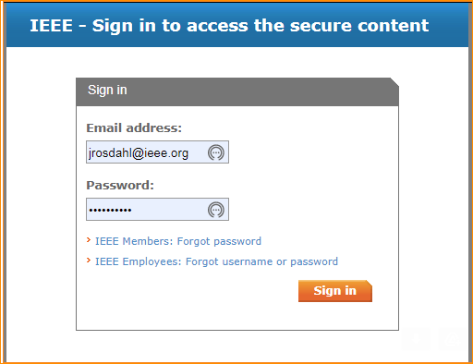
Clicking the link in the invite email

Slide 15
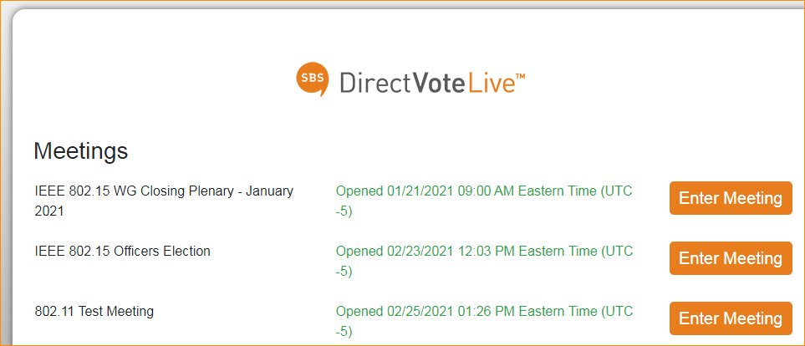
Brings you to this page – click “Enter Meeting”

Slide 16
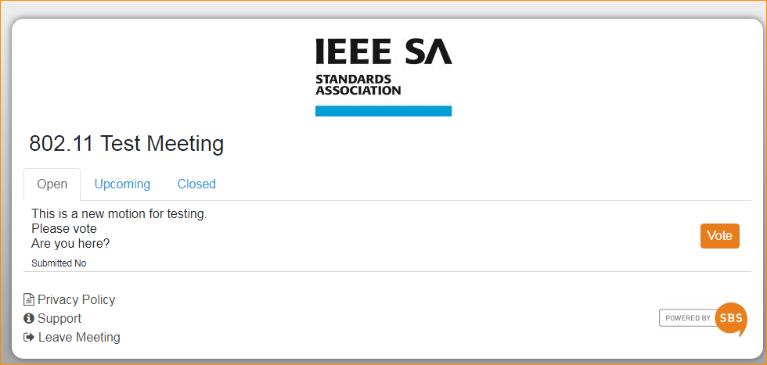
Provides view of Test Meeting – 3 Tabs (“Open/Upcoming/Closed”)

Slide 17
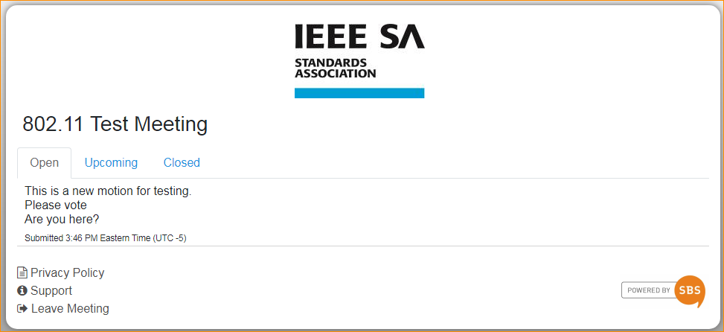
After Submitting, you see the vote has been “Submitted” and the time stamp is given.

Slide 18
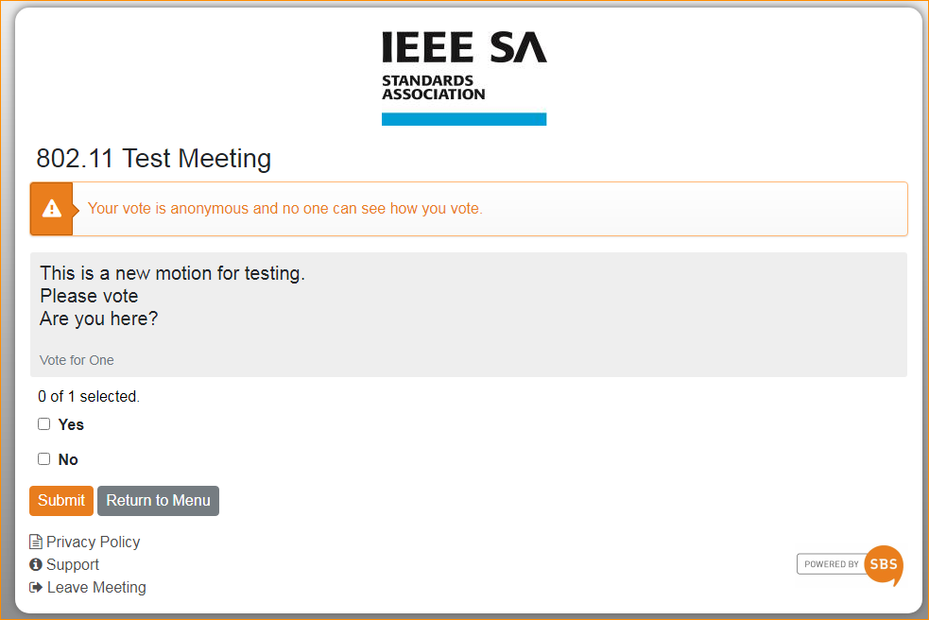
After selecting “Vote” you are shown the Motion vote options. (“Yes/No”)
After selecting the desired choice, remember to submit.
Note your vote is anonymous.

Slide 19
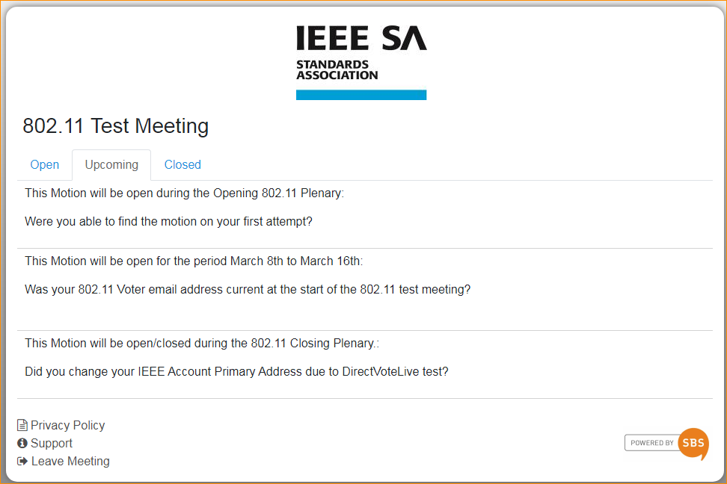
Selecting the “Upcoming” tab
You can see we have 3 motions loaded and ready to open for voting. During a meeting where the tool is used, motions can be dynamically loaded. Motions can be hope for the required duration. 1 minute to more than a month.

Slide 20
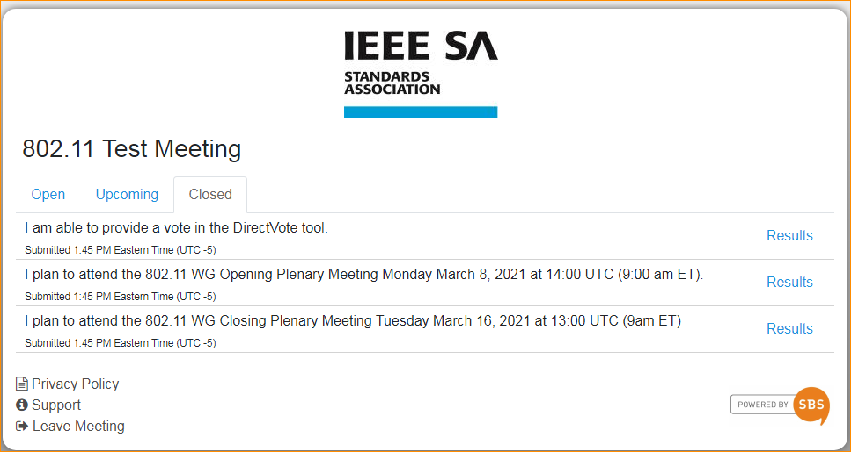
Select the Closed Tab
Once a motion has closed, the results are available for viewing.

Slide 21
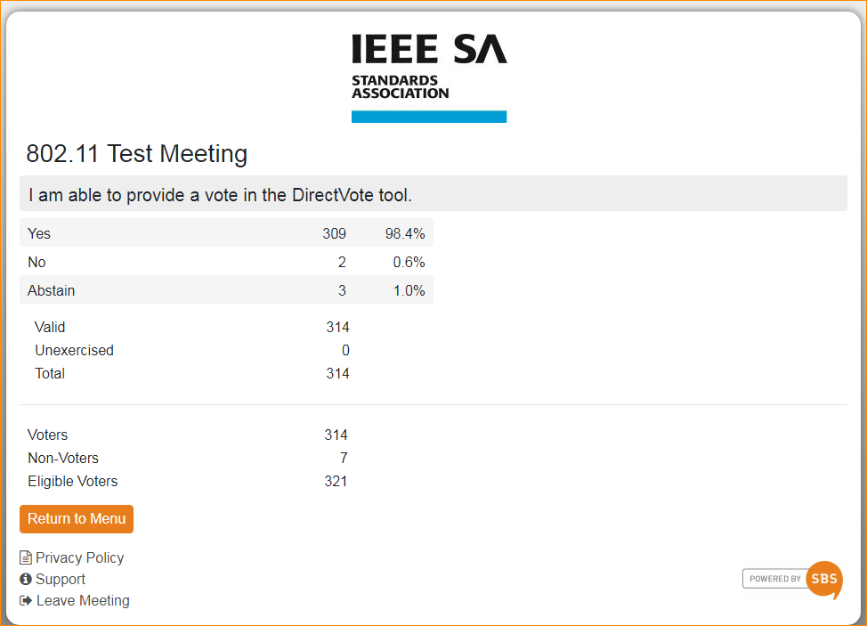
Selecting Results for first motion
We have had 321 of 486 attendees invited participate in the test meeting with only 314 voting on this motion.
We need to qualify 165 more voters.

Slide 22
March 16 Closing Plenary

Slide 23
Status as of 8 am ET
Attendance: 395 of 487 attendees invited are present.
7 Motions were opened, 5 have closed.
Open new Motion now – Please vote

Slide 24
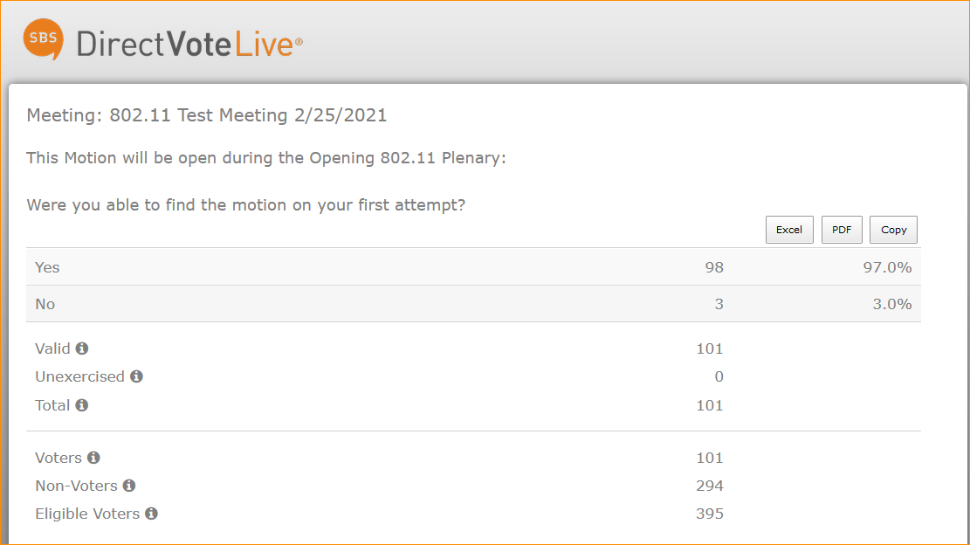

Slide 25
IEEE-SA response to Questions
- How do individuals opt-out of using third-party proxy without their permission or ability to audit? - How does a person have their information completely removed from DirecVote?
If they opted out are you saying they would not use DirectVote Live to vote? I do not have enough information. Best practice is opt-in for any service and give informed consent. In general, if individuals cannot opt-out on their own, a process would need to be determined based on if SA administrates the accounts or the third party, etc. The same goes for account deletion. I do not have enough information. Are DirectVote Live votes formal votes on record, or is this for informal meeting discussions? Official voting history would fall under the rules of how we use personal data under the Standards Development section of the IEEE Privacy Policy (legal and accreditation requirements, etc.) I do not know if information can be completely removed from DirectVote.

Slide 26
IEEE-SA Response to Questions
- How does IEEE respond to breach of privacy?
IEEE is required to report data breaches to regulatory authorities within 72 hours of first becoming aware of the breach.
- DirectVoteLive usability.
a. once you have submitted your vote, it is locked. you cannot review it. you cannot change it. Some groups would like to have the option of reviewing and changing their vote.
b. the indication that your have voted gives the timestamp without a "day". this can be annoying when the motion is open for more than one day.
We have spoken with the vendor about this and they are looking into options to improve this.

Slide 27
IEEE-SA Response to Questions
The IEEE Single Sign On is a nice validation method, but there are several subtleties that need to be addressed.
a. Email is case sensitive. Can this be changed?
b. if authentication fails, no meaningful message is given, but rather an endless looping page of try again to login.
c. if you fail to login, and get to the DirectVoteLive login page, you have lost. it is not really going to let you login, as you have to start with the IEEE SSO page.
d. If you timeout on a page, then you have to start over with the link provided. you cannot use the presented DirectVoteLive login page.
We have spoken with the vendor about this and they are looking into options to improve the login experience.

Slide 28
IEEE-SA Response to Questions
- What is being done for emails that are not considered valid by DVL?
The vendor is currently working on a fix for this.

Slide 29
References

