Slide 1
Jan 2021
[LAA/Wi-Fi Coexistence Issues: Wi-Fi Client Association and Data Transmission]
Date: 2021-01-13
Authors: Vanlin Sathya, Muhammed Iqbal Rochman, and Monisha Ghosh
Name | Affiliations | Address | Phone | email
Vanlin Sathya | University of Chicago |  | 312-774-3596 | vanlin@uchicago.edu
Muhammed Iqbal Rochman | University of Chicago |  | 773-808-4193 | muhiqbalcr@uchicago.edu
Monisha Ghosh | University of Chicago |  | 914-953-1800 | monisha@uchicago.edu
Slide 1
Vanlin Sathya, University of Chicago
Notes:
doc.: IEEE 802.11-yy/xxxxr0
Month Year
John Doe, Some Company
Page 1

Slide 2
Jan 2021
Abstract
The hidden-node problem has been well studied in the context of overlapping Wi-Fi APs. However, when Wi-Fi coexists with LAA, the hidden node problem is exacerbated since the well known RTS/CTS mechanism cannot be used to resolve contentions, resulting in throughput degradation for Wi-Fi. We have made careful measurements of this phenomenon in deployed LAA networks in the Chicago area and we present our measurement results in two locations: one in the IIT campus and one in the UChicago campus.
Slide 2
Vanlin Sathya, University of Chicago
Notes:
doc.: IEEE 802.11-yy/xxxxr0
Month Year
John Doe, Some Company
Page 2

Slide 3
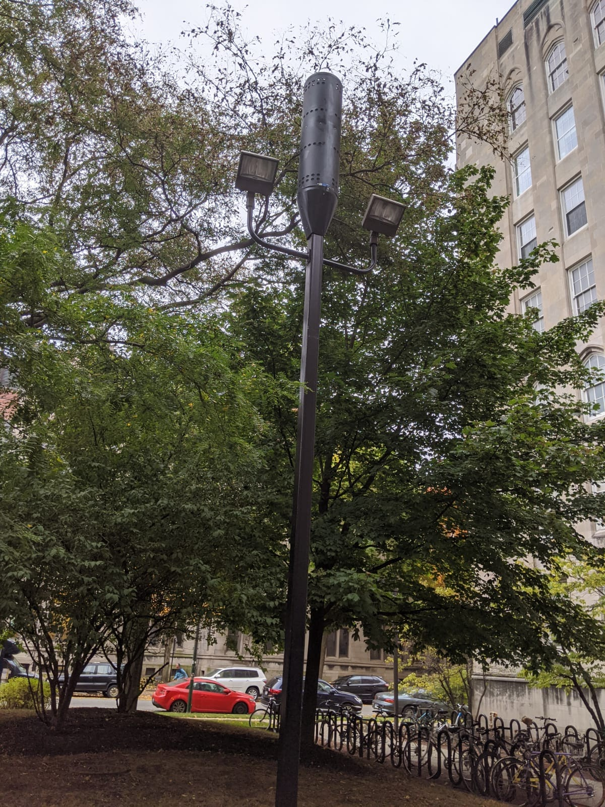
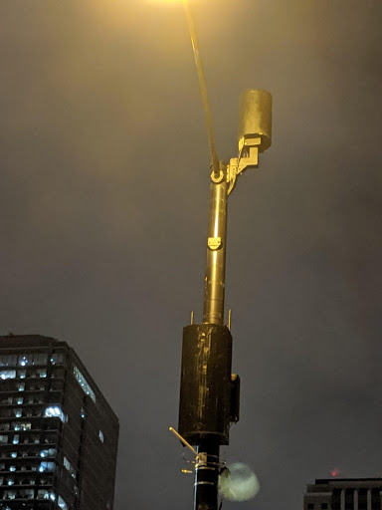
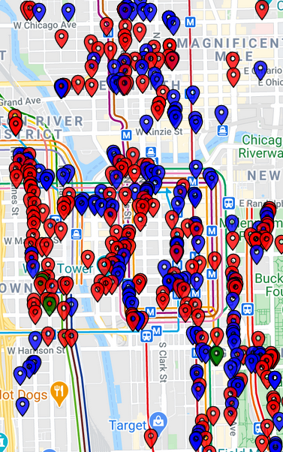
Jan 2021
Example LAA deployments in Chicago
LAA @ UChicago
LAA @ Downtown Chicago
Approximation of LAA BS @ Downtown in Jan 2020 AT&T (blue), T-Mobile (green), Verizon (red)
Vanlin Sathya, University of Chicago

Slide 4
Jan 2021
Hidden Node Experiments
Experiment 1, IIT: A hidden node scenario with a deployed T-Mobile LAA small cell coexisting with 5 Wi-Fi APs that we deployed to study performance in a controlled manner. We observe that the Wi-Fi clients experience association problems when they try to connect to their corresponding Wi-Fi APs. This is due to the LAA BS being unaware of the Wi-Fi AP’s transmission, and transmitting with the maximum transmission opportunity time (TXOP) of 8 ms.
Experiment 2, UChicago: A hidden node scenario with a deployed AT&T LAA small cell coexisting with the 3 Wi-Fi APs that we deployed inside the UChicago bookstore in close proximity to the outdoor LAA. We present one set of results where 5 Wi-Fi clients are associated with one AP, which operates with a 80 MHz bandwidth and primary channel 157. We performed three different kinds of experiments: (i) clients midway between LAA & Wi-Fi, (ii) clients close to the Wi-Fi AP, and (iii) clients close to the LAA BS.
Slide 4
Vanlin Sathya, University of Chicago
Notes:
doc.: IEEE 802.11-yy/xxxxr0
Month Year
John Doe, Some Company
Page 4

Slide 5
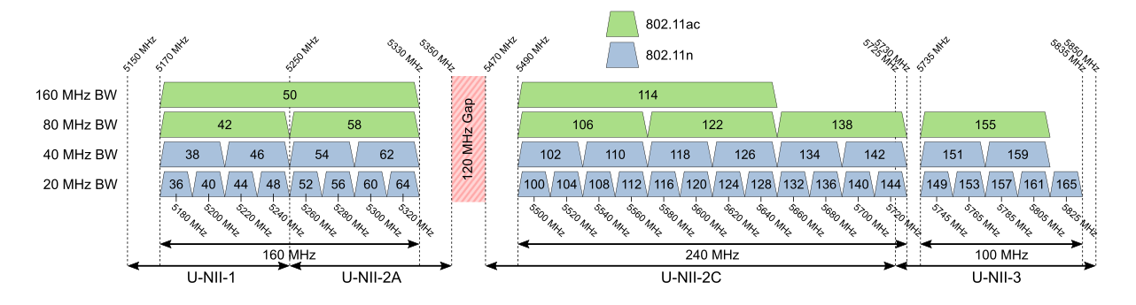
Jan 2021
Wi-Fi & LAA Channelization for the experiments
LAA
Usage
DFS (Dynamic Frequency Switching)
requirement
LAA
Usage
Experiment 1: the T-Mobile LAA BS deployed at IIT uses channels 36, 40, and 44
Experiment 2: the AT&T LAA BS deployed at UChicago uses channels 149, 153, and 157
Vanlin Sathya, University of Chicago

Slide 6
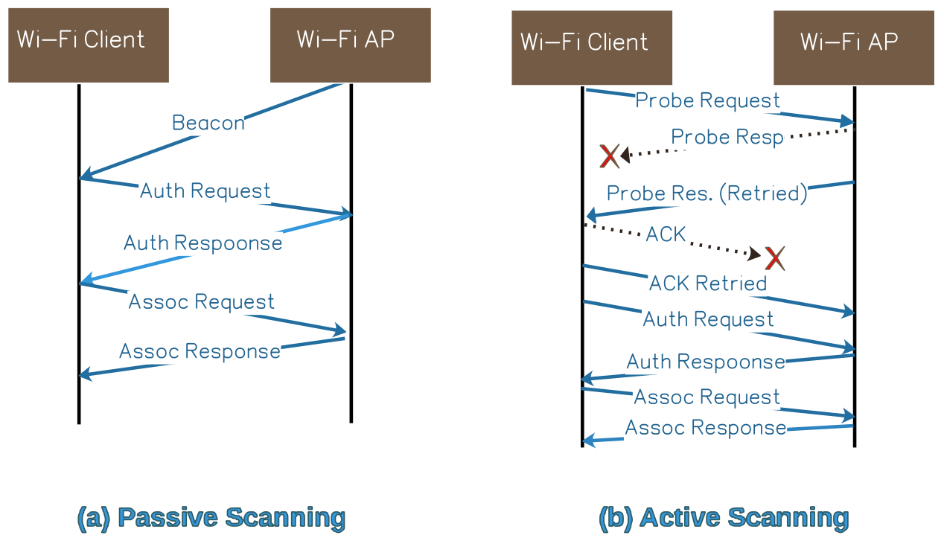
Jan 2021
Wi-Fi Client Association Problem
There are two ways Wi-Fi clients can discover APs: passive and active scanning
All of transmission in this process are unicast, except beacon and probe request
Due to hidden node problem or high interference, association process may be timed out
Vanlin Sathya, University of Chicago

Slide 7
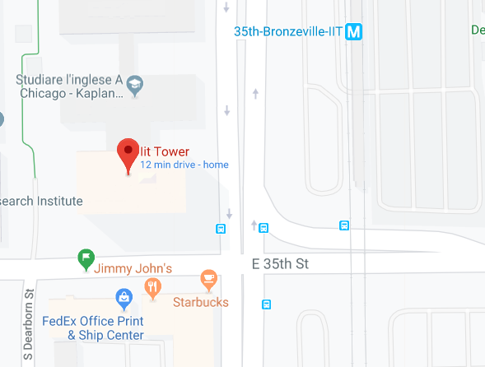
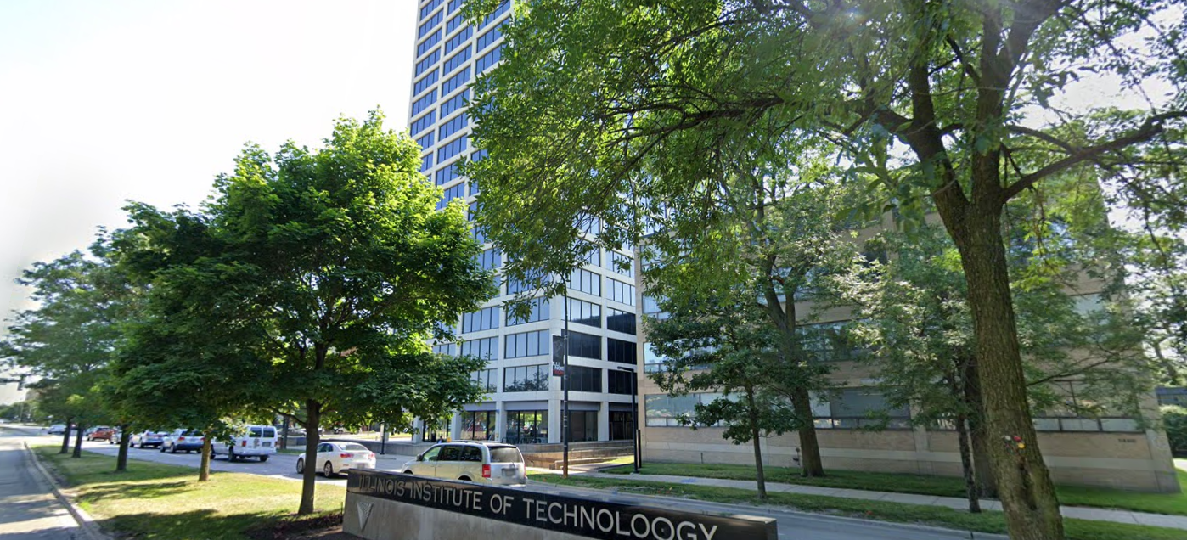
Jan 2021
Experiment 1: IIT Campus
Wi-Fi APs
3rd floor
By the
Window
Clients (Wi-Fi and LAA on the sidewalk
Wi-Fi Indoors:
  5 Wi-Fi APs connected to the IIT network
  3 Laptops running Wireshark in monitor mode
LAA Outdoors:
  T-Mobile on a pole
  5 Wi-Fi clients (Google Pixel 3, Samsung S10, Xiaomi A2, OnePlus 6, Chuwi Hi9)
  1 LAA client (Google Pixel 3)
IIT Tower
LAA BS at corner of 35th and state
Wi-Fi Aps
3rd floor
By the
Window
Wi-Fi APs
3rd floor
By the
Window
Clients at
Sidewalk
Vanlin Sathya, University of Chicago

Slide 8
Jan 2021
Experiment 1, contd.
Distances:
  98 m (322 ft) between LAA BS and clients
  12 m (39 ft) between Wi-Fi APs and clients, due to elevation
The clients have good signals to their corresponding AP/BS
  RSSI at the Wi-Fi clients is around -35 dBm
  SINR at the LAA client is around 18 dB
The LAA signal is very weak at the APs, and vice versa
Perfect condition for a hidden node
Wi-Fi Aps
3rd floor
By the
Window
12 m (39 ft)
(at elevation)
Clients (Wi-Fi and LAA) on the sidewalk
98 m
(323 ft)
LAA BS (outdoor)
Slide 8
Vanlin Sathya, University of Chicago
Notes:
doc.: IEEE 802.11-yy/xxxxr0
Month Year
John Doe, Some Company
Page 8

Slide 9
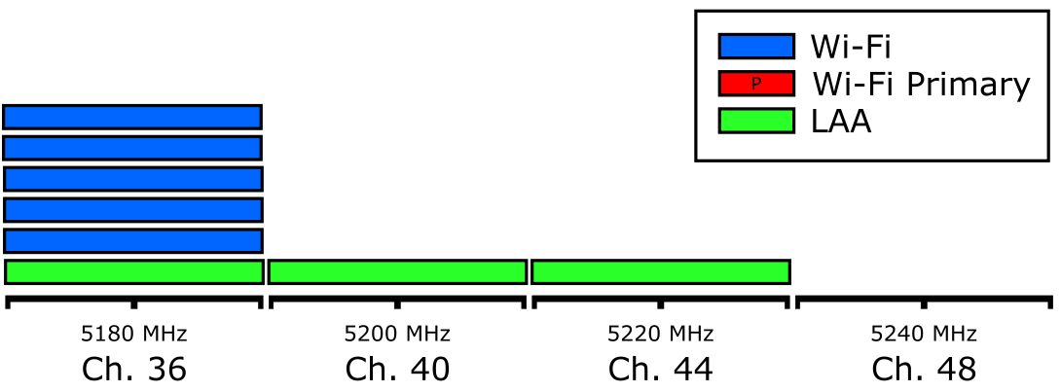
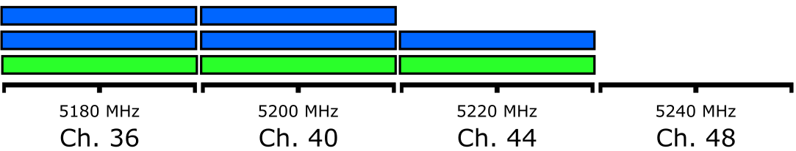
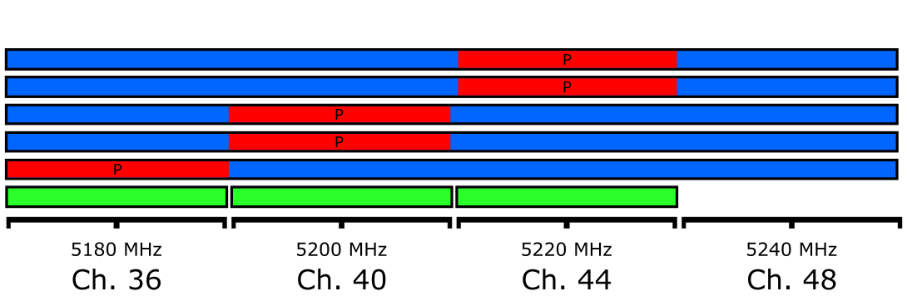
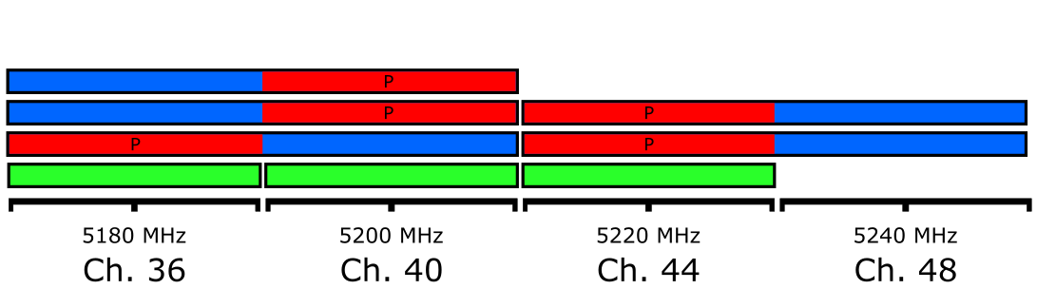
Jan 2021
Experiment 1: Wi-Fi AP Configurations
(a) Fixed 20 MHz
(b) Varying 20 MHz
(c) Varying 40 MHz
(d) Varying 80 MHz
We vary the primary channel around Channels 36, 40, and 44 which are being used by LAA.
Primary channel is important for backward compatibility and management packets (beacon)
Only 20 MHz was captured by Wireshark, therefore we do not present the throughput performance of the “Varying 40” and “Varying 80” configurations above
Vanlin Sathya, University of Chicago

Slide 10
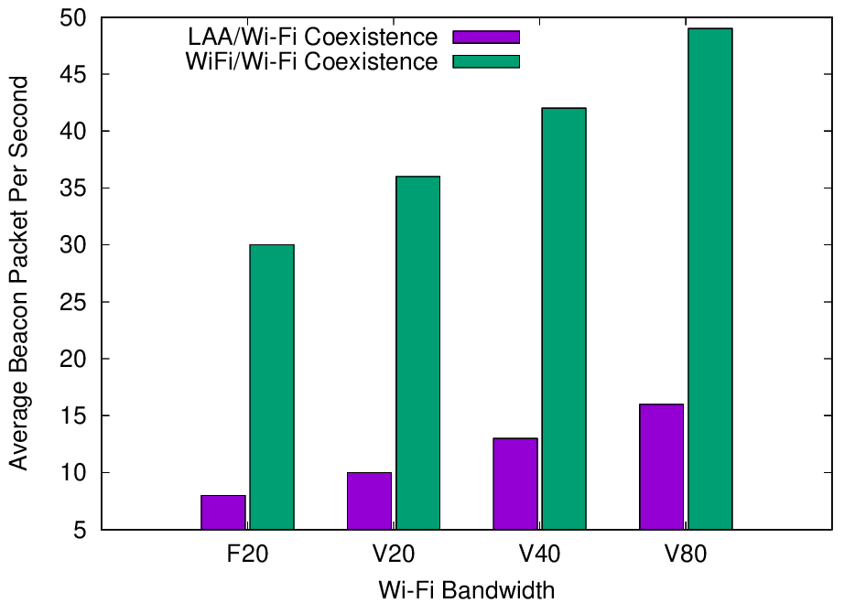
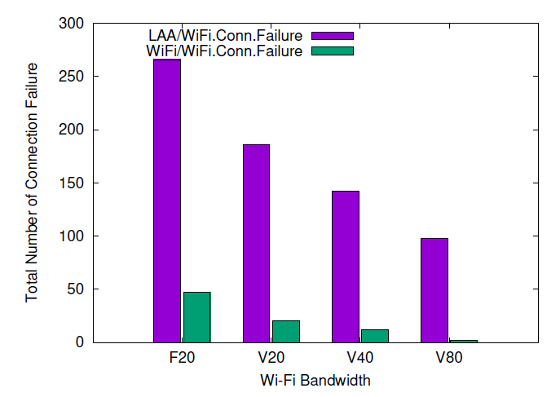
Jan 2021
Experiment 1: Wi-Fi Association Process and Beacon Transmissions
Successful beacon transmissions
Number of Dis-association connections
Successful beacon transmissions and reception are important for passive scanning
We see a decrease in the number of successful beacon transmissions when LAA and Wi-Fi coexist
With 5 APs and a beacon interval of 102.4 ms, we expected around 50 beacons per second: even without LAA, when 5 APS coexist on the same channel (F20), beacon transmissions are affected.
Slide 10
Vanlin Sathya, University of Chicago
Notes:
doc.: IEEE 802.11-yy/xxxxr0
Month Year
John Doe, Some Company
Page 10

Slide 11
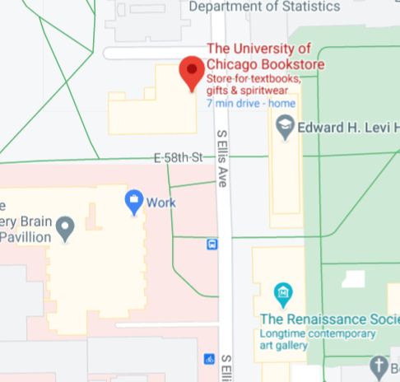
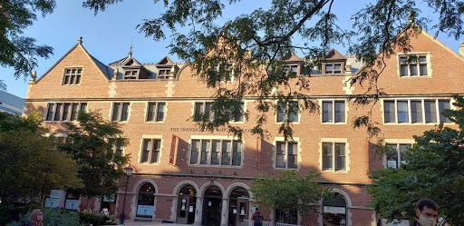
Jan 2021
Experiment 2: UChicago Bookstore
Wi-Fi Aps
3rd floor
@
Bookstore
89.91 ft
27.4 m
AP1
Clients
Close to
Wi-Fi AP
136.96 ft
41.7 m
AP3
AP2
261.7 ft
79.8 m
Clients at
Center
Location
217.59 ft
66.3 m
Clients
Close to
LAA BS
132.90 ft
40.5 m
Wi-Fi AP Deployment
LAA BS
(outdoor)
AT&T LAA Deployment
40.12 ft
12.23 m
Note: We deployed our own Wi-Fi APs to operate on primary channel 149, 153 and 157 with a 80 MHz. The LAA BS operates on 3 unlicensed channels: 149, 153, and 157.
Slide 11
Vanlin Sathya, University of Chicago
Notes:
doc.: IEEE 802.11-yy/xxxxr0
Month Year
John Doe, Some Company
Page 11

Slide 12
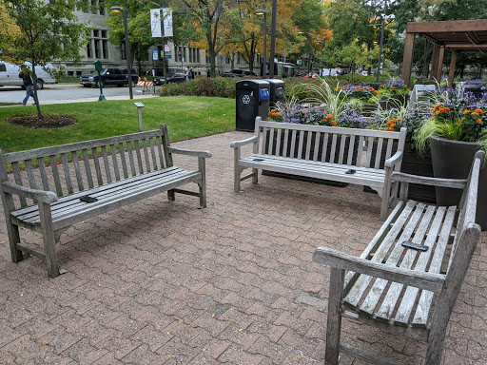
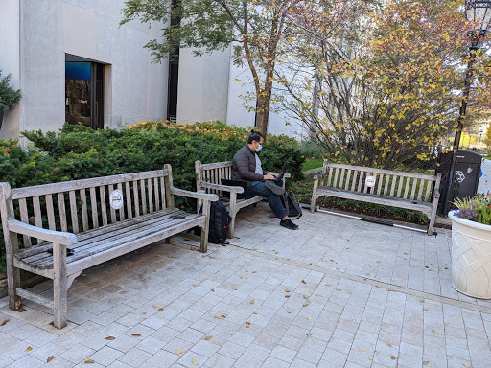
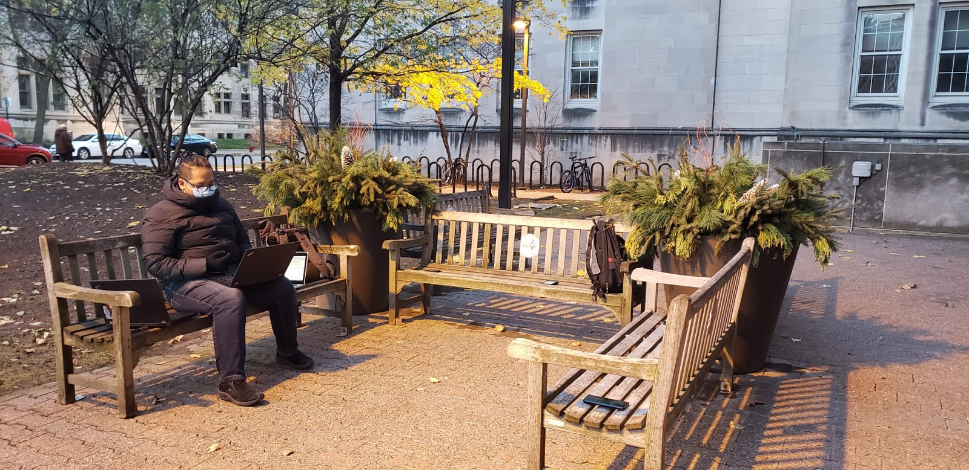
Jan 2021
Experiment 2: Wi-Fi Clients and Wireshark Deployment
Wireshark
Area
Wireshark
Area
A
C
B
C
A
C
D
A
Wireshark
Area
B
B
A
LAA
Client
LAA
Client
C
LAA
Client
D
Clients at Center
Clients Close to Wi-Fi AP
Clients Close to LAA
All 5 Wi-Fi clients are associated with one AP on channel 157. Both LAA and Wi-Fi clients initiate the same traffic as explained in the next slide.
Slide 12
Vanlin Sathya, University of Chicago
Notes:
doc.: IEEE 802.11-yy/xxxxr0
Month Year
John Doe, Some Company
Page 12

Slide 13
Jan 2021
Experiment 2: parameters
We assume that we are the only LAA user in the vicinity
  LAA-capable phones are new and expensive, therefore not widely used
    Confirmed by measurements showing all RBs allocated to our device.
We used 5 different traffic types on all clients:
  Data (D): Pure data traffic is generated by downloading a large YUV dataset (>10 GB) from Derf Test Media Collection
  Video (V): A Youtube video is downloaded, with a resolution of 1920×1080 and bit-rate of around 12 Mbps.
  Streaming (S): A live stream video on Youtube is loaded, with a resolution of 1280×720 and bit rate of around 7.5 Mbps.
  Data + Video (D+V): Combination of data and video traffic as described above.
  Data + Streaming (D+S): Combination of data and streaming traffic as described above.
Initiated traffic on all clients for 2 minutes each
Slide 13
Vanlin Sathya, University of Chicago
Notes:
doc.: IEEE 802.11-yy/xxxxr0
Month Year
John Doe, Some Company
Page 13

Slide 14
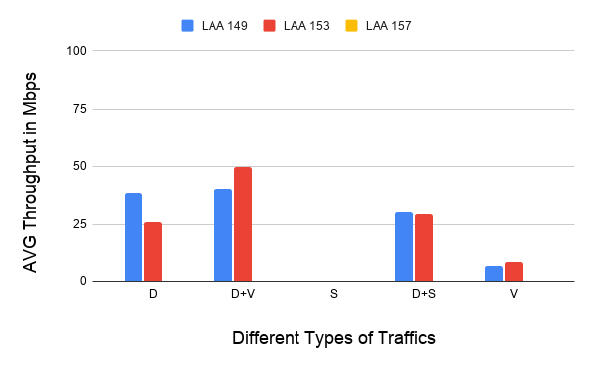
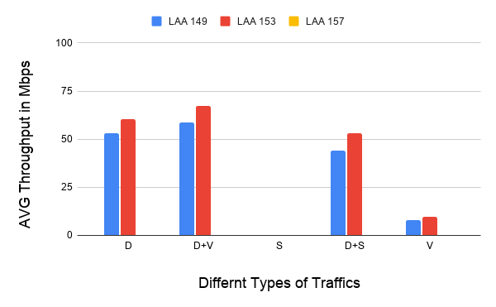
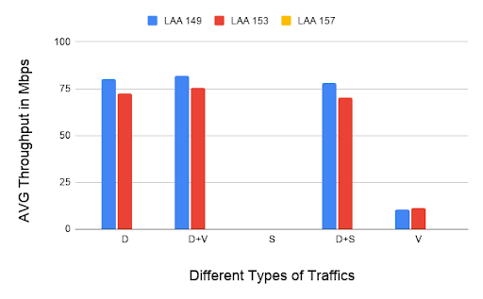
Jan 2021
Experiment 2: LAA throughput
(a) Clients at Center
(b) Clients Close to Wi-Fi AP
(c) Clients Close to LAA
The LAA and Wi-Fi Clients are deployed close to the same location.
The LAA BS turns the transmission OFF on Channel 157 because the SINR on this channel is -3 dB.
No transmission on unlicensed channel for Streaming traffic due to QoS (transmission only on licensed)
The LAA BS operates with a maximum transmission opportunity (TXOP) of 8ms on channel 149 and 153.
Slide 14
Vanlin Sathya, University of Chicago
Notes:
doc.: IEEE 802.11-yy/xxxxr0
Month Year
John Doe, Some Company
Page 14

Slide 15
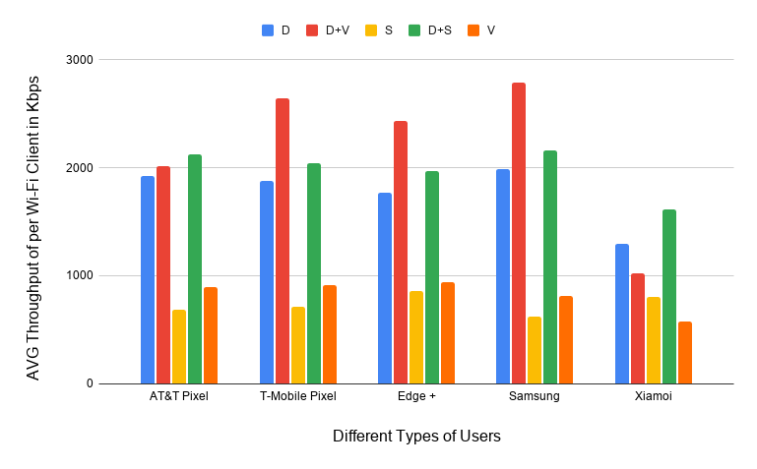
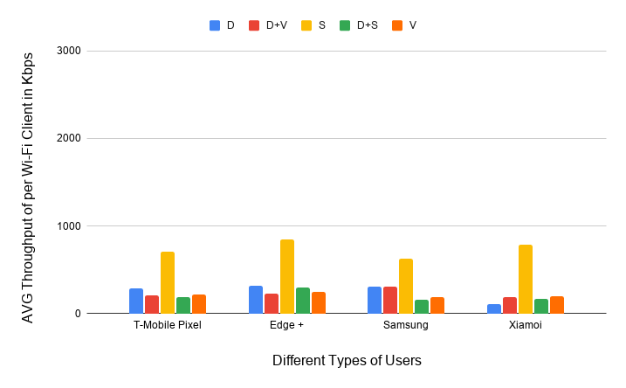
Jan 2021
Experiment 2 Wi-Fi throughput, all clients at center
(a) Wi-Fi/Wi-Fi Scenario
(b) Wi-Fi/LAA Scenario
The LAA transmission on channel 149 and 153 impacts the Wi-Fi/LAA scenario in terms of number of transmission streams, modulation coding schemes, Wi-Fi bandwidth scaling (e.g., 80 MHz to 40 MHz)
Slide 15
Vanlin Sathya, University of Chicago
Notes:
doc.: IEEE 802.11-yy/xxxxr0
Month Year
John Doe, Some Company
Page 15

Slide 16
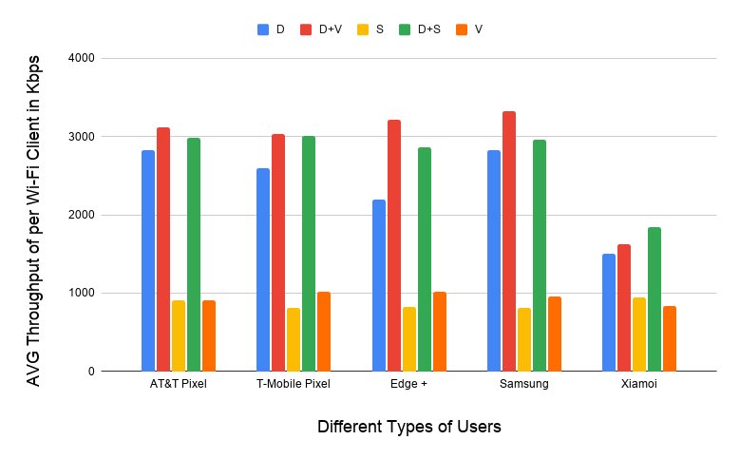
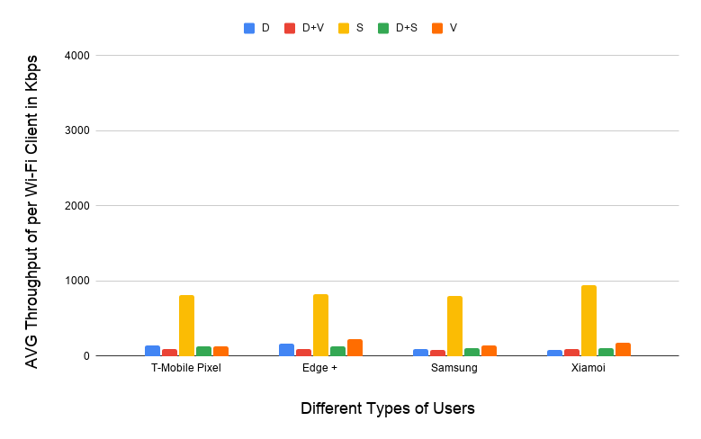
Jan 2021
Experiment 2: Wi-Fi throughput, all clients close to Wi-Fi
(a) Wi-Fi/Wi-Fi Scenario
(b) Wi-Fi/LAA Scenario
All clients are close to Wi-Fi AP, the Wi-Fi AP and LAA BS are in a clear line of sight.
The streaming traffic on Wi-Fi does not have much impact on LAA transmission, since LAA transmits streaming traffic only on the licensed spectrum.
Lower throughput on Xiaomi phone due to being limited by 11n only.
Slide 16
Vanlin Sathya, University of Chicago
Notes:
doc.: IEEE 802.11-yy/xxxxr0
Month Year
John Doe, Some Company
Page 16

Slide 17
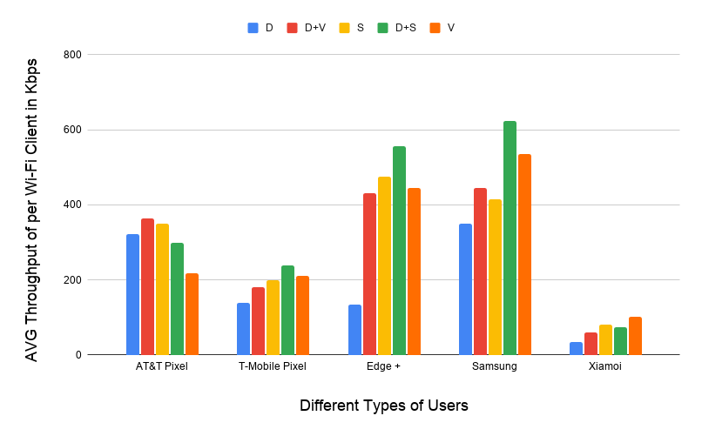
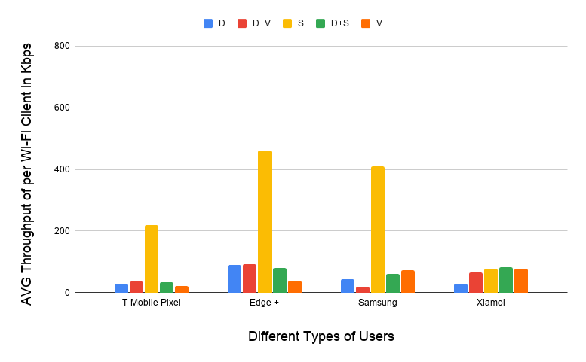
Jan 2021
Experiment 2: Wi-Fi throughput, all clients close to LAA
(a) Wi-Fi/Wi-Fi Scenario
(b) Wi-Fi/LAA Scenario
Since the clients are distant from the Wi-Fi AP, even without LAA the throughput is low.
The throughput decreases further when LAA transmits since there is additional interference from LAA as well, but the percentage decrease is less compared to the previous cases.
Slide 17
Vanlin Sathya, University of Chicago
Notes:
doc.: IEEE 802.11-yy/xxxxr0
Month Year
John Doe, Some Company
Page 17

Slide 18
Jan 2021
Conclusions and ongoing work
Even though Wi-Fi is deployed indoors and LAA outdoors, in typical outdoor Wi-Fi usage prevalent on college campuses, we observe a degradation of Wi-Fi performance.
    The hidden node scenario will impact association of Wi-Fi clients.
      Even though LAA does not use the primary channel of a 80 MHz Wi-Fi AP, throughput of the Wi-Fi transmission over 80 MHz suffers.
  We observed similar performance when all APs use Channel 149 as the primary channel
When Wi-Fi clients are just associated, without transmitting any data, the LAA BS operates on all 3 channels.
We continue to make measurements with different scenarios and combinations of all 3 APs: we welcome input on scenarios of interest to the community.
Slide 18
Vanlin Sathya, University of Chicago
Notes:
doc.: IEEE 802.11-yy/xxxxr0
Month Year
John Doe, Some Company
Page 18

Slide 19
Jan 2021
References
V. Sathya, M.I.C Rohman, and M.Ghosh, “Measurement-based coexistence studies of LAA & Wi-Fi deployments in Chicago,” IEEE Wireless Communication Magazine, November 2020.
V. Sathya, SM Kala, M.I.C Rohman, M.Ghosh and S. Roy, “Standardization advances for cellular and Wi-Fi coexistence in the unlicensed 5 and 6 GHz bands,” ACM GetMobile Magazine, August 2020.
M. Mehrnoush, S. Roy, V. Sathya and M. Ghosh, “On the fairness of Wi-Fi and LTE-LAA coexistence,” IEEE Transactions on Cognitive Communications and Networking, December 2018.
V. Sathya, M. Mehrnoush, M. Ghosh and S. Roy, “Energy detection based sensing of multiple Wi-Fi BSSs for LTE-U CSAT,” IEEE Globecom 2018, December 2018.
M. Mehrnoush, V. Sathya, S. Roy, and M. Ghosh, “Analytical Modeling of Wi-Fi and LTE-LAA Coexistence: Throughput and Impact of Energy Detection Threshold,” IEEE/ACM Transactions on Networking, vol. 26, pp. 1990 – 2003, August 2018.
V. Sathya, M. Mehrnoush, M. Ghosh and S. Roy, “Analysis of CSAT performance in Wi-Fi and LTE-U coexistence,” IEEE Workshop on 5G Ultra-Dense Networks at ICC, May 20, 2018.
V. Sathya, M. Mehrnoush, M. Ghosh and S. Roy, “Association fairness in Wi-Fi and LTE-U coexistence,” IEEE WCNC 2018, April 25, 2018.
M.I.C. Rochman, V. Sathya and M. Ghosh, “Impact of changing energy detection thresholds on fair coexistence of Wi-Fi and LTE in the unlicensed spectrum,” IEEE WTS 2017, April 28, 2017.
Slide 19
Vanlin Sathya, University of Chicago
Notes:
doc.: IEEE 802.11-yy/xxxxr0
Month Year
John Doe, Some Company
Page 19

