Slide 1
Discussion of Frequency and Time Domain Attack
Date: 2020-12-08
Authors:

Slide 2
PHY Security
Attacker tries to modify the measured range
Make STA appear closer to AP to fake proximity detection
Spoof time-stamps t2 or t4 to achieve that
Focus on physical layer attack
Assume that MAC level is authenticated/encrypted
Includes time-stamps t1/t4 feedback to initiator

Slide 3
Integrity Attack Scenario
First line security
Use secure LTF (sequence unknown to attacker)
Replace Cyclic Prefix (CP) with zero-padded Guard Interval (to reduce structure)
Attack types
Frequency Domain/ Computational attack: attacker observes fraction of symbol and predicts the rest to attack the later part
Time Domain/MMSE Attack: attacker continuously observes and attacks using low pass nature of baseband signal

Slide 4
Frequency Domain/Computational Attack
Steps
Attacker will listen to first half portion of LTF
Then try to estimate the full time-domain LTF waveform (typically by estimating frequency QAM symbols)
Change measured t2 or t4 by transmitting the last (estimated) quarter of time-domain LTF waveform with timing advance
Advantages:
High received SNR (listen only)
Processing delay of 100 ns okay
Disadvantages
Attack correlation limited by attack duration
Receiver will notice poor SINR if boost power
6.4 µs
Waveform for channel measurement
First half
Timing advance
Waveform transmitted by attacker
Last quarter

Slide 5
Time Domain/MMSE Attack
Attack here
Steps
Attacker will try to predict the waveform sample-by-sample
Use finite bandwidth of signal and pulse shape/sidelobes
Subtract out predicted symbols
Start tx attack, while rx more data
Advantages
Can attack large part of symbol
Does not depend on finite constellation
Disadvantages
Needs full duplex, limits receive SNR
Needs to account for inter-symbol-interference
Can only change RTT by prediction time (less proc. Delay)
Maximum RTT
effect
Measure here

Slide 6
Example: Computational Attack
Setup
40 MHz, overlap-add receiver
LTF with random QPSK symbols
Observation period 50%
Observations
First half of time domain, contains information about all symbols
Intercarrier-interference (ICI) between neighboring symbols

Slide 7
Frequency Domain/Computational Attack
Attack challenge
Partial observation of OFDM symbol leads to ICI
Without removing ICI, SINR is around 0 dB
Attacker can apply Viterbi or Sphere decoder
Counters
Move to high order constellation, e.g., 64 QAM
Use “poor” constellation to increase decoding errors
Remove structure in frequency domain, e.g., random Gaussian modulation or DFT precoded modulation

Slide 8
Modulation examples
64 QAM – equal minimum distance
64 QAM + 4PSK

Slide 9
Other choices
Various combinations possible
Can choose additive with few quantization levels

Slide 10
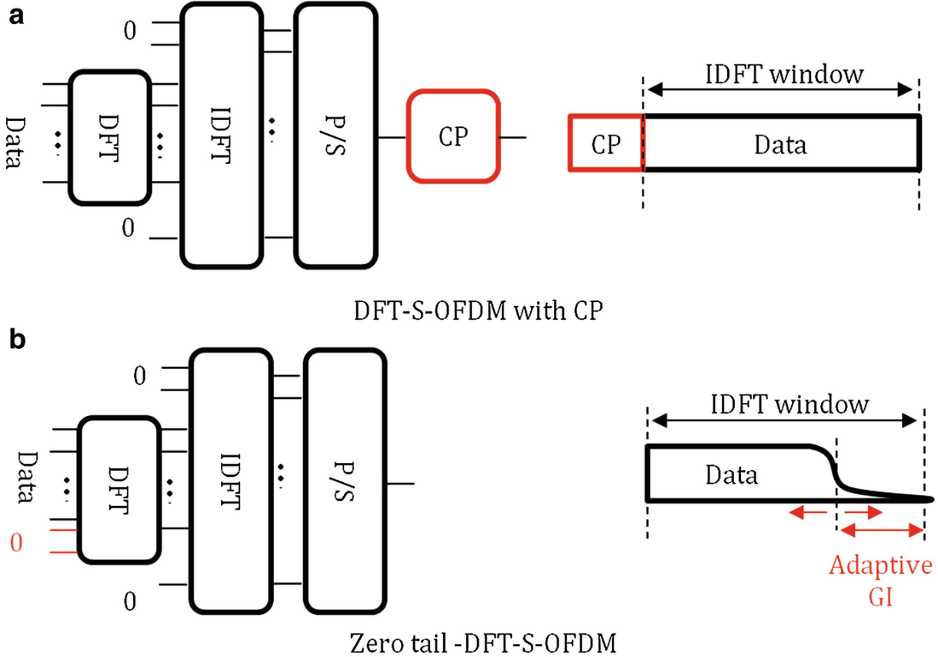
DFT Precoded OFDM
Overview
Data symbols are precoded with a DFT matrix before IFFT processing
Can be used with cyclic prefix or without
Effectively Sinc interpolation of symbols instead of traditional pulse shaper
Can also omit DC

Slide 11
Example of DFT Precoded LTF
Setup
Use VHT40 as example
128 QPSK symbols, DFT precoded
Zero out 3 DC tones + guard bands
Keep 114 non-zero subcarriers

Slide 12
Spectrum
Using VHT40 as example
Generate three LTF
4x time-domain oversampling
Zero padding
Take large FFT to estimate average spectrum

Slide 13
Comparison to regular OFDM and Mask

Slide 14
PAPR Comparison
DFT Precoded OFDM
Peaks up to 2x due to interpolation (same neighboring symbols)
About 1 dB worse than Golay
About 2-3 dB better than QPSK

Slide 15
Performance Results
Simulate different modulation
One repetition
18 dB SNR
MMSE-frequency channel estimation
MUSIC based and FFT based

Slide 16
Conclusion
Presented Discussion on Frequency and Time Domain Attack
Frequency Domain Attack can be Averted
Use higher order constellation
Use “poor” constellation to increase decoding errors
Use random Gaussian modulation or DFT precoded modulation
Time Domain Attack needs further study
Use of windowing?
Effect on performance?

